Slide 1

Customer & Vehicle
Insights
Data-Driven Analysis for Insurance Optimization

Slide 2

01
DATA
UNDERSTANDING
Exploring raw insurance data to understand its structure, quality, and key attributes.
Structure | Quality | Attributes

Slide 3
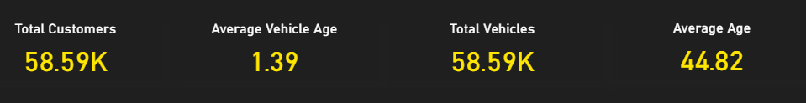
DATA OVERVIEW
• Dataset contains insurance customer and vehicle information
• Key Attributes:
Customer Age
Vehicle Age
Fuel Type
Region Code
Claim Status
• Total Records: ~58K+
Key Observation
The dataset represents a large and diverse customer base (~58K records),
providing a strong foundation to analyze customer behavior, vehicle characteristics,
and claim patterns.

Slide 4
02
DATA
PREPARATION
Preparing raw data by handling missing values, removing inconsistencies, and ensuring data quality for further analysis.
Cleaning | Structuring | Data Quality

Slide 5
DATA CLEANING
❌ Problems
✅Actions Taken
Missing or null values present
Inconsistent data formats across fields
Presence of noisy / irrelevant records
Duplicate entries affecting accuracy
Handled missing values using appropriate methods
Standardized and corrected data formats
Filtered out irrelevant and noisy records
Ensured data consistency and removed duplicates
Clean data ensures reliable analysis and drives accurate business insights.

Slide 6
03
DATA
TRANSFORMATION
Transforming raw data into structured formats through SQL operations, feature extraction, and data standardization.
SSQL Processing | Feature Engineering | Structuring

Slide 7
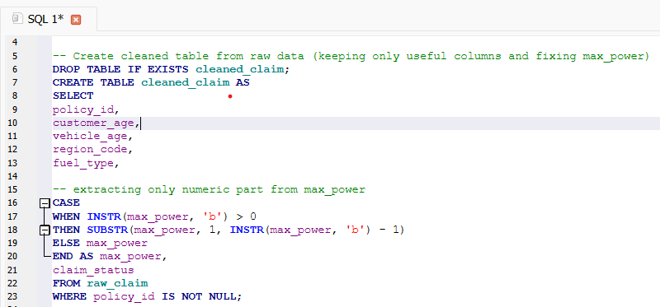
DATA TRANSFORMATION & SQL
Key Transformations
Data Cleaning & Structuring
Feature Extraction
Handling Missing Values
Data Modeling (Table Creation)
Raw Data
Structured
Data
SQL-based transformation enabled structured and analysis-ready data.

Slide 8
04
DATA
MODELING
Designing structured data models by organizing data into logical tables and defining relationships for efficient analysis.
Table Design | Relationships | Optimization

Slide 9
DATA MODELING
Why Data Modeling?
Improved Data Organization
Reduced Data Redundancy
Better Query Performance
Defined Table Relationships
Customers
policy_id
customer_age
region_code
Vehicles
policy_id
vehicle_age
fuel_type
max_power
JOIN ON policy_id
Raw Data → Structured Tables → Efficient Analysis
Data modeling ensured structured storage and enabled efficient data retrieval.

Slide 10
05
DATA
VALIDATION
Ensuring data accuracy and integrity by applying validation rules and constraints to prevent incorrect or inconsistent data.
Data Integrity | Validation Rules | Accuracy

Slide 11
DATA VALIDATION
Ensuring Data Integrity
To maintain data quality, validation was required
to prevent incorrect or unrealistic entries.
Key Risk:
• Invalid customer age
• Data inconsistency
• Incorrect insights
Trigger-Based Validation
• Implemented at database level
• Prevents age < 18
• Ensures valid records only
Raw Input → Validated Data
CREATE TRIGGER validate_age
BEFORE INSERT ON customers
WHEN NEW.customer_age < 18
BEGIN
SELECT RAISE(ABORT, 'Age must be 18+');
END;

Slide 12
06
DASHBOARD
ANALYSIS
Analyzing customer behavior, vehicle trends, and claim patterns through interactive dashboards.
KPIs | Customer Behavior | Vehicle Trends | Claims Analysis

Slide 13
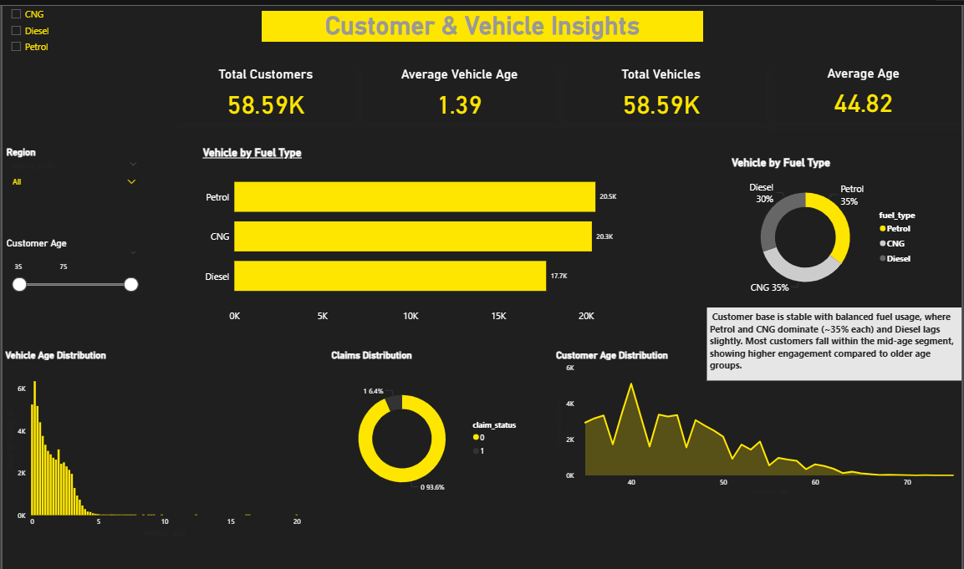
DASHBOARD OVERVIEW
KPIs | Fuel Trends | Age Distribution | Claims

Slide 14
07
KEY INSIGHTS
Deriving meaningful insights from data to understand customer behavior, vehicle trends, and claim patterns.
Customer Insights | Fuel Trends | Vehicle Analysis | Claims Patterns

Slide 15
KEY INSIGHTS
● Customer Profile
Majority of customers fall within the mid-age group (35–50), indicating higher engagement in this segment.
● Fuel Distribution
Petrol and CNG dominate the market (~35% each), while Diesel usage is slightly lower (~30%).
● Vehicle Trends
Most vehicles are relatively new, resulting in a lower average vehicle age across the dataset.
● Claims Insight
Very low claim rate (~6%) observed, indicating a stable and low-risk customer base.

Slide 16
08
DATA
ANALYSIS
Transforming data into meaningful patterns to understand customer behavior, vehicle trends, and risk insights.
Customer Behavior | Fuel Trends | Vehicle Patterns | Risk Insights

Slide 17
DATA ANALYSIS SUMMARY
Customer Base
Strong mid-age customer presence driving engagement
Fuel Usage
Petrol & CNG dominate, indicating modern usage trends
Vehicle Pattern
Newer vehicles observed across majority of customers
Risk Level
Low claim rate reflects a stable and low-risk portfolio
→
→
→
The analysis reveals a well-balanced customer base with modern vehicle adoption and a low-risk claims profile, enabling strong data-driven decision making.
From Raw Data to Actionable Insights

Slide 18
09
CONCLUSION
Summarizing key outcomes and insights derived from data transformation, analysis, and visualization. Data Transformation | Analysis | Insights | Decision Making

Slide 19
CONCLUSION
Bringing together the entire data journey, this project highlights how raw insurance data was transformed into structured, reliable, and analysis-ready datasets.
Through systematic data cleaning, transformation, modeling, and validation, meaningful patterns were uncovered. Leveraging interactive dashboards, the analysis provided clear insights into customer behavior, vehicle trends, and claim patterns, ultimately enabling informed and data-driven business decision making.
From Raw Data to Actionable Insights

Slide 20
Thank You

