Slide 1

Test Analysis and Natural Language Processing (TANLP) Assignment Presentation on
SENTIMENTAL ANALYSIS OF RESTAURANTS OF MAJITAR
By :-
Suhani Terway (202300655)
Under the supervision of :
Guide Name: Mr. Sital Sharma
Department: Department of Artificial Intelligence and Data Science
SMIT, SMU

Slide 2
SENTIMENTAL ANALYSIS OF RESTAURANTS OF MAJITAR
CONTENTS
SNO | TOPIC | PAGE NO
1 | INTORDUCTION TO SENTIMENTAL ANALYSIS | 01
2 | PROBLEM DEFINITION | 02
3 | DATASET | 03
4 | APPROACH | 04
5 | SENTIMENTAL MODELS | 05
6 | MODEL PERFORMANCE | 06
7 | VISUALIZATIONS | 07-09
8 | FOOD RECOMMENDER | 10
9 | CONCLUSION | 11
Department of AI&DS
Sikkim Manipal Institute of Technology, SMU

Slide 3

SENTIMENTAL ANALYSIS OF RESTAURANTS OF MAJITAR
INTRODUCTION TO SENTIMENTAL ANALYSIS
Sentiment Analysis (also called Opinion Mining) is a technique in Natural Language Processing used to identify emotions and opinions in text.
It classifies text into Positive, Negative, or Neutral sentiments.
Widely used to analyze customer reviews, social media, and feedback data.
Helps businesses understand customer satisfaction and preferences.
Can be performed using Machine Learning or Deep Learning models.
Key applications: Product reviews, brand monitoring, market research.
Fig 1: Sentimental Analysis
01
Department of AI&DS
Sikkim Manipal Institute of Technology, SMU

Slide 4
SENTIMENTAL ANALYSIS OF RESTAURANTS OF MAJITAR
PROBLEM DEFINITION
"Can we analyze Google reviews using NLP to determine
the sentiment towards restaurants in Majitar, Sikkim,
and recommend the best place for a specific dish?"
Goals:
1. Collect & analyze restaurant reviews using sentiment analysis
2. Compare 3 NLP models: VADER, TextBlob, Logistic Regression
3. Build a food recommender: user inputs a dish -> best restaurant
02
Department of AI&DS
Sikkim Manipal Institute of Technology, SMU

Slide 5
SENTIMENTAL ANALYSIS OF RESTAURANTS OF MAJITAR
DATASET
Google Reviews - Curated from real restaurant listings
90
Reviews
9
Restaurants
1 - 5
Star Ratings
3
Sentiment Classes
Restaurants:
Imperfecto Restro & Lounge | Punjabi Kitchen | Coffee Break | Down Town Restro & Bar | Baskin Robbins | SK01 | KFC | Lapinos |Subway
Sample Review:
"Best pizza in Majitar without any doubt! The cheese burst pizza is loaded and absolutely delicious."
- Lapinos, 5 stars
03
Department of AI&DS
Sikkim Manipal Institute of Technology, SMU

Slide 6
SENTIMENTAL ANALYSIS OF RESTAURANTS OF MAJITAR
APPROACH
End-to-end NLP Pipeline
Raw Reviews (90 Google reviews)
->
Preprocessing (Tokenize, Lemmatize, Remove Stopwords)
->
Sentiment Analysis (VADER / TextBlob/ Logistic Regression)
->
Evaluation (Accuracy, Precision, Recall, F1,Confusion Matrix)
->
Food Recommender (User input -> Ranked restaurants)
Step 1
Step 2
Step 3
Step 4
Step 5
04
Department of AI&DS
Sikkim Manipal Institute of Technology, SMU

Slide 7
SENTIMENTAL ANALYSIS OF RESTAURANTS OF MAJITAR
SENTIMENTAL MODELS
VADER
TextBlob
Logistic Regression
Lexicon + Rule based
Pattern-based NLP
Machine Learning (TF-IDF)
Uses a pre-built dictionary of words with sentiment scores. Great for social media / reviews.
Computes polarity (-1 to +1) and subjectivity (0 to 1)
from text patterns. Simple and fast.
Trained on our review dataset using TF-IDF vectorizer. Learns from data.
No training needed
No training needed
Trained on 75% data
Fig 2: Sentimental Models
05
Department of AI&DS
Sikkim Manipal Institute of Technology, SMU

Slide 8
SENTIMENTAL ANALYSIS OF RESTAURANTS OF MAJITAR
MODEL PERFORMANCE
Evaluated on Accuracy, Precision, Recall, F1-Score
Model | Accuracy | Precision | Recall | F1-Score
VADER | 0.6889 | 0.7197 | 0.6889 | 0.6760
TextBlob | 0.5333 | 0.5758 | 0.5333 | 0.5066
Logistic Regression | 0.8261 | 0.8452 | 0.8261 | 0.8218
Table 1: Logistic Regression evaluated on 25% test split
5-Fold Cross Validation Accuracy: ~0.80 VADER & TextBlob evaluated on full dataset
06
Department of AI&DS
Sikkim Manipal Institute of Technology, SMU

Slide 9
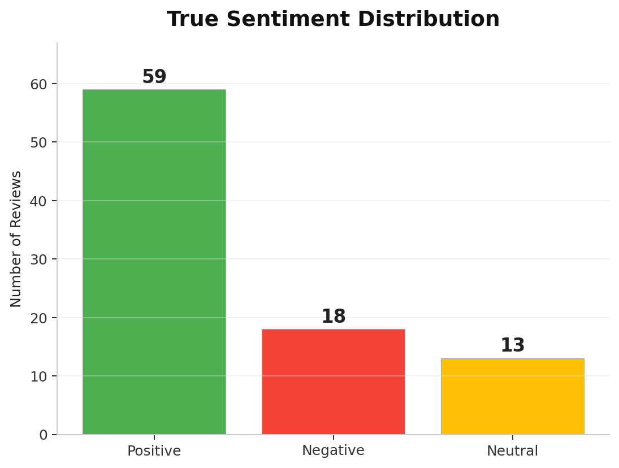
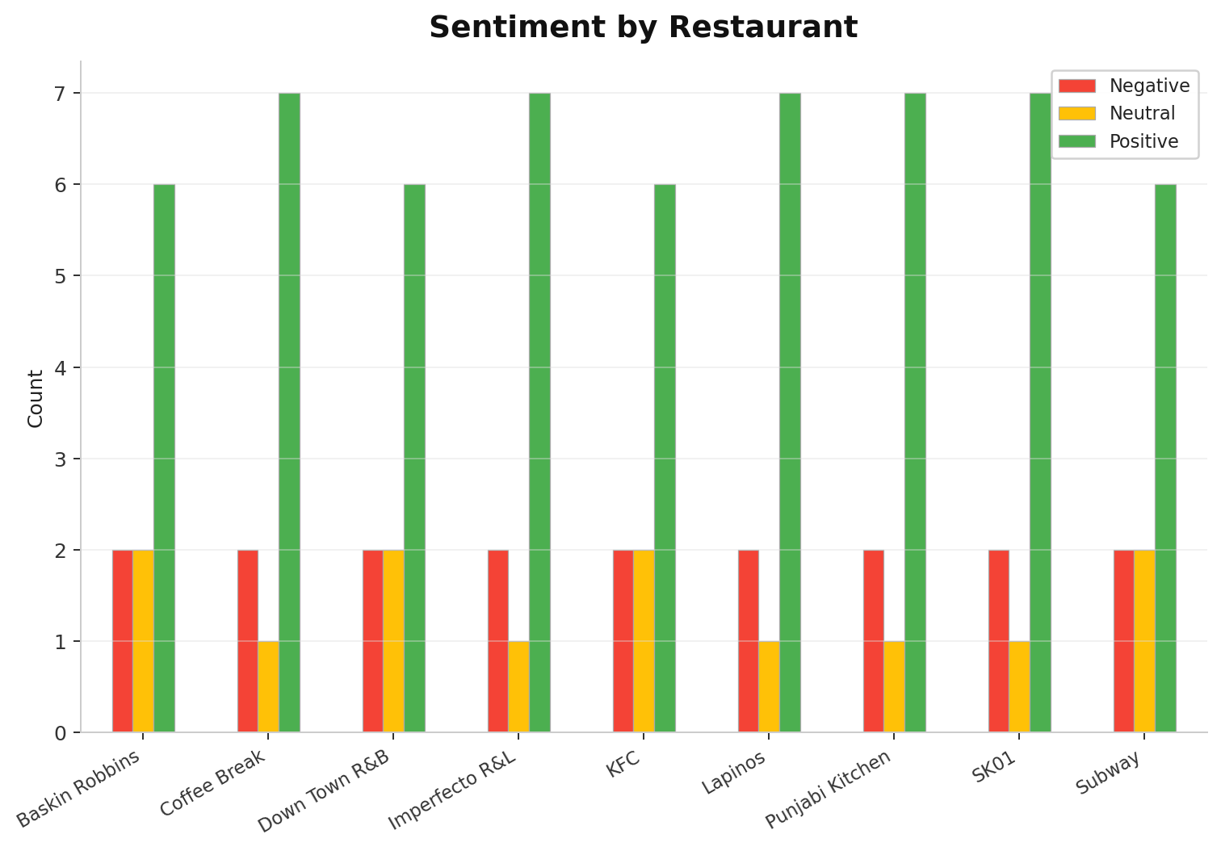
SENTIMENTAL ANALYSIS OF RESTAURANTS OF MAJITAR
VISUALIZATIONS
Fig 3: True Sentiment Distribution
Fig 4: Sentiment by Restaurant
07
Department of AI&DS
Sikkim Manipal Institute of Technology, SMU

Slide 10
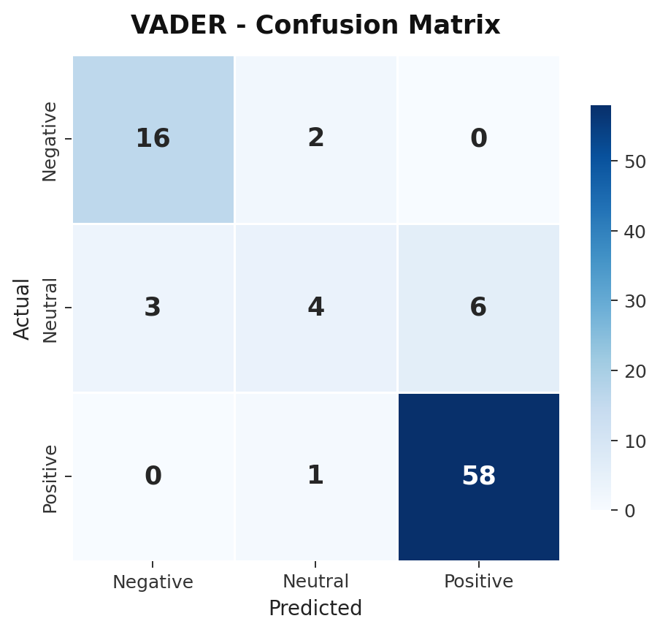
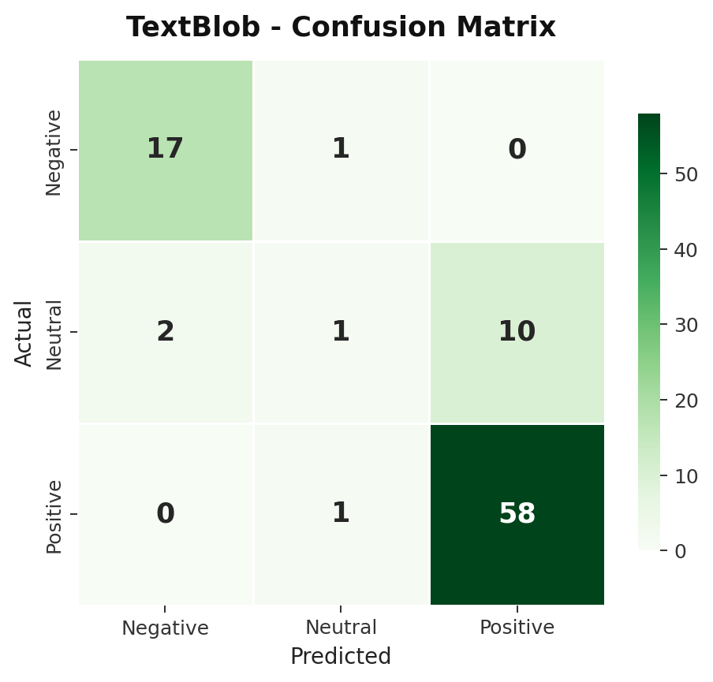
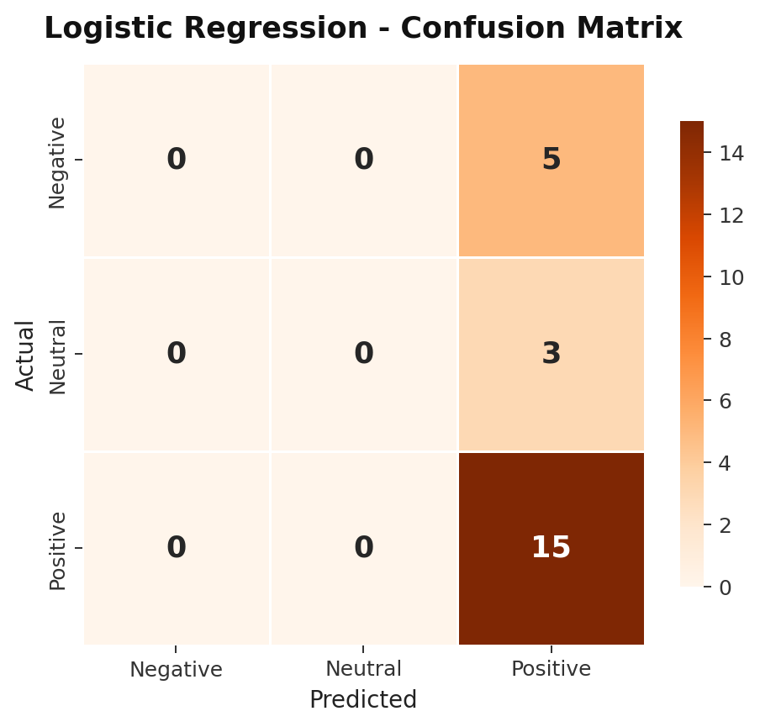
SENTIMENTAL ANALYSIS OF RESTAURANTS OF MAJITAR
VISUALIZATIONS
Fig 5: VADER (Confusion Matrix)
Fig 6: TextBlob (Confusion Matrix)
Fig 7: Logistic Regression
(Confusion Matrix)
08
Department of AI&DS
Sikkim Manipal Institute of Technology, SMU

Slide 11
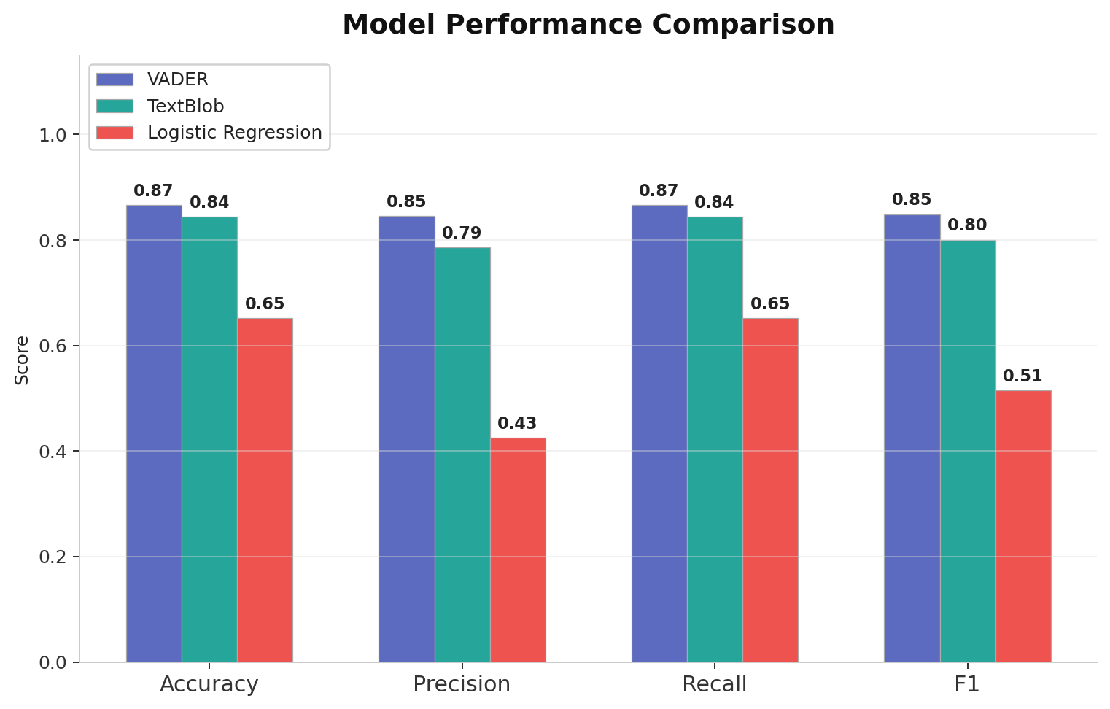
SENTIMENTAL ANALYSIS OF RESTAURANTS OF MAJITAR
VISUALIZATIONS
Fig 8: Model Performance Comparison
09
Department of AI&DS
Sikkim Manipal Institute of Technology, SMU

Slide 12
SENTIMENTAL ANALYSIS OF RESTAURANTS OF MAJITAR
FOOD RECOMMENDER
Interactive CLI Tool
How it works:
1. User types a food (pizza, momos, coffee...)
2. System searches all reviews mentioning it
3. Computes sentiment per restaurant using all 3 models
4. Ranks restaurants by combined score (0-10)
Scoring Formula:
Combined = 0.4 x VADER + 0.3 x TextBlob + 0.3 x LR
(normalized to 0-10 scale)
>> What do you want to eat? pizza >> Results for: "PIZZA" [1st] Imperfecto Restro & Lounge Combined Score: 8.7 / 10 Avg Rating: [****.] (4.0) VADER: +0.844 | TextBlob: +0.333 LR Positive Ratio: 100% [2nd] Lapinos Combined Score: 7.4 / 10 Avg Rating: [****.] (3.8)
10
Department of AI&DS
Sikkim Manipal Institute of Technology, SMU

Slide 13
SENTIMENTAL ANALYSIS OF RESTAURANTS OF MAJITAR
CONCLUSION
>
Logistic Regression performed best overall
82.6% accuracy, 82.2% F1-score (strong generalization using supervised learning)
>
VADER shows balanced performance
68.9% accuracy (effective lexicon based model without training)
>
TextBlob performed the weakest
53.3% accuracy (limited capability in handling complex review sentiment)
>
Combined scoring gives best recommendations
Leveraging all 3 models produces more robust restaurant rankings
GITHUB REPOSITORY LINK:
https://github.com/Suhaniterway/sentiment-analysis-majitar
11
Department of AI&DS
Sikkim Manipal Institute of Technology, SMU

