Slide 1


Modern C++17 Smart Pointers & Memory
Presented By Dr. Samriddhi Khade
DPU Course Material
Dr. D. Y. Patil Vidyapeeth, Pune (Deemed to be University)

Slide 2
Unique Pointer & Move Semantics
• Zero-overhead exclusive resource ownership
• Move-only semantics prevent accidental aliasing
• Destructor guarantees automatic heap cleanup
// CPP
#include <iostream>
#include <memory>
struct Buffer {
int id;
Buffer(int i) : id(i) {}
};
std::unique_ptr<Buffer> make_buffer(int id) {
auto buf = std::make_unique<Buffer>(id);
return buf; // Move semantics applied
}
Dr. D. Y. Patil Vidyapeeth, Pune (Deemed to be University)

Slide 3
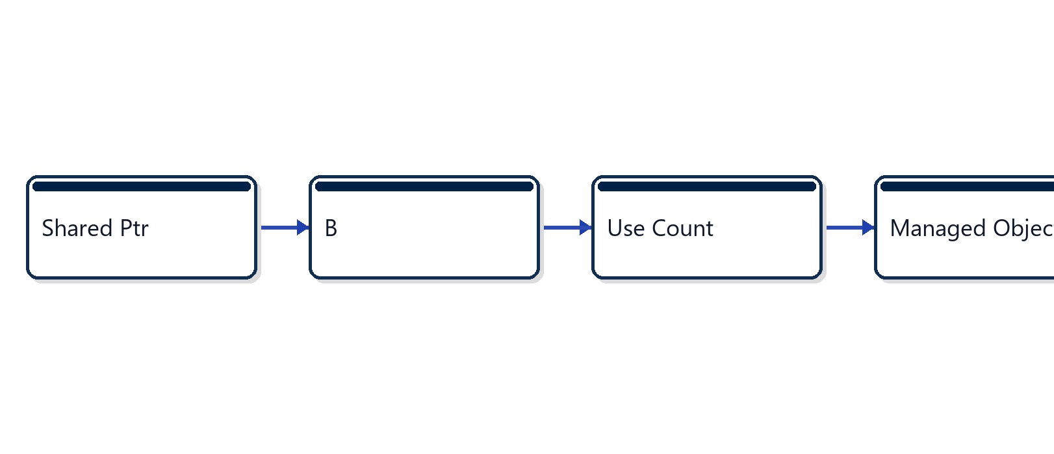
Shared Pointer Control Block Architecture
• Atomic reference counting across threads
• Weak pointer breaks cyclic reference leaks
• Control block allocated alongside payload
Dr. D. Y. Patil Vidyapeeth, Pune (Deemed to be University)

Slide 4
Modern C++ Memory Safety Rules
• Strictly avoid raw pointer new and delete calls
• Use std::make_shared for unified cache locality
• Break circular ownership graphs with weak_ptr
• Pass by const reference to avoid ref-count bumps
Exercise Reference: exercise_3_cpp_raii
Dr. D. Y. Patil Vidyapeeth, Pune (Deemed to be University)

