Slide 1


Java 21 Architecture & Virtual Threads
Presented By Dr. Samriddhi Khade
DPU Course Material
Dr. D. Y. Patil Vidyapeeth, Pune (Deemed to be University)

Slide 2
Virtual Thread Per Task Executor
• Million thread capability without memory exhaustion
• Automated mounting on underlying carrier pool
• Transparent non-blocking I/O multiplexing
// JAVA
try (var pool = Executors.newVirtualThreadPerTaskExecutor...
IntStream.range(0, 10).forEach(idx -> {
pool.submit(() -> {
Thread.sleep(Duration.ofMillis(50));
return idx * 2;
});
});
}
Dr. D. Y. Patil Vidyapeeth, Pune (Deemed to be University)

Slide 3
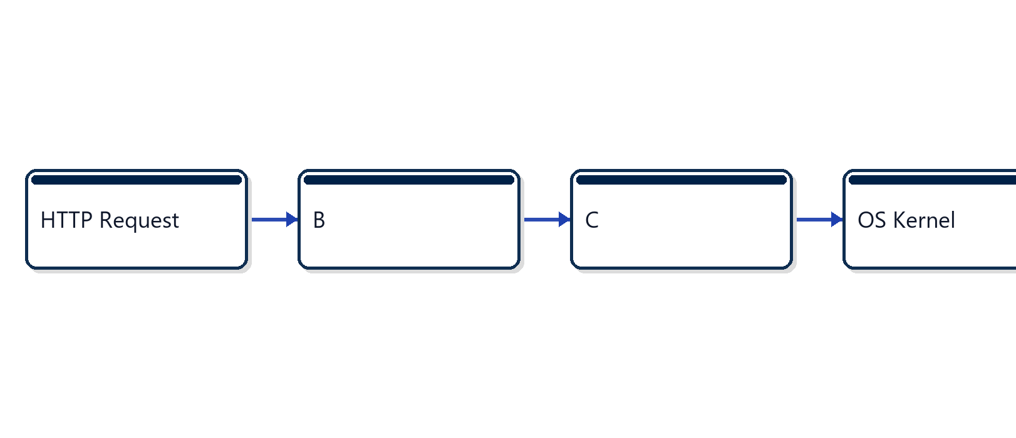
Carrier Thread Scheduling Architecture
• Virtual threads yield during blocking syscalls
• ForkJoinPool manages carrier workers efficiently
• Deterministic stack unmounting in heap memory
Dr. D. Y. Patil Vidyapeeth, Pune (Deemed to be University)

Slide 4
Production Virtual Thread Guidelines
• Never pool virtual threads; spawn per task
• Avoid pinning with synchronized keyword
• Migrate to ReentrantLock for critical sections
• Inspect heap footprint with JFR telemetry
Exercise Reference: exercise_1_virtual_threads
Dr. D. Y. Patil Vidyapeeth, Pune (Deemed to be University)

