Slide 1


Python 3.12 Asynchronous Concurrency
Presented By Dr. Samriddhi Khade
DPU Course Material
Dr. D. Y. Patil Vidyapeeth, Pune (Deemed to be University)

Slide 2
Structured Concurrency with TaskGroup
• Clean exception aggregation and auto-cancellation
• Deterministic lifecycle without lingering coroutines
• Zero dangling background task leaks
// PYTHON
import asyncio
async def fetch_service(svc_id: int) -> str:
await asyncio.sleep(0.05)
return f"Service {svc_id} ready"
async def main():
async with asyncio.TaskGroup() as tg:
t1 = tg.create_task(fetch_service(1))
t2 = tg.create_task(fetch_service(2))
return t1.result(), t2.result()
Dr. D. Y. Patil Vidyapeeth, Pune (Deemed to be University)

Slide 3
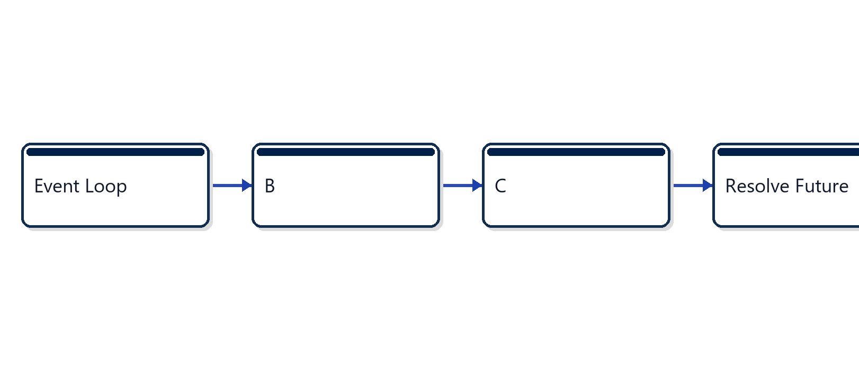
AsyncIO Event Loop Workflow
• Single-threaded cooperative task scheduling
• Epoll event notification on OS sockets
• Future resolution wakes paused coroutines
Dr. D. Y. Patil Vidyapeeth, Pune (Deemed to be University)

Slide 4
Best Practices in AsyncIO Systems
• Never invoke blocking synchronous code on event loop
• Delegate CPU intensive workloads to process pools
• Utilize asyncio.timeout for network deadlines
• Always await graceful cancellation on shutdown
Exercise Reference: exercise_2_async_gather
Dr. D. Y. Patil Vidyapeeth, Pune (Deemed to be University)

