Slide 1


Python 3.12 AsyncIO & High-Performance Coroutines
Presented By sam
VIT Course Material
VIT • Python 3.12 AsyncIO & High-Performance Coroutines
Notes:
Speaker Hint:
Welcome students and set clear expectations for today's session.

Slide 2
Agenda
• Introduction to AsyncIO
• Understanding Coroutines
• Writing Simple Async Code
• Performance Considerations
VIT • Agenda

Slide 3
Introduction to AsyncIO
• AsyncIO is for asynchronous I/O operations
• Allows non-blocking I/O in Python
// PYTHON 3.12.8
# Concept: Introduction to AsyncIO
message = "Introduction to AsyncIO Executed in Python 3.12"
print(message)
return message
asyncio.run(demonstrate_concept())
VIT • Introduction to AsyncIO
Notes:
Trainer Notes:
Complete Runnable File (ex_python_s3_introduction_to_asyncio):
```python
import sys
import asyncio
async def demonstrate_concept():
# Concept: Introduction to AsyncIO
message = "Introduction to AsyncIO Executed in Python 3.12"
print(message)
return message
def main():
asyncio.run(demonstrate_concept())
if __name__ == '__main__':
main()
```

Slide 4
Simple Async Function
// PYTHON 3.12.8
async def simple_coroutine():\n await asyncio.sleep(1)...
VIT • Simple Async Function

Slide 5
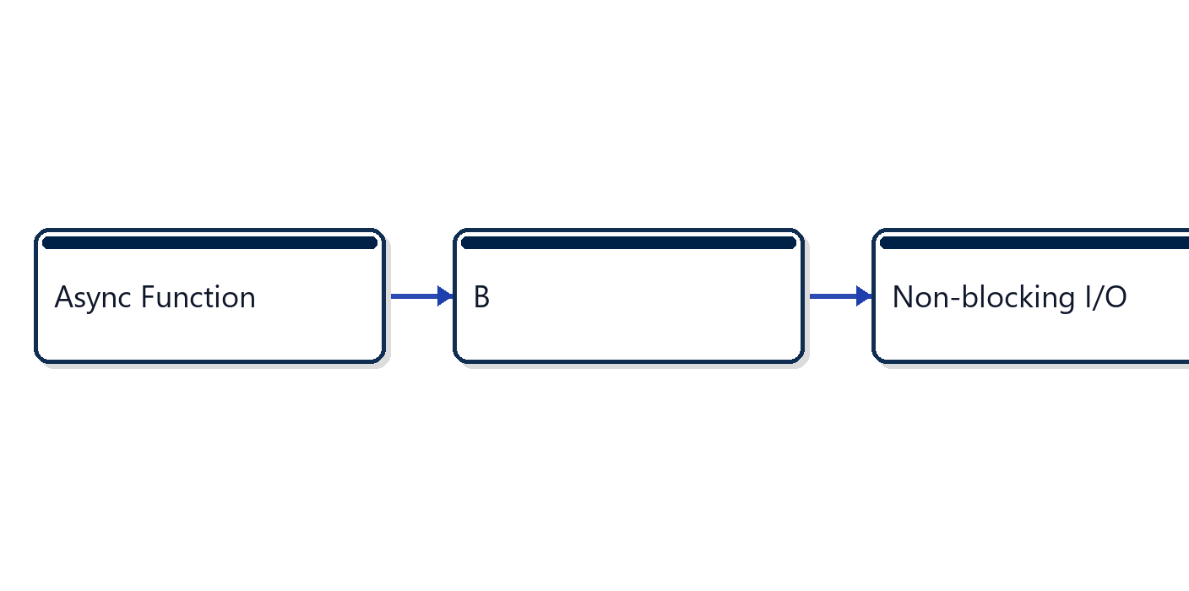
Python 3.12 AsyncIO & High-Performance Coroutines: Part 5
VIT • Python 3.12 AsyncIO & High-Performance Coroutines: Part 5

Slide 6
Understanding Coroutines
• Coroutines are lightweight threads
• Can be paused and resumed
// PYTHON 3.12.8
# Concept: Understanding Coroutines
message = "Understanding Coroutines Executed in Python 3.12"
print(message)
return message
asyncio.run(demonstrate_concept())
VIT • Understanding Coroutines
Notes:
Trainer Notes:
Complete Runnable File (ex_python_s6_understanding_coroutines):
```python
import sys
import asyncio
async def demonstrate_concept():
# Concept: Understanding Coroutines
message = "Understanding Coroutines Executed in Python 3.12"
print(message)
return message
def main():
asyncio.run(demonstrate_concept())
if __name__ == '__main__':
main()
```

Slide 7
Coroutine Example
// PYTHON 3.12.8
async def coroutine_example():\n print('Coroutine star...
VIT • Coroutine Example

Slide 8
Coroutine Exercise
// PYTHON 3.12.8
// Example: Coroutine Exercise
var result = computeState();
System.out.println(result);
VIT • Coroutine Exercise

Slide 9
Writing Simple Async Code
• Use `async def` for coroutines
• Use `await` for I/O operations
// PYTHON 3.12.8
# Concept: Writing Simple Async Code
message = "Writing Simple Async Code Executed in Python 3...
print(message)
return message
asyncio.run(demonstrate_concept())
VIT • Writing Simple Async Code
Notes:
Trainer Notes:
Complete Runnable File (ex_python_s9_writing_simple_async_cod):
```python
import sys
import asyncio
async def demonstrate_concept():
# Concept: Writing Simple Async Code
message = "Writing Simple Async Code Executed in Python 3.12"
print(message)
return message
def main():
asyncio.run(demonstrate_concept())
if __name__ == '__main__':
main()
```

Slide 10
Async Function with Await
// PYTHON 3.12.8
async def async_function():\n await asyncio.sleep(1)\n...
VIT • Async Function with Await

Slide 11
Async Function Exercise
// PYTHON 3.12.8
// Example: Async Function Exercise
var result = computeState();
System.out.println(result);
VIT • Async Function Exercise

Slide 12
Python 3.12 AsyncIO & High-Performance Coroutines: Part 12
• AsyncIO for non-blocking I/O
• Coroutines are lightweight threads
• Use `async def` and `await`
VIT • Python 3.12 AsyncIO & High-Performance Coroutines: Part 12

Slide 13
Thank You
• Questions?
• References: Python AsyncIO Docs
VIT • Thank You

