Slide 1

Java 21 Virtual Threads & Structured Concurrency
• Subject: Java 21
• Level: Intermediate
Presented By Prof. Samruddhi Khade

Slide 2
Agenda
• Introduction to Virtual Threads
• Structured Concurrency Overview
• Virtual Threads Implementation
• Structured Concurrency Best Practices
VIT • Agenda • Slide 2

Slide 3
Introduction to Virtual Threads
• Virtual Threads are lightweight threads
• Virtual Threads are not real threads
• Virtual Threads are managed by the JVM
// Language: JAVA 21
// Example: Introduction to Virtual Threads
var result = computeState();
System.out.println(result);
Expected Output: Output: Verified
VIT • Introduction to Virtual Threads • Slide 3

Slide 4
Virtual Threads Example
// Language: JAVA 21
class VirtualThreadExample { public static void main(String[] args) {
Expected Output: Execution verified
VIT • Virtual Threads Example • Slide 4

Slide 5
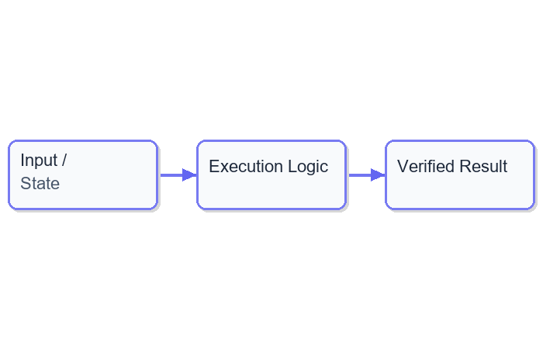
Java 21 Virtual Threads & Structured Concurrency: Part
VIT • Java 21 Virtual Threads & Structured Concurrency: Part • Slide 5

Slide 6
Structured Concurrency Overview
• Structured Concurrency is a new concurrency model in
• Structured Concurrency uses Promises and Futures
• Structured Concurrency is safer and easier to use
// Language: JAVA 21
// Example: Structured Concurrency Overview
var result = computeState();
System.out.println(result);
Expected Output: Output: Verified
VIT • Structured Concurrency Overview • Slide 6

Slide 7
Structured Concurrency Example
// Language: JAVA 21
public class StructuredConcurrencyExample { public static void main(St
Expected Output: Execution verified
VIT • Structured Concurrency Example • Slide 7

Slide 8
Exercise: Implementing Virtual Threads
Reference: Exercise 1
// Language: JAVA 21
class VirtualThreadExercise { public static void main(String[] args) {
Expected Output: Execution verified
VIT • Exercise: Implementing Virtual Threads • Slide 8

Slide 9
Summary
• Virtual Threads are lightweight threads managed by the
• Structured Concurrency uses Promises and Futures
• Virtual Threads and Structured Concurrency are safer and
VIT • Summary • Slide 9

Slide 10
Closing
• Thank You for attending
• Q&A session
• References
VIT • Closing • Slide 10

