Slide 1

MongoDB 7.0 Aggregation Pipelines & Document Modeling
• Subject: MongoDB 7.0.16
• Level: Advanced
Presented By Samruddhi Khade

Slide 2
Agenda
• Introduction to Aggregation Pipelines
• Aggregation Pipeline Components
• Common Aggregation Patterns
• Performance Considerations
• Document Modeling Best Practices
VIT • Agenda • Slide 2

Slide 3
Introduction to Aggregation Pipelines
• Transform data in a stream of documents
• Flexible and powerful data processing
• Similar to SQL queries for data retrieval
// Language: MONGODB 7.0.16
// Example: Introduction to Aggregation Pipelines
var result = computeState();
System.out.println(result);
Expected Output: Output: Verified
VIT • Introduction to Aggregation Pipelines • Slide 3

Slide 4
Example Aggregation Pipeline
// Language: MONGODB 7.0.16
db.collection.aggregate([{$match: {age: {$gt: 20}}}, {$group: {_id: '$
Expected Output: Execution verified
VIT • Example Aggregation Pipeline • Slide 4

Slide 5
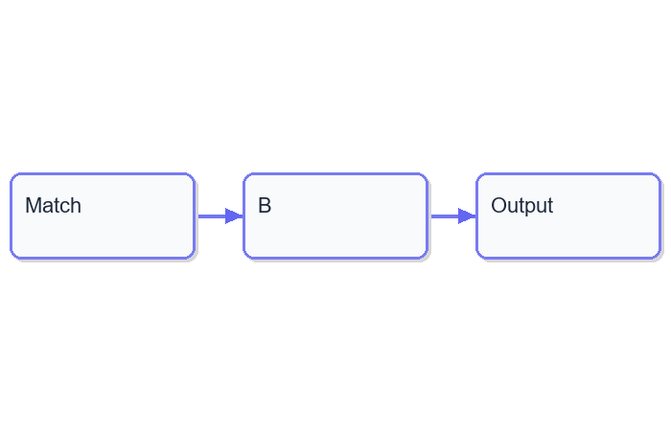
Aggregation Pipeline Flow
VIT • Aggregation Pipeline Flow • Slide 5

Slide 6
Aggregation Pipeline Components
• Match
• Group
• Sort
• Project
• Unwind
// Language: MONGODB 7.0.16
// Example: Aggregation Pipeline Components
var result = computeState();
System.out.println(result);
Expected Output: Output: Verified
VIT • Aggregation Pipeline Components • Slide 6

Slide 7
Match Stage
// Language: MONGODB 7.0.16
db.collection.aggregate([{$match: {age: {$gt: 20}}}]
Expected Output: Execution verified
VIT • Match Stage • Slide 7

Slide 8
Group Stage
// Language: MONGODB 7.0.16
db.collection.aggregate([{$group: {_id: '$gender', count: {$sum: 1}}}]
Expected Output: Execution verified
VIT • Group Stage • Slide 8

Slide 9
Common Aggregation Patterns
• Count
• Sum
• Avg
• Min
• Max
// Language: MONGODB 7.0.16
// Example: Common Aggregation Patterns
var result = computeState();
System.out.println(result);
Expected Output: Output: Verified
VIT • Common Aggregation Patterns • Slide 9

Slide 10
Count Documents
// Language: MONGODB 7.0.16
db.collection.aggregate([{$count: 'count'}]
Expected Output: Execution verified
VIT • Count Documents • Slide 10

Slide 11
Performance Considerations
• Use stages efficiently
• Avoid unnecessary stages
• Optimize pipeline stages
// Language: MONGODB 7.0.16
// Example: Performance Considerations
var result = computeState();
System.out.println(result);
Expected Output: Output: Verified
VIT • Performance Considerations • Slide 11

Slide 12
Document Modeling Best Practices
• Use embedded documents for related data
• Use reference documents for related data
• Avoid deep nesting
// Language: MONGODB 7.0.16
// Example: Document Modeling Best Practices
var result = computeState();
System.out.println(result);
Expected Output: Output: Verified
VIT • Document Modeling Best Practices • Slide 12

Slide 13
Exercise: Building an Aggregation Pipeline
// Language: MONGODB 7.0.16
db.collection.aggregate([{$match: {age: {$gt: 20}}}, {$group: {_id: '$
Expected Output: Execution verified
VIT • Exercise: Building an Aggregation Pipeline • Slide 13

Slide 14
Summary
• Aggregation Pipelines for data processing
• Components and patterns
• Performance considerations
• Best practices for document modeling
VIT • Summary • Slide 14

Slide 15
Closing
• Thank you for attending
• Questions and Answers
• References
VIT • Closing • Slide 15

