Slide 1
The Queue

Slide 2
Queues
Queue: a collection whose elements are added at one end (the rear or tail of the queue) and removed from the other end (the front or head of the queue)
A queue is a FIFO (first in, first out) data structure
Any waiting line is a queue:
The check-out line at a grocery store
The cars at a stop light
An assembly line

Slide 3
Conceptual View of a Queue
Adding an element
Front of queue
New element is added to the rear of the queue

Slide 4
Conceptual View of a Queue
Removing an element
New front element of queue
Element is removed from the front of the queue

Slide 5
Uses of Queues in Computing
For any kind of problem involving FIFO data
Printer queue (e.g. printer in MC 235)
Keyboard input buffer
GUI event queue (click on buttons, menu items)

Slide 6
Uses of Queues in Computing
In simulation studies, where the goal is to reduce waiting times:
Optimize the flow of traffic at a traffic light
Determine number of cashiers to have on duty at a grocery store at different times of day
Other examples?
Notes:
Ticket counter simulation

Slide 7
Queue Operations
enqueue : add an element to the tail(rear end) of a queue
dequeue : remove an element from the head(front) of a queue
first : examine the element at the head of the queue (“peek”)
Other useful operations (e.g. is the queue empty)
It is not legal to access the elements in the middle of the queue!

Slide 8
Operations on a Queue
Operation | Description
dequeue | Removes an element from the front of the queue
enqueue | Adds an element to the rear of the queue
first | Examines the element at the front of the queue
isEmpty | Determines whether the queue is empty
size | Determines the number of elements in the queue

Slide 9
Just as stacks can be implemented as arrays or linked lists, so with queues.

Slide 10
Queue (Linear Queue)
It is a linear data structure consisting of list of items.
In queue, data elements are added at one end, called the rear and removed from another end, called the front of the list.
Two basic operations are associated with queue:
1. “Insert” operation is used to insert an element into a queue.
2. “Delete” operation is used to delete an element from a queue.
FIFO list
Example:
Queue: AAA, BBB, CCC, DDD, EEE
7
6
EEE
5
1
2
3
4
5
6
7
DDD
4
AAA
BBB
CCC
DDD
EEE
CCC
3
BBB
2
Front
Rear
AAA
1
Rear
Front

Slide 11
Algorithms for Insert and Delete Operations in Linear Queue
For Insert Operation
Insert-Queue(QUEUE, REAR, FRONT,MAX, NUM)
Here, QUEUE is the place where to store data. REAR represents the location in which the data element is to be inserted and FRONT represents the location from which the data element is to be removed. Here MAX is the maximum size of the QUEUE and finally, NUM is the new item to be added.
Step 1: IF REAR = MAX-1
Write OVERFLOW
Goto step 4
[END OF IF]
Step 2: IF FRONT = -1 and REAR = -1
SET FRONT = REAR =0
ELSE
SET REAR = REAR + 1
[END OF IF]
Step 3: SET QUEUE[REAR] = NUM
Step 4: EXIT.

Slide 12
For Delete Operation
Delete-Queue(QUEUE, FRONT, REAR, NUM)
Here, QUEUE is the place where data are stored. REAR represents the location in which the data element is to be inserted and FRONT represents the location from which the data element is to be removed. Front element is assigned to NUM.
Step 1: IF FRONT = -1 OR FRONT > REAR
Write UNDERFLOW
ELSE
NUM=QUEUE[FRONT]
SET FRONT = FRONT + 1
[END OF IF]
Step 2: EXIT

Slide 13
#include <stdio.h>
#include <conio.h>
#define MAX 10 // Changing this value will change length of array
int queue[MAX];
int front = -1, rear = -1;
void insert(void);
int delete_element(void);
int peek(void);
void display(void);
int main()
{
int option, val;
do
{
printf(“\n\n ***** MAIN MENU *****”);
printf(“\n 1. Insert an element”);
printf(“\n 2. Delete an element”);
printf(“\n 3. Peek”);
printf(“\n 4. Display the queue”);
printf(“\n 5. EXIT”);
printf(“\n Enter your option : “);
scanf(“%d”, &option);

Slide 14
switch(option)
{
case 1:
insert();
break;
case 2:
val = delete_element();
if (val != -1)
printf(“\n The number deleted is : %d”, val);
break;
case 3:
val = peek();
if (val != -1)
printf(“\n The first value in queue is : %d”, val);
break;
case 4:
display();
break;
}
}while(option != 5);
getch();
return 0;
}

Slide 15
void insert()
{
int num;
printf(“\n Enter the number to be inserted in the queue : “);
scanf(“%d”, &num);
if(rear == MAX-1)
printf(“\n OVERFLOW”);
else if(front == -1 && rear == -1)
front = rear = 0;
else
rear++;
queue[rear] = num;
}

Slide 16
int delete_element()
{
int val;
if(front == -1 || front>rear)
{
printf(“\n UNDERFLOW”);
return -1;
}
else
{
val = queue[front];
front++;
if(front > rear)
front = rear = -1;
return val;
}
}

Slide 17
int peek()
{
if(front==-1 || front>rear)
{
printf(“\n QUEUE IS EMPTY”);
return -1;
}
else
{
return queue[front];
}
}

Slide 18
void display()
{
int i;
printf(“\n”);
if(front == -1 || front > rear)
printf(“\n QUEUE IS EMPTY”);
else
{
for(i = front;i <= rear;i++)
printf(“\t %d”, queue[i]);
}
}

Slide 19
Example: Consider the following queue (linear queue).
Rear = 4 and Front = 1 and N = 7
10
50
30
40
1
2
3
4
5
6
7
(1) Insert 20. Now Rear = 5 and Front = 1
10
50
30
40
20
1
2
3
4
5
6
7
(2) Delete Front Element. Now Rear = 5 and Front = 2
50
30
40
20
1
2
3
4
5
6
7
(3) Delete Front Element. Now Rear = 5 and Front = 3
30
40
20
1
2
3
4
5
6
7
(4) Insert 60. Now Rear = 6 and Front = 3
30
40
20
60
1
2
3
4
5
6
7

Slide 20
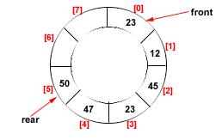
Drawback of Linear Queue
Once the queue is full, even though few elements from the front are deleted and
some occupied space is relieved, it is not possible to add anymore new elements,
as the rear has already reached the Queue’s rear most position.
Circular Queue
This queue is not linear but circular.
Its structure can be like the following figure:
In circular queue, once the Queue is full the
"First" element of the Queue becomes the
"Rear" most element, if and only if the "Front"
has moved forward. otherwise it will again be
a "Queue overflow" state.
Figure: Circular Queue having
Rear = 5 and Front = 0

Slide 21





Algorithms for Insert and Delete Operations in Circular Queue
For Insert Operation
Insert-Circular-Q(CQueue, Rear, Front, N, Item)
Here, CQueue is a circular queue where to store data. Rear represents the location in which the data element is to be inserted and Front represents the location from which the data element is to be removed. Here MAX is the maximum size of CQueue and finally, VALis the new item to be added. Initailly Rear = -1 and Front = -1
Step 1: IF FRONT = and Rear = MAX-1
Write OVERFLOW
Step 2: IF FRONT=-1 and REAR=-1
SET FRONT = REAR = 0
ELSE IF REAR = MAX-1 and FRONT != 0
SET REAR = 0
ELSE
SET REAR = REAR+1
[END OF IF]
Step 3: SET QUEUE[REAR] = VAL
Step 4: EXIT

Slide 22
For Delete Operation
Delete-Circular-Q(CQueue, Front, Rear, Item)
Here, CQueue is the place where data are stored. Rear represents the location in which the data element is to be inserted and Front represents the location from which the data element is to be removed. Front element is assigned to Item. Initially, Front = 1.
Step 1: IF FRONT=-1
Write UNDERFLOW
Goto Step 4 [END of IF]
Step 2: SET VAL = QUEUE[FRONT]
Step 3: IF FRONT = REAR
SET FRONT = REAR=-1
ELSE IF FRONT = MAX -1
SET FRONT = 0
ELSE SET FRONT = FRONT+1
[END of IF]
[END OF IF]
Step 4: EXIT

Slide 23
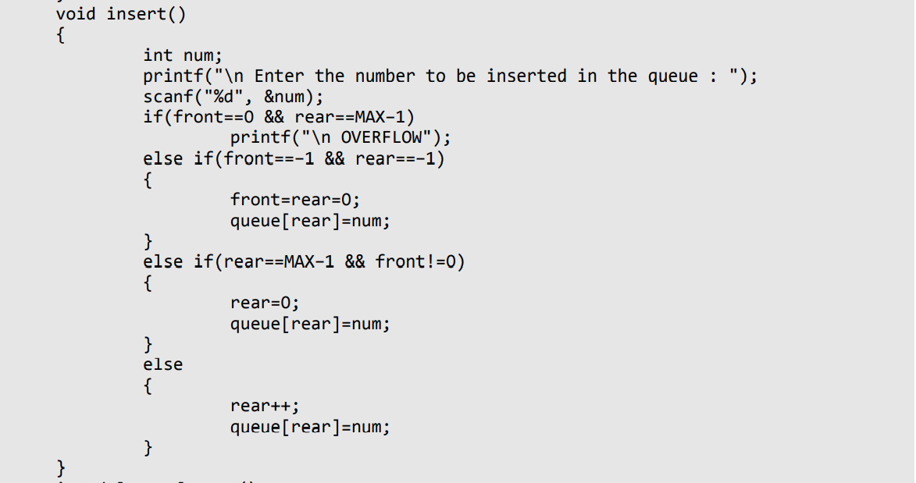

Slide 24
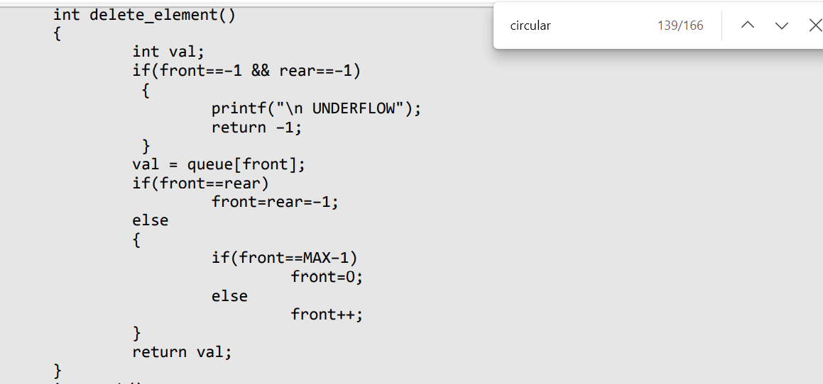

Slide 25
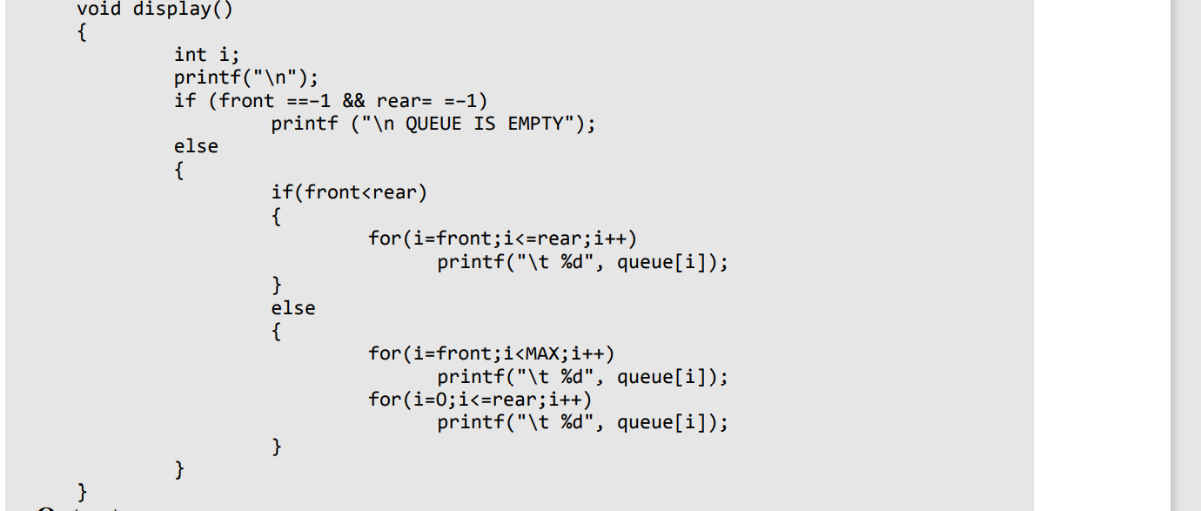

Slide 26
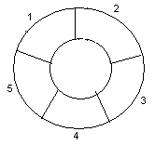
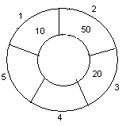
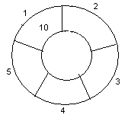
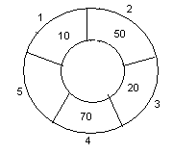
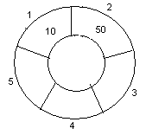
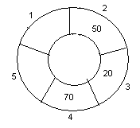
Example: Consider the following circular queue with N = 5.
1. Initially, Rear = 0, Front = 0.
4. Insert 20, Rear = 3, Front = 0.
Front
Rear
2. Insert 10, Rear = 1, Front = 1.
5. Insert 70, Rear = 4, Front = 1.
Rear
Front
Front
Rear
3. Insert 50, Rear = 2, Front = 1.
6. Delete front, Rear = 4, Front = 2.
Front
Rear
Front
Rear

Slide 27
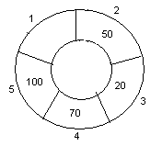
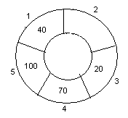
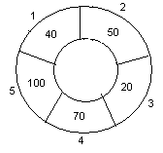
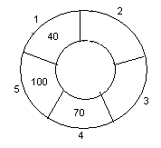
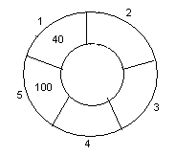
7. Insert 100, Rear = 5, Front = 2.
10. Delete front, Rear = 1, Front = 3.
Front
Rear
Front
Rear
8. Insert 40, Rear = 1, Front = 2.
11. Delete front, Rear = 1, Front = 4.
Rear
Rear
Front
Front
9. Insert 140, Rear = 1, Front = 2.
As Front = Rear + 1, so Queue overflow.
12. Delete front, Rear = 1, Front = 5.
Rear
Rear
Front
Front

Slide 28
while inserting an element rear=(rear+1) mod (size)
while deleting an element
front=(front+1) mod (size)
Overflow?
front=(rear+1) mod (size)
Empty?
front=rear

Slide 29
Double Ended Queue
A deque (pronounced as ‘deck’ or ‘dequeue’) is a list in which the elements can be inserted or deleted at either end.
It is also known as a head-tail linked list because elements can be added to or removed from either the front (head) or the back (tail) end.
In a deque, two pointers are maintained, LEFT and RIGHT, which point to either end of the deque.
It is a circular
The elements in a deque extend from the LEFT end to the RIGHT end and since it is circular, Dequeue[N–1] is followed by Dequeue[0].

Slide 30
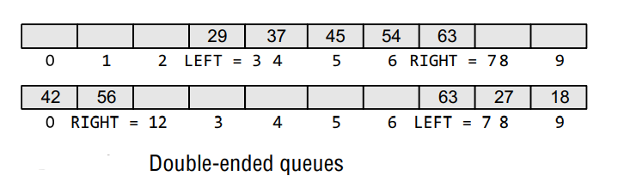

Slide 31
Variants of Deque
Input restricted deque: In this dequeue, insertions can be done only at one of the ends, while deletions can be done from both ends.
Output restricted deque :In this dequeue, deletions can be done only at one of the ends, while insertions can be done on both ends.

Slide 32
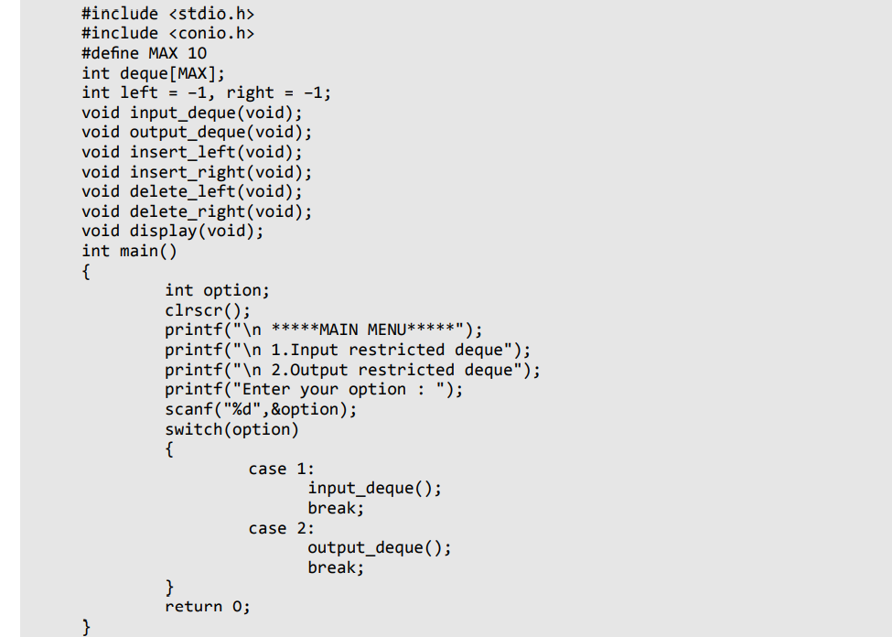
DEQUEUE

Slide 33
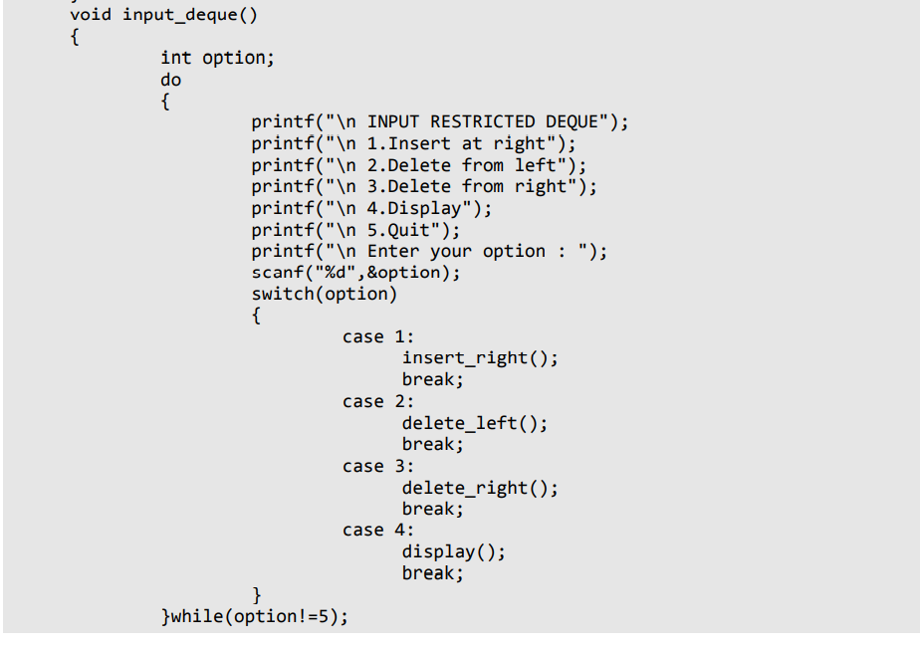
INPUT RESTRICTED DEQUEUE

Slide 34
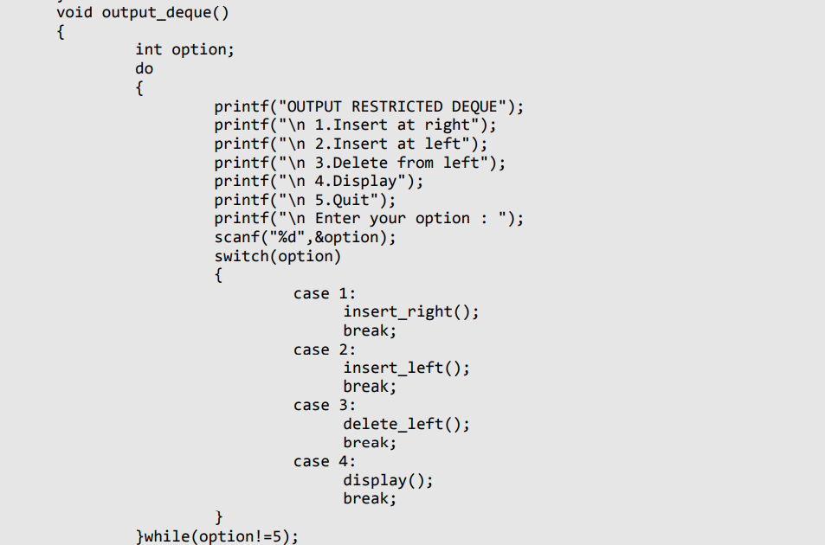
OUTPUT RESTRICTED DEQUEUE

Slide 35
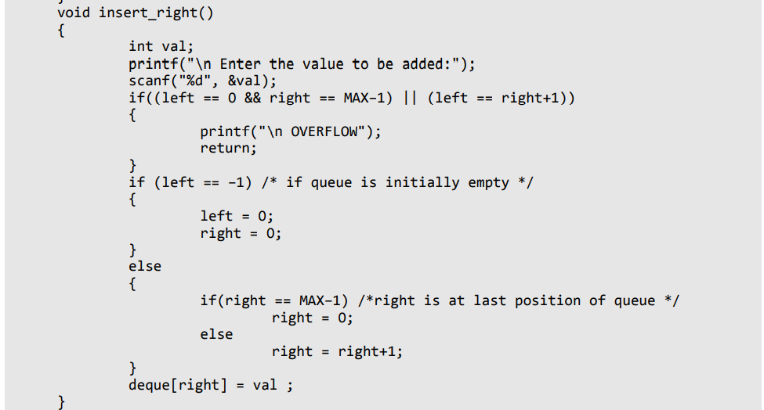

Slide 36
void insert_left()
{
int val;
printf("\n Enter the value to be added:");
scanf("%d", &val);
if((left == 0 && right == MAX–1) || (left == right+1))
{
printf("\n Overflow");
return;
}
if (left == –1)/*If queue is initially empty*/
{
left = 0;
right = 0;
}
else
{
if(left == 0)
left=MAX–1;
else
left=left–1;
}
deque[left] = val;
}

Slide 37
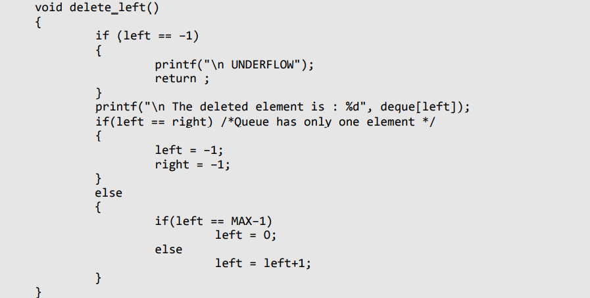

Slide 38
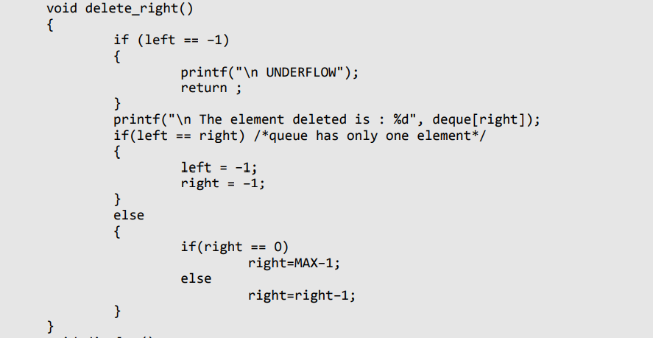

Slide 39
void display()
{
int front = left, rear = right;
if(front == –1)
{
printf("\n QUEUE IS EMPTY"); return;
}
printf("\n The elements of the queue are : ") if(front <= rear )
{
while(front <= rear)
{
printf("%d",deque[front]); front++;
}
}
else
{
while(front <= MAX–1)
{
printf("%d", deque[front]); front++;
}
front = 0;
while(front <= rear)
{
printf("%d",deque[front]);front++;
}
}
printf("\n");
}

Slide 40
Priority Queue
A priority queue is a data structure in which each element is assigned a priority. The priority of the element will be used to determine the order in which the elements will be processed.
The general rules of processing the elements of a priority queue are
An element with higher priority is processed before an element with a lower priority.
Two elements with the same priority are processed on a first-come-first-served (FCFS) basis.

Slide 41
Array Representation of a Priority Queue
When arrays are used to implement a priority queue, then a separate queue for each priority number is maintained.
Each of these queues will be implemented using circular arrays or circular queues.
A two-dimensional array for this purpose where each queue will be allocated the same amount of space.

Slide 42
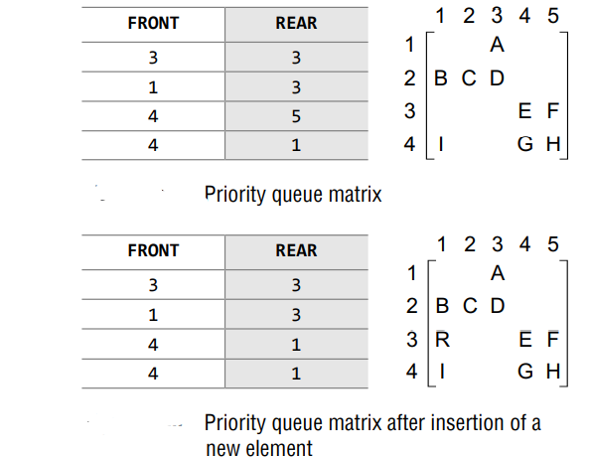

Slide 43
Insertion: Insertion To insert a new element with priority K in the priority queue, add the element at the rear end of row K, where K is the row number as well as the priority number of that element.
Deletion: To delete an element, we find the first nonempty queue and then process the front element of the first non-empty queue

