Slide 1
Advanced Machine Learning Project Title: Forecasting of Agricultural CO2 emissions to mitigate Climate Change
Suhas S(2348563)
Guhan K S(2348519)
Sai Darshan(2348548)

Slide 2
Table of Contents
Abstract
Introduction
Objective
Problem Statement
About Data
EDA
Algorithms Implemented
Evaluation Metrics
Conclusion

Slide 3
Abstract
In recent years, the agri-food sector has become a significant contributor to global carbon dioxide (CO2) emissions, examining the surge in agri-food sector CO2 emissions, this exploration employs machine learning to forecast using comprehensive datasets. Accurate predictions aid policymakers and businesses in implementing targeted interventions, promoting sustainability, and shaping policies for reducing the carbon footprint in agri-food production. The methodology explores various ML algorithms, emphasizing their potential impact on informed decision-making and sustainable practices.

Slide 4
Introduction
This exploration utilizes advanced Machine Learning techniques to analyze and forecast carbon dioxide emissions from the agri-food sector, addressing global climate change concerns. ML models, including Linear, Multiple Regressions, Random Forest, Decision Tree, SVM and ARIMA models are employed to reveal patterns and trends in a diverse dataset, offering crucial insights for policymakers and stakeholders to mitigate environmental impact and promote sustainable practices in agri-food systems. The study establishes a foundation for future analyses and informed decision-making in advancing sustainability within the sector.

Slide 5
Objective
The main objective aims to analyze and forecast carbon dioxide (CO2) emissions from the agri-food sector using advanced Machine Learning (ML) techniques, utilizing a diverse dataset encompassing variables from agricultural and food-related activities.

Slide 6
Problem Statement
Addressing the pressing need to mitigate climate change, this project focuses on forecasting agricultural CO2 emissions.
By leveraging historical data and predictive modeling, the goal is to develop insights and strategies for sustainable agricultural practices, aiding in the reduction of greenhouse gas emissions and contributing to global climate change mitigation efforts.

Slide 7
About Data
The dataset contains of 6,940 rows and 29 columns, was created for investigating the relationship between CO2 emissions and temperature fluctuations in various countries from 1990 to 2020. The data was gathered from the FAO (Food and Agriculture Organization of the United Nations) and IPCC (Intergovernmental Panel on Climate Change). Emissions values were recorded in kilotons (kt), where 1kt equals 1000 kg.
Several Attributes are:
(['Area', 'Year', 'Savanna fires', 'Forest fires', 'Crop Residues', 'Rice Cultivation', 'Drained organic soils (CO2)', 'Pesticides Manufacturing', 'Food Transport', 'Forestland', 'Net Forest conversion', 'Food Household Consumption', 'Food Retail', 'On-farm Electricity Use', 'Food Packaging', 'Agrifood Systems Waste Disposal', 'Food Processing', 'Fertilizers Manufacturing', 'IPPU', 'Manure applied to Soils', 'Manure left on Pasture', 'Manure Management', 'Fires in organic soils', 'Fires in humid tropical forests', 'On-farm energy use', 'Total Population - Male', 'Total Population - Female', 'total_emission', 'Average Temperature °C'])

Slide 8
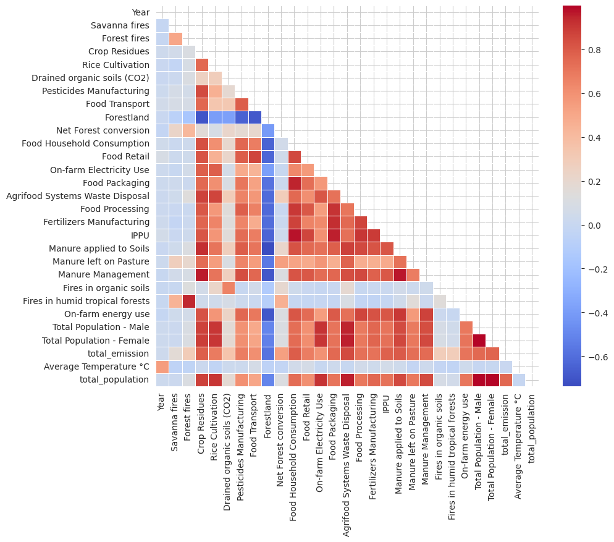
EDA(Exploratory Data Analysis)

Slide 9
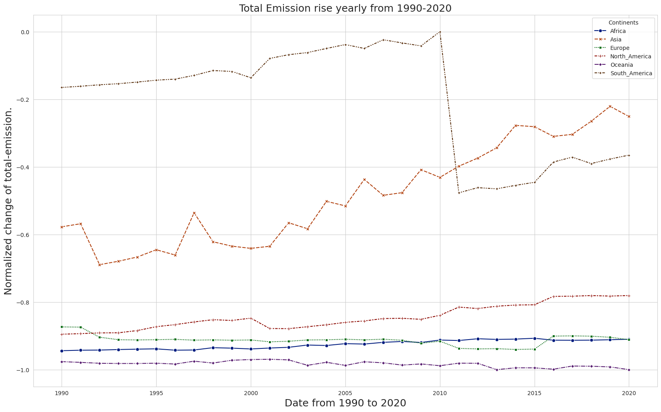
EDA

Slide 10
Algorithms Implemented
Linear Regression
Multiple Regression
Random forest regressor
Ridge and Lasso regressions
Support Vector Machine
Random Forest Classifier
Decision Tree Classifier
ARIMA Model for forecasting

Slide 11
Regression Techniques
Linear Regression provides a baseline model assuming a linear relationship between features and the target.
Multiple Regression extends this to handle multiple predictors.
Random Forest, being an ensemble method, captures complex non-linear relationships and interactions in the data.
Lasso and Ridge Regression introduce regularization to address potential multicollinearity issues and enhance model generalization.
The diverse set of models allows for a comprehensive exploration of different facets of the data, considering both linear and non-linear patterns, as well as potential overfitting or feature selection challenges. The evaluation and visualization provide a holistic understanding of their performance and characteristics in predicting the target variable.

Slide 12
Evaluation Metrics for Regression Techniques
Linear Regression: Mean Absolute Error (MAE): 0.36,Mean Squared Error (MSE): 0.22,Root Mean Squared Error (RMSE): 0.47, R2 Score: 0.31
Multiple Regression: Mean Absolute Error (MAE): 0.36Mean Squared Error (MSE): 0.22,Root Mean Squared Error (RMSE): 0.47, R2Score: 0.31
Random Forest Regression: Mean Absolute Error (MAE):0.27,Mean Squared Error (MSE):0.14, Root Mean Squared Error (RMSE): 0.37,R2 Score: 0.58
Lasso Regression: Mean Absolute Error (MAE): 0.36,Mean Squared Error (MSE): 0.23,Root Mean Squared Error (RMSE): 0.48, R2 Score: 0.29
Ridge Regression: Mean Absolute Error (MAE): 0.36, Mean Squared Error (MSE): 0.22, Root Mean Squared Error (RMSE): 0.47, R2 Score: 0.31

Slide 13
Classification Techniques
Support Vector Machines (SVM) and Random Forest (RF) are employed as classification algorithms to discern patterns and relationships within the data.
The SVM model aims to find the optimal hyperplane that separates different temperature categories in a high-dimensional feature space.
On the other hand, the Random Forest model leverages an ensemble of decision trees to capture complex interactions and feature importance.
Decision tree model achieves a balanced performance in predicting temperature categories
develop predictive models that can effectively classify temperature categories based on various emissions and environmental factors. This predictive capability serves as a valuable tool for forecasting temperature fluctuations related to climate change.

Slide 14
Evaluation Metrics for Classification Techniques
Support Vector Machine: Precision: 0.809, Recall: 0.7444, F1 Score: 0.6354, SVM Accuracy: 0.7444
Random Forest Classification: Precision: 0.7741, Recall: 0.7889,F1 Score: 0.7779, ROC AUC Score: 0.7787
Decision Tree Classification: Precision: 0.7408, Recall: 0.7387, F1 Score: 0.7395, ROC AUC Score: 0.6619

Slide 15
ARIMA model for CO2 emission forecasting
ARIMA, which stands for Autoregressive Integrated Moving Average, is a popular time series forecasting model used in statistics and econometrics. It is a powerful tool for predicting future values based on historical data. ARIMA models are particularly effective when dealing with time-dependent data, where patterns and trends exist over time.
The ARIMA model is denoted as ARIMA (p, d, q), where
p is the order of the autoregressive component.
d is the degree of differencing.
q is the order of the moving average component

Slide 16
General Observations:
General Observations:
- Regression models capture some variability but may benefit from further refinement or more sophisticated models.
- Classification models effectively categorize temperature levels.

Slide 17
THANK YOU

