Slide 1

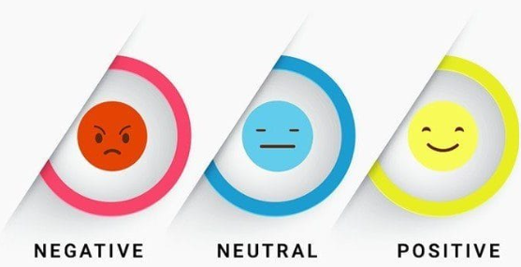
SENTIMENT ANALYSIS OF SOCIAL MEDIA POSTS
Team Members:
Samruddhi Patil
Athrva Karve
Pratik Patil
Sahil Kamble
Date:-21/04/2025

Slide 2
Introduction of this Project:
In today’s fast-paced digital world, people express their opinions and feelings across various social media platforms every second. These opinions whether positive, negative, or neutral hold valuable information that can help brands, businesses, and researchers understand public sentiment toward products, events, or services.
This project focuses on analyzing and visualizing social media sentiment data to gain meaningful insights into how users feel and react online. By cleaning the data, processing sentiment labels, and using charts to visualize trends, we aim to explore patterns such as:
Which platforms receive the most engagement
The distribution of sentiments (positive, negative, neutral)
How likes and retweets vary based on sentiment
When users are most active or expressive

Slide 3
Features of the Dataset:
Rows: 732
Columns: 15
Source: Sentiment Analysis Dataset
Null Values: No Null Values
Duplicates: No Duplicates
Tools:
Pandas and Numpy
Matplotlib
Seaborn
Read CSV file into Data Frame
Google Collab

Slide 4
The Primary goals of this project are:
To visualize the distribution of sentiments across social media platforms
To analyze the relationship between sentiment and post engagement (likes and retweets)
To compare the average likes received by positive and negative posts
To explore hourly activity trends and user engagement based on time
To evaluate which platforms have the most active sentiment-sharing users
To understand how text length varies with sentiment categories
To provide visual summaries using bar charts, pie charts, and box plots for easier interpretation of emotions

Slide 5
Data Loading :
- Import necessary libraries: pandas, numpy, matplotlib, seaborn
- Load the dataset using pandas.read_csv()
- Inspect the first few rows using .head() and check dataset shape using .shape()
- Use .info() and .describe() to understand data types, missing values, and distribution
Import Libraries:
Import Pandas and NumPy
Import Matplotlib
Import Seabron
Load Data:
Read CSV file into Data Frame
Display first few rows
Inspect:
View Data Frame information
Describe the data

Slide 6
Data Preprocessing and Cleaning:
2. Data Preprocessing and Cleaning:
Handle missing values:
Drop rows with missing or invalid timestamps using dropna()
Remove rows with missing essential fields (e.g., Sentiment, Text)
Convert date columns:
Convert Timestamp column to datetime format using pd.to_datetime() with error handling
Remove duplicates:
Use df.duplicated() and df.drop_duplicates() to eliminate any repeated rows
Fix formatting issues:
Strip extra spaces from Platform and Sentiment columns using .str.strip()
Standardize case: capitalize Platform, lowercase Sentiment
Normalize sentiment labels and filter only: 'positive', 'negative', 'neutral'

Slide 7
Data Preprocessing and Cleaning:
Column Type Handling:
Convert Timestamp to datetime
Create new columns like:
Hour (from Timestamp) → to analyze hourly trends
text_length → to measure post length
Missing Values:
Check for missing values using df.isnull().sum()
Drop rows with missing timestamps or sentiments
Drop Unnecessary Columns:
Drop unnamed or irrelevant columns if present (e.g., Unnamed: 0, Unnamed: 0.1,Year,Month,Day,Hour)

Slide 8
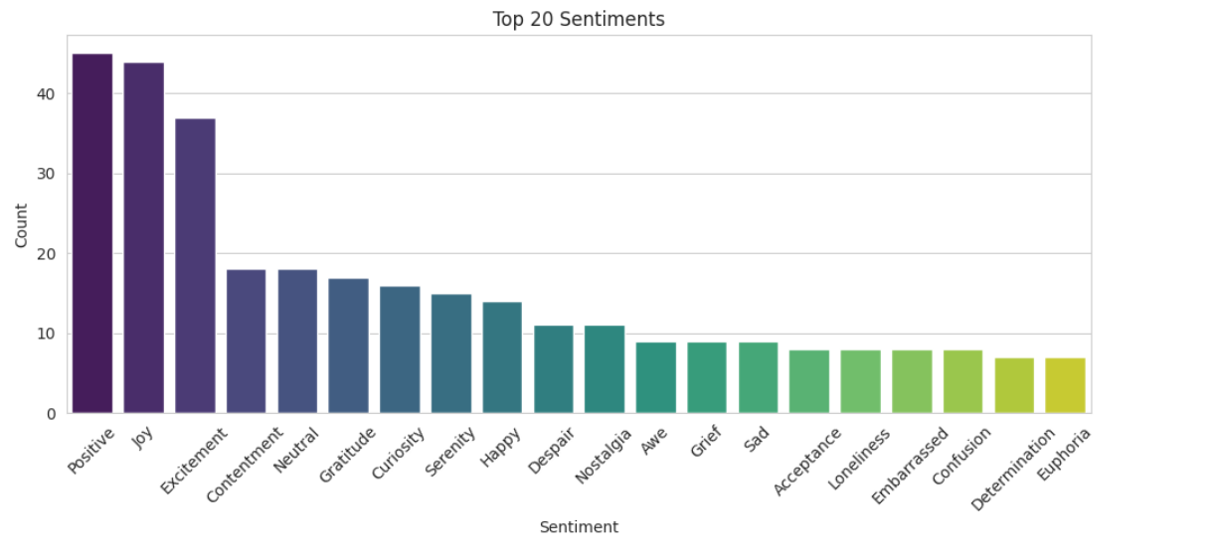
Exploratory Data Analysis(EDA):
Sentiment Overview: Shows the 20 most common emotions from user posts.
Top Emotions: Positive, Joy, and Excitement dominate, indicating high user positivity.
Balanced Feelings: Neutral, Gratitude, and Contentment reflect mixed sentiments.
Rare Emotions: Emotions like Grief and Confusion are less frequent but valuable.
Why It Matters: Helps in tracking user mood, improving engagement, and personalizing content strategies.
Barchart:Top 20 Sentiments

Slide 9
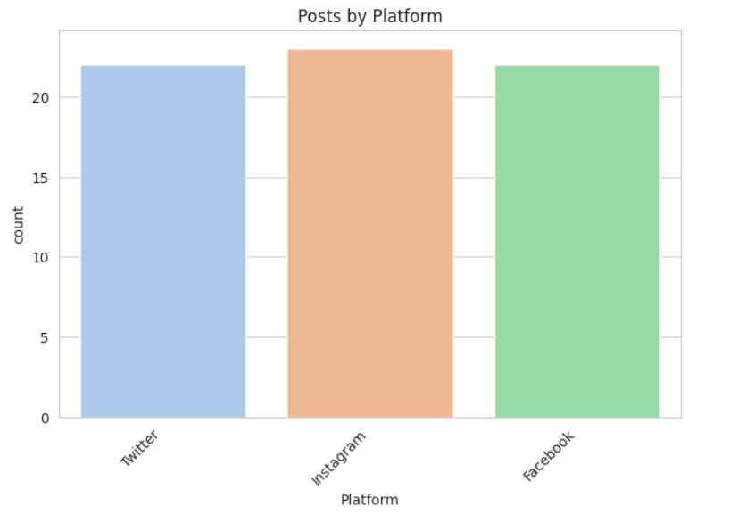
Countplot :Posts by Platforms
Platform Distribution: Shows the number of user posts across Twitter, Instagram, and Facebook.
Balanced Activity: All three platforms have nearly equal contributions, with Instagram slightly leading.
Platform Engagement: Indicates where users are most active in expressing sentiments.
Business Use: Helps identify key platforms for outreach, campaign targeting, and audience analysis.

Slide 10
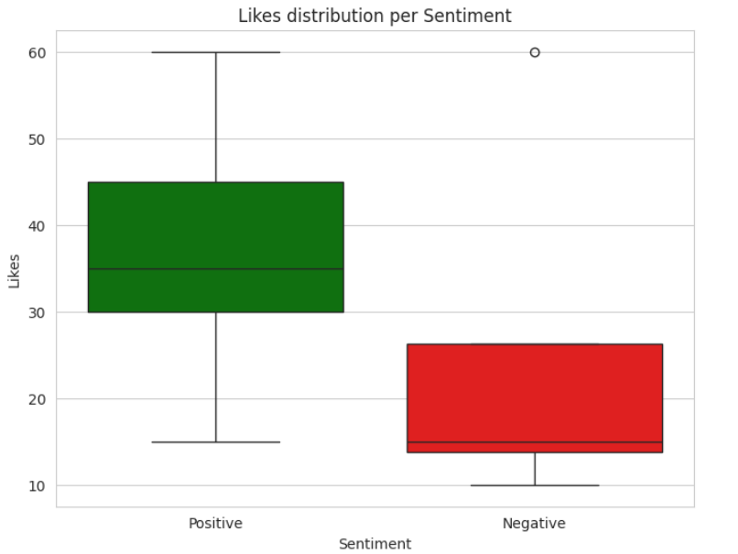
Boxplot:Likes by sentiment
Engagement by Emotion: Compares likes received for Positive vs. Negative sentiments.
Positive Sentiments Get More Likes: Positive posts show higher median and wider like range, suggesting stronger user engagement.
Outlier Insight: Outliers indicate some exceptionally liked posts regardless of sentiment type.
Business Use: Useful for optimizing content tone to drive more engagement and visibility.

Slide 11
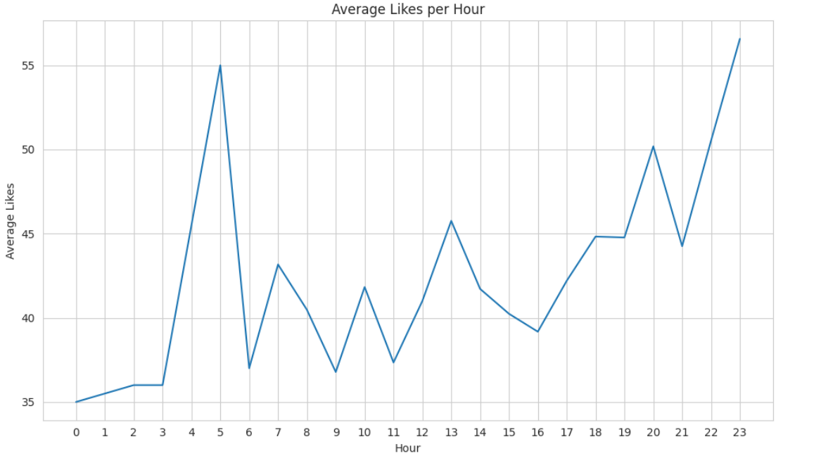
Linechart: Avg likes per hour
Peak Engagement Times: Highest average likes occur around 5 AM and 11 PM, suggesting ideal posting windows.
Evening Surge: Likes steadily rise post-6 PM, showing strong evening user activity.
Strategic Posting: Brands can maximize visibility and engagement by aligning content drops with high-like hours.

Slide 12
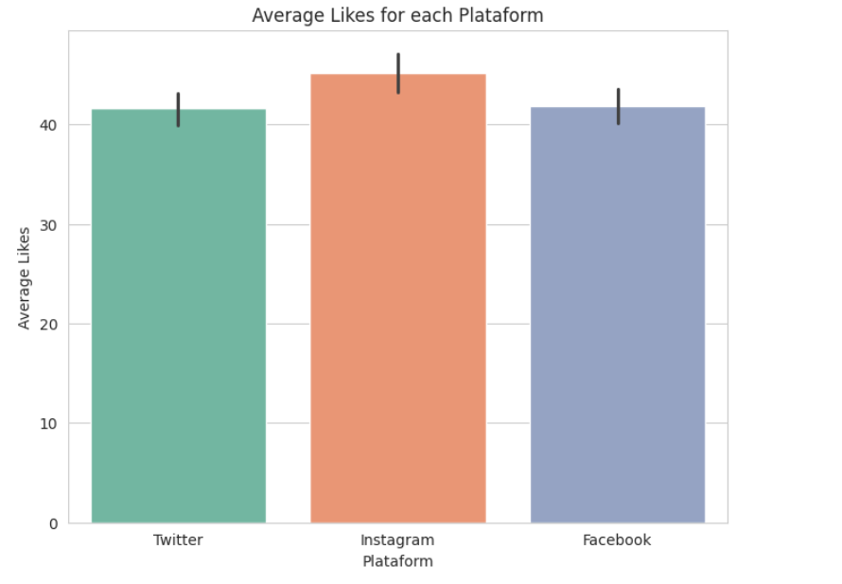
Barchart:Avg likes for each platform
Platform Performance: Instagram leads in average likes, followed by Facebook and Twitter.
Engagement Insight: Instagram yields the highest engagement, highlighting its visual-first appeal.
Strategy Tip: Focus content strategies more on Instagram for higher interaction rates.

Slide 13
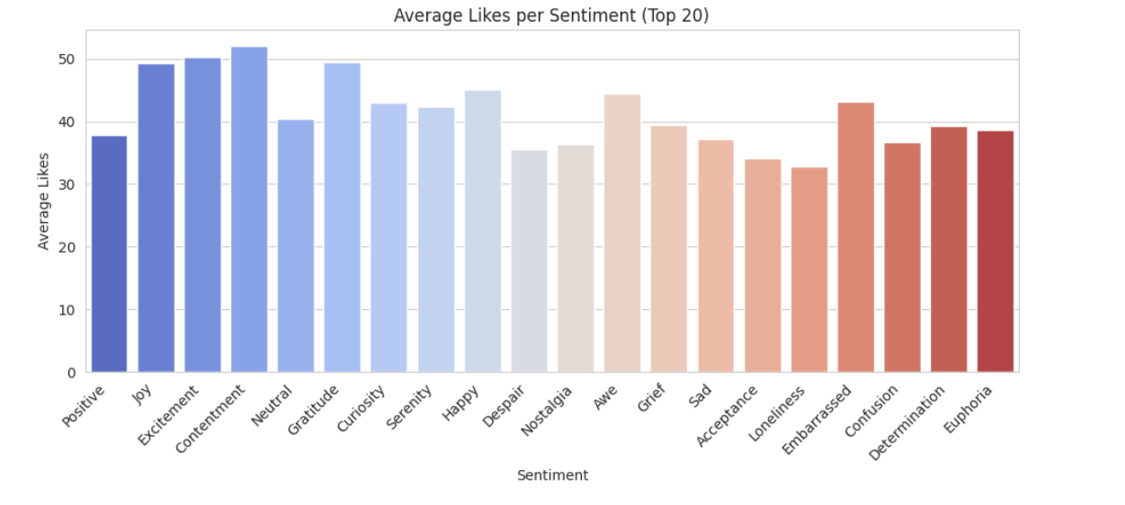
Barchart:Avg likes per sentiment(Top 20)
Sentiment-wise Engagement – Emotional Impact on Likes
Top Performing Sentiments: Contentment, Excitement, and Joy attract the highest average likes.
Emotional Strategy: Posts evoking positive and energetic emotions drive more engagement.
Insight Use: Tailor content with sentiments like Joy and Gratitude to boost audience interaction.

Slide 14
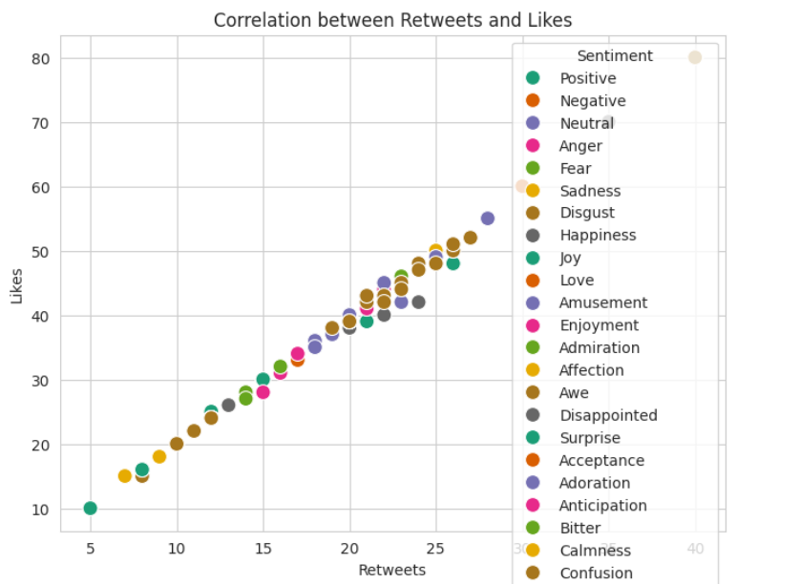
Scatterplot:Retweets and Likes
Sentiment-wise Engagement – Emotional Impact on Retweets and Likes
Top Performing Sentiments: Affection, Excitement, and Happiness are linked to higher likes and retweets.
Emotional Strategy: Tweets expressing warm, uplifting, or enthusiastic emotions tend to generate stronger engagement.
Insight Use: Focus on crafting emotionally resonant content with sentiments like Joy, Love, and Excitement to enhance visibility and audience interaction.

Slide 15
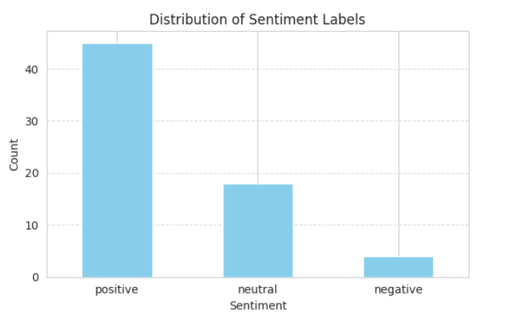
Barchart:Distribution of Sentiment Labels
Sentiment Distribution – Overview of Emotional Tone
Dominant Sentiment: Positive sentiments significantly outnumber neutral and negative.
Audience Mood Insight: Majority of content evokes positivity, suggesting a generally upbeat tone.
Content Planning: Leverage this insight to maintain or increase positive sentiment for stronger audience alignment.

Slide 16
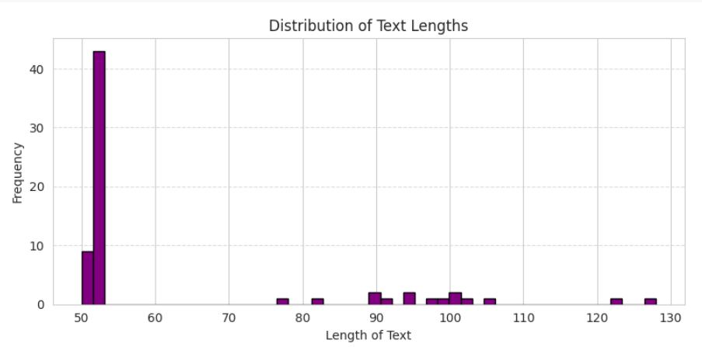
Barchart:Distribution of Text Lengths
Text Length Distribution – Content Size Patterns
Dominant Range: Most texts are clustered around 50–52 characters.
Content Strategy Insight: Short-form content is heavily preferred or more common.
Optimization Use: Focus on concise messaging formats to match prevalent content length trends and possibly improve engagement.

Slide 17
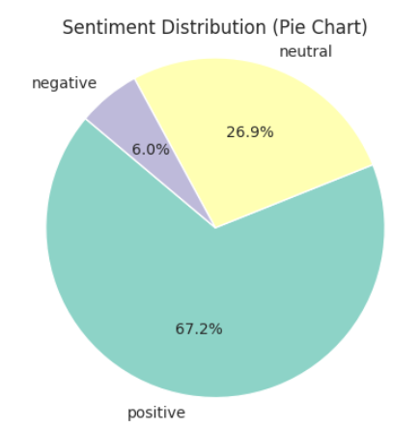
Piechart : Sentiment Distribution
Sentiment Distribution (Pie Chart) – Visualizes the proportion of sentiment categories in the dataset:
Positive (67.2%) dominates, indicating overall favorable feedback.
Neutral (26.9%) suggests a notable portion of ambivalent or balanced responses.
Negative (6.0%) shows minimal dissatisfaction.

Slide 18
Key Findings:
Evening Hours Drive More Engagement: Posts shared between 5 PM and 11 PM receive significantly higher average likes, peaking at 11 PM, indicating optimal posting times.
Instagram Outperforms Other Platforms: Among Twitter, Instagram, and Facebook, Instagram leads in average likes, making it the most engaging platform for sentiment-rich content.
Positive Emotions Attract More Likes: Sentiments like Contentment, Excitement, and Joy consistently generate higher average likes, showing that uplifting content resonates best with audiences.
Neutral and Grateful Tones Are Also Effective: Sentiments such as Neutral and Gratitude rank high in engagement, suggesting that emotionally balanced posts are well-received.
Negative Sentiments Still Spark Engagement: Sentiments like Grief, Sadness, and Confusion attract moderate likes, indicating audiences engage with emotionally vulnerable or thought-provoking content.
Platform Consistency in Engagement: Twitter and Facebook show similar average likes, with minor variation, suggesting users on these platforms respond similarly to sentiment-driven content.
Emotional Variety Enhances Reach: A wide range of sentiments – from Awe to Determination – maintain average engagement levels, highlighting the importance of diverse emotional storytelling.

Slide 19
Recommendations :
Post During Peak Engagement Hours
Focus on Emotionally Positive Content
Leverage Instagram for High-Engagement Campaigns
Incorporate Meaningful and Neutral Messaging
Diversify Sentiment Themes in Posts
Create Content That Resonates With Shared Human Experiences
Optimize Platform Strategy Based on Sentiment Trends

Slide 20
Thank You

