Slide 1
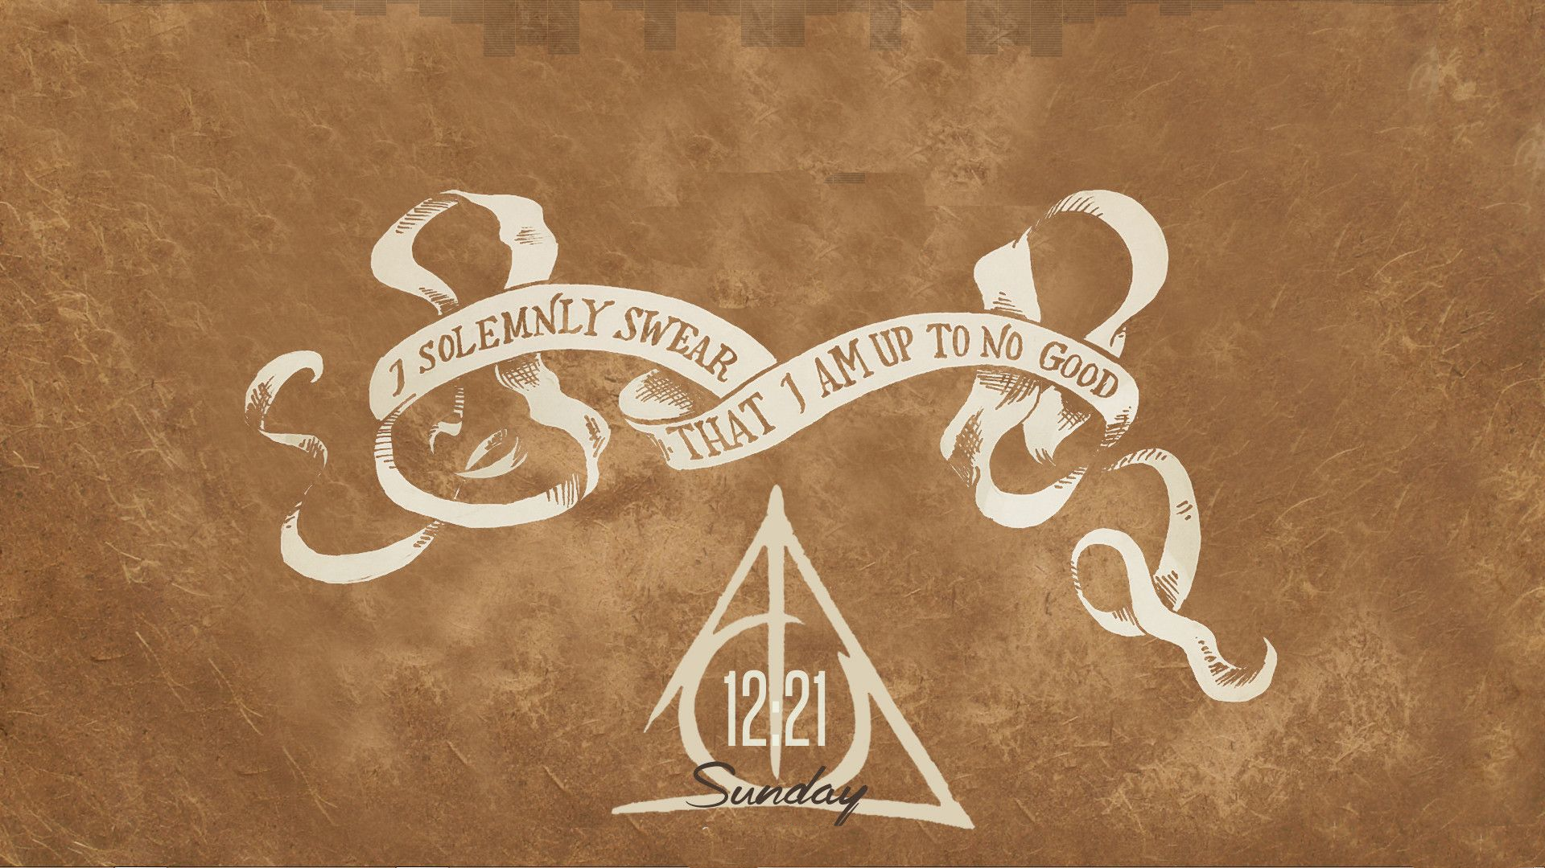

Slide 2
The
Marauders’
Chess
By the Marauders :
Prathik S. Nayak
P. Suhas
Yash Kumar
Aman Raj
Ankur Ingale

Slide 3
Object of the Game
The Marauders’ Chess is a strategic game in which two opponents play against each other using their 4 characters.
The objective is to kill the opponent's king. To this end, a player's pieces are used to attack and capture the opponent's pieces, while supporting each other.
In addition to that, the players can earn points by killing the other pieces of opponents.

Slide 4
Setup at the Start
All the players are trapped in dungeons(main board), which consists of 6 square rooms. Each square room is a 5x5 maze with some walls blocking the movement of pieces through them.
Each player begins the game with 4 pieces: one king, one rook, one knights and one bishops.
The White player starts from the left side and The black player from the right.

Slide 5
Movements of the pieces
All the pieces have traditional chess moves.
As the pieces are trapped in a maze, the giant walls block the direct movement of King, Rook, Bishop through them.
However, a Knight can jump over “one wall” in a move.

Slide 6
Mazes in Motion!
Thanks to the creators of the Marauders’ maze! Each room is equipped with a complex wheels and gears mechanism allowing it to rotate.
The rooms can be rotated clockwise 90º. The Rotation Gear which triggers this movement is represented by a colored button on the left side of the screen.
Escaping the mazes is made easy with this rotation of the rooms.

Slide 7
How to play
To start the game, each player has to transfer 4 of his pieces onto the board from a starting platform within 30 seconds.
The game will be a turn based , in which he can decide to either move one of his pieces or Rotate one of the Rooms.
Each player has 15 minutes (max 1 min each turn) which automatically halts during the opponents turn.

Slide 8
During the game, each player must try to kill the pieces of the opponent.
To initiate a move, select the piece and then select the destination cell. The piece can be moved only if it is its valid movement and no other piece or wall is blocking its way.
To Rotate a Room, just click on the respective Rotate gear button on the left side of the screen.

Slide 9
How does it End?
You may leave the dungeon in different scenarios :
The opponent is defeated if his King is killed => The game ends and you escape the Labyrinth.
A player runs out of his time => His forces are down and the other player can escape the Labyrinth without any fear.
Unable to kill the king => If only the king is left and the other player is unable to kill it within 7 of its moves, both must give up and leave the Labyrinth.
Each of the player gets points according to his performance in the game.
But!!! Do not rest here…..
There are many more deepest Dungeons you need to escape by defeating your enemy forces.

Slide 10
Time

Slide 11
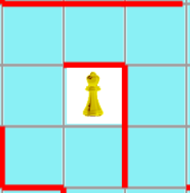
Special Rules
RESTRICTION IN ROATING ROOMS:
The rooms can be rotated only clockwise 90º .
A player cannot use rotation gears in consecutive moves.
A room cannot be rotated if the opponent’s King is present in that room.
MOVEMENT OF THE BISHOP:
The bishop cannot cross a cornered wall as shown in move A.
The bishop can however cross a single wall from the edge as shown in move B , but not move C.
B
A
C

Slide 12
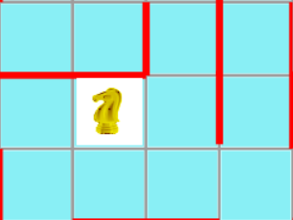
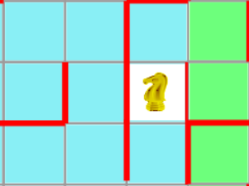
MOVEMENT OF THE KNIGHT:
The knight move must be first 2 forward moves and then 1 side move only but not 1 forward and 2 sideways as in move C.
During this movement if it comes across only one wall as in move A, it is a valid move.
If the it comes across more than 1 wall as in move B, it is invalid.
A
B
C

Slide 13
POINTS
The player gets points for each kill he makes. The value of each piece is as follows:
King - 70 points
Knight - 40 points
Rook - 35 points
Bishop - 35 points
For the each check a player makes to the opponent’s king, he gets 5 extra points(only if your move leads to check).

Slide 14
Normal game:
The game continues with some kills and then one of the king is killed, then
Each player gets the sum of the value of pieces they killed.
Time isn't considered for giving points.
The Winner is decided.
Draw Type 1:
If the game is draw type1 (time drains completely for a player), the winner will be getting points from his time
( minutes left * 10 + half of the value of the opponent pieces left on board) apart from the points each player gets according to their kills.
Draw Type 2:
If one player is left with only King, he should defend it in 7 moves.
1.If he isn't killed, the game is draw type 2, the player with more time gets points from his time (minutes left * 10) apart from the kill points.
2.If he is killed, the points will be given like normal game.

Slide 15
End of the Event
In order to escape from Marauders Game, you need to escape 8 of the dungeons defeating your enemies who will be decided by the Marauders(The Creators)
The scores in each game are tracked by the Marauders.

