Slide 1
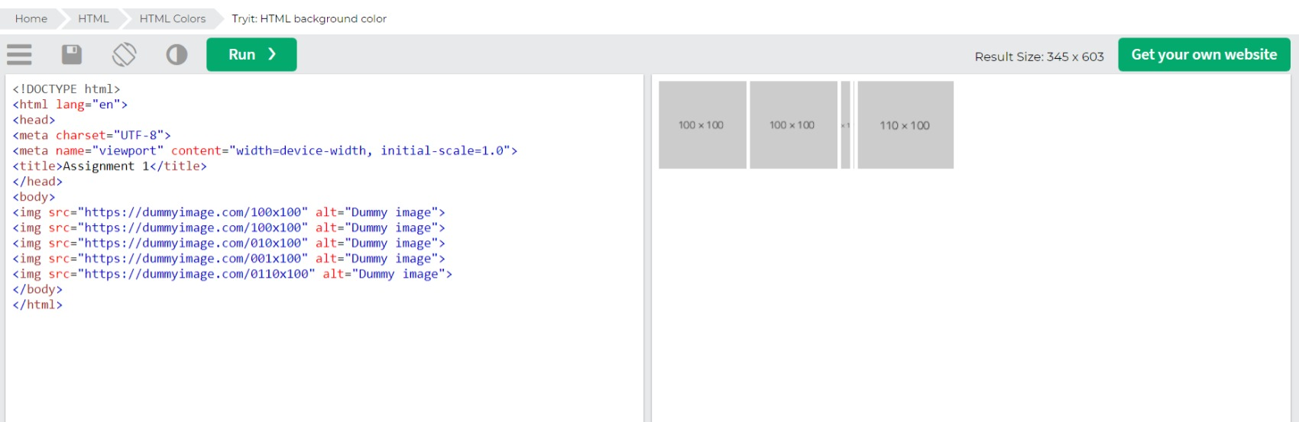
1. Create an image gallery that holds multiple images.

Slide 2
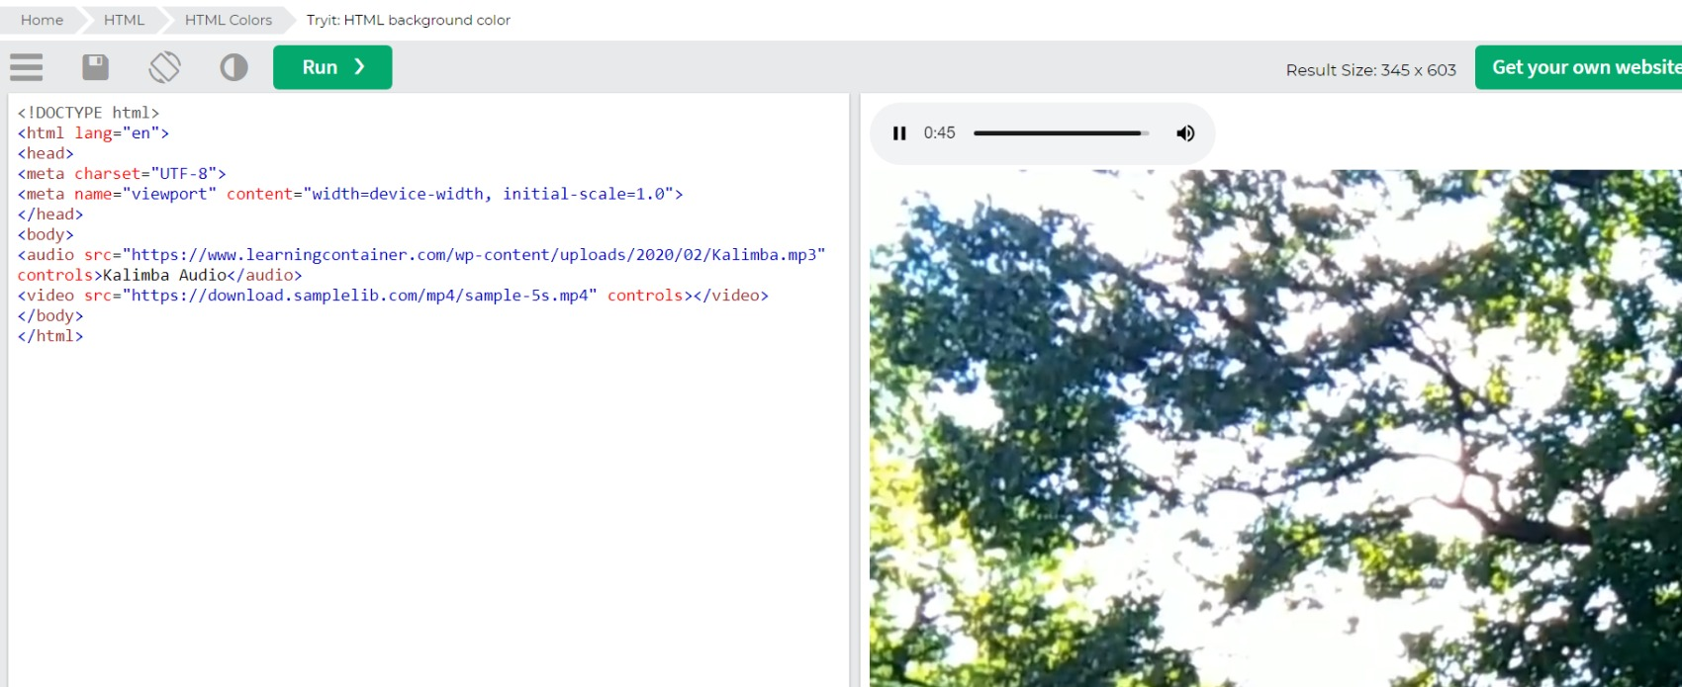
2. Use video and audio tags to display video and audio with the playback, and audio controls

Slide 3
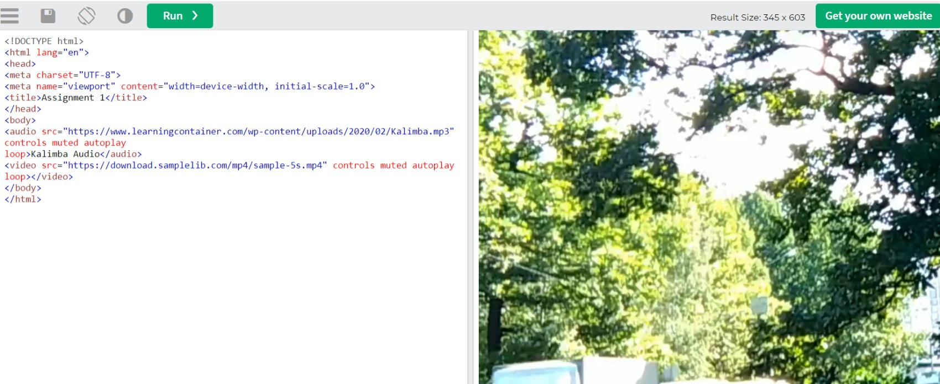
3. Modify the previous assignment so that the audio and video play automatically as the page is loaded and
they should play infinitely

Slide 4
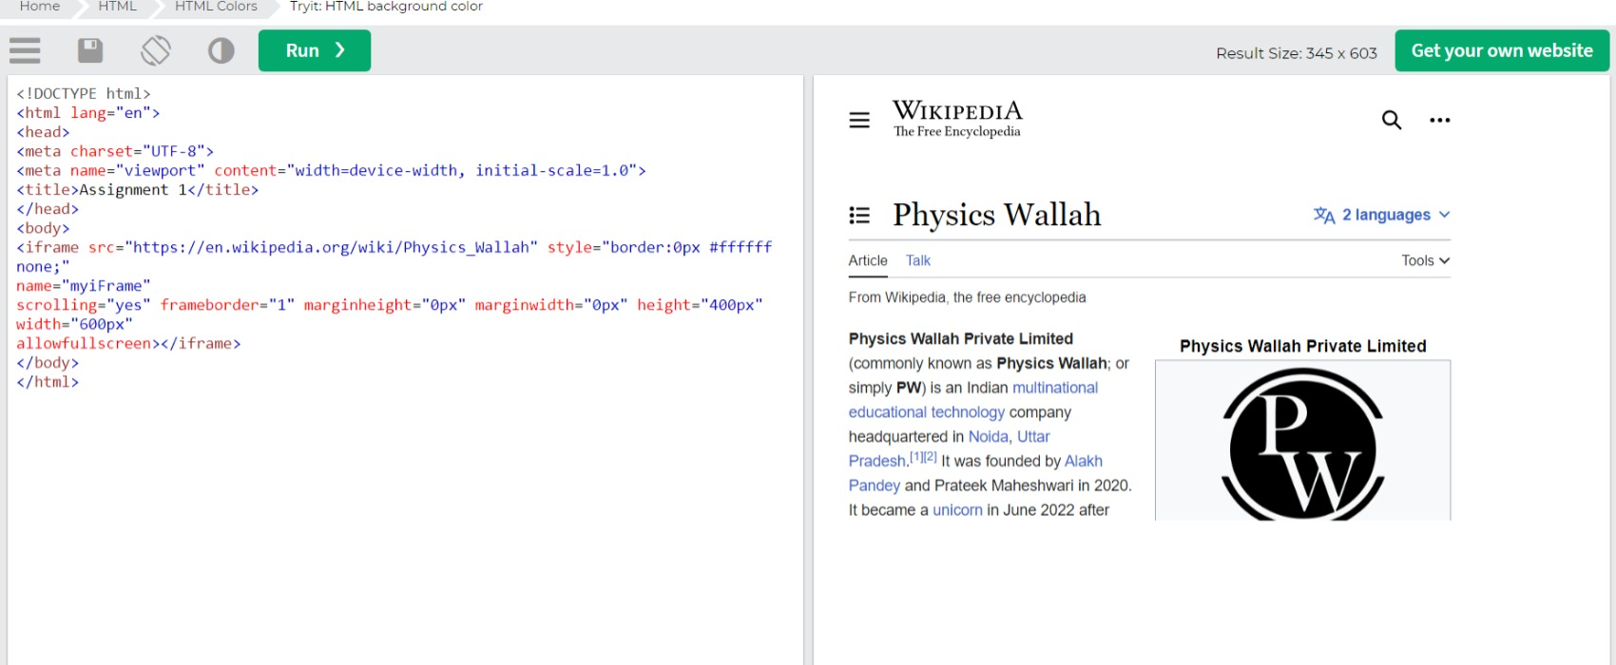
4. Use iframe to embed the PhysicsWallah Wikipedia page properly.

Slide 5
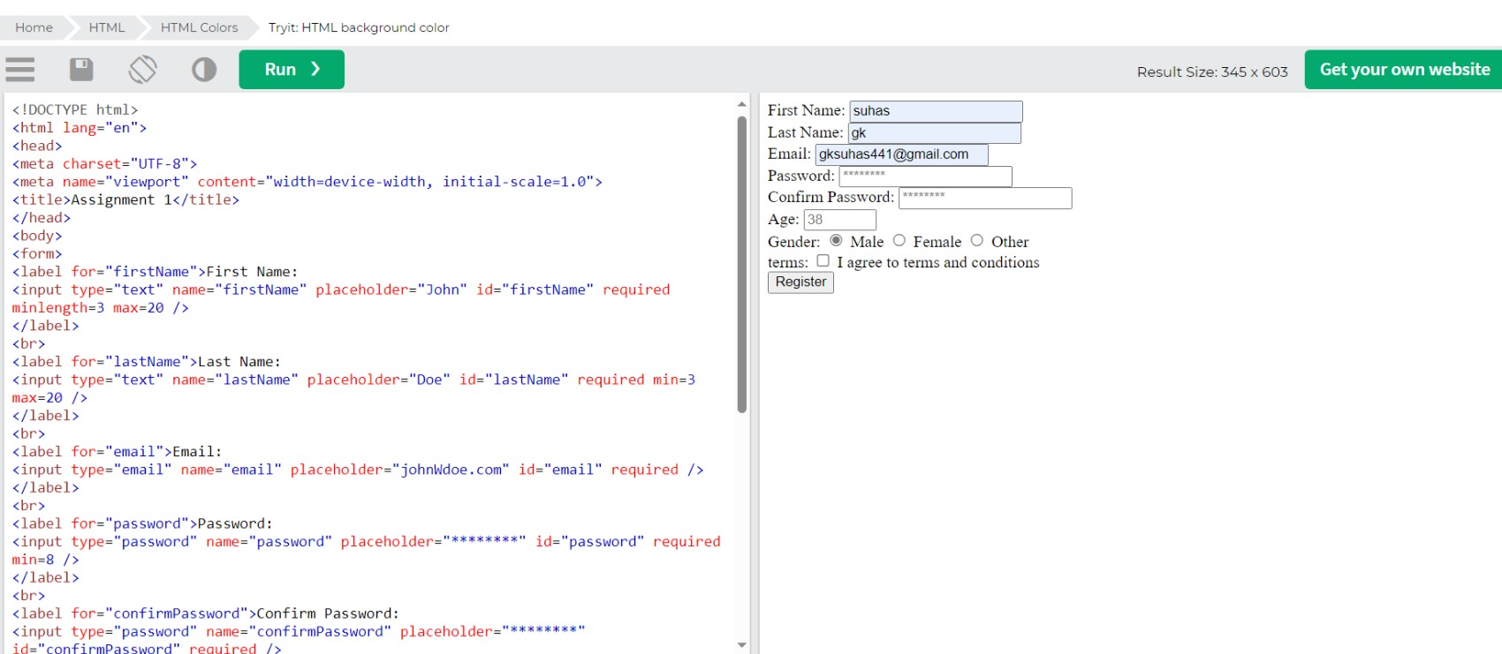
5)

