Slide 1
Problem Statement
Write c[de t[ p[siti[n 3 equal-sized (30 X 30px) b[xes A/ B/ C/ D/ and E as f[ll[*s.
)( b[x A ,00px fr[m the left/ and ,00px fr[m the t[p [f the vie*p[rt(
+( b[x B -`0px left/ and -`0px ab[ve fr[m the center [f b[x A(
_( b[x B -`0px right/ and -`0px ab[ve fr[m the center [f b[x A(
Z( b[x B -`0px left/ and -`0px bel[* fr[m the center [f b[x A(
2( b[x B -`0px right/ and -`0px bel[* fr[m the center [f b[x A.

Slide 2
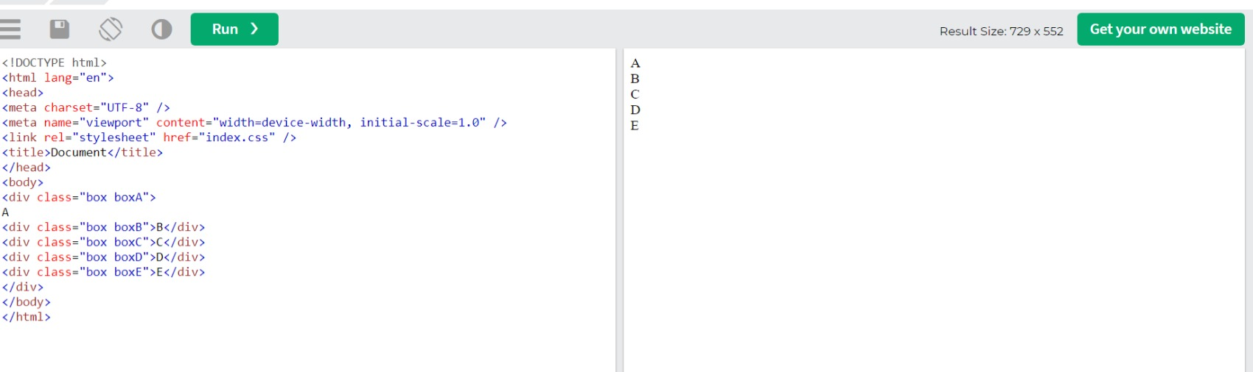
.task 1
Index.html

Slide 3
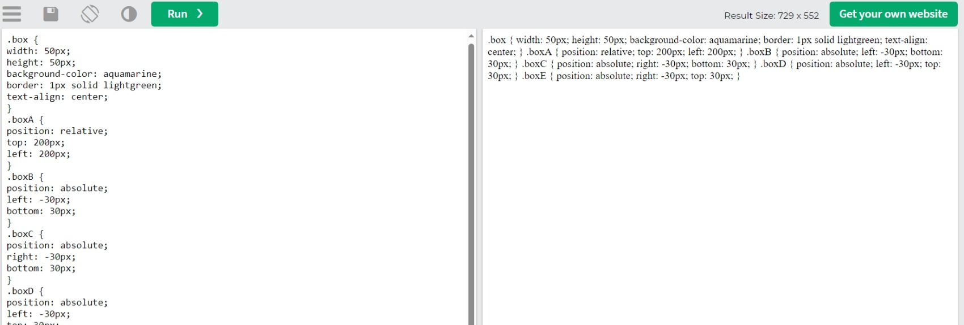
Index.css

Slide 4
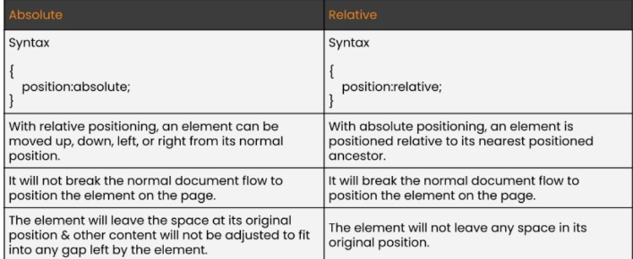
Task 2)
Explain the difference between Absolute and Relative positioning.

Slide 5
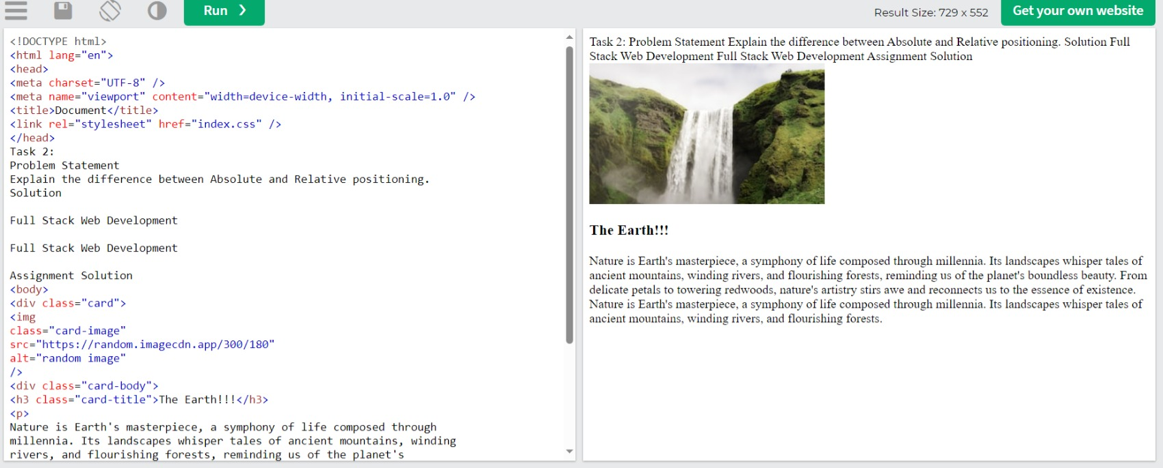
Create a card as shown in the picture below.
Index.html

Slide 6
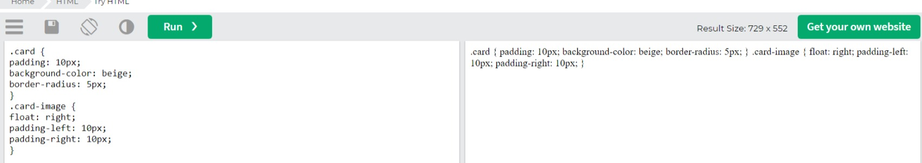
Index.css

Slide 7
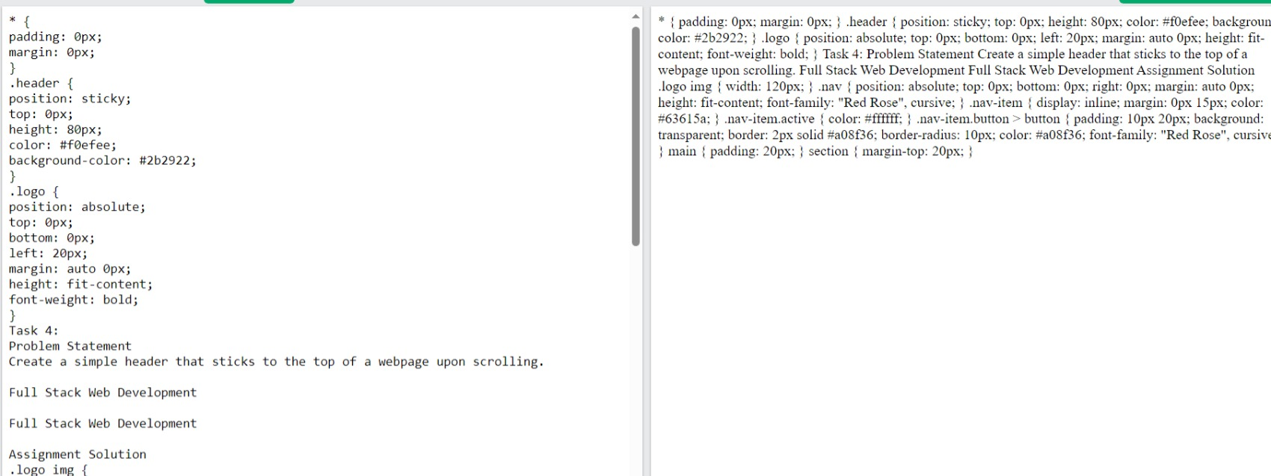
Task 4)
Create a simple header that sticks to the top of a webpage upon scrolling.
Index.css

Slide 8
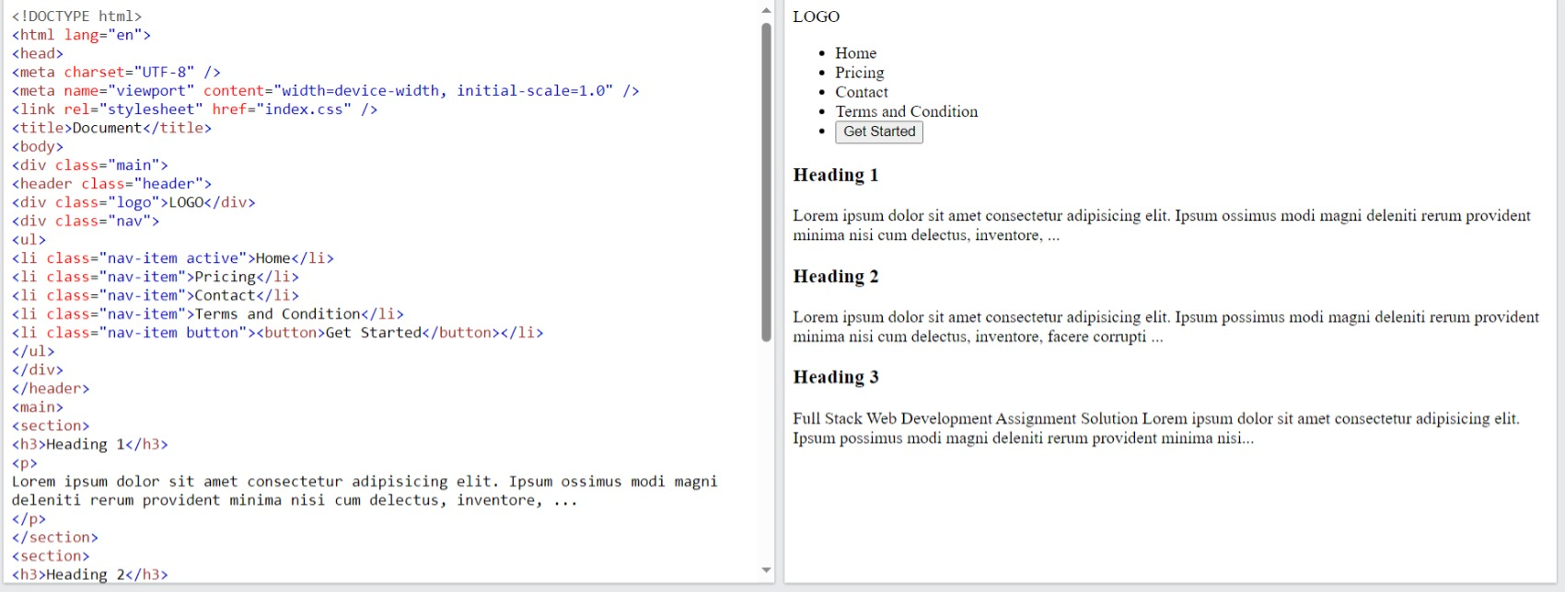
Index.html

Slide 9
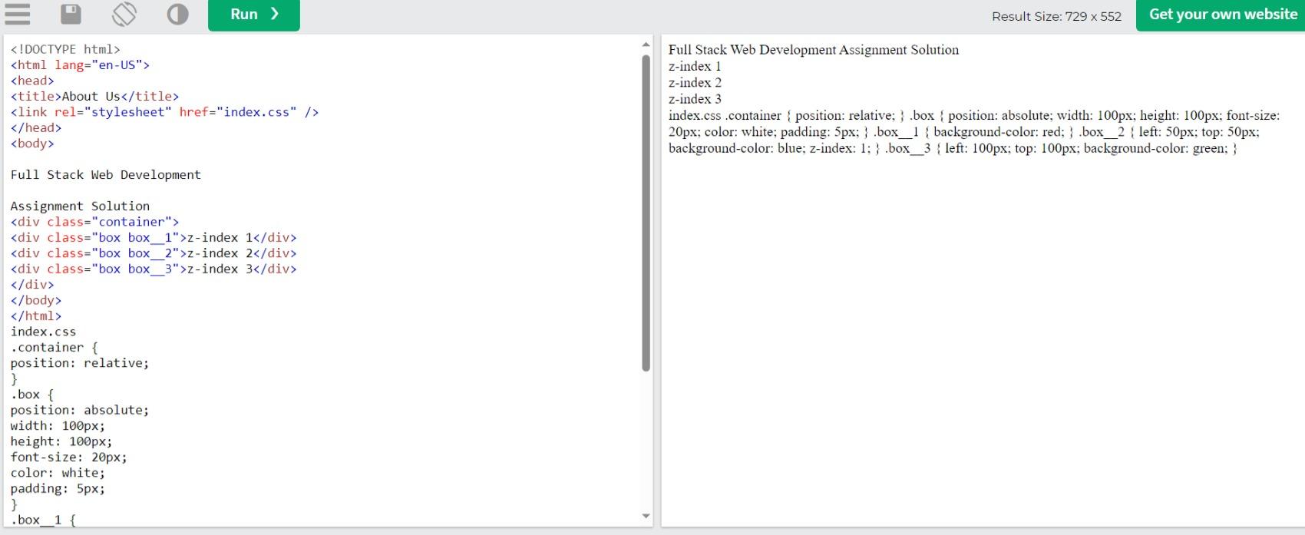
Explain the z-index, with a code example.

