Slide 1
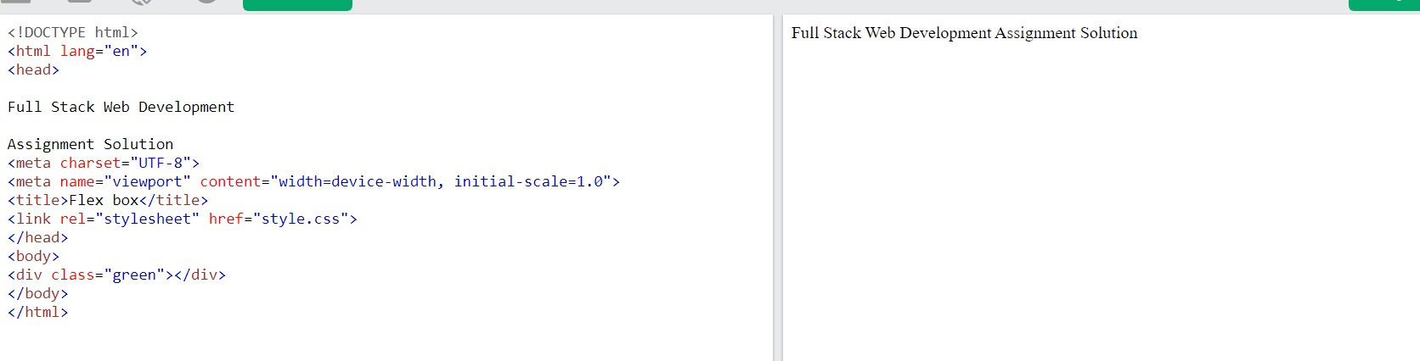
Q3. Write the code to center R div using CSS Flexbox.
Index.html

Slide 2
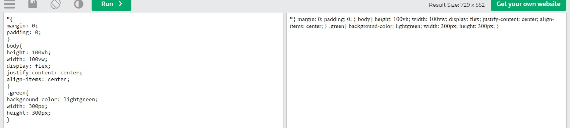
Index.css

Slide 3
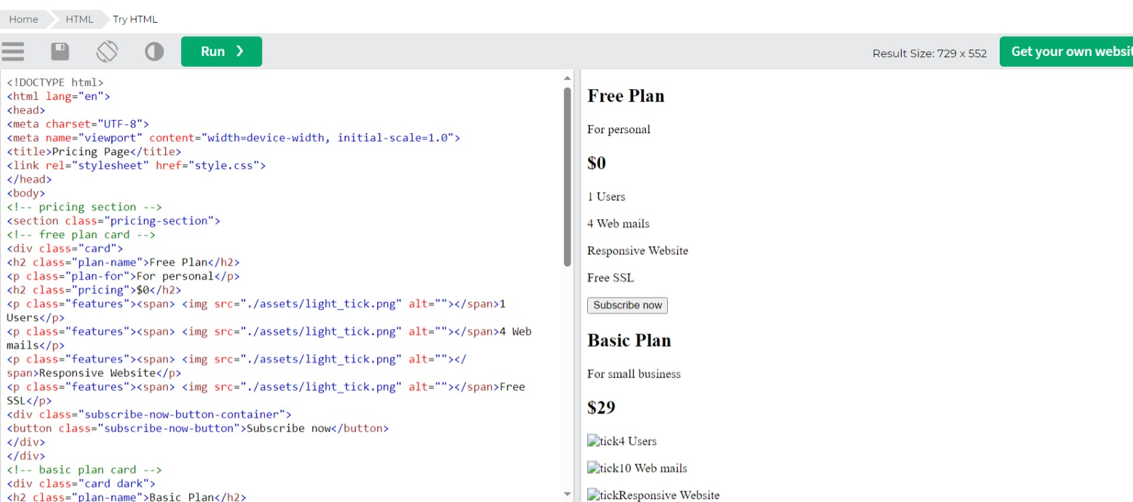
Q4. A client of yours wants to add a pricing section on their website to showcase their newly introduced
premium plans.
You have to build
Index.html

Slide 4
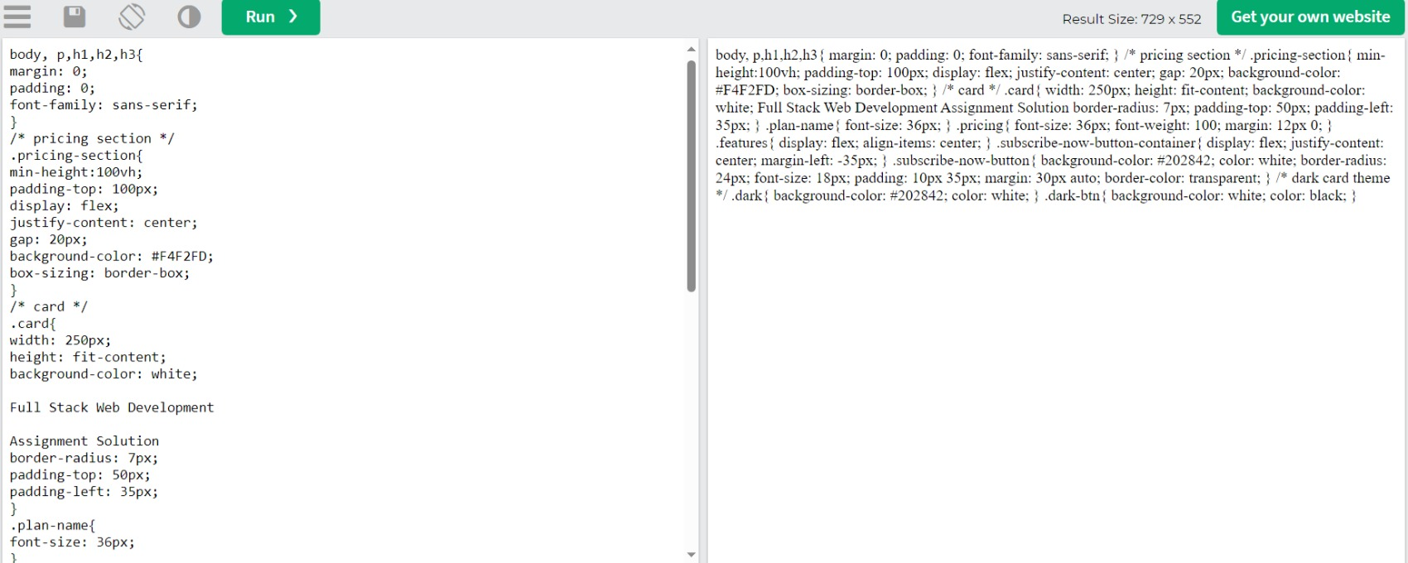
Style.css

Slide 5
Q5. build a clone of the IRCTC Ticket booking page.
<!DOCTYPE html>
<html lang="en">
<head>
<meta charset="UTF-8">
<meta name="viewport" content="width=device-width, initial-scale=1.0">
<title>CSS FLEX</title>
<link rel="stylesheet" href="style.css">
</head>
<body>
<!-- full wrapper container -->
<div class="full-container">

Slide 6
<!-- left section -->
<section class="left">
<!-- navigation container -->
<nav>
<div class="logos-container">
<img src="assets/IRCTCLogo.png" alt="IRCTC">
<img src="assets/indianRailwaysLogo.png" alt="indian Railways">
</div>
<div class="navigation-container">
<ul>
<li>Ask Disha</li>
<li>Contact us</li>
<li>Alerts</li>
</ul>
<ul>
<li>
<button class="selected">Login</button>
</li>
<li>
<button>Register</button>

Slide 7
</li>
<li>
<button>Agent Login</button>
</li>
</ul>
</div>
</nav>
<!-- main section -->
<main>
<div>
<h2 class="main-title">Indian Railways</h2>
<p class="sub-main-title">
<span class="green-text">
Safety
</span>
<span class="orange-text">
Security
</span>
<span class="blue-text">
Punctuality
</span>
</p>
</div>
<div class="choose-container">
<button class="selected"><img src="assets/ticket_icon.png" alt=""> BOOK
Ticket</button>
<button><img src="assets/tick_icon.png" alt=""> PNR Status</button>

Slide 8
<button><img src="assets/chart_icon.png" alt=""> Charts / Vacancy</
button>
</div>
<div class="journey-details-container">
<div class="journey-details-section-container">
<div class="card-element">
<div class="card-element-image-container">
<img src="assets/departure_train_icon.png" alt="">
</div>
<div class="select-option">
<div class="dropdown">
<span>From</span>
<img src="assets/expand_more_icon.png" alt="">
</div>
<div class="choose-location">
<h2>Bangalore</h2>
<span>KSR - Bangalore</span>
</div>
</div>
</div>
<div class="center-from-to-arrow">
<img src="assets/to_from_arrow.png" alt="">
</div>
<div class="card-element">
<div class="card-element-image-container">
<img src="assets/destination_train_icon.png" alt="">
</div>
<div class="select-option">
<div class="dropdown">
<span>To</span>
<img src="assets/expand_more_icon.png" alt="">
</div>
<div class="choose-location">
<h2>Kasaragod</h2>
<span>KSD - Kasaragod</span>
</div>
</div>
</div>
</div>
<div class="journey-details-section-container">
<div class="card-element">
<div class="card-element-image-container">
<img src="assets/calander-icon.png" alt="">
</div>
<div class="select-option">

Slide 9
<div class="dropdown">
<span>Date</span>
<img src="assets/expand_more_icon.png" alt="">
</div>
<div class="choose-location">
<h2>01 Aug 23</h2>
<span>Tuesday</span>
</div>
</div>
</div>
<div class="card-element ">
<div class="card-element-image-container">
<img src="assets/threedot-icon.png" alt="">
</div>
<div class="select-option">
<div class="dropdown">
<span>Class</span>
<img src="assets/expand_more_icon.png" alt="">
</div>
<div class="choose-location">
<h2>3A</h2>
<span>AC 3 tier</span>
</div>
</div>
</div>

Slide 10
<div class="choose-location">
<h2>TATKAL</h2>
<span>AC 3 Tier</span>
</div>
</div>
</div>
</div>
</div>
<button class="search-button">Search Train <img src="assets/right-arrow-
icon.png" alt=""></button>
</main>
</section>
<!-- right section -->
<section class="right">
<img src="assets/heroImage.png" alt="">
</section>
</div>
</body>
</html>

Slide 11
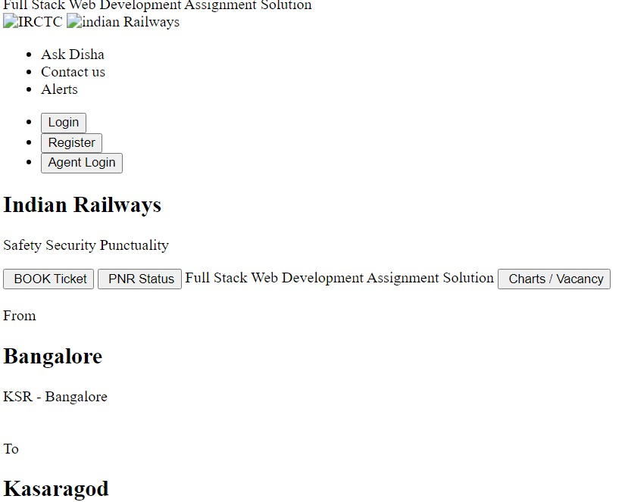
o/p

Slide 12
