Slide 1
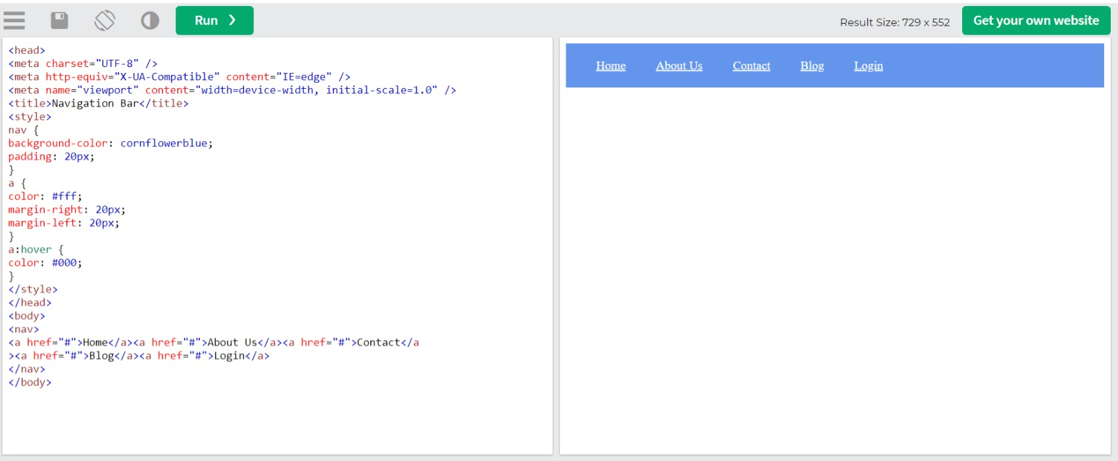
1) Create a navigation bar similar to the below-mentioned image. The navigation bar must vontain 5
navigation links that are properly plaved within the navigation bar using the CSS box model. The navigation
items must vhange their text volor on hover.

Slide 2
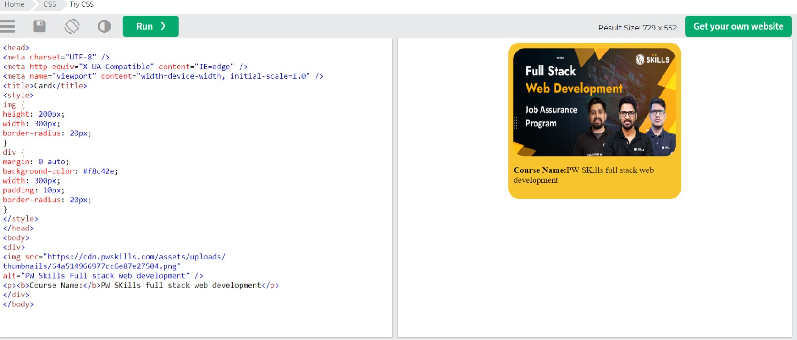
2) Create a div ventered with an image and paragraph similar to the image mentioned below.

Slide 3
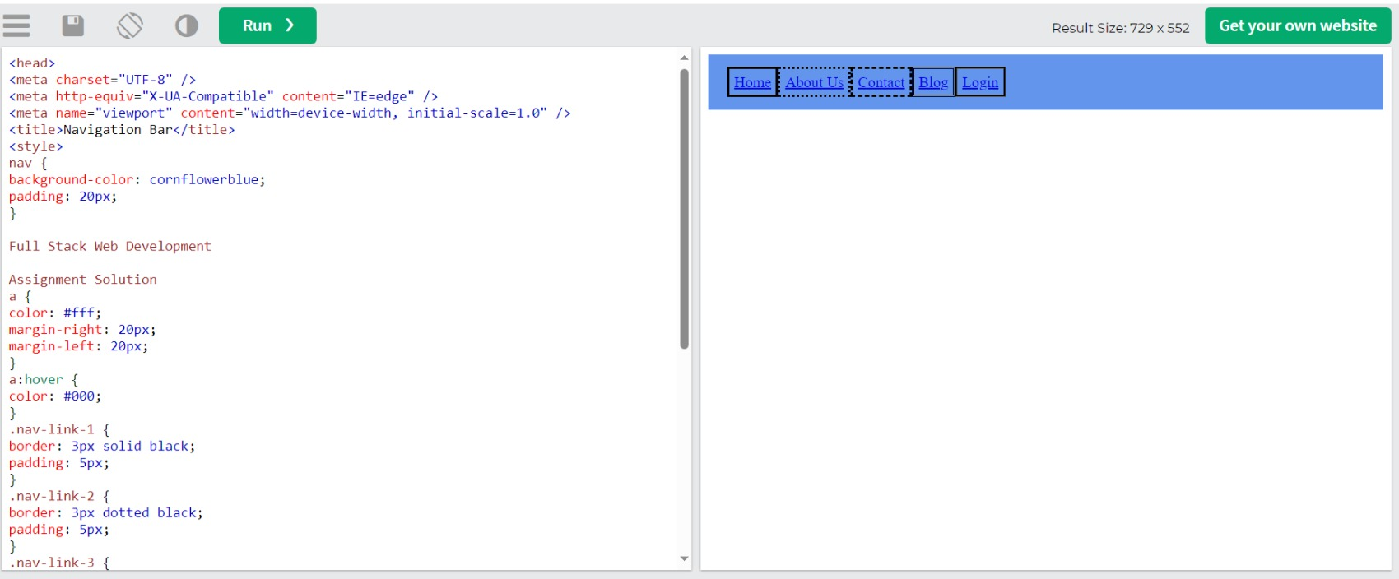
3) Create a navigaion bar similar to quesion 1. For each navigaion item, use a different order syle.

Slide 4
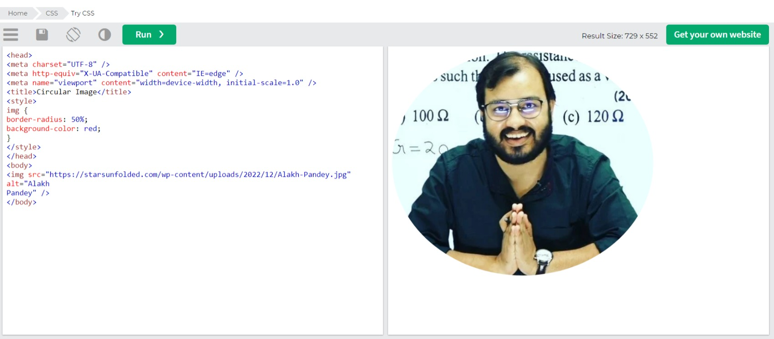
4)Create a simple webpage within an image and make the image circular using border-radius.

Slide 5
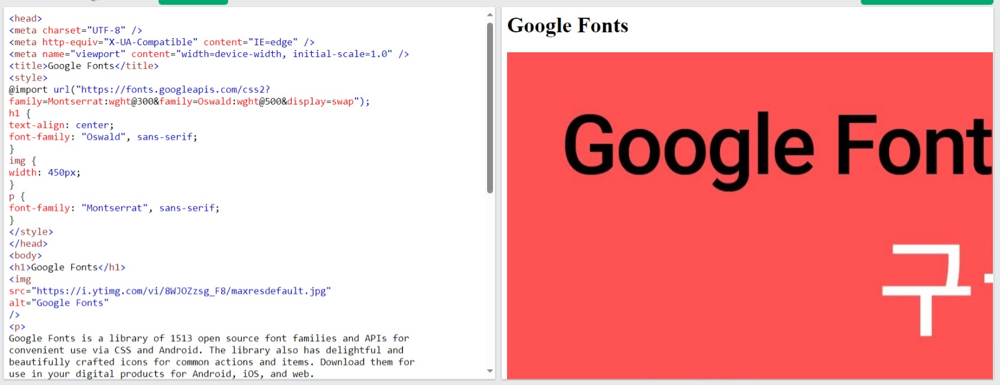
5)Create a simple blog website about Google forms. The webpage must have the heading wih “Oswald” font
align center to the page, below he heading have an image of Google fonts and a paragraph about Google
fonts in fon “Monserra” paragraph font style should be“monserra” font.

Slide 6
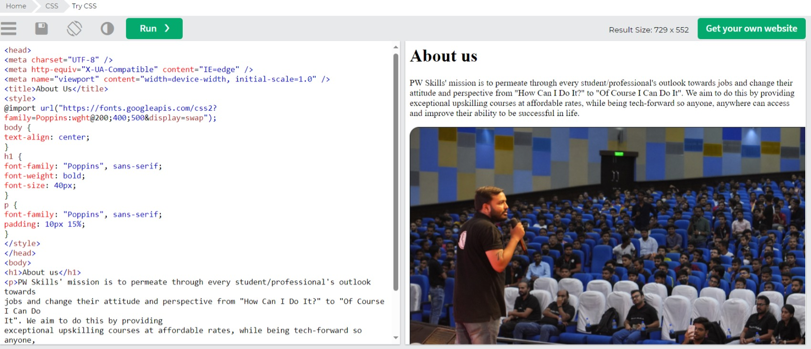
6)Create a simple website as mentioned in the below image. You can get the assets by visiting https://
pwskills.com/about-us.

Slide 7
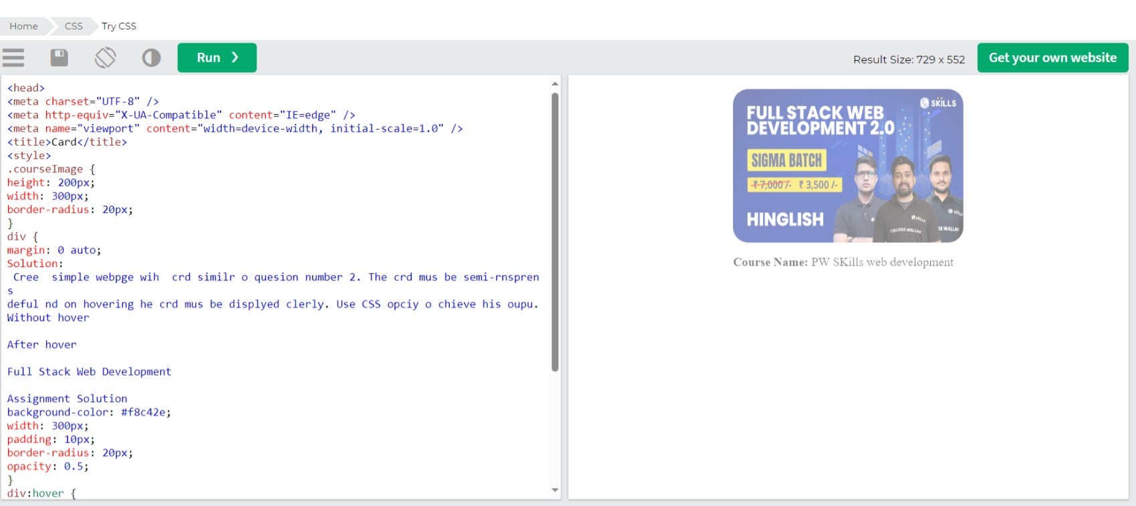
7Create simple webpge wih card similr to quesion number 2. The card must be semi-transprent as
default and on hovering the card mus be displayed clearly. Use CSS opaciy to achieve this output.

Slide 8
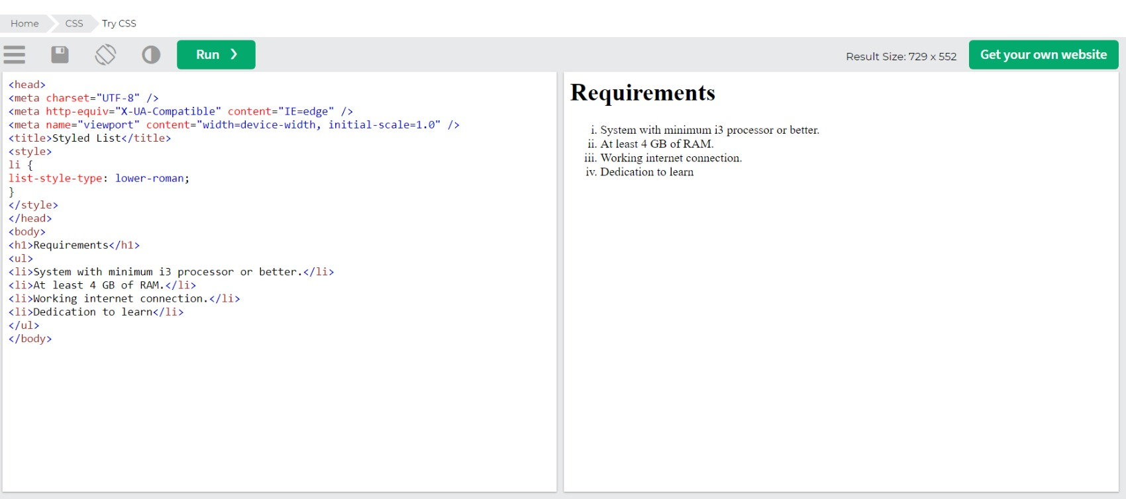
8) Create a simple list of items as menlioned in the below image.

