Slide 1
1. List out the features of HTML5.
Improved Multimedia support - HTML5 allows for the integration of multimedia elements such as audio and
video directly into web pages without the need for plugins like Flash.
Canvas element - HTML5 introduced the <canvas> element, which allows for dynamic, interactive graphics to
be created and manipulated within a web page.
Geolocation API - HTML5 provides an API for obtaining the user's location, enabling web applications to offer
Location-based services.
Local Storage - HTML5 introduced the localStorage API, which allows for the storage of data on the user’s
device, improving performance and reducing the need for round-trips to the server.
New Structural Elements - HTML5 introduced new semantic elements such as <header>, <footer>, <nav>, and
<article> that makes it easier to structure and organize content on a web page.
Form Improvements - HTML5 introduced several improvements to forms, including new input types like date,
time, and color, as well as new attributes such as required and autofocus.
Accessibility improvements - HTML5 provides better support for accessibility, including the ability to provide
alternative text for images and improved support for screen readers.

Slide 2
2. What are HTML Entities? List out 5 commonly used HTML entities.
HTML Entities:
HTML entities are special codes that represent reserved characters, symbols, or characters with specific
meanings in HTML. They are used to display characters that might otherwise be interpreted as HTML code or
cause rendering issues in web browsers. HTML entities are written using an ampersand (&) followed by a
specific code or name, and ending with a semicolon (;).
5 Commonly Used HTML Entities:
&lt; - Represents the less-than symbol <.
Example: <p>This is an example &lt;em&gt;text&lt;/em&gt;.</p>
&gt; - Represents the greater-than symbol >.
Example: <p>For more information, visit our website &gt; <a href="#">here</a>.</p>
&amp; - Represents the ampersand symbol &.
Example: <p>For further details, contact us &amp; we'll assist you.</p>
&quot; - Represents a double quotation mark "
Example: <p>The title of the book is "The Great Gatsby".</p>
&copy; - Represents the copyright symbol ©.
Example: <p>&copy; 2023 ACME Corporation. All rights reserved.</p>

Slide 3
3) Define accessibility in the context of web development? Discuss why it's essential to create accessible
websites and how it benefits different user groups
Accessibility in Web Development: Accessibility in web development refers to designing and coding websites
in a way that ensures people with disabilities can perceive, understand, navigate, and interact with digital
content effectively. It involves making web content inclusive and usable for everyone, regardless of their
abilities.
Importance of Accessible Websites:
Inclusivity: Accessible websites ensure that everyone, including people with disabilities, can access and use
online information and services.
legal Compliance: Many countries have laws requiring websites to be accessible, avoiding legal issues and
Promoting equal access.
User Experience: Accessible design often leads to improved user experiences for everyone, including clear
navigation and content structure.
Business Growth: Accessible websites reach a wider audience, increasing engagement, loyalty, and potential
customer base.

Slide 4
4) list any 3 ways which help us in improving the accessibility of HTML
Use Semantic HTMl Elements: Using semantic HTML elements helps improve accessibility by providing
meaningful structure to your content. Semantic elements like <header>, <nav>, <main>, <article>, and <footer>
convey the purpose of different sections to assistive technologies, making it easier for users with disabilities to
navigate and understand the content.
Provide Alt Text for Images: Adding descriptive alt text to images using the alt attribute ensures that users who
cannot see the images can understand their content and purpose. Screen readers read aloud the alt text,
making visual content accessible to people with visual impairments. Aim to make alt text concise, informative,
and relevant to the image.
Use Color with Care: Color plays an important role in web design, but it should not be the only means of
conveying information. Ensure that color is not the sole indicator of meaning. For example, when using error
messages, pair color with text that explains the error. Additionally, maintain sufficient color contrast between
text and background to enhance readability for users with low vision.

Slide 5
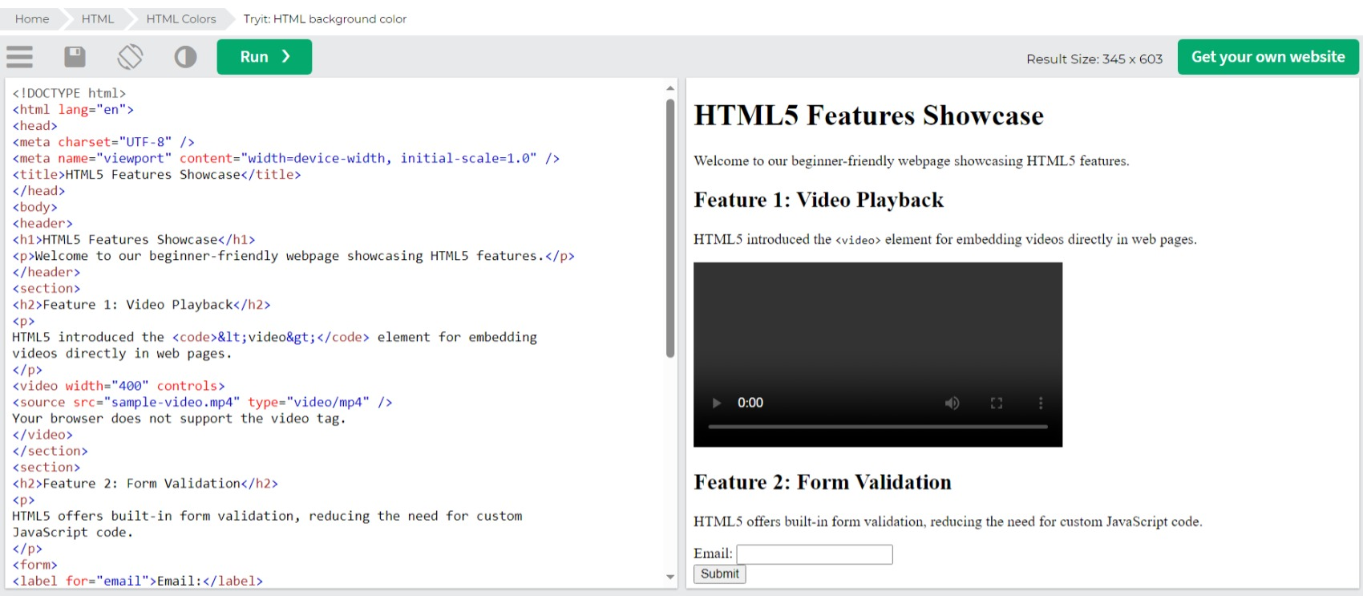
5. Create a web page that highlights the features of HTML5. Use appropriate semantic tags to structure the
content and showcase at least three key features of HTML5 with explanations.

Slide 6
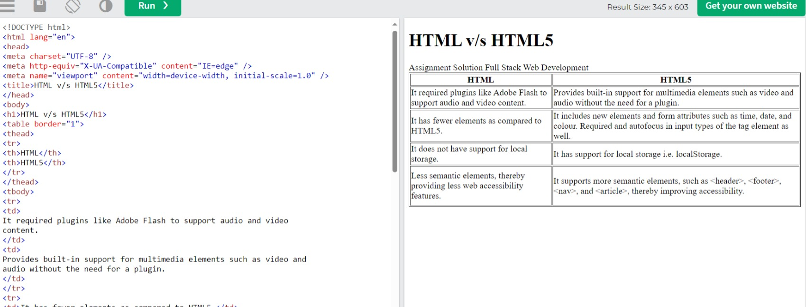
6. Create a simple web page which has a table. The table must have 2 columns HTML and HTML5. The table
should include a minimum of three rows describing the differences between HTML and HTML5.

