Slide 1
1) What is SEO and explain the importance of SEO?
SEO stands for Search Engine Optimization. It helps you optimize your websites so that they have better
rankings on Search Engines like Google, Bing, and Yahoo.
The ultimate goal of SEO is to rank higher in search engine results pages for relevant keywords and phrases,
which can increase visibility, traffic, and ultimately revenue for the website.
The importance of SEO -
Meta tags are important for SEO because they provide information to search engines about the content on your
site and can help improve your website's visibility and ranking in search engine results pages.

Slide 2
2). Create an HTML document with appropriate <title> and <meta> tags for SEO optimization. Ensure the title
is descriptive and the meta description is concise.
<!DOCTYPE html>
<html lang="en">
<head>
<meta charset="UTF-8" />
<meta name="viewport" content="width=device-width, initial-scale=1.0" />
<title>Online Courses - Learn to code anywhere, anytime | PW Skills</title>
<meta
name="title"
content="Online Courses - Learn to Code Anywhere, Anytime | PW Skills"
/>
<meta
name="description"
content="PW Skills - A One Stop Tech Solution where all your skills get sharpened and
learn from the best tutors around the world that can easily boost your career."
/>
<meta name="author" content="PW Skills" />
<meta
name="robots"
content="index, follow, max-image-preview:large, max-snippet:-1, max-video-preview:-1"
/>
<meta http-equiv="X-UA-Compatible" content="ie=edge" />
<link rel="stylesheet" href="styles.css" />
</head>
<body></body>
</html>

Slide 3
Q3. What are the Benefits of Using Meta Tags
SEO - (Search Engine Optimization): Meta tags, such as the "description" and "keywords" tags, can help
improve a webpage's visibility on search engine result pages (SERPs).
Social Media Sharing - Meta tags like the Open Graph Protocol tags allow developers to control how web
pages are displayed when shared on social media platforms like Facebook, Twitter, and LinkedIn.Z
Character Encoding and Language - The meta tag specifying the character encoding (e.g., .TF-8) ensures
that the browser interprets the text correctly, especially when dealing with special characters or multilingual
content
Viewport control - The viewport meta tag is crucial for responsive web design-
HTTP-Equiv tags - Meta tags with http-equiv attribute (e.g., <meta http-equiv="refresh">) enable specific

Slide 4
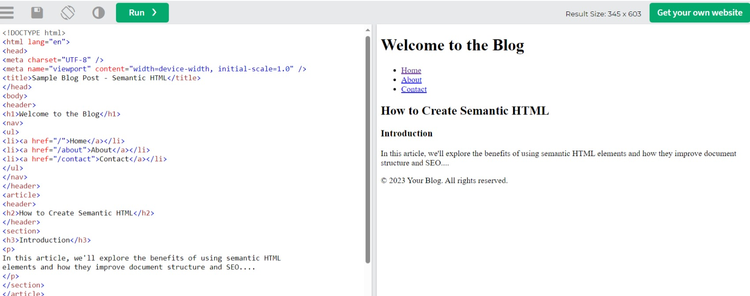
Q4. Create an HTML document that properly incorporates semantic elements like <header>, <article>,
<section>, or <nav> to improve SEO and document structure.

Slide 5
Q5. Define Favicon and give an illustrative example.
A favicon that stands for a favorite icon is a tiny icon included along with a website, which is displayed in places
like the browser's address bar, page tabs, and bookmarks menu. It is usually 16 * 16 pixels in size and stored in
GIF, PNG, or ICO file format.
They are used to improve user experience and enforce brand consistency. When a familiar icon is seen in the
browser address bar.
Example
<!DOCTYPE html>
<html lang="en">
<head>
<meta charset="UTF-8">
<meta name="viewport" content="width=device-width, initial-scale=1.0">
<title>BookWorld - Your Online Bookstore</title>
<!-- Favicon -->
<link rel="icon" href="favicon.ico" type="image/x-icon">
</head>
<body>
</body>

