Slide 1


E qua

Slide 2

PROBLEM STATEMENT
Farmers are unable to determine the percentage of chemicals present in the fish pond time to time.
they use traditional technique of maintaining lake which may result in overrated or under rated chemical composition .
Every day the farmers have to visit the lake on a timely basis to maintain the composition, but it is not being followed due to lack of information regarding the changing chemical composition of the lake

Slide 3
solution
E-qua is an Automated IOT device which helps to maintain a constant chemical composition of the lake.
It automatically dispenses the chemical or fertilizers
To maintain the desired eco-system.
The user can always monitor his lake from anywhere and anytime with the help of the E-qua Mobile application .

Slide 4
VALUE STATEMENT
For Aqua cultivation farmers
Who are dissatisfied with the Healthy growth of their farm.
Our product is a autonomous machine which helps to maintain desired ecosystem.
That ensures healthy growth of the fishes.

Slide 5
Competitors
https://patents.google.com/patent/CN105052814A/en?oq=water+monitoring+system+using+iot+for+fish+farm
https://patents.google.com/patent/CN203072684U/en?oq=water+monitoring+system+using+iot+for+fish+farm
https://patents.google.com/patent/CN203799237U/en?oq=water+monitoring+system+using+iot+for+fish+farm
https://patents.google.com/patent/CN204495401U/en?oq=water+monitoring+system+using+iot+for+fish+farm
https://patents.google.com/patent/CN204904072U/en?oq=water+monitoring+system+using+iot+for+fish+farm
https://www.sciencepubco.com/index.php/ijet/article/view/24214https://iopscience.iop.org/article/10.1088/1757-899X/340/1/012014
https://ieeexplore.ieee.org/document/8704133

Slide 6
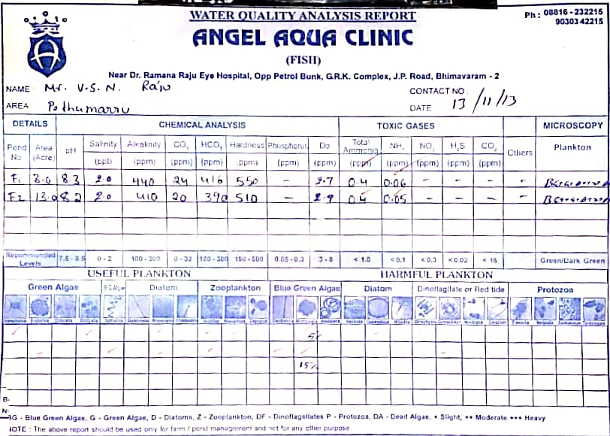
Market research

Slide 7
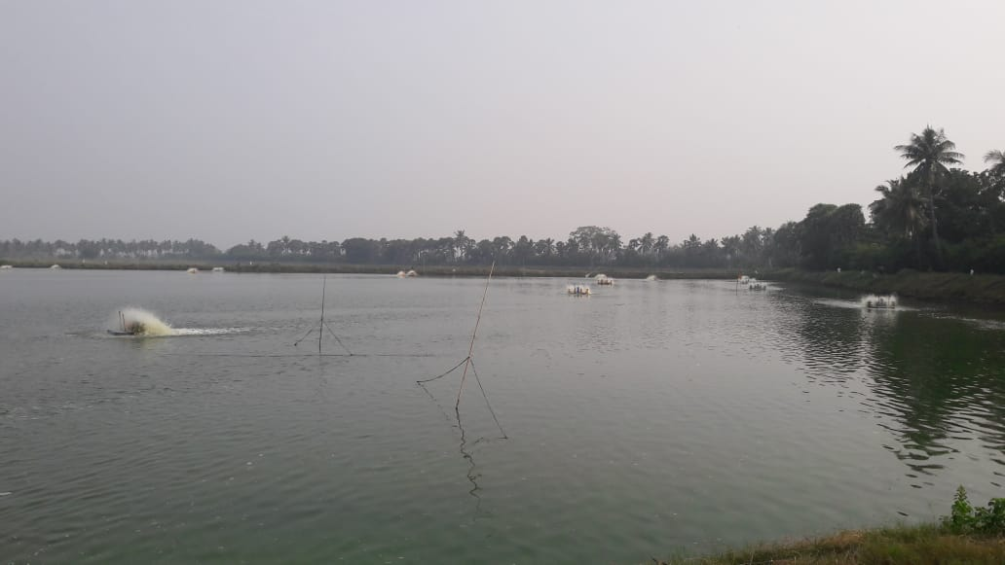
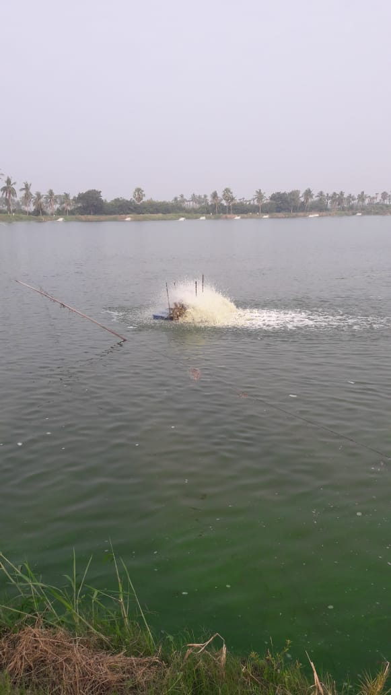
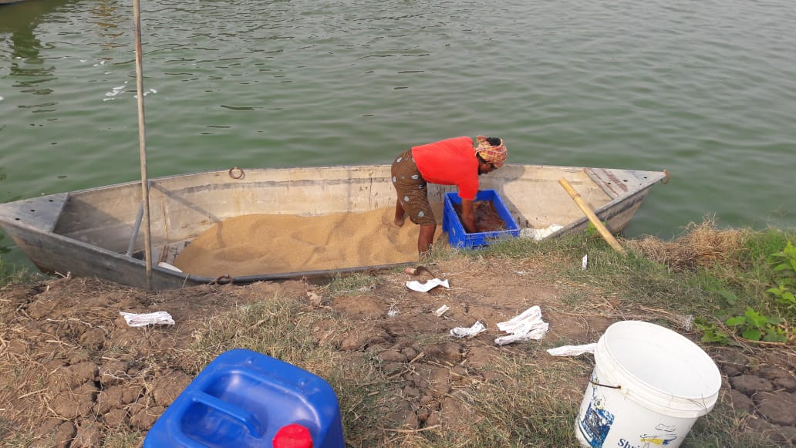

Slide 8
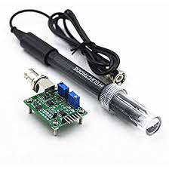
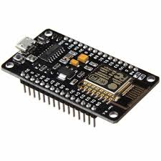
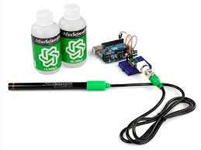
Technology stack
Node MCU
PH sensor
DO sensor
Temperature sensor
Salinity sensor
Ammonia and nitrate sensor
Chemical dispenser

Slide 9
Feasibility
The E-qua mobile application has an user friendly UI ,easy to use.
User needs a minimum level to internet connection for regular monitoring of the lake
It is cost-effective in long run
Based on the present development rate there is a high probability for increase in demand for the product
Easily serviceable product.

Slide 10
Marketing strategy
Our product is mostly useful for the Aqua Cultivation farmers. There are around Thousands of Aqua Cultivation farmers in South India who are facing difficulty to increase their productivity.
reach out to them by word of mouth or by spreading awareness .
Our marketing channels
1. Direct selling
2. Selling through intermediaries

Slide 11
TEAM NUMBER : 93
E-QUA
Name | Roll number | Contact
G Suhas | 18241A04Q0 | 9247073758
K Bharath varma | 18241A04P0 | 7093914413
Ankith Cirgir | 18211A0515 | 7386991912
Arjun Alluri | 18211A0518 | 9381621241

Slide 12
Q&a

