Slide 1

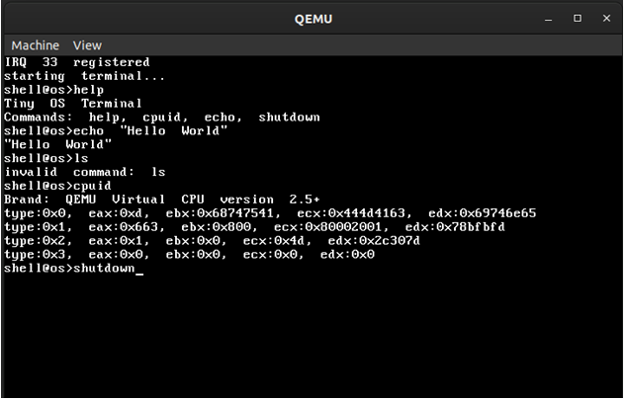


Implementation of a Command-Line Interface in a 32-Bit Kernel
R V College of Engineering
INTRODUCTION
Bootloader Development:
Hardware Intialization
Interrupt Descriptor Table
This project endeavours to design and implement a lightweight 32-bit kernel with a fully functional Command-Line Interface (CLI). The primary objective is to create a minimalistic yet versatile kernel capable of booting on x86 architecture, initializing essential hardware components, and providing users with an intuitive interface for system interaction. Leveraging principles of kernel development and system programming, the project aims to explore the intricate details of operating system internals while focusing on simplicity, efficiency, and functionality.
Understanding Boot Process:
  Familiarize yourself with the boot process of x86 systems. This involves understanding the BIOS/UEFI initialization process, loading stages, and transitioning to protected mode.
Choosing Bootloader:
  Decide whether to use an existing bootloader like GRUB or develop a custom one.
  For simplicity, you might choose GRUB, which is widely used and supports loading kernels in various formats.
Configuration:
  Configure the bootloader (e.g., grub.cfg for GRUB) to specify the location of the kernel image on disk, kernel parameters, and any additional options.
Loading Kernel:
  Write assembly code or configure bootloader settings to load the kernel image from disk into memory.
  Perform any necessary setup before transferring control to the kernel, such as setting up a stack and initializing registers.
Transition to Kernel:
  Once the kernel is loaded into memory, transfer control to its entry point.
  This typically involves a jump or call instruction to the entry point specified by the kernel.
CPU Initialization:
  Set up the CPU in the desired mode (e.g., protected mode for 32-bit systems).
  Configure segment registers, descriptor tables (GDT, IDT), and enable paging if necessary.
Memory Initialization:
  Initialize memory controllers and set up memory regions (e.g., kernel space, user space).
  Configure paging structures for virtual memory management.
Interrupt Controller:
  Initialize the Programmable Interrupt Controller (PIC) or Advanced Programmable Interrupt Controller (APIC) for handling hardware interrupts.
  Set up interrupt service routines (ISRs) and interrupt handlers.
Timer Initialization:
  Configure hardware timers (e.g., Programmable Interval Timer - PIT) for scheduling and system timing.
  Set up periodic interrupts for timekeeping and scheduling purposes.
Peripheral Devices:
  Initialize essential peripheral devices such as the keyboard controller, disk controller, and serial ports.
  Configure device drivers and interrupt handlers for handling input/output operations.
The location of the IDT is kept in the IDTR (IDT register). This is loaded using the LIDT assembly instruction, whose argument is a pointer to an IDT Descriptor structure:
Size: One less than the size of the IDT in bytes.
Offset: The linear address of the Interrupt Descriptor Table (not the physical address, paging applies).
Note that the amount of data loaded by LIDT differs in 32-bit and 64-bit modes, Offset is 4 bytes long in 32-bit mode and 8 bytes long in 64-bit mode.
This is similar to the GDT, except:
The first entry (at zero offset) is used in the IDT.
There are 256 interrupt vectors (0..255), so the IDT should have 256 entries, each entry corresponding to a specific interrupt vector.
Although the IDT can contain more than 256 entries, they are ignored.
Although the IDT can contain less than 256 entries, any entries that are not present (due to this or other reasons) will generate a General Protection Fault when an attempt to access them is made. Ideally the IDT should contain enough entries so that this fault (which is itself an interrupt vector) can be handled.
OBJECTIVE
Output
  The primary goal is to create a lightweight kernel capable of running on 32-bit x86 architecture.
  Secondary objectives include implementing a functional CLI for user interaction and providing basic filesystem support.
Global Descriptor Table
The GDT is pointed to by the value in the GDTR register. This is loaded using the LGDT assembly instruction, whose argument is a pointer to a GDT Descriptor structure:
Size: The size of the table in bytes subtracted by 1. This subtraction occurs because the maximum value of Size is 65535, while the GDT can be up to 65536 bytes in length (8192 entries). Further, no GDT can have a size of 0 bytes.
Offset: The linear address of the GDT (not the physical address, paging applies).
Note that the amount of data loaded by LGDT differs in 32-bit and 64-bit modes, the offset is 4 bytes long in 32-bit mode and 8 bytes long in 64-bit mode.
References
References:
OSDev Wiki: https://wiki.osdev.org/Expanded_Main_Page
Bootlin: https://elixir.bootlin.com/linux/latest/source/kernel
U-Boot Wiki: https://gitlab.denx.de/u-boot/u-boot
Linux Kernel Documentation: https://docs.kernel.org/
Conclusion
TEAM MEMBERS
This project aims to provide a comprehensive exploration of kernel development concepts and techniques, culminating in the creation of a functional 32-bit kernel with a versatile Command-Line Interface. Through hands-on experimentation and meticulous design, the project seeks to deepen understanding of operating system internals while demonstrating the practical application of system programming principles.
Suhas Gowda L 1RV22CS207
Suhas Raj HR 1RV22CS209

