Slide 1

AI-Driven Adaptive Honeypot for Cyber Threat Detection->MIMICNET
HARVESTX
Alok VK · Girish MJ · Gururaj H
Cambridge Institute of Technology

Slide 2
The Problem
Sophisticated Attacks Are Rising
Cyber threats are growing in complexity, scale, and frequency — outpacing conventional defenses.
Traditional IDS Falls Short
Signature-based systems cannot detect zero-day exploits or novel attack patterns.
No Real-Time Response
Existing tools lack the ability to monitor, analyze, and respond to threats in real time.
Attacker Behavior Is Opaque
Without deception-based systems, understanding attacker intent and methodology remains difficult.
Proactive Defense Is Needed
Organizations require systems that actively engage threats rather than passively reacting to them.

Slide 3

Project Scope
Network-Based Detection
Decoy Architecture
Operates as a honeypot — a fake system designed to attract and trap attackers.
Focused on monitoring and analyzing network-level intrusion attempts.
Target Environments
Suitable for enterprise security operations and academic research settings.

Slide 4

The Solution: Adaptive "Chameleon" Honeypot
Mimics Real Systems
Emulates vulnerable services and operating systems to appear as legitimate targets.
AI-Powered Analysis
Uses GPT/Claude to generate realistic shell responses and engage attackers dynamically.
Self-Adapting Behavior
The system evolves its responses based on attacker actions — staying one step ahead.
Realistic Attack Environment
Creates a convincing decoy landscape that encourages prolonged attacker engagement.

Slide 5
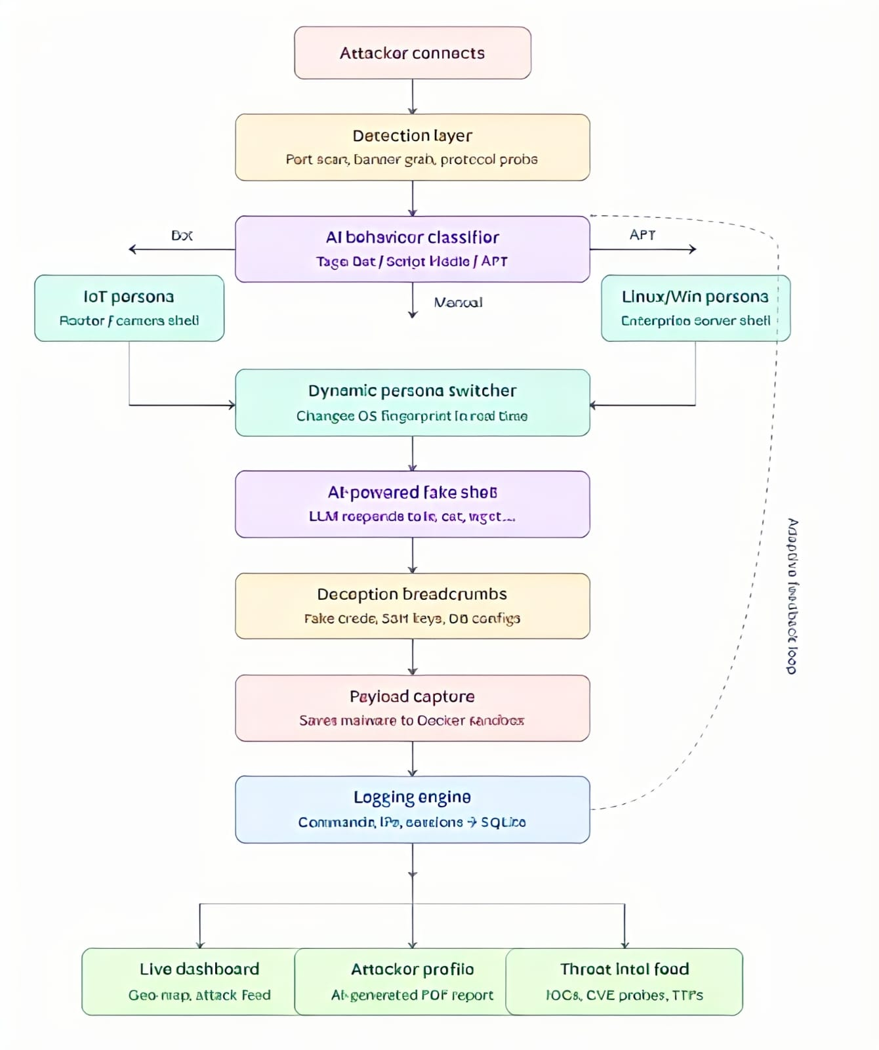
Technical Approach
Honeypot Tools
Backend
Cowrie (SSH/Telnet) and Dionaea (malware capture)
Python for logging, processing, and orchestration
AI Integration
Dashboard
GPT/Claude APIs for dynamic fake-shell responses
Flask/Streamlit for real-time visualization
Sandbox
Docker containers for safe, isolated malware execution

Slide 6
Impact & Benefits
Early Threat Detection
Reduced Risk to Real Systems
Attacker Intelligence
Identifies malicious activity before it reaches production infrastructure.
Attackers engage with decoys — keeping live systems isolated and safe.
Captures tactics, techniques, and procedures (TTPs) for deeper analysis.
Training & Research
Enterprise Scalability
Provides a safe environment for cybersecurity education and threat research.
Designed to scale across distributed enterprise security architectures.

Slide 7
Conclusion & Future Scope
What We've Built
Future Scope
1
Proactive Threat Detection
SIEM Integration — Connect with Security Information and Event Management platforms for unified monitoring.
Advanced ML Prediction — Implement machine learning models for proactive threat forecasting.
Cloud Deployment — Enable distributed honeypot networks across cloud environments.
Honeypot-based deception actively engages and studies attackers.
2
AI + Cybersecurity Fusion
Combines adaptive AI with proven honeypot frameworks for smarter defense.
3
Scalable & Adaptable
Modular Docker architecture supports enterprise-level deployment.

Slide 8

Thank You
We appreciate your time and attention. We welcome your questions and feedback.
Team HarvestX
Institution
Alok VK · Girish MJ · Gururaj H
Cambridge Institute of Technology
Project
AI-Driven Adaptive Honeypot for Cyber Threat Detection

