Slide 1
CAPSTONE PROJECT
Secure Data Hiding in Image Using Steganography
Presented By:
Student Name : Suhas Martha
College Name & Department : SR University,
School of Computer Science & Artificial Intelligence

Slide 2
OUTLINE
Problem Statement
Technology used
Wow factor
End users
Result
Conclusion
Git-hub Link
Future scope

Slide 3
Problem Statement
With the rise in cybersecurity threats, confidential data transmission is at risk. Traditional encryption methods attract attention, making them susceptible to attacks. This project focuses on securely hiding data within images using steganography techniques to ensure secret communication without raising suspicion.

Slide 4
Technology used
Programming Language: Python
Libraries: OpenCV, NumPy, Pillow (PIL)
Steganography Technique: Least Significant Bit (LSB) Method
GUI (if applicable): Tkinter/PyQt for User Interface
Encryption: AES-256 for additional security

Slide 5
Wow factors
Dual-layer Security: Combines steganography with encryption for enhanced security.
High Capacity: Supports large data hiding without noticeable image distortion.
Automated Extraction: Users can retrieve hidden messages with minimal effort.
Cross-Platform Compatibility: Works on multiple operating systems.

Slide 6
End users
Government & Intelligence Agencies – Secure communication for sensitive data.
Journalists & Activists – Hiding critical information in images for anonymity.
Corporate Sector – Secure document transmission without suspicion.
General Users – Personal data protection and private messaging.

Slide 7
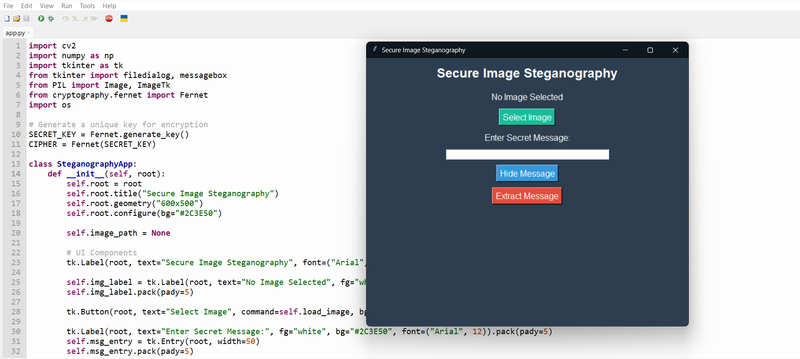
Results

Slide 8
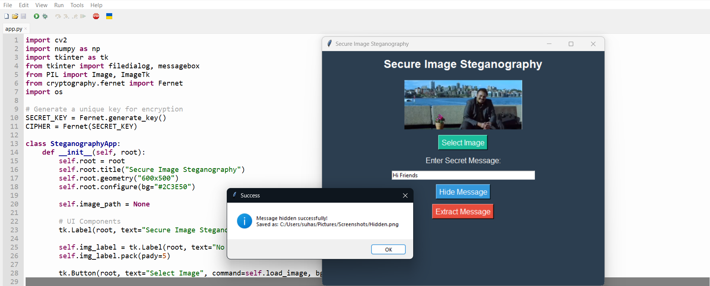
Results

Slide 9
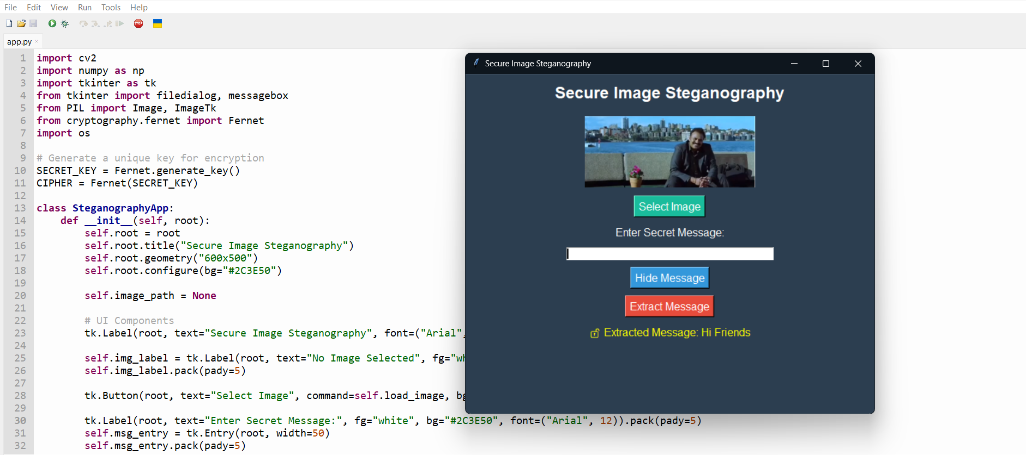
Results

Slide 10
Conclusion
This project successfully demonstrates a secure method for data hiding using steganography, making confidential communication undetectable. By implementing the LSB method along with encryption, it provides an additional security layer, making it a robust solution for secure data transmission.

Slide 11
GitHub Link
https://github.com/SuhasMartha/Steganography

Slide 12
Future scope(optional)
Implementation of AI-based steganalysis resistance.
Use of frequency domain techniques like DCT and DWT for improved security.
Support for hiding data in audio and video files.
Cloud integration for remote secure communication.

Slide 13
THANK YOU

