Slide 1
“Real Time Software Based Communication System for Speech and Hearing Impaired”
Suhas Meda 1DS17CS749
Raj Kumar Singh 1DS17CS741
Paran Sarmah 1DS17CS736
DR.Mahammed Tajuddin
Asst. Professor
Dept of CSE

Slide 2
INDEX
INTRODUCTION.........................................................................................................3
PROBLEM ANALYSIS................................................................................................5
PROBLEM STATEMENT...........................................................................................6
LITURATURE SURVEY…………………………………………………………......7
SYSTEM DIAGRAM...................................................................................................10
SOFTWARE REQUIREMENTS……………………………………………………11
OBJECTIVES...............................................................................................................12
TENSORFLOW............................................................................................................13
SCREENSHOTS OF OUTPUTS WITH EXPLANATION....................................14
CONCLUSION............................................................................................................33
FUTURE WORK……………………………………………………………………..34
REFERENCES............................................................................................................35

Slide 3
INTRODUCTION
In India itself, close to 3 million people are categorized as speech and hearing impaired according to a general survey conducted.
There is a large communication gap that is faced by the speech and hearing-impaired community with normal people and vice versa.
The deaf/mute person is taught sign language from a very young age to overcome this barrier.
Sign language allows these people to communicate with other members of the community as well as the members of the society.
However, in society very few people have actually learned sign language hence only a small percentage of the population is able to converse with a deaf or mute person.
It is also difficult to find an interpreter to interpret sign language to required language and vice versa as not many interpreters exist in India.
Educational institutions do not take a step forward to teach sign language to students even as an optional course hence further creating a communication barrier with the hearing impaired.

Slide 4
Solving this problem from the root would mean educating the society about sign language from a very young age itself.
On a massive scale it would take years to educate most of the population and would prove to be a costly method as well.
Another solution that is more applicable is to use the available existing technology to bridge the communication gap.
This would allow people without any prior knowledge of sign language to communicate with the disabled community.
Our proposed work is a software solution as the current solutions mostly use hardware like hand gloves, smart wearable devices and Kinect camera which are heavy and produce inaccurate results if part of any hardware is damaged.
Out of the available algorithms, we are using CNN architecture and algorithm which has the most robust sign recognition system.
This paper utilizes Computer Vision, Image Processing techniques and Deep Learning based Convolutional Neural Networks to build an ISL recognition system which is cheaper and has higher efficiency.

Slide 5
Problem Analysis
Hand detection is done using defining a region of interest on the screen in which the user must place its hand.
We need to define the range color of the skin in ‘hsv’ format so that skin color segmentation can be performed on the same.
We need to create a script that extracts that sets the hand histogram for us.
In this process of getting the hand histogram, we extrapolate the hand to fill dark spots within and blur the image using median blur.
This reduces the noise in the image up to a great extent.
The next step in this process is contour detection. We find the contours in the image using the ‘findContours’ function of OpenCV.
Then find the contour with the maximum area which is the hand.

Slide 6
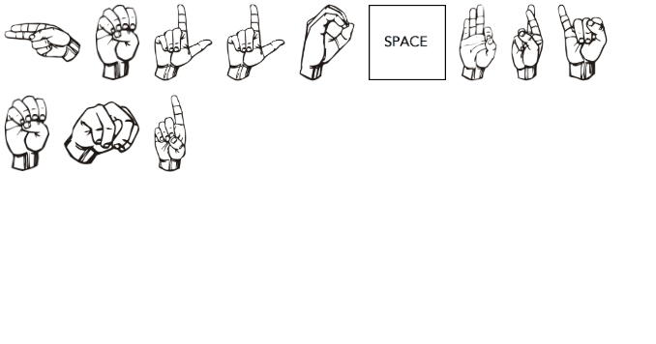
Problem Statement
In order to let deaf/mute people to communicate between themselves or with other people at low cost and use simple hardware, we have created this simple yet efficient sign language to speech translator and vice versa.

Slide 7

LITERATURE SURVEY
S.NO | Author Name | Title of Paper | Year of Publication | Highlights | Challenges
1 | Cheok Ming Jin, Zaid Omar , Mohamed Hisham Jaward | A Mobile Application of American Sign Language Translation via Image Processing Algorithms. | 2016 | A BoF model is employed to create a visual vocabulary from the cluster centroids and lastly, SVM is applied to classify the sign languages. The recognized sign language may then be translated into text and then to speech in the form of an output on the smartphone app created. Their proposed framework uses 16 classes of ASL alphabet which has an accuracy of 97.13%. [SVM algorithm] | Uses SURF technology to get an accuracy is old n out-dated 87.13%
2 | Kalpattu S. Abhishek, Lee Chun Fai Qubeley, and Derek Ho | Glove Based Hand Gesture Recognition Sign Language Translator Using Capacitive Touch Sensor. | 2016 | The proposed work implements the recognition of all 26 English alphabets and 10 digits into ASL. Each of the 8 touch sensors in the glove are implemented using the PIC-116 capacitive sensor module. The advantage of using combinations of binary sensor signals is that it is unambiguous. [PIC-116 capacitive sensor module] | Uses Raspberry pi embedded system with complex of connection and sencers which makes it costly n heavy.
3 | Keerthi S Warrier, JyateenKumar Sahu, Himadri Halder, Rajkumar Koradiya, and Karthik Raj V | Software Based Sign Language Converter. | 2016 | [LabVIEWMicrosoft Speech SDK] Various different templates of sign language for numbers (0 to 10) were made and used for geometric matching to recognize the geometric pattern and thus, audio and visual outputs were generated accordingly in real-time. The proposed work provides users, the advantage of portability as smartphone cameras are connected through Wi-Fi | Vision Acquisition Express VI, Vision Assistant Express VI are out-dated
4 | Maryam Pahlevanzadeh, Mansour Vafadoost, Majid Shahnazi | Sign Language Recognition. | 2007 | [3D Hopfield NN] [GCD hand shape features] Motion history image along with Fourier descriptors are both used for key frame selection and motion direction recognition respectively. Generic cosine descriptor (GCD) feature is used for extraction of hand postures. Generic cosine descriptor remains constant to scale, translation and rotation of hand shapes. | 3D Hopfield NN - 91% accuracy for input recognition GCD hand shape features -96% accuracy For input recognition

Slide 8
S.NO | Author Name | Title of Paper | Year of Publication | Highlights | Challenges
5 | Dasari Vishal, H M Aishwarya, K Nishkala, B Toshitha Royan, T K Ramesh | Sign Language to Speech Conversion | 2017 | The biological electrical reading is taking in millivolt units for precise detection. The problem with this work is that operation on this data is very susceptible to noise and signal interference with other signals near it thus hampering the expected result hence lowering the accuracy of the device. [SVM algorithm] | Histogram of gradients descriptors using SVM algorithm to get an accuracy of 88.38% which is a low accuracy
6 | Kohsheen Tiku, Jayshree Maloo, Aishwarya Ramesh, Indra R | Real-time Conversion of Sign Language to Text and Speech | 2020 | Color-based segmentation has been implemented using libraries present in OpenCV. Their work uses digital image processing to obtain the images from the video recording of the hand gestures. The technique used for this work is Histogram of gradients (HOG) [IMU Sensor Fuzzy logic] | IMU Sensor which is used to obtain a low accuracy and its very sensitive
7 | Aarthi M, Vijayalakshmi P | SIGN LANGUAGE TO SPEECH CONVERSION | 2016 | HMM,HTS. The flex sensor is interfaced with the digital ports of Atmega328 microcontroller. The output from the microcontroller is the recognized text which is fed as input to the speech synthesizer. Arduino microcontroller processes the data for each particular gesture made | Requires lot of hardware(sensors,microcontrolles,etc) which are high in cost. The letters such as M, N and T have similar gestures and also the letters U and V show similarity in their gestures through this model which decreases the accuracy of the output. Has an accuracy of 87% only.
8 | Prof.R.R.Itkarkar, Dr. Anil V Nandi | Hand Gesture to Speech Conversion using Matlab | 2013 | The gesture to speech system, G2S consist of simply three functional blocks - Camera, Personal computer, Speaker. Gesture recognition is done from the wrists to the fingers in this model using X and Y axis only on the captured image | The proposed system shows maximum classification accuracy of 80% only. The segmentation portion of the algorithm is too simple, and would need to be improved if this technique would need to be used in challenging operating conditions.

Slide 9
S.NO | Author Name | Title of Paper | Year of Publication | Highlights | Challenges
9 | Abey Abraham , Rohini V | Real time conversion of sign language to speech and prediction of gestures using Artificial Neural Network | 2018 | Uses flex sensors to detect gestures from the glove. Uses average of squares of errors or deviation for finding the difference between the actual values and the expected values. | Uses hardware gloves equipped with heavy sensors that are costly and heavy to carry. Also the flex sensors need to detect many needs of the mute person as input to convert gestures to weights for the model.
10 | Tanuj Bohra, Shaunak Sompura, Krish Parekh, Purva Raut | Real-Time Two Way Communication System for Speech and Hearing Impaired Using Computer Vision and Deep Learning | 2019 | CNN architecture was used to operate on the datasets and process the information. Doesn’t use any hardware and is free. Datasets of all letters and numbers are taken from standard source. 2 dimensional images of 50X50 pixel is used to reduce processing time to a great extent. | There are some delay and misclassification that can occur in classifying the letter "n" due to its similarity to letter "m” hence the decrease in accuracy of the model. The proposed algorithm checks each letter/number with each data in the huge database to get output every time it is run , which takes a lot of time to fetch and process.

Slide 10
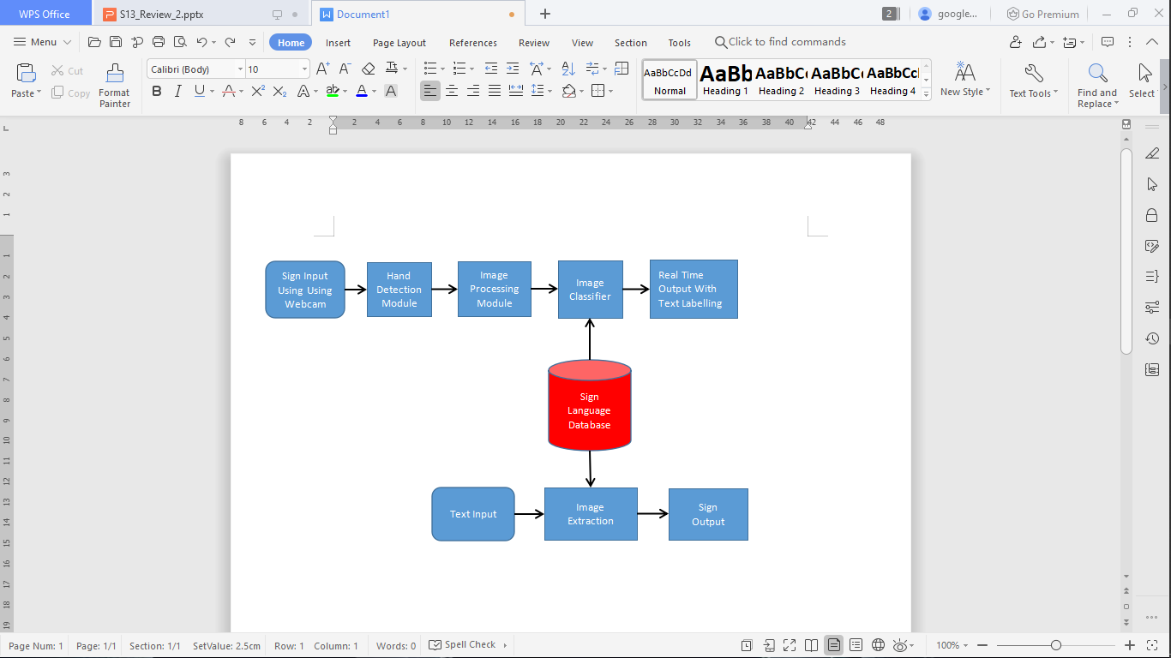
System Diagram

Slide 11
System requirements
Webcam
Flex 14-IWL
CMOS camera
Packages Installed
TensorFlow
TensorFlow is a machine learning end to end open source platform where its libraries are used for processing images and to test and train the model.
Object Detection
Its API is used to detect the signs made from the webcam and providea label for its conversion to human language.
Numpy
NumPy can be used as an efficient multi-dimensional container of generic data. Arbitrary data-types can also be defined. This allows NumPy to seamlessly and speedily integrate with a wide variety of databases for our proposed work. It provides a powerful N-dimensional array object sophisticated (broadcasting) functions tools for integrating C/C++ code useful linear algebra, Fourier transform, and random number capabilities,etc.

Slide 12
pyttsx3
This is a library which help us to convert text to speech. Unlike alternative library it works in both online and offline mode. It works in both python2 as well as python3.
Win32api
This is only have to be installed when we find a error when we install pyttsx3. If not then no need of installing this package. The errors which will show up are:
No module name win32com.client
No module name win32
No module name win23api
That’s when we have to install this extra package if not then we are good to go
Pandas
We have used the Panda library in our python script to perform real world data analysis of the created objects in Python language.We have also used it for importing JSON files into our program.It is also used in cleaning the datasets which are used to train our model. Real Time Software Based Communication System for Speech and Hearing Impaired

Slide 13
Cython
The Cython language makes writing C extensions for the Python language as easy as Python itself. Cython is a source code translator based on Pyrex, but supports more cutting edge functionality and optimizations. Hence we use cython to convert all c++ code into python code.This makes Cython the ideal language for writing glue code for external C/C++ libraries which we used, and for fast C modules that speed up the execution of Python code.
pycocotools (COCO)
COCO provides multi-object labeling, segmentation mask annotations, image captioning, key-point detection and panoptic segmentation annotations with a total of 81 categories, making it a very versatile and multi-purpose dataset. This is used in our proposed work to for image detection,labelling and matching with our database hence performing the core functions of the project.

Slide 14
Objectives
Sign language allows people to communicate with other members of the community as well as the members of the society.
It works without a human interpreter to interpret sign language to required language and vice versa
To overcome the communication gap that is faced by the speech and hearing-impaired community with normal people and vice versa.

Slide 15
TensorFlow
TensorFlow is an open source library for numerical computation and large-scale machine learning.
We had used Tensorflow 2.2.0 which has Keras API included which was one of of the main reasons why we were able to process the images and keep them for training the model.
TensorFlow bundles together a slew of machine learning and deep learning (aka neural networking) models and algorithms.

Slide 16
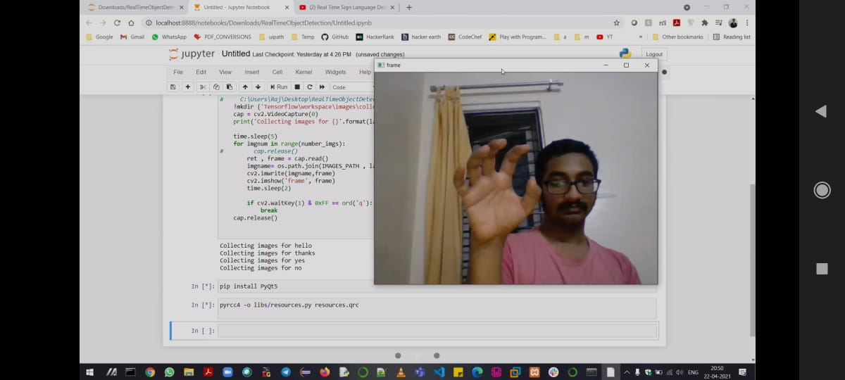
Screenshots

Slide 17
After execution of the python program in Jupyter Notebook , a webcam window pops up and takes pics of the different signs at periodic intervals.
It captures images in real time
We have set the limit to 15 pictures for better training and testing of the model.
These pics are then stored inside a folder created by the program for training and testing purposes.

Slide 18
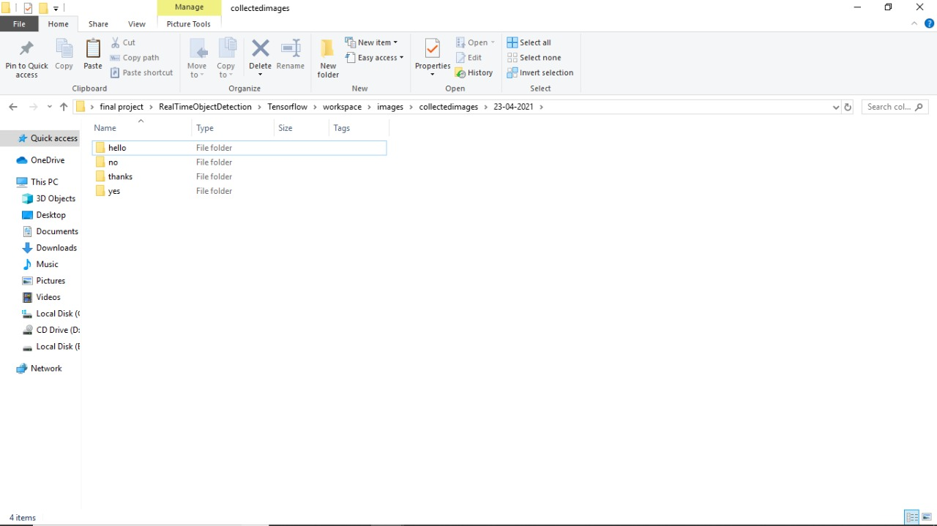

Slide 19
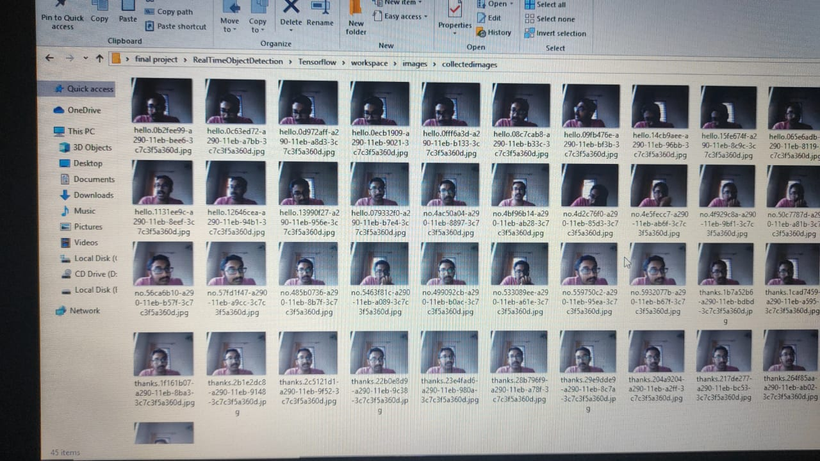

Slide 20
We program the outputs in such a way that 4 folders are created with different labels.
Each of these labels contains multiple images of the same sign to improve the accuracy and train the model.
labels = ['hello' ,'thanks','yes','no']
number_imgs = 15
After the images have been obtained for detection purpose , we put all these pics into a single directory for labelling.

Slide 21
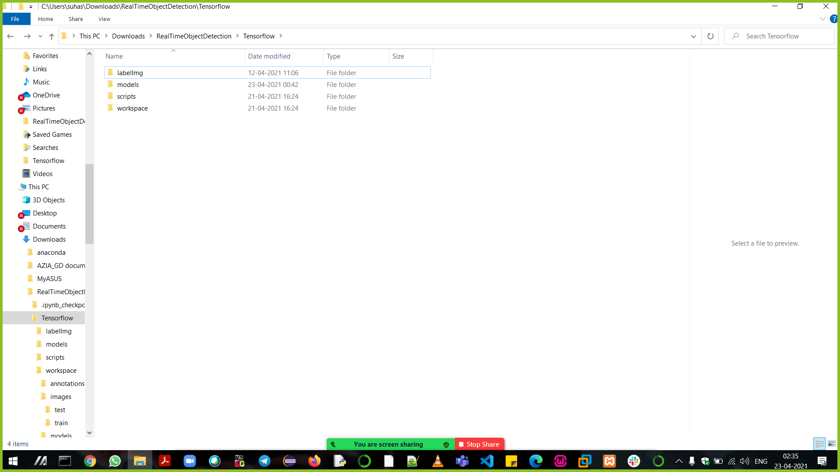

Slide 22
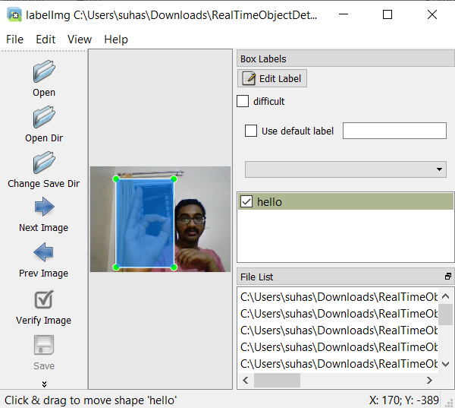

Slide 23
We create a python script to perform labelling for each and every image that has been taken by the webcam.
Upon executing this python script the labelling tool opens ,where we specify the source folder and saved folder where all the images to be labelled are stored.
Here we label each and every image taken by the webcam and provide a label for it.
All the labelled images are cropped in such a way that only the sign is taken from the whole picture to be labelled.

Slide 24
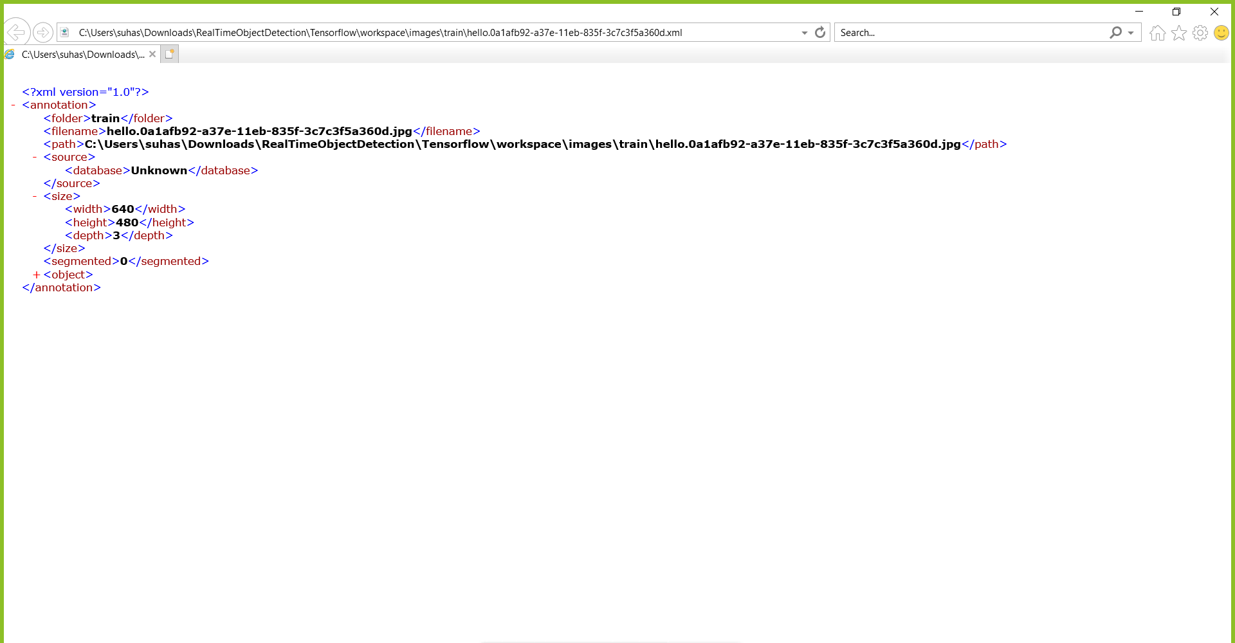

Slide 25
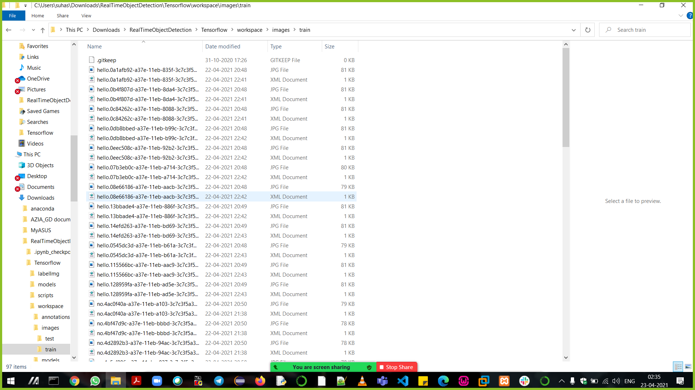

Slide 26
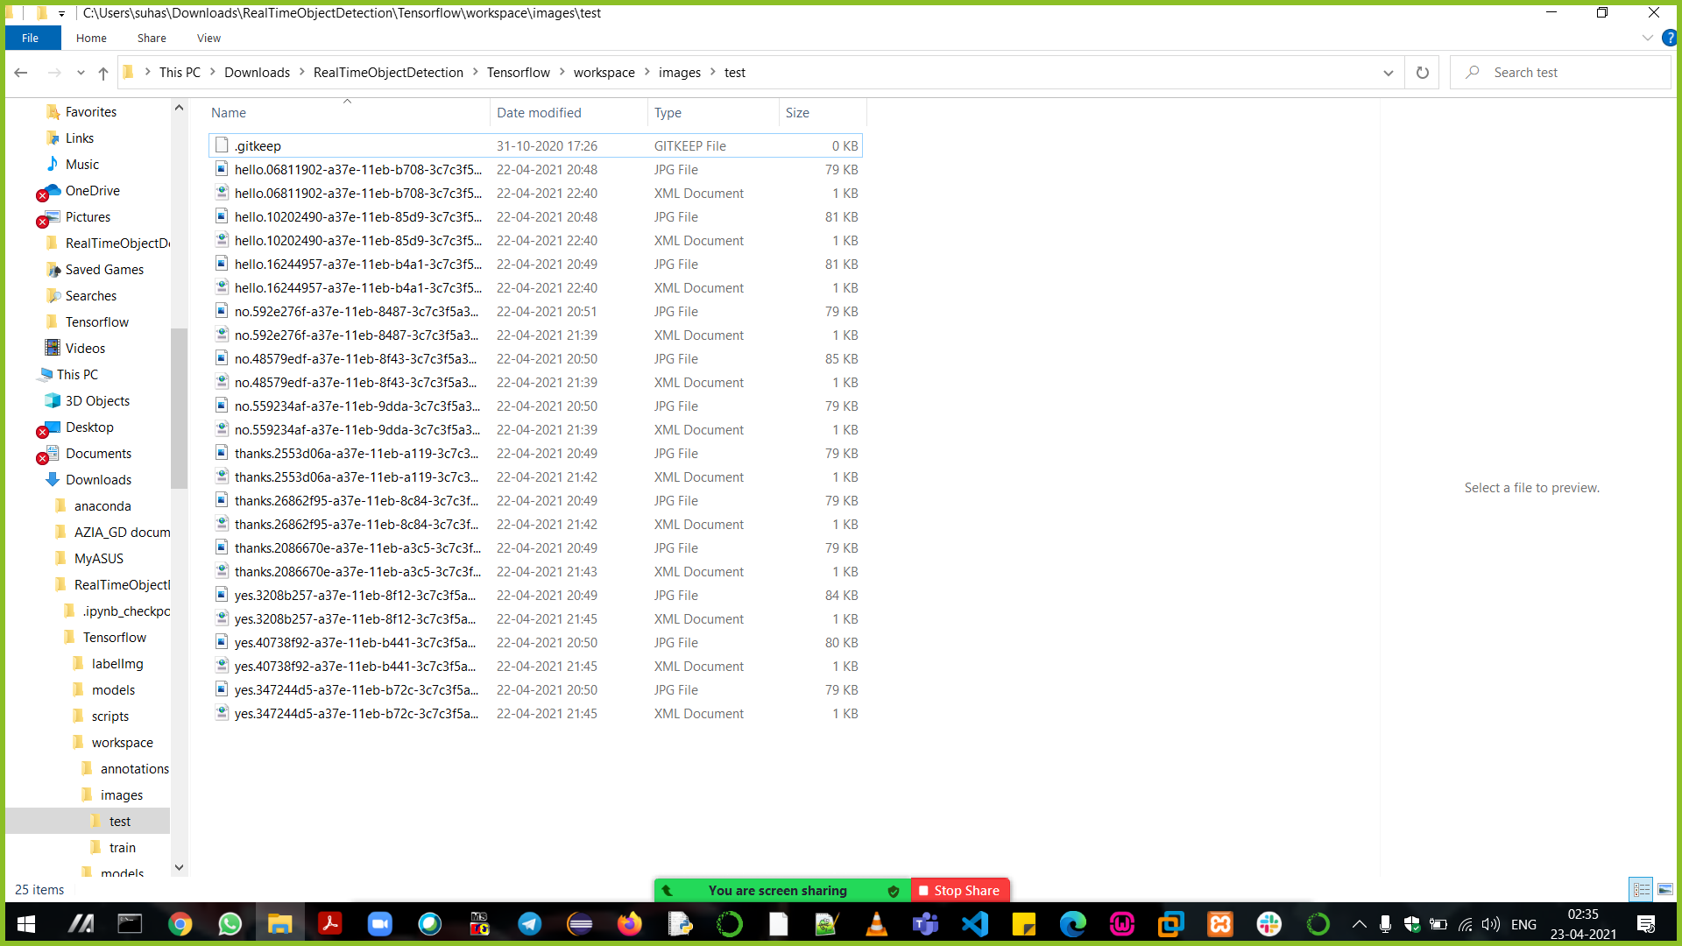

Slide 27
After the labelling of these images has been completed , the labelling tool automatically creates an xml file for each of these images which gives the full description of that specific image.
Here we split a certain % of the images into 2 folders- 1 for testing and 1 for training where more weight is given towards the training part so as to make the model more accurate for testing.
We have also installed Tensor Flow software to perform object detection for detecting hand movements from the camera.

Slide 28
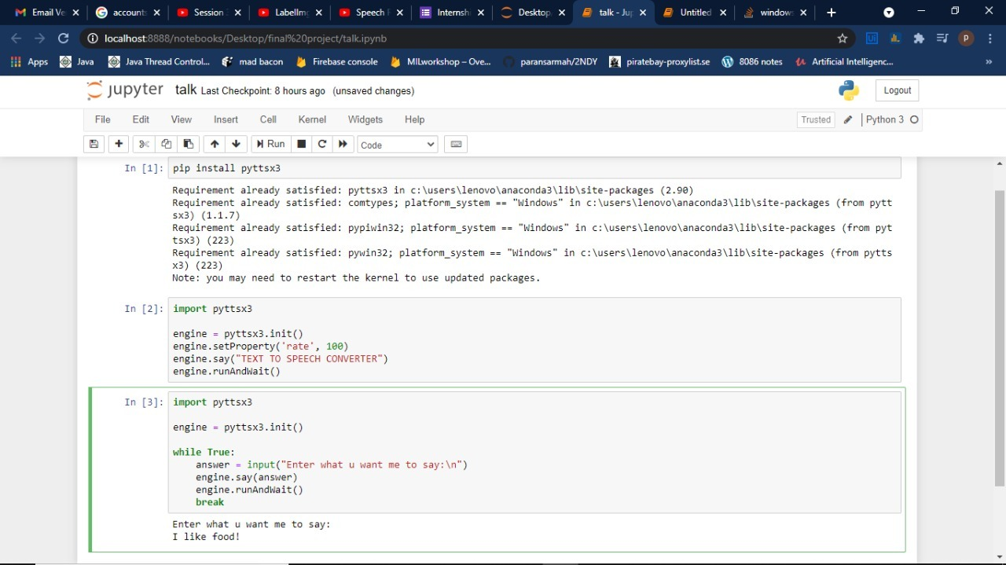

Slide 29
We created a python script which converts text to speech.
we have added a timer to control the rate of speech as well

Slide 30
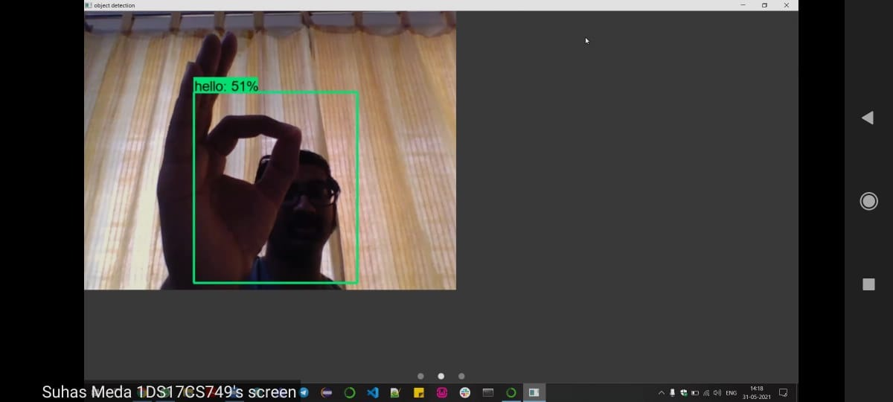
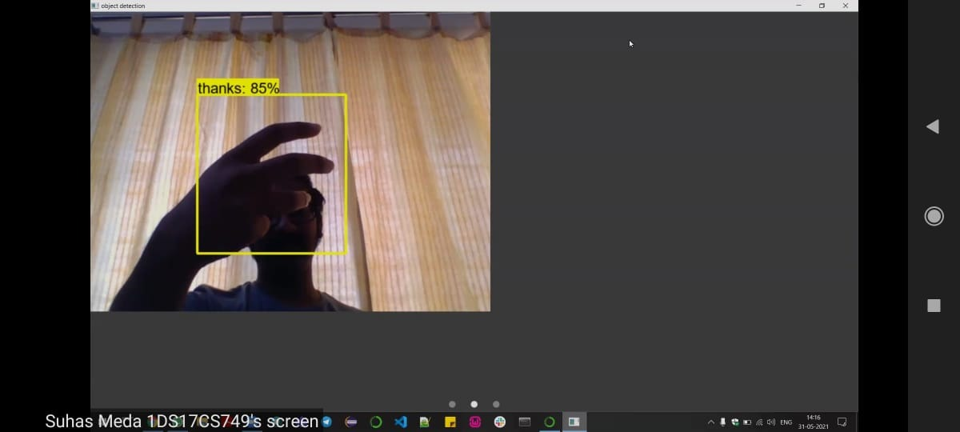

Slide 31
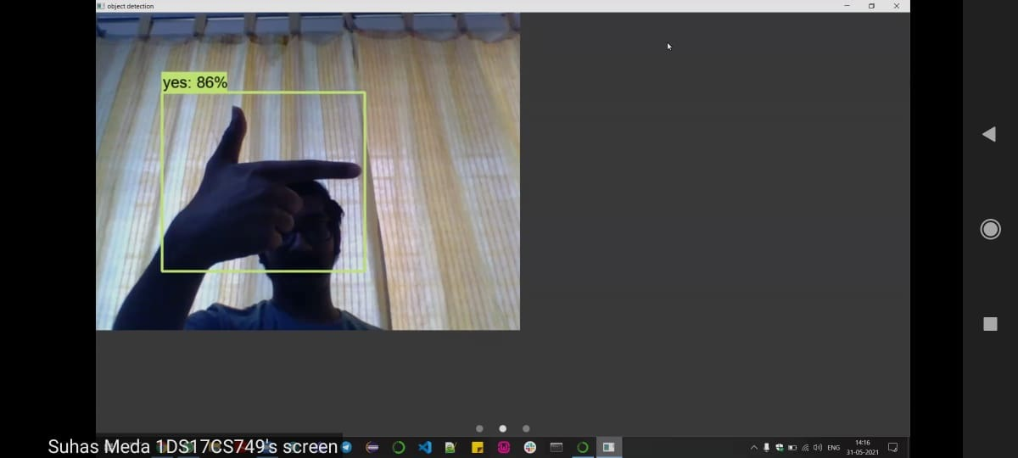
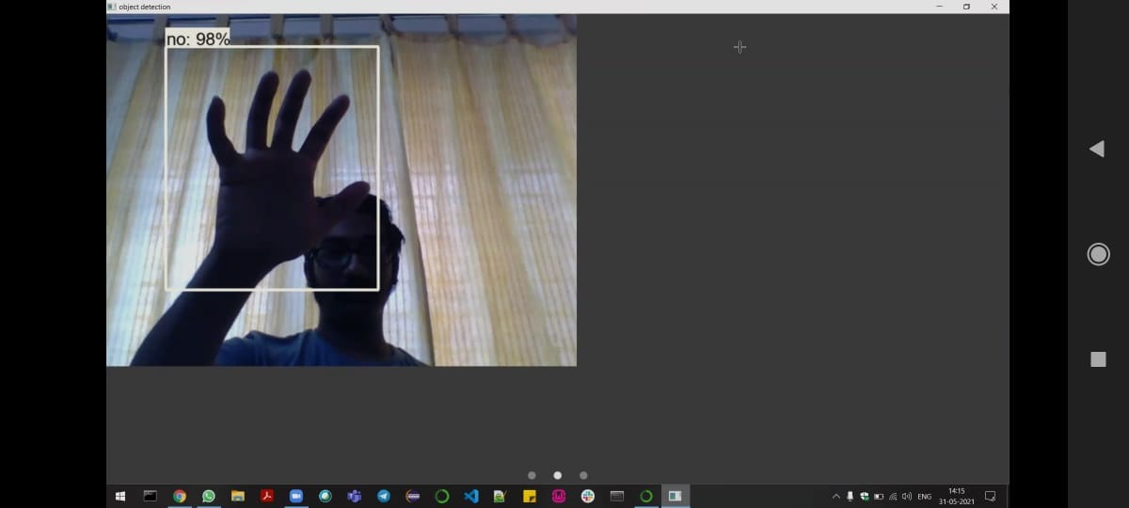

Slide 32
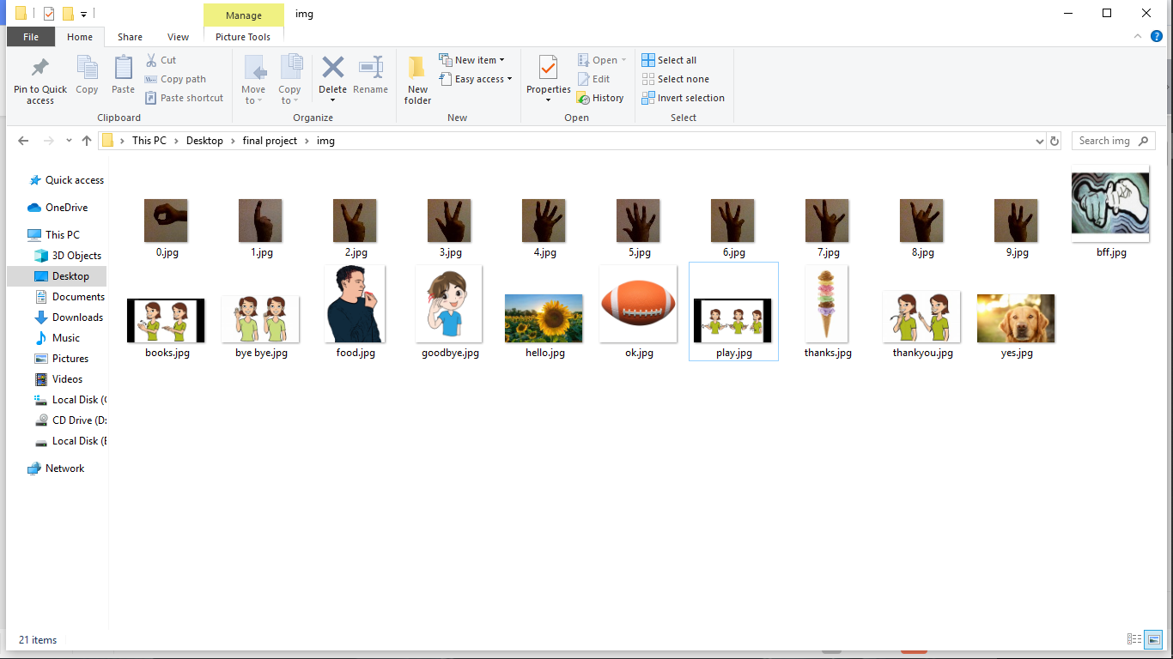

Slide 33
Conclusion
Many different software and hardware solutions have been implemented for field of sign language to speech translator that have been reviewed for our paper.
These includes many different methods and algorithms that have been proposed by different authors.
Various machine learning and image processing techniques have been implemented through the years and have been studied deeply to make these solutions.
The survey of these papers has helped us to choose which techniques and algorithms to use to make our proposed work more efficient and easier to use compared to other proposed works in same field thus improving the sign to speech translator making it easier and better to use.

Slide 34
Future Work
This works better only in the light, so night vision can be added to make it more useful.
This model can be converted into the mobile application which can be used.

Slide 35
References
Cheok Ming Jin, Zaid Omar , Mohamed Hisham Jaward “A Mobile Application of American Sign Language Translation via Image Processing Algorithms” 2016 IEEE Region 10 Symposium (TENSYMP), Bali, Indonesia.
Kalpattu S. Abhishek, Lee Chun Fai Qubeley, and Derek Ho “Glove Based Hand Gesture Recognition Sign Language Translator Using Capacitive Touch Sensor” 2016 IEEE International Conference on Electron Devices and Solid-State Circuits (EDSSC).
Keerthi S Warrier, JyateenKumar Sahu, Himadri Halder, Rajkumar Koradiya, and Karthik Raj V “Software Based Sign Language Converter ” International Conference on Communication and Signal Processing, April 6-8, 2016, India.
Maryam Pahlevanzadeh, Mansour Vafadoost, Majid Shahnazi “Sign Language Recognition” 1-4244-0779-6/07/$20.00 ©2007 IEEE.
Kohsheen Tiku , Jayshree Maloo , Aishwarya Ramesh , Indra R “Real-time Conversion of Sign Language to Text and Speech [5]” Proceedings of the Second International Conference on Inventive Research in Computing Applications (ICIRCA-2020) IEEE Xplore Part Number: CFP20N67-ART; ISBN: 978-1-7281-5374-2.
Dasari Vishal, H M Aishwarya, K Nishkala, B Toshitha Royan, T K Ramesh “Sign Language to Speech Conversion Using Smart Band and Wearable Computer Technology” 2017 IEEE International Conference on Computational Intelligence and Computing Research.
Aarthi M, Vijayalakshmi P “SIGN LANGUAGE TO SPEECH CONVERSION.” 2016 FIFTH INTERNATIONAL CONFERENCE ON RECENT TRENDS IN INFORMATION TECHNOLOGY, 978-1-4673-9802-2/16/$31.00© 2016 IEEE
Prof.R.R.Itkarkar, Dr. Anil V Nandi “Hand Gesture to Speech Conversion using Matlab” 4th ICCCNT 2013 July 4-6, 2013, Tiruchengode, India, IEEE - 31661
Abey Abraham , Rohini V “Real time conversion of sign language to speech and prediction of gestures using Artificial Neural Network.” Real time conversion of sign language to speech and prediction, raham and Rohini V/ Procedia Computer Science 00 (2018) 587–594
Tanuj Bohra, Shaunak Sompura, Krish Parekh, Purva Raut “Real-Time Two Way Communication System for Speech and Hearing Impaired Using Computer Vision and Deep Learning” Second International Conference on Smart Systems and Inventive Technology (ICSSIT 2019) IEEE Xplore Part Number: CFP19P17-ART; ISBN:978-1-7281-2119-2, 978-1-7281-2119-2/19/$31.00 ©2019 IEEE

