Slide 1
METASTABILITY in digital systems

Slide 2
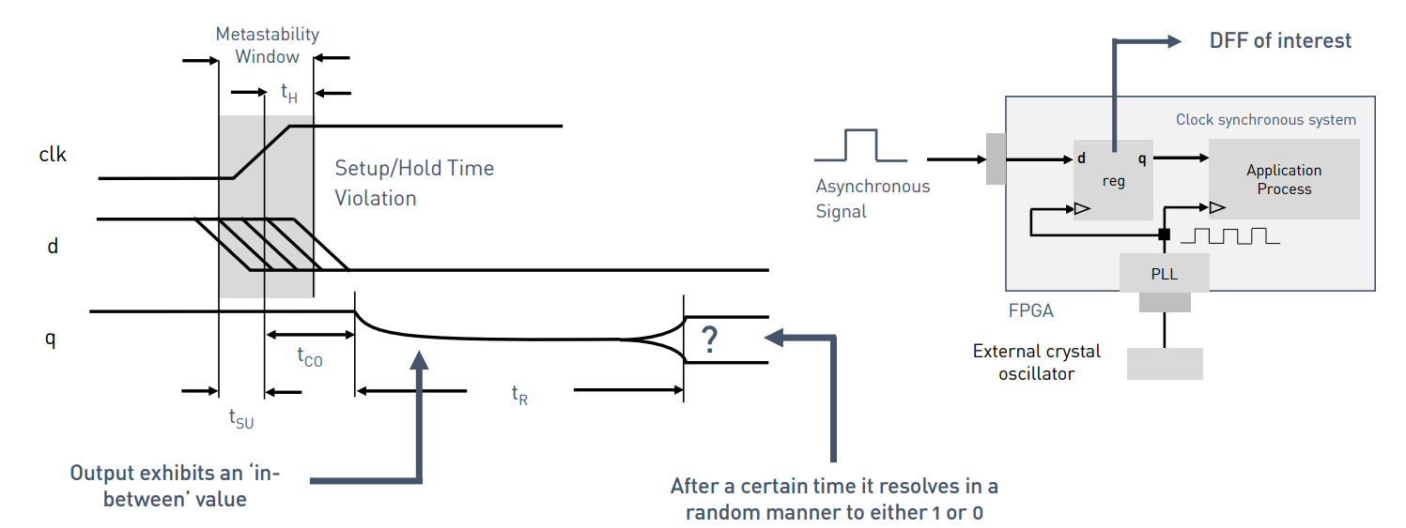
metastability
Notes:
-> Metastability arises due to voilation od setup and holdtime.
-> Every ff has a certain time/ window dueing which the input data should not legally permitted to change before/ after the rising edge of the clock, if it changes the output becomes metastable.
If a ff enters metastable cond, the output depicts an intermediate value for a certain time and resolves to a stady state.
Why do we care?
Digital cmos circuits are designed to draw more power when switching bw 0 and 1. If the sig is in the míntermediate metastable zone, the n-mos and p-mos transistors might interpret this diff and leads to short circuit, invalid states, and memory crashes.

Slide 3
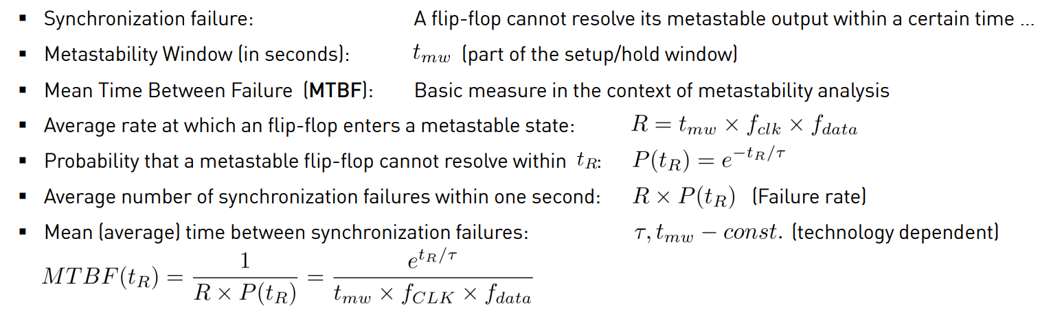
Synchronization Techniques
Notes:
Synchronizers are a set of flipflops that are used to capture the asynchronous signals and align it with the system clock domain, by providing extra clock cycles for the metastability to settle down. It ensures the output is stable (though potentially delayed) through the digital logic level.

Slide 4
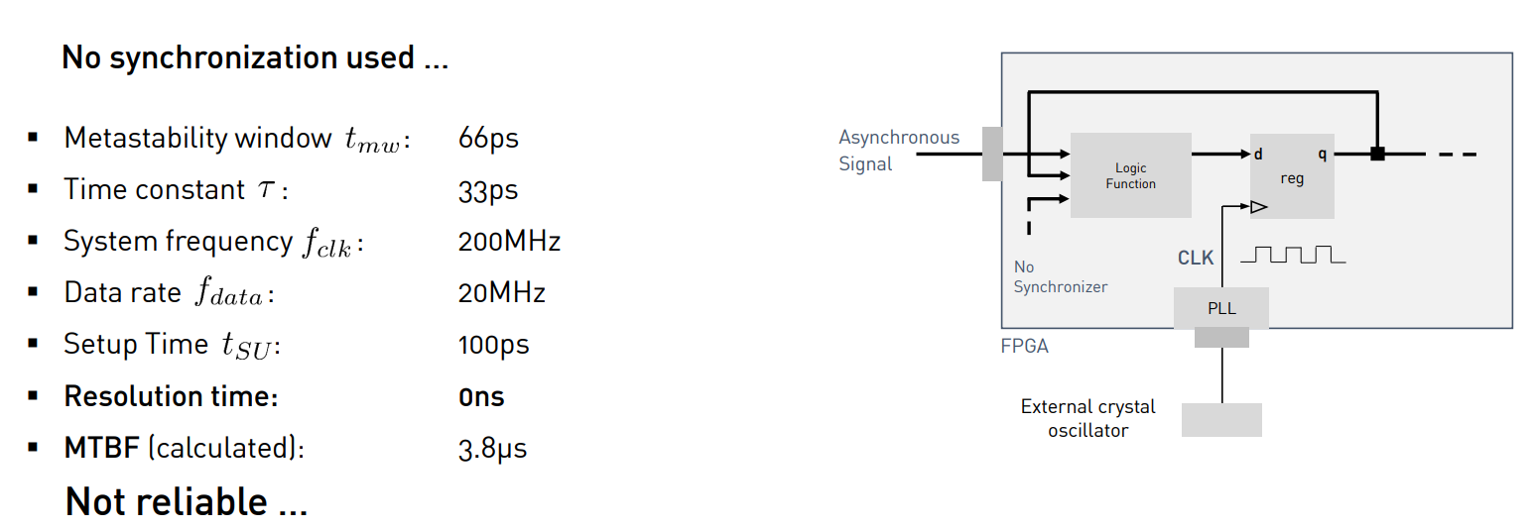

Slide 5
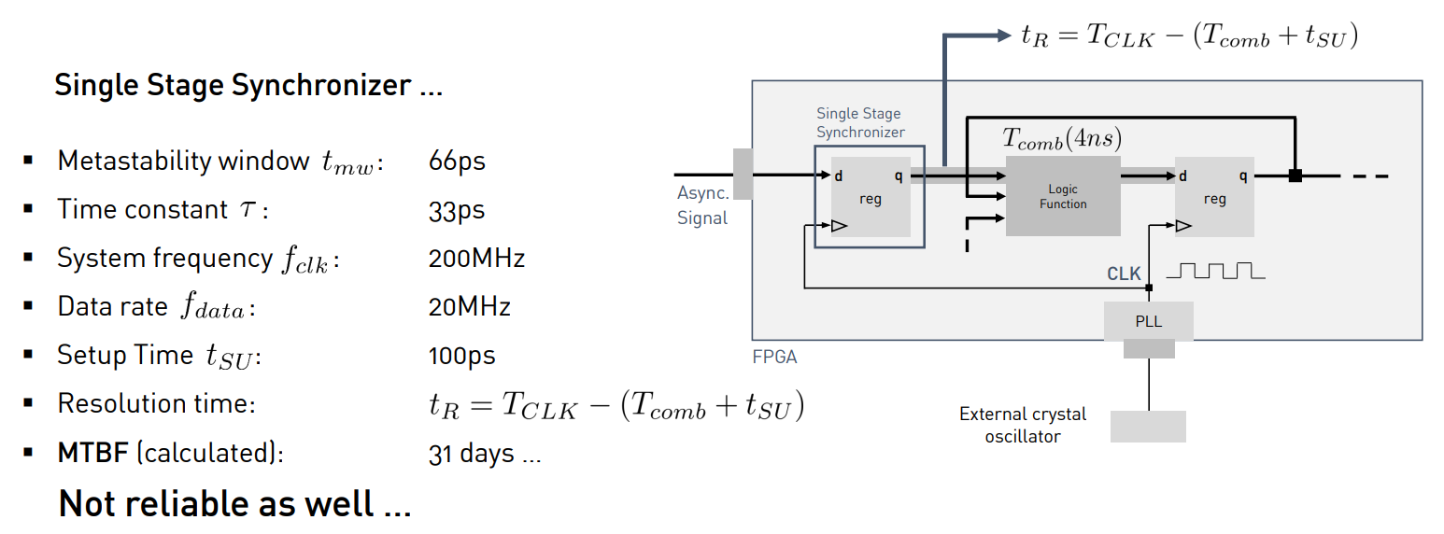

Slide 6
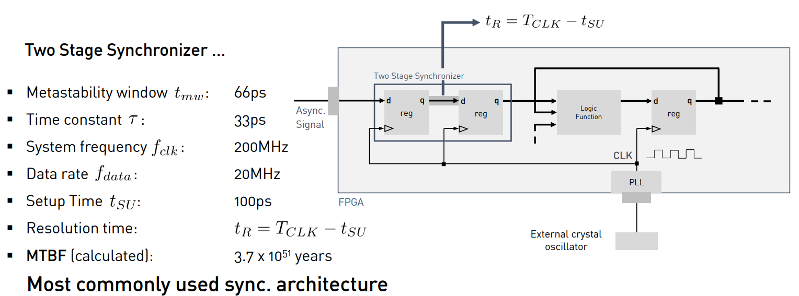

Slide 7
THANK YOU

