Slide 1

RAPID FPGA VERIFICATION STRATEGIES FOR SERVO DRIVES USING MPSOC
30.01.2026
Suhas Bangalore Mruthunjaya

Slide 2
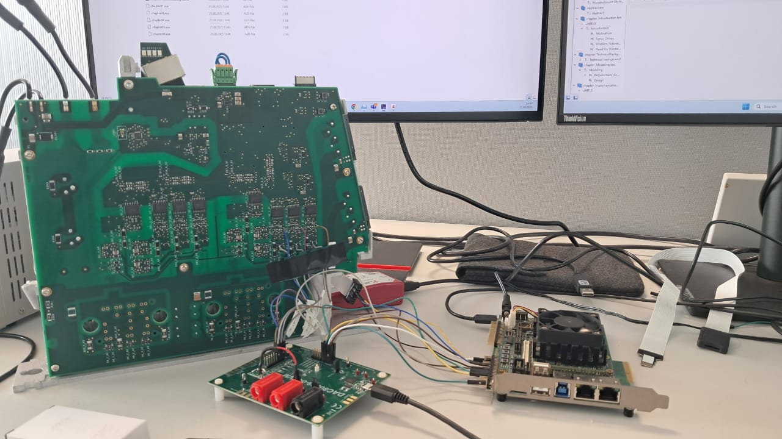
Agenda
Motivation
Problem Statement
Technical Background
Objectives
Relevant ServoDrive Control Board Design (DUT)
Understanding the DUTs
Block Diagram of the System
Design and Implementation
Results
Future Work

Slide 3
MOTIVATION
Schneider Electric Automation GmbH is a global leader in energy management and automation. It’s innovations in industrial automation and robotics rely heavily on the precise control of mechanical motion. At the heart of this motion control are Servo Drives.
Each new version of the servo drive control board uses an MPSoC with updated or redesigned FPGA modules. These modules must be validated under realistic operating conditions before release. However, the current verification process has several limitations.
To address these challenges, the company requires a dedicated FPGA Verification Platform designed to modernize and enhance the verification process. This platform must emulate necessary inputs, automate test sequences, and enable dynamic, independent verification of FPGA modules.

Slide 4
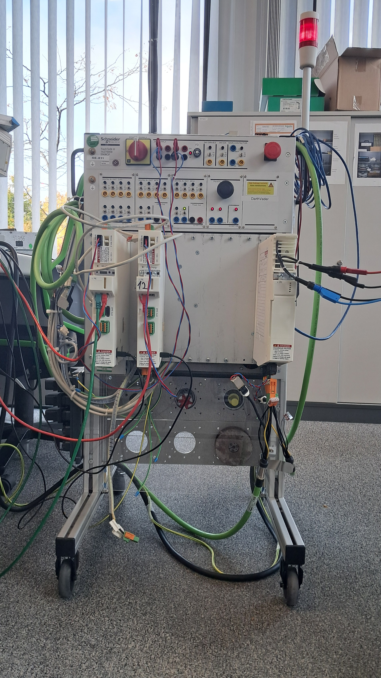
PROBLEM STATEMENT
Manual and Resource – Intensive Verification Process.
Limited Test Coverage.
Dependence on Physical Hardware and Motors.
Inefficient Measurement Techniques.
Lack of Modular and Isolated FPGA Verification.
Notes:
1. Manual and Resource Internsive verification process- Engineers has to configure manually the bare metal application in vitis and connect the debugger and follow certain steps even before the test is actually began, which is very much manual and there is a need for Automation.
2. Limited Test Coverage – The present Verification platform only supports static testing and hence limited test coverage.
3. Dependence on physical Hardware – As we can see in the picture, there is a dependence on external motors to generate relialistic feedback signals. Measuring current on the motor phase using ADCs require additional hardware components, which results in Increase in costs and hardware wear and tear issues.
4. Inefficient Measurement Techniques – Current measurement techniques are also inefficient, as the PWM duty cycle values are converted to current levels relying on the manual estimation using the motor parameters, so this process also was needed to be automated.
5. Lack of Modular and Isolated FPGA Verification – In present Verification methods, To Verify a current-sense FPGA module, a PWM module must also be in operation, to drive the motors and generate some measurable current value. So this interdependence on FPGA modules would lead to a bug being undetetected until later stages of development and hence to mitigate all these problems there is a need for one single FPGA Verification platform where inputs are emulated and outputs from the control board are analysed.

Slide 5
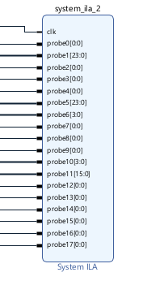
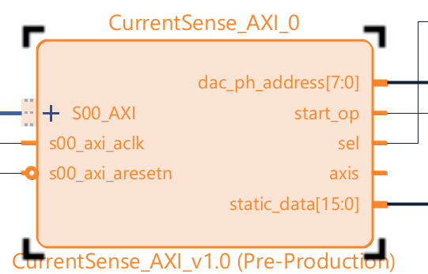
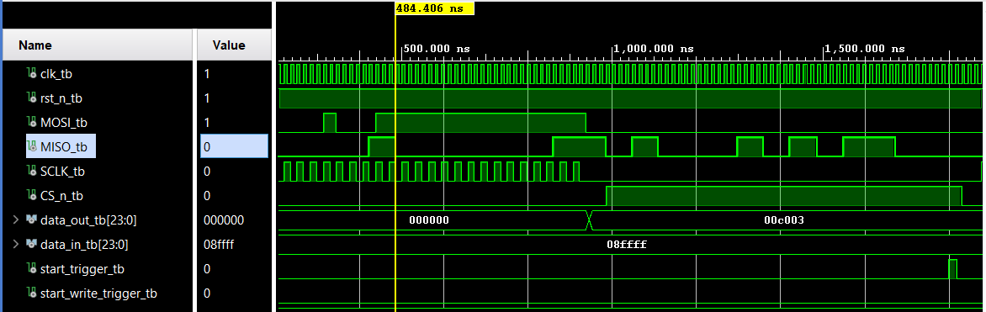
Technical Background
Types of FPGA Verification
Simulation-Based Verification: FPGA designs can be varified through RTL, post-synthesis, and post-implementation simulations, encompassing both functional and timing analyses to validate logic correctness and timing behavior across the entire design flow.
Hardware-in-loop (HIL) Verification: FPGA is integrated with real-world hardware (sensors, actuators, processors) for real-time verification.
In-System Debug: Using tools like Xilinx System ILA or Integrated logic analyzer to capture internal FPGA signals in real time.
Software-Driven Verification: Running test software or firmware on embedded processors (ARM, MicroBlaze, Nios II) integrated with FPGA logic, using AXI Interfaces to enable communication between hardware and software.

Slide 6
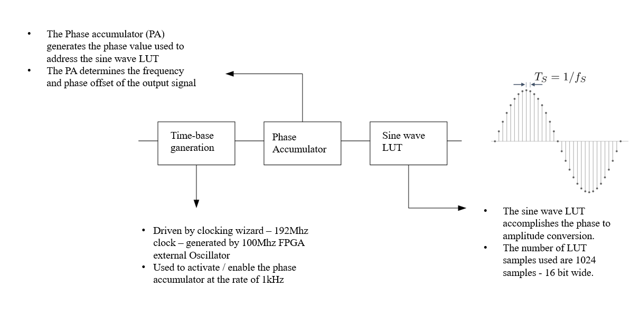

From Classroom to Thesis.
Direct Digital Frequency Synthesis.
CMSIS FFT
Stands for Cortex Microcontroller Software Interface Standard.
A software library provided by ARM for Cortex M microcontrollers which provides a common API, so the code can work across differenr vendors‘ chips without major changes.
CMSIS-DSP – Optimized functions for digital signal processing. Includes filters, FFTs, matrix math, etc.

Slide 7
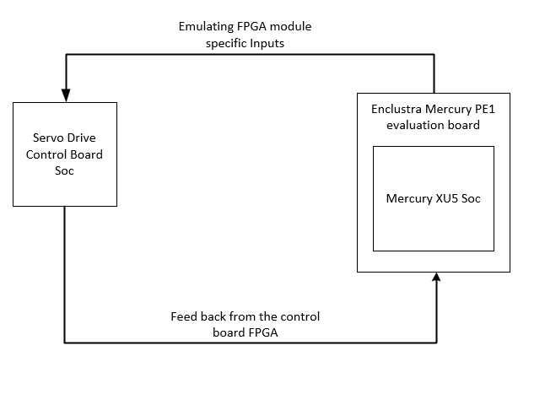
Objectives
The primary objective was to develop a robust proof of concept for a dedicated FPGA Verification Platform. This platform wíll facilitate the comprehensive verification and testing of new FPGA modules of the control board prior to their release.
Automated Verification.
Comprehensive Test Coverage.
Independent Module Testing.
Complex Data Handling.
Scalability and Compatibility.
Improved User Experience.
Notes:
1. The proposed platform will automate the verification workflow, reducing or eliminatig manual intervention.
2. Will support both static and dynamic verifcation for increasing test coverage.
3. A key ability to test individual modules independentaly of other FPGA components or external hardware.
4. The system incorporates mechanisms for complex data handling wíthout any error-prone manual estimations.
5. The flatform is compatible with various versions of CB
6. The platform will have significantly improved user expeience compared to the exixting verification setup.

Slide 8
Relevant ServoDrive Control Board Design (DUT)
Notes:
This modules perform essential functions to maintain reliable operation of servodrive system.

Slide 9
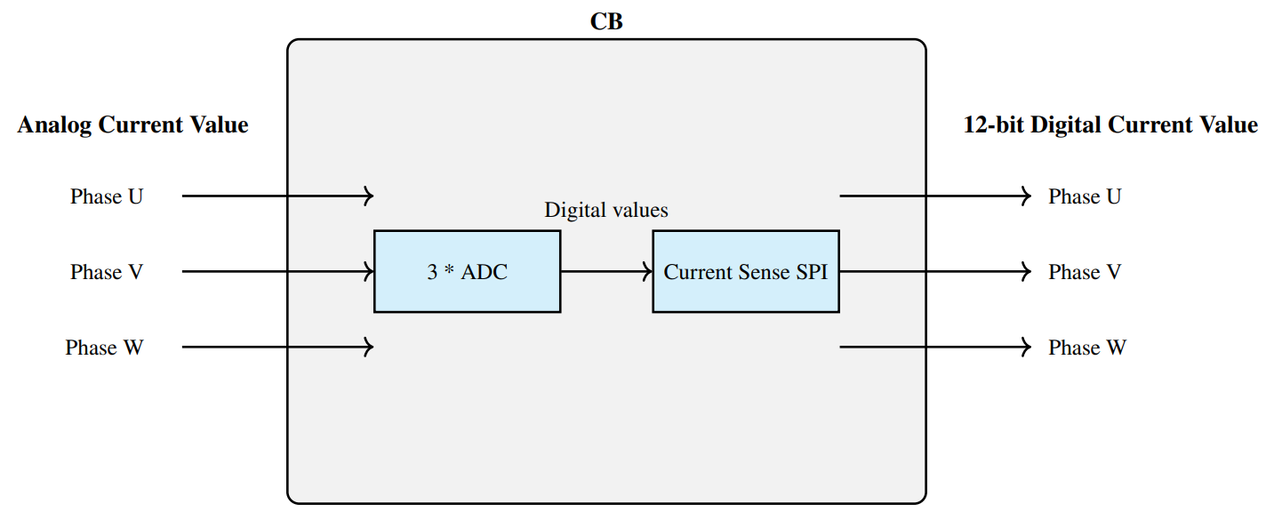
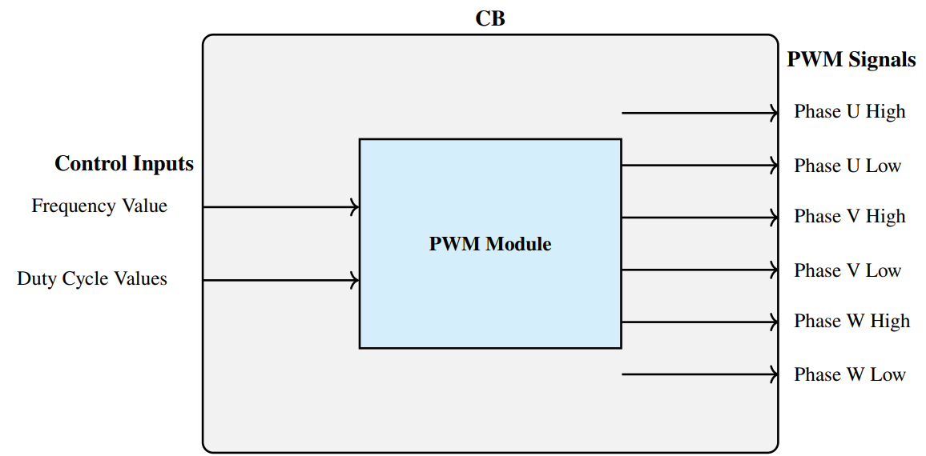
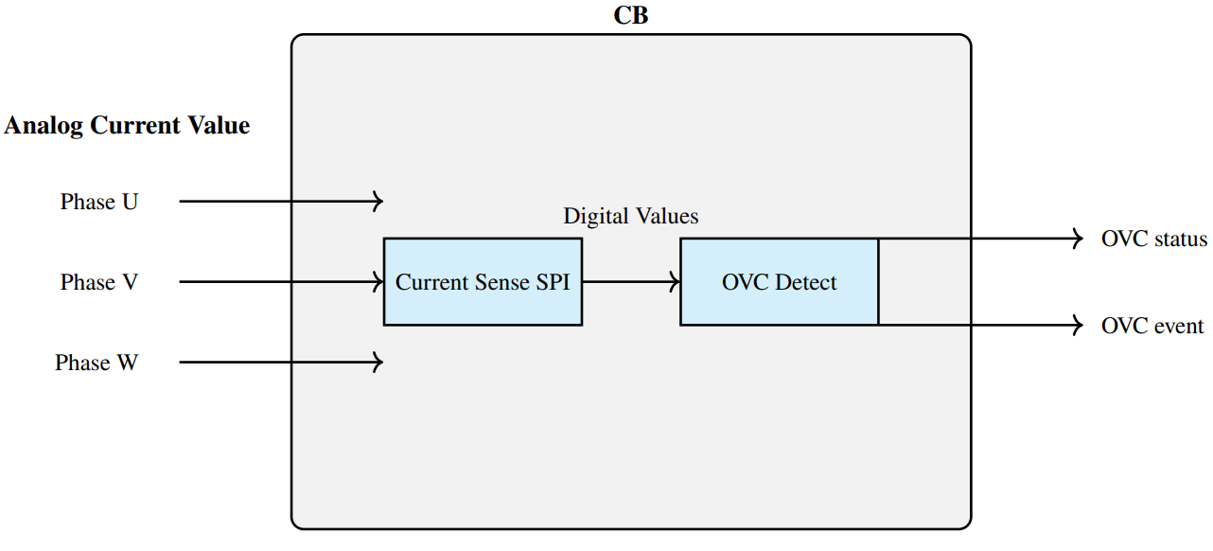
Understanding the DUTs
Notes:
CS: The boards ADC continously acquire feedback signals from the motor phases, and convert these to Digital values. The SPI module processes these for sub control and monitoring.
PWM: This module supports 3 switching frequencies.. 16kh, 8khz and 4 khz, with variable DutyCycle config.
This outputs are transmitted to motor inverter stage where it generates phasecurrnets in motor windings.

Slide 10
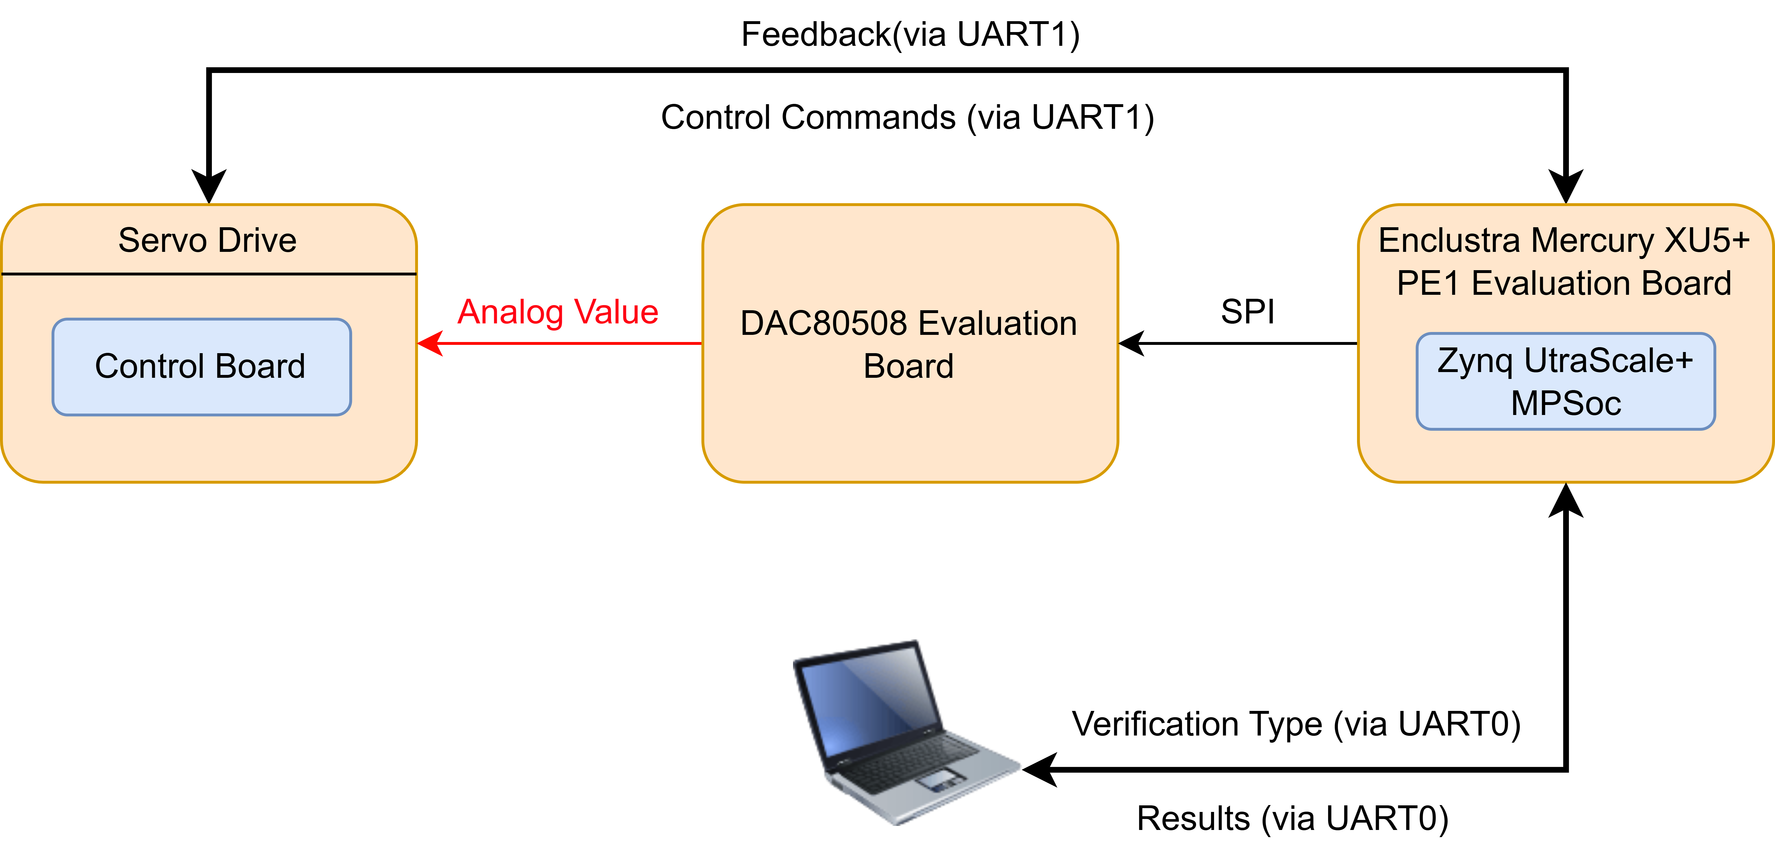
Block Diagram of the System

Slide 11
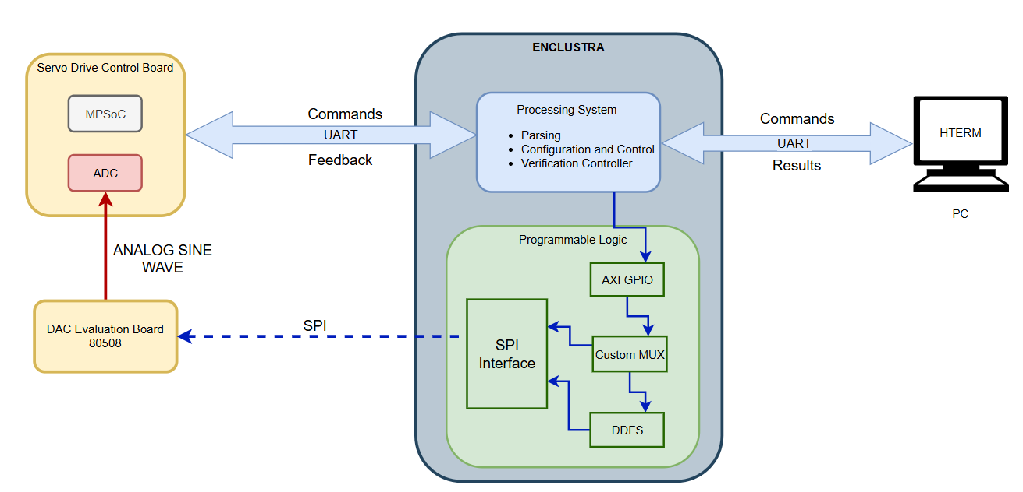
Design and Implementation
1. Current Sense Verification

Slide 12
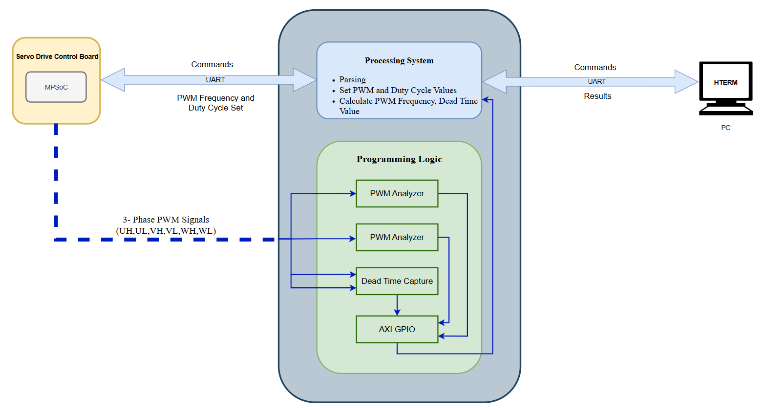
2. PWM VERIFICATION

Slide 13
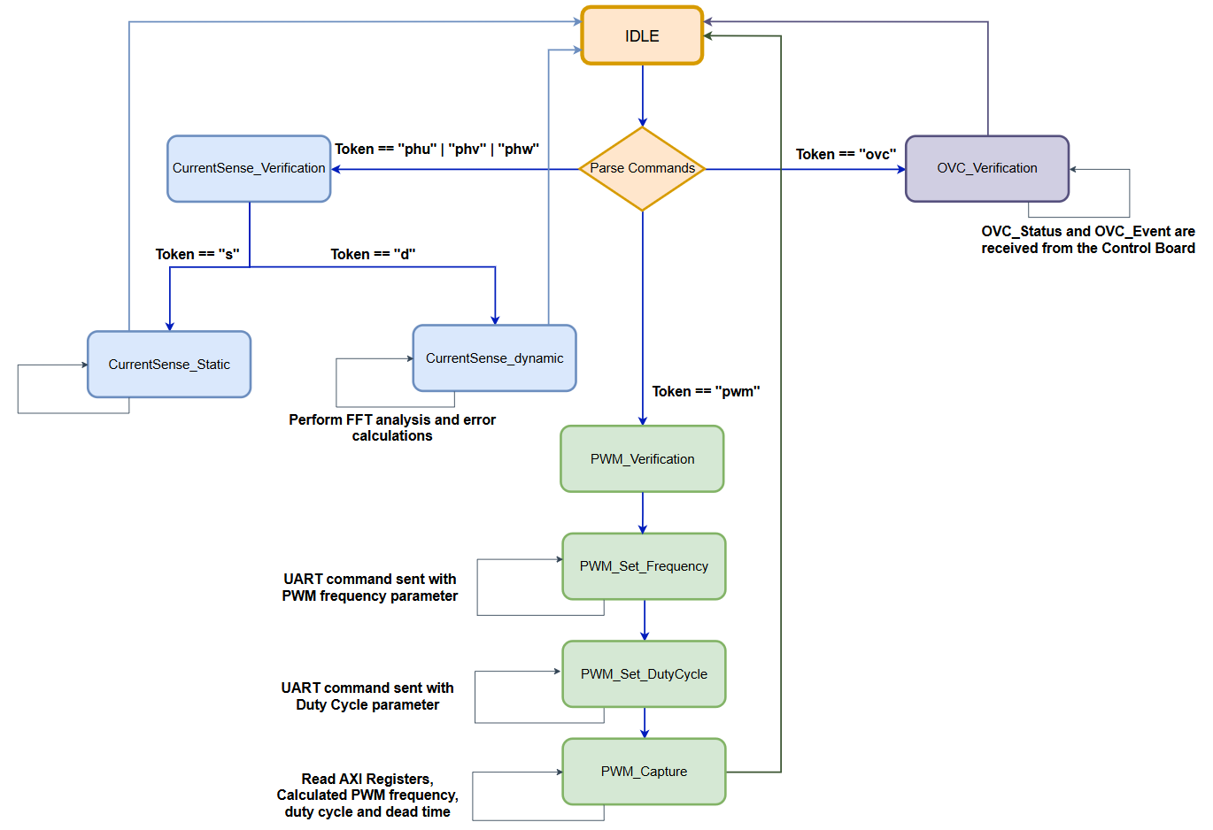
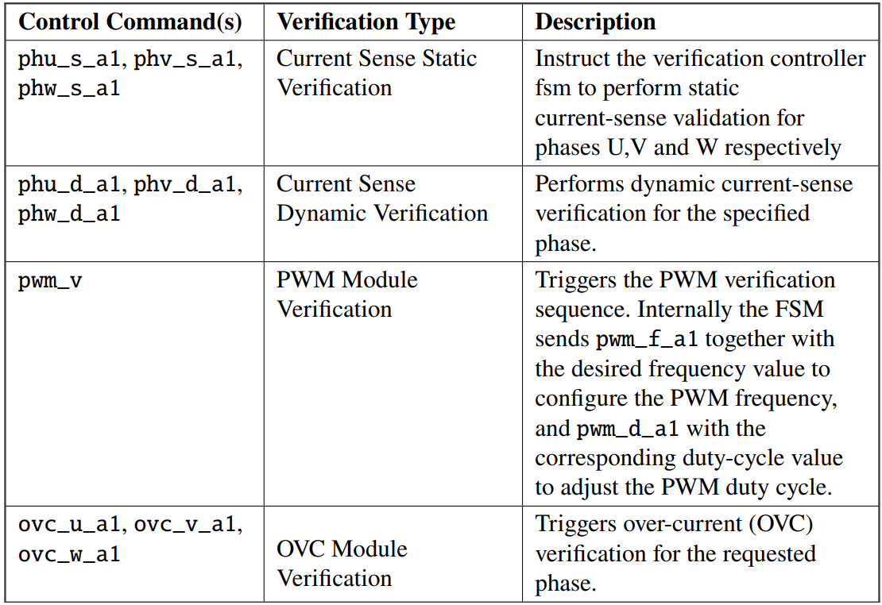
3. Verification Controller Statemachine

Slide 14
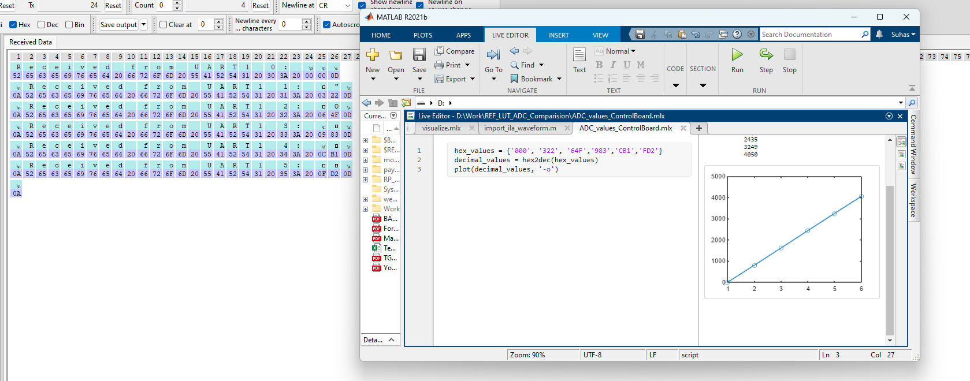
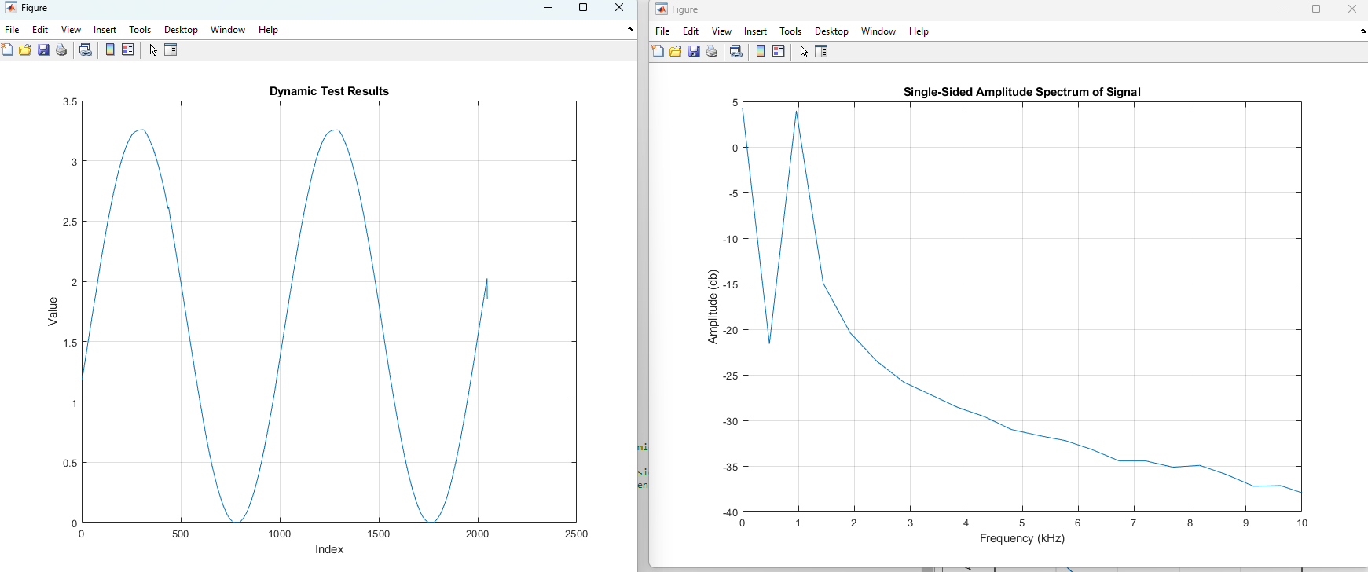
Results
CurrentSense Verification Results
Static Test
Dynamic Test

Slide 15
Signal Acquisition and Spectral Analysis
FFT Computation
decData = (12 bit raw Data / pow(2, 12)) * 3.3.
arm_mean_f32(decData, FFT_SIZE , &mean)
arm_rfft_fast_f32 (&S, data_input_buffer , fft_output_buffer , 0)
arm_max_f32 (magnitude_buffer , (FFT_SIZE /2) + 1, &max_val , & max_index )
freq = max_index * bin_width
Error Calculations
error_f = 100/ REF_MAX_FREQUENCY * fabsf( REF_MAX_FREQUENCY - freq)
error_amp = 100/ REF_PEAK2PEAK_VALUE * ( REF_PEAK2PEAK_VALUE - peak2peak_f32 ( dynamic_data , FFT_SIZE))
arm_rms_f32 ( dynamic_data, FFT_SIZE , & rms_result )
error_rms = 100/ REF_RMS_VALUE * ( REF_RMS_VALUE - rms_result );

Slide 16
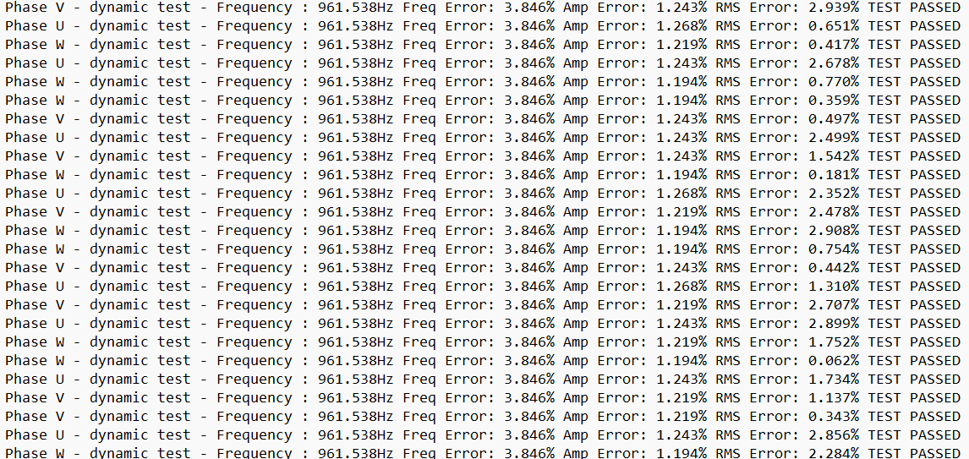

Slide 17
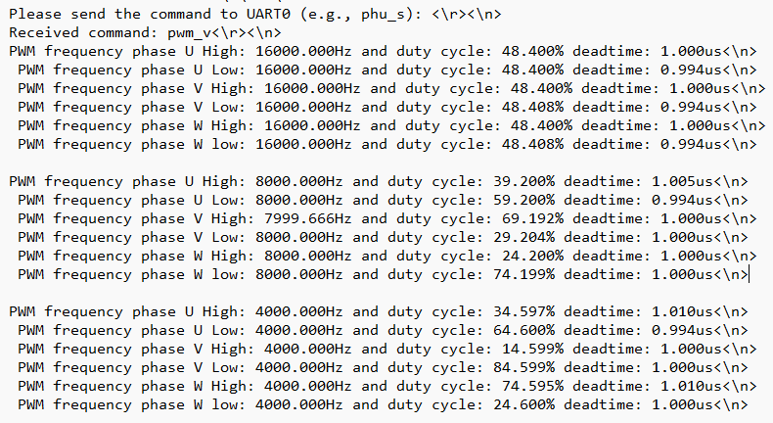


PWM Verification Results

Slide 18
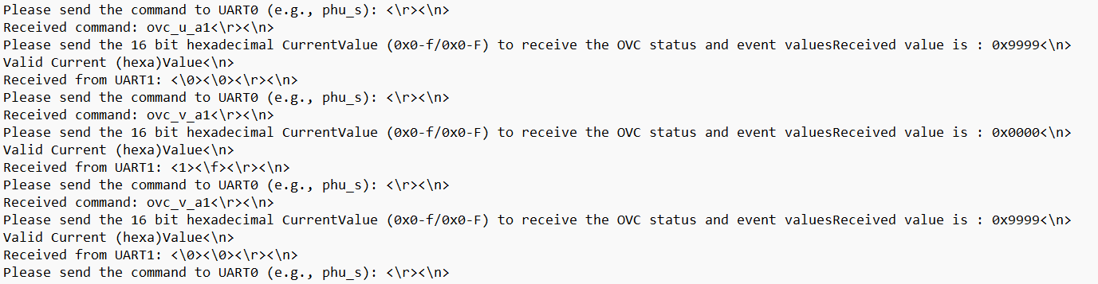
OVC Results

Slide 19
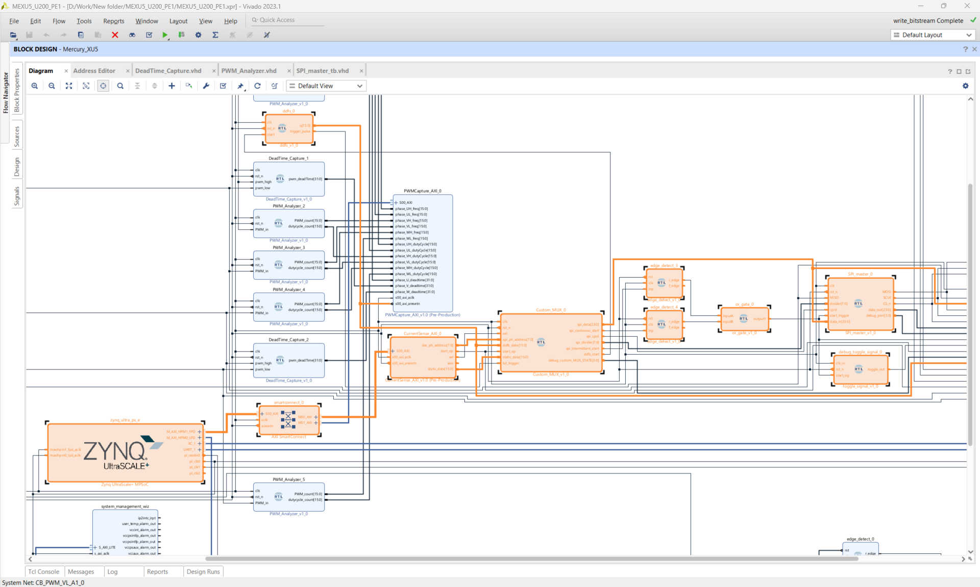
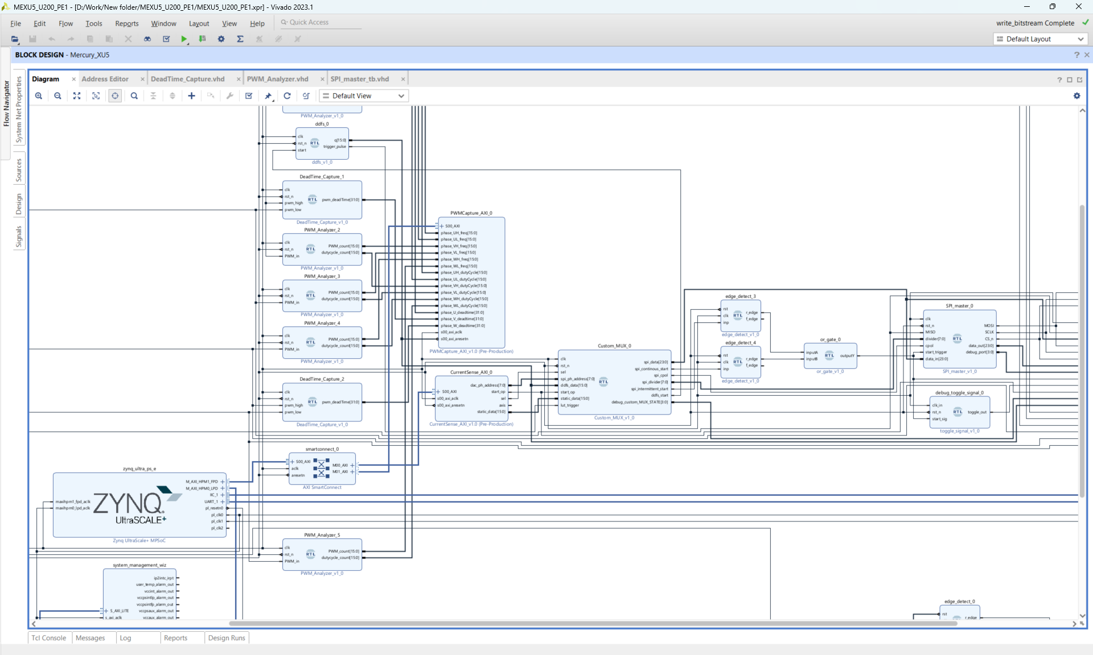
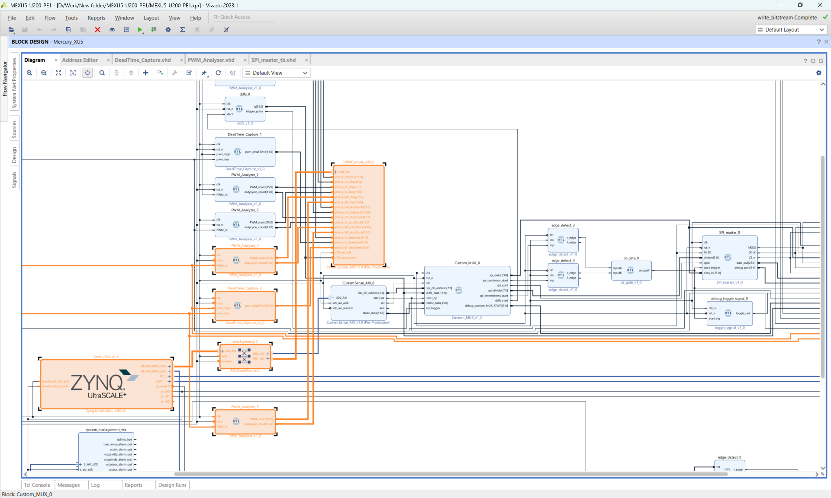

Slide 20
Future Work
The current UART-based communication can be replaced with an Ethernet-based interface to enable higher bandwidth, lower latency, and improved robustness for real-time verification data transfer.
The platform can be extended to support verification of additional FPGA modules, including encoder interfaces, brake-control logic, analog measurement paths, Ethernet TSN, and digital I/O subsystems.
FPGA-accelerated HIL/FIL architectures can be incorporated to enable closed-loop simulation of complete motor-drive and power-electronic systems without physical hardware.
A high-level software interface can be developed to support automated test execution, report generation and result visualization.
Integration into CI/CD pipelines can be achieved to support automated regression testing and continuous FPGA hardware validation

Slide 21
THANK YOU.

