Slide 1
RPA Foundations
Module 1

Slide 2
RPA Foundations : What the Technology Can Do
RPA (robotic process automation) has become one of the hottest categories for venture capital investment.
Automation Anywhere announced that the Softbank Vision Fund invested $300 million in the start-up
UiPath announced it raised $568 million for its Series B round, with tier-one investors like Coatue, Wellington, CapitalG, Accel, and Sequoia.
UiPath had seen an explosion in growth: The valuation went from $110 million to $7 billion, annual recurring revenues surged from $8 million to $200 million, six new releases of the UiPath Enterprise RPA platform

Slide 3
What is RPA?
Software-based robot (or bot)
That can automate human actions in the workplace (generally for white collar applications in clerical and administrative functions).
A bot can be delivered via the cloud or through downloadable software.
RPA involves bots that perform a set of specified actions or tasks, such as the following:
The cut-and-paste of information from one app to another
The opening of a web site and login
The opening of an e-mail and attachments
The read/write of a database
The extraction of content from forms or documents
The use of calculations and workflows
Such things may sound kind of mundane, boring, and simplistic. But that’s the point.
RPA is focused on those tasks that are really a waste of efforts for workers

Slide 4
What Is RPA? : UiPath
Robotic Process Automation is the technology that allows anyone today to configure computer software, or a ‘robot’ to emulate and integrate the actions of a human interacting within digital systems to execute a business process.
RPA robots utilize the user interface to capture data and manipulate applications just like humans do. They interpret, trigger responses and communicate with other systems in order to perform on a vast variety of repetitive tasks.
Only substantially better: an RPA software robot never sleeps, makes zero mistakes and costs a lot less than an employee

Slide 5
What Is RPA? : Automation Anywhere
RPA is really as simple – and powerful – as it sounds.
Robotic Process Automation enables you with tools to create your own software robots to automate any business process. Your ‘bots’ are configurable software set up to perform the tasks you assign and control.
“Think of them as your Digital Workforce. Show your bots what to do, then let them do the work. They can interact with any system or application the same way you do. Bots can learn. They can also be cloned. See how they are working and adjust and scale as you see fit. It’s code-free, non-disruptive, and easy

Slide 6
What Is RPA? : PEGA
Robotic process automation (RPA) can be a fast, low-risk starting point for automating processes that rely on outdated legacy systems.
Bots can pull data from manual systems without APIs into digital processes, ensuring faster and more efficient outcomes

Slide 7
What Is RPA? : Kryon Systems
Robotic Process Automation enables enterprises to create true virtual workforces that drive business agility and efficiency.
A virtual workforce, comprised of software robots that can execute business tasks on enterprise applications, becomes an integral part of an enterprise’s greater workforce.
It is managed just as any other team in the organization and can interact with people just as other employees would interact with one another.
Virtual workers (robots) complete business processes, just as a person would, but in less time, with greater accuracy and at a fraction of the cost.
RPA stands out for its ability to impact business outcomes, resulting in significant ROI

Slide 8
What Is RPA?
Difference with RPA vs. other forms of automation?(Like Excel macro)
A macro is only for a particular application. RPA can used for just about anything, whether on a PC or even a mainframe.
RPA can record a person’s actions to help create the automation. Some systems will even use sophisticated technologies like AI (Artificial Intelligence) to help with this.
RPA platform will become a valuable repository of knowledge about how work is done in an organization. This can provide insights on how to improve workflows and processes, which could drive even further efficiency.

Slide 9
Flavors of RPA
Attended RPA (referred to as robotic desktop automation or RDA): First form of RPA that emerged, back in 2003 or so.
software provides collaboration with a person for certain tasks.
call center, where a rep can have the RPA system handle looking up information while he or she talks to a customer.
Unattended RPA : Second generation of RPA. You can automate a process without the need for human involvement – that is, the bot is triggered when certain events happen, such as when a customer e-mails an invoice.
Consider that unattended RPA is generally for back-office functions.
Intelligent process automation or IPA (referred to as cognitive RPA): Latest generation of RPA technology, which leverages AI to allow the system to learn over time (an example would be the interpretation of documents, such as invoices).
even less human intervention since the RPA software will use its own insights and judgements to make decisions.

Slide 10
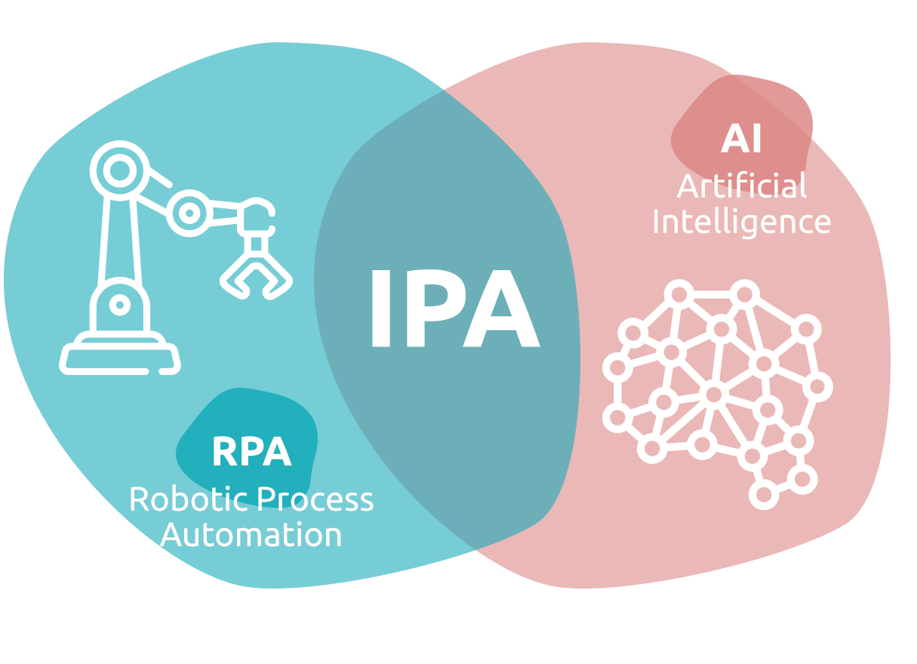
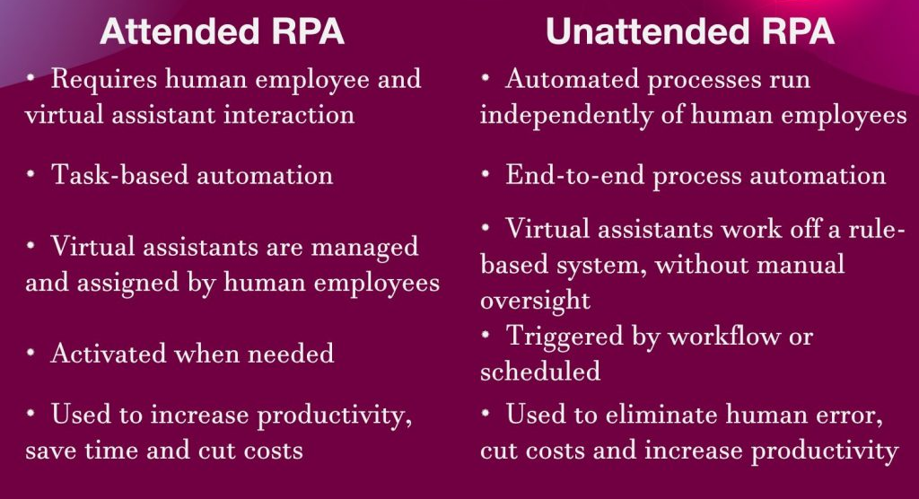
Flavors of RPA …

Slide 11
History of RPA
Mainframe Era: These were huge machines developed by companies like IBM. They were expensive and mostly available to large companies. Yet they were incredibly useful in helping manage core functions for companies, such as payroll and customer accounts.
PC Revolution: Intel’s development of the microprocessor and Microsoft’s development of its operating system revolutionized the technology industry. As a result, just about any business could automate processes, say by using word processors and spreadsheets.
But the automation technologies – while powerful – still had their drawbacks. They could easily result in complex IT environments, which required expensive and time-consuming integrations and custom coding.

Slide 12
History of RPA …
From the emerged the key elements for RPA, which came about in the early 2000s. A big part of this was screen scraping, which is the automation of moving data among applications
But the emerging RPA market got limited attention. It was mostly apparent as low-tech and a commodity.
But around 2012 or so, the RPA market hit an inflection point. There was a convergence of trends that made this happen, such as the following:
In the aftermath of the financial crisis, companies were looking for ways to lower their costs. Simply put, traditional technologies like ERP were reaching maturation. So companies needed to look for new drivers.
Companies also realized they had to find ways to not be disrupted from technology companies. RPA was considered an easier and more cost-effective way to go digital.

Slide 13
History of RPA …
RPA technology was starting to get more sophisticated and easier to use, allowing for higher ROI (return on investment).
Large companies were starting to use RPA for mission-critical applications.
“The evolution of the RPA market is like any major technology trend,” said Mihir Shukla, who is the CEO and cofounder of Automation Anywhere.

Slide 14
History of RPA …
RPA is the fastest growing part of the software industry. According to Gartner, the spending on this technology jumped by 63% to $850 million in 2018 and is forecasted to reach $1.3 billion by 2019.
By 2020, RPA along with AI will reduce the business shared-service centers by 65%. There will also be adoption by 40% of large enterprises, compared to 10% in 2019.
Likely be saturation in the RPA market by 2023 (Deloitte).
The financial impact from RPA could hit $6.7 trillion by 2025.
In terms of the global market share for RPA software, North America represents 51% and Western Europe is at 23%. But Asia is starting to get traction, especially Japan.
By 2023, the forecast is that there will be $12 billion in spending on RPA services (Forrester).

Slide 15
The Benefits of RPA
When it comes to RPA, the most talked about benefit is the ROI
Take the Computer Economics Technology Trends 2019 report, which is a survey of 250 companies. Among them, about 12% implemented RPA within their organizations and half of them said there was a positive ROI within 18 months most talked about benefit is the ROI.
Another perspective from consulting firm, A.T. Kearney: “On average, a software robot costs one-third as much as an offshore employee and one-fifth as much as onshore staff.
Barclays Bank attributes savings worth the equivalent of roughly 120 full-time employees and an annual reduction in bad debt provisions of $250 million.
Telefónica O2, which uses more than 160 robots to automate 15 core processes and nearly 500,000 transactions per month, says that its return on investment in robotic process automation has exceeded 650 percent.”

Slide 16
The Benefits of RPA …
The Impact of Small Improvements: On the surface, an employee who saves 10 to 20 seconds on a task – even something as simple as a series of cut-and-paste actions – may seem trivial. But it’s not. When scaled across thousands of employees across a global organization, the impact can certainly be significant.
For example, some companies will keep track of the metric of how many hours are saved by using RPA, which becomes a part of the overall ROI calculation.
A survey form Forrester found that 86% of the respondents reported an increase in efficiency from RPA.

Slide 17
The Benefits of RPA …
Relative Ease of Implementation: Unlike traditional business applications like a CRM or ERP, RPA generally does not involve an tedious implementation and integration.
The people implementing RPA will get to their objectives quicker and the IT department will have more time to devote to higher priority items.
Compliance: Just one violation of a government regulation can have a serious adverse impact on a company. It could even be a threat to its very existence. Humans can make mistakes.
RPA bots can be configured to make sure the actions are compliant with regulatory requirements.
less intervention with the data from people, which lessens the possibility of fraud

Slide 18
The Benefits of RPA …
Customer Service: Nowadays, people want quick and accurate responses from their companies. But this is difficult to provide. The RPA bots are programmed to make sure that all the necessary steps are taken – at scale.
The result is often an increase in customer satisfaction metrics.
“RPA can take the processing of a mortgage application from 15 days to 7 minutes,” said Shukla.
Employee Satisfaction: Office team should do not have to spend their valuable time on tedious activities. The result may be less turnover and higher productivity.

Slide 19
The Benefits of RPA …
Wide Application: RPA can be used for virtually any part of a company, such as legal, finance, HR, marketing, sales and so on.
Data Quality: It should be greatly improved as there will be less chance of human error. In fact, there will probably be much more data because of the scalability of the automation.
Digital Transformation: RPA can replace the legacy process, which is often quicker and less costly.
Scalability: If there is a sudden jump in demand, it can be extremely difficult to hire new employees.RPA is much cheaper and faster to ramp up new bots to meet the demand.

Slide 20
The Downsides of RPA
Cost of Ownership: The business models vary. Some have a subscription or multiyear license. Other vendors may charge based on the number of bots.
There is the need for some level of training and ongoing maintenance.
Depending on the circumstances, there may be requirements for buying other types of software and hardware.
Have to retain third-party consultants to help with the implementation process.
Technical Debt: As a company’s processes change, the bots may not work properly.
Enterprise Scale : It is extremely difficult to manage the numerous bots and there also needs to be strong collaboration among IT.

Slide 21
The Downsides of RPA …
Security : In mission-critical areas of a company’s processes. If there is a breach, then highly sensitive information could easily be obtained.
Actually as RPA gets more persistent in manufacturing, there may even be risks of property damage (likely be the case with attended RPA).
Expectations: With the hype at feverish levels for RPA, may leads to disappointment.. According to a survey from PEGA, the average time it takes to develop a quality bot was 18 months, with only 39% being deployed on time.
Preparation: You need to do a deep dive in how your current tasks work. If not, you may be automating bad approaches.

Slide 22
The Downsides of RPA …
Limits: RPA technology is somewhat constrained. For the most part, it works primarily for tasks that are routine and repetitive.
If there is a need for judgment – say to verify a document – then there should be human intervention. Although, as AI gets more pervasive, the issues are likely to fade away.
Virtualized Environments: In desktop accesses applications remotely, RPA system fail. RPA cannot capture the text on the screen.
However, some of the latest RPA offerings, such as from UiPath, are solving the problem.

Slide 23
RPA Compared to BPO, BPM, and BPA
BPM: US companies (1970-80) were seeking new and innovative approaches to improve their efficiency and competitiveness by adopting different management approaches, such as Six Sigma (combination of project management and statistical techniques), lean production (manufacturing principles of Toyota), and total quality management or TQM (a blend of Six Sigma and lean production).
FileNet introduced a digital workflow management system to help better handle documents and ERP vendors, such as PeopleSoft.
Comprehensive improvement on business processes
Business process management software (BPMS) solutions to help implement BPM. One was Laserfiche, to use OCR (optical character recognition) technology.

Slide 24
RPA Compared to BPO, BPM, and BPA …
BPM different from RPA
BPM requires more time and effort with the implementation BPM is about changing extensive processes, not tasks. There also needs to be detailed documentation and training.
BPM uses rigorous approach, so often attractive to industries such as financial services and healthcare.
The risk is that there may be too much structure, which can suppress innovation.
RPA can be complementary to BPM.
UiPath analogy of self-driving cars.

Slide 25
RPA Compared to BPO, BPM, and BPA …
BPO : Company outsources a business service function like payroll, customer support, procurement, and HR.
Top players are ADP, Accenture, Infosys, IBM, TCS, and Cognizant.
BPO is the benefit of lower wage rates in other countries
The employee bases will also often be educated and multilingual.

Slide 26
RPA Compared to BPO, BPM, and BPA …
BPO have three types of strategies:
Offshore: Employees are in another country, usually far away.
Nearshore: When the BPO is in a neighboring country.
Onshore: The vendor is in the same country. For example, there can be wide differences in wages in the United States.

Slide 27
RPA Compared to BPO, BPM, and BPA …
Drawbacks with a BPO
quality issue(when you call a company and get an agent )
Security: If a BPO company is developing an app with company’s data, it can still be difficult to enforce and manage the security of the data.
Costs: Over the years, countries like China and India have seen rising labor costs. This has resulted in companies moving to other locations, which can be disruptive and expensive.
Politics: This can be a wildcard. Uncertainty can easily mean having to license a BPO operator in a particular country.

Slide 28
RPA Compared to BPO, BPM, and BPA …
RPA connection with BPO
RPA is automating BPO-type activities. Based on studies ( by Everest Group, KPMG, and Deloitte), the cost advantages of RPA over outsourcing can be as much as 70%.
There may be less outsourcing in the coming years.

Slide 29
RPA Compared to BPO, BPM, and BPA …
BPA : Technology to automate a complete process. One common use case is onboarding.
For example, bringing on a new employee involves many steps, which are repeatable and entail lots of paperwork.
For a large organization, the process can be time-consuming and expensive.
But BPA can streamline everything, allowing for the onboarding at scale.
RPA is about automating a part of the process, whereas BPA will take on all the steps.

Slide 30
Consumer Willingness for Automation
The automation of consumer-facing activities , such as with chatbots on a smartphone or web site, are becoming more ubiquitous.
Consider a report from Helpshift, an AI-based digital customer service platform automating 80% of customer support issues for huge D2C (direct-to-consumer) brands including companies like Flipboard, Microsoft, and 60 others.
Here are some of the findings:
A total of 55% of the respondents – and 65% of millennials (23-38) – prefer chatbots with customer service is more efficient and reduces phone time to resolve an issue and explain a problem.
A total of 49% say they appreciate the 24/7 availability of chatbots.

Slide 31
Consumer Willingness for Automation …
According to research, white collar workers still spend 60% of their time on manual tasks, such as with answering e-mails, using spreadsheets, writing notes, and making calls.
A report estimates that $575 billion is wasted in the United States because of inefficient processes.
RPA will impact on the workplace by automating repetitive processes.
There may be growing job losses. A survey says that – as of 2025 – software automation will mean the loss of 9% of the world’s jobs or 230 million.

Slide 32
Consumer Willingness for Automation …
New technologies and approaches will open many new opportunities.
Some study forecasts that there will be replacement of 16% of US jobs and the creation of 9% of new ones.
RPA could automate 45% of the activities of a company’s workforce

Slide 33
Conclusion
RPA is really an exciting area of technology.
It has shown result in quick ROI and has helped companies – in many industries – to transform themselves.
Some benefits → improved compliance, better customer service, and greater data quality.
It has some challenges and issues.
The technology can be tough to manage, say when there are many bots.
RPA has some potential complications with security and scalability.

Slide 34
Summary
RPA is software that helps to automate certain business tasks, like a digital worker.
Attended RPA is where the software helps a person with certain tasks.
call center → where the software can help the agent handle a customer question.
Unattended RPA is software that runs without human intervention. The bot acts when there is a trigger, such as when an invoice is sent via e-mail to the company.
IPA involves the use of AI and other new technologies to deal with judgements and better decision-making in the automation process.

Slide 35
Summary …
BPM software involves automation, but is much more comprehensive than RPA.
BPO is when a company outsources a business service function like payroll, customer support, procurement, and HR.
BPA involves the use of technology to automate a complete process.

Slide 36
RPA Skills : The Technologies You Need to Know
RPA does not require programming skills, there is still a need to understand high-level concepts about technology
Endless number of acronyms like ACL, API, OCR, CPU, HTTP, IP, JSON, NOC, PCI, RAM, and SaaS.

Slide 37
RPA Skills : On-Premise Vs. the Cloud
Traditional IT system approach is the use of on-premise technology → company purchases and sets up its own hardware and software in its own data center.
Benefits : complete control over everything, industries that require high levels of security and privacy, better ability to customize the solution to your company’s needs and IT policies.
Drawbacks: cost, which often involves large up-front capital expenses. need for maintenance, upgrades, and monitoring.
IT department may be spending time on noncore activities.

Slide 38
RPA Skills : On-Premise Vs. the Cloud
Cloud computing : One of the first business applications in this industry was developed by Salesforce.com. users to use the software through a browser.
CEO vision is to make software easier to purchase, simpler to use, and more democratic without the complexities of installation, maintenance, and constant upgrades, sell Software-as-a-Service through a model known as cloud computing.
Companies could pay per-user, per-month fees for the services they used, and those services would be delivered to them immediately via the Internet, in the cloud.
Salesforce.com is the dominant cloud applications company. In fiscal 2020, the company posted revenues of more than $13 billion and the market cap was $131 billion.

Slide 39
RPA Skills : On-Premise Vs. the Cloud
Downsides with cloud software
More vulnerabilities to security and privacy lapses
Outages can be extremely disruptive and costly for enterprises that need reliability.
Cloud computing is not necessarily cheap
Market for public cloud services is forecasted to jump from $214.3 billion in 2019 to $331.2 in 2022.

Slide 40
RPA Skills : On-Premise Vs. the Cloud
Amazon.com’s AWS platform(2005) allowed any company to build their own cloud-native applications. The business has actually become much bigger than Salesforce.com’s as revenues are expected to exceed $30 billion in 2019.
AWS essentially handles the complex administrative and infrastructure requirements like storage, security, compute, database access, content delivery, developer tools, deployment, IoT (Internet of Things), and analytics
AWSs costs are generally lower and the fees are based on a per-use basis.

Slide 41
RPA Skills : On-Premise Vs. the Cloud
Microsoft’s Azure and Google Cloud some cloud
Public Cloud: Cloud is accessed from remote servers, such as from AWS, Salesforce.com, and Microsoft. The servers have an architecture known as multitenant that allows the users to share a large IT infrastructure in a secure manner.
Private Cloud: This is when a company owns the data center. Some companies may want a private cloud because of control and security.
Hybrid Cloud: This is a blend of the public and private clouds. For example, the public cloud may handle less mission-critical functions.

Slide 42
RPA Skills : On-Premise Vs. the Cloud
Most RPA platforms actually started as on-premise software and generally did not transition to the cloud until recently.
Developing cloud-native systems is not easy for RPA as there needs to be deep hooks across many applications and environments.
In some cases, an on-premise RPA system may be loaded onto a cloud service like AWS. While there are benefits with this, it is not cloud native.

Slide 43
RPA Skills
Web technology
Programming languages and low code
OCR (Optical Character Recognition)
Databases
APIs (Application Programming Interfaces)
AI (Artificial Intelligence)
Cognitive automation
Agile, Scrum, Kanban, and Waterfall
DevOps
Flowcharts

Slide 44
RPA Skills : Web Technology
Mastermind of the development of the World Wide Web -which involved the use of hyperlinks to navigate web pages – was a British scientist(Tim Berners-Lee).
Core of WWW is HTML or hypertext markup language, which was a set of commands and tags to display text, show colors, and present graphics.
System was fairly easy to learn and use, which accelerate the number of web sites.
HTML involve surrounding content with tags, such as the following:
<strong>This is a Title</strong>
text is bold.

Slide 45
RPA Skills : Web Technology
HTML would be simple.
Some other systems to provide even richer experiences
CSS (Cascading Style Sheets, which provides for borders, shadows, and animations)
JavaScript (sophisticated interactivity, with the use of forms or calculations).
RPA must deal with such systems to work effectively.
RPA will have to take actions like identify the commands and tags to automate tasks.

Slide 46
RPA Skills : Programming Languages and Low Code
Programming language allows to instruct a computer to take actions.
The commands generally use ordinary words like IF, Do, While, and Then.
To use an RPA system, you must use some code – but it’s not particularly difficult. It’s known as low code. It is about using minimal manual input.
To do low code correctly, you will need to understand certain types of workflows and approaches.

Slide 47
RPA Skills : OCR (Optical Character Recognition)
Key feature for an RPA platform is OCR (Optical Character Recognition)
Two parts: a document scanner (like your smartphone) and software to recognize text.
There are many challenges with effective OCR scanning:
The size of a font
The shape of the text
The skewness (is the text rotated or slanted?)
Blurred or degraded text
Background noise
Understanding different languages

Slide 48
RPA Skills : OCR (Optical Character Recognition)
OCR can better capture the workflows by recognizing words and other visuals on the screen.
Something else: Automation involves large numbers of documents. OCR will greatly improve the processing (processing a loan).
Finally, even though RPA systems may have their own OCR, this may not necessarily be enough. Some industries such as healthcare, insurance, government and banking, still rely heavily on handwritten forms – which is time-consuming and costly.
Some OCR systems that can help, such as HyperScience. The software leverages Machine Learning (ML) technology to quickly and accurately extract the information (understanding cursive writing).

Slide 49
RPA Skills : Databases
Heart of most applications : which stores data that can be searched and updated
Dominant form is the relational database – developed in 1970 by IBM researcher
To interact, scripting language SQL
Drawbacks
Data extension: growing number of tables that get proliferated across the organization. Difficult to centralize the data, which can make it challenging to get a holistic view.
Not cheap
More difficult to process the data with new technologies(cloud computing and real-time mobile applications)

Slide 50
RPA Skills : Databases
Various alternatives to relational databases.
Data warehouse that started as an open-source project in late 1990s : the development of Hadoop
Yahoo! used Hadoop to handle the Big Data demands, Later Facebook and Twitter, adopted Hadoop
Data warehouse could make it possible to get a 360-degree view of data.
Market has seen lots of growth and change. Companies like Google, Amazon.com, and Microsoft have been investing heavily in data warehouse systems

Slide 51
RPA Skills : Databases
New approaches that gone against the model for relational databases. Like MySQL (by Oracle) and PostgreSQL.
Next-generation database technology: NoSQL. An open-source project and saw tremendous growth.
MongoDB has 14,200 customers across 100 countries and there have been over 70 million downloads
NoSQL is based on a document model that can handle huge amounts of data at petabyte scale.
Transition of databases to the cloud

Slide 52
RPA Skills : APIs (Application Programming Interfaces)
API : Software that connects two applications.
APIs are universal in enterprise environments since they are so effective. Most common structure is REST (representational state transfer) API.
APIs can be used as a form of automation.
The technology requires having people with technical backgrounds

Slide 53
RPA Skills : APIs (Application Programming Interfaces)
The development of an API can take time and require complex integration.
Off-the-shelf APIs also available
Issues : metering, which means that you may be limited to a certain number of requests per day or hour. Or may be higher pricing.
APIs can have bugs and glitches, especially in complex IT environments.
RPA is alternative to API. RPA development is easier and is less of a need for integration.

Slide 54
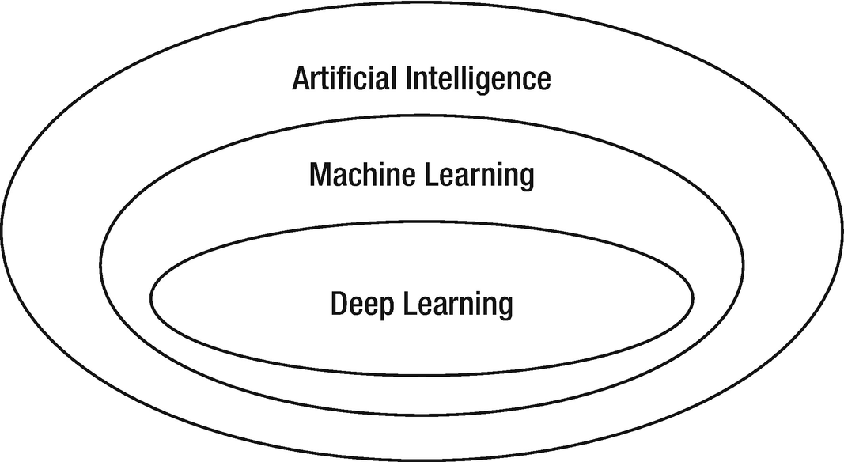
RPA Skills : AI (Artificial Intelligence)
Typical RPA system does not have much AI
AI gets more powerful and accessible, RPA will increasingly start to use this powerful technology
AI is a software that downs large amounts of data that is processed with sophisticated algorithms that help answer questions, detect patterns, or learn.

Slide 55
RPA Skills : AI (Artificial Intelligence)
Machine Learning(ML) : Computer can learn and improve by processing data without having to be explicitly programmed. ML is oldest forms of AI, uses traditional statistical methods like k-nearest neighbor (k-NN) and the naive Bayes classifier
Deep learning is about using so-called neural networks – such as recurrent neural networks (RNNs), convolutional neural networks (CNNs), and generative adversarial networks (GANs) – to find patterns that humans often cannot detect.
NLP (Natural Language Processing): This is AI that helps understand conversations. Some examples are Siri, Cortana, and Alexa

Slide 56
RPA Skills : AI (Artificial Intelligence)
Drawbacks
AI : Data must be cleaned (tedious manual process)
The science fiction movies exposes strong AI or AGI (artificial general intelligence), in which computers act like humans.
Systems can think, engage in conversion, and walk around.
Weak AI : the applications are focused on narrow areas(like predict weather or mining insights about customers).

Slide 57
RPA Skills : AI (Artificial Intelligence)
Major issues
Bias : According to IBM: “Bad data can contain implicit racial, gender, or ideological biases”. Many AI systems will continue to be trained using bad data, making an ongoing problem
Causation: Humans have a strong grasp of this (hammer to hit a glass)
Common Sense: Human does not have to process many cases to understand certain rules (AI problem with ambiguity and the lack of useful data for infinite use cases)
Black Box : Deep learning can have an enormous number of layers and parameters. Nearly impossible for a person to understand why the model is generating certain results.

Slide 58
RPA Skills : AI (Artificial Intelligence)
Major issues
Comprehension : AI system cannot truly understand what it is reading or observing
Static: Deep learning has been mostly useful with constrained environments, such as with board games. There is a defined set of dimensions, objects, and rules (the real world is much more dynamic, open-ended, and chaotic.)
Conceptual Thinking: AI cannot understand abstract ideas like justice, misery, or happiness. Lack of imagination and creativity
Brain: A typical brain has 86 billion neurons and trillions of synapses. It only needs 50 watts a day to run.

Slide 59
RPA Skills : AI (Artificial Intelligence)
AI and RPA
two main types of data:
Structured Data : formatted (social security numbers, addresses, etc.) that can be stored in a relational database or spreadsheet.
Unstructured Data : Unformatted (images, videos, voicemails, PDFs, e-mails, and audio files).
RPA uses structured data (30% of what’s available in a typical organization)
with AI, an RPA system will be more effective, able to process unstructured data
Benefits: judgement, the use of reasoning, and the detection of highly complex patterns

Slide 60
RPA Skills : Cognitive Automation
Pre-trained to automate specific business processes and needs less data
It’s often confused with AI
Cognitive automation to be an application of AI
Focused on automation of the workplace or processes in business.
Uses technologies like speech recognition and NLP.
Something else: Unlike other forms of AI, cognitive automation is usually effective with the use of much less data

Slide 61
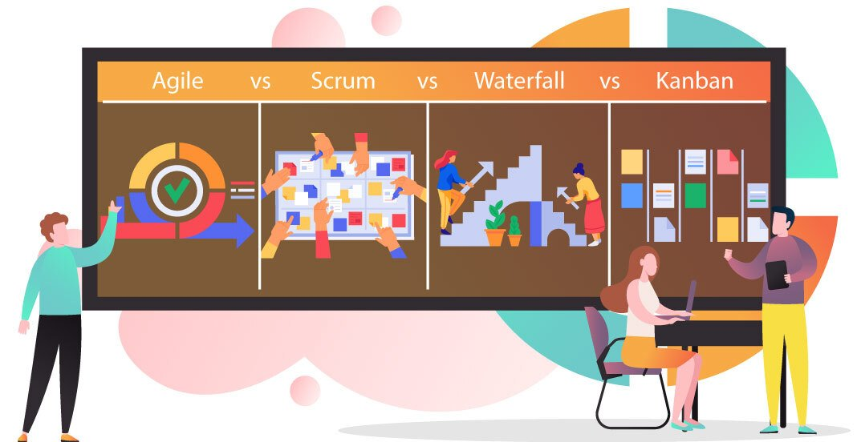
RPA Skills : Agile, Scrum, Kanban, and Waterfall

Slide 62
RPA Skills : Agile, Scrum, Kanban, and Waterfall
Waterfall works best for projects completed in a linear fashion and does not allow going back to a prior phase.
Agile focuses on adaptive, simultaneous workflows. Agile methods break projects into smaller, iterative periods.
Kanban is primarily concerned with process improvements.
Scrum is concerned with getting more work done faster.

Slide 63
RPA Skills : Agile, Scrum, Kanban, and Waterfall
Software development become more difficult due to emergence of new platforms like the cloud and the hybrid cloud
Agile was created back in the 1990s. Agile focus on incremental and iterative development, which begins with a detailed plan. This requires much communication across the teams and should involve people from the business side of the organization.
Agile has gotten easier because of the emergence of sophisticated technologies like Slack and Zoom that help with collaboration

Slide 64
RPA Skills : Agile, Scrum, Kanban, and Waterfall
Scrum: It is a subset of Agile. But the iterations are done as quick sprints, which may last a week or two. This can help with the momentum of a project but also make a larger project more manageable
Kanban: Japanese word for visual sign or card. With Kanban, there is the use of visuals to help streamline the process. It is like Agile as there is iterative development.
Waterfall: Traditional code development model(1970s). This model is using a structured plan that goes over each step in much detail. It can be tough to make changes, the process can be tedious, and there is often a risk of a project being late

Slide 65
RPA Skills : DevOps
DevOps has emerged as a critical part of a company’s digital transformation.
“Dev”: more than just about coding software. complete application process (project management and quality assurance or QA).
“Ops” : which encompasses system engineers and administrators as well as database administrators, network engineers, security experts, and operations staff.
DevOps has come about because of some major trends in IT.
One is the use of agile development approaches.
Realization that organizations need to combine technical and operational staff when introducing new technologies and innovations.
DevOps has proven effective in working with cloud computing environments.

Slide 66
RPA Skills : Flowcharts
Essential part of RPA is understanding workflows and systems
With a flowchart
can both sketch out the existing workflows of a department.
can brainstorm ways of improving them.
can use the flowchart to design a bot for the automation.
Flowchart is relatively simple to use, provides a quick visual way to understand what you are dealing with.
a picture is worth a thousand words.

Slide 67
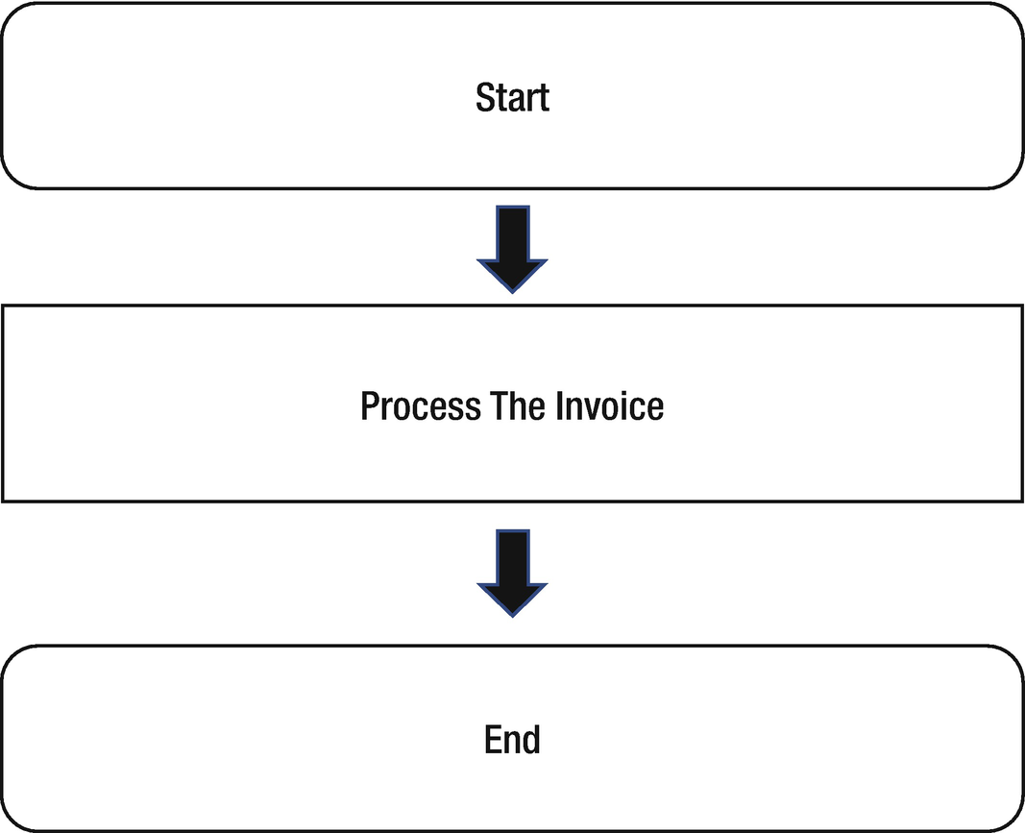
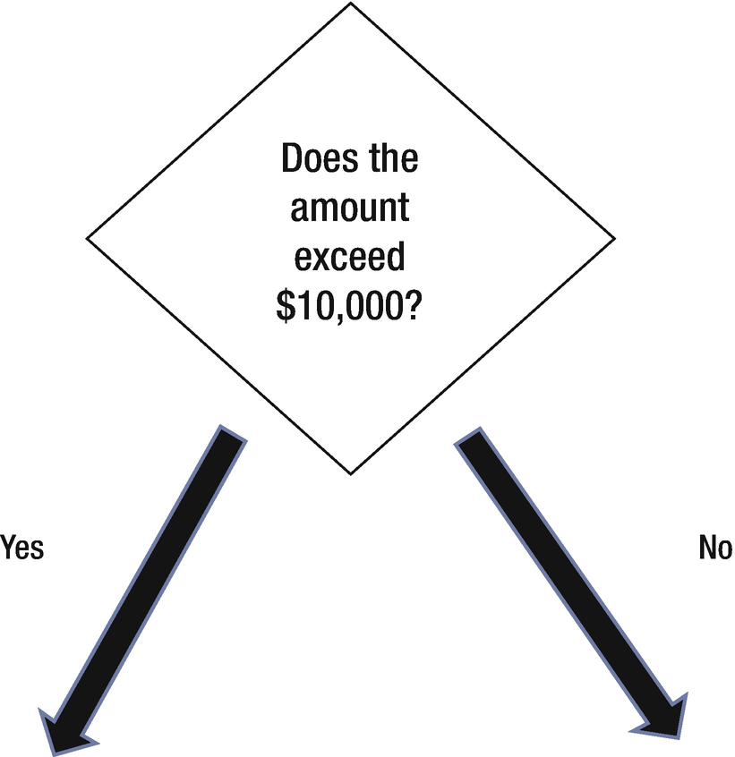
RPA Skills : Flowcharts
Terminator: Rectangle with rounded corners and is used to start and end the process
Process: Rectangle, With this, there is only one next step in the process
Decision: Square symbol that is at an angle. There will be at least two possible paths

Slide 68
Conclusion
On-premise software is where a company installs and maintains its technology within its data center, traditional approach and generally allows for more control, security, and privacy. But on the other hand, on-premise software can be costly, difficult to customize
Cloud computing is software that is accessed via a browser, include lower costs, less maintenance, and seamless upgrades, risks with security and reliability
Public cloud, private cloud, the hybrid cloud
web technologies – allows for the creation of web pages – include HTML (Hypertext Markup Language), CSS (allows for creating borders, and animations), and JavaScript

Slide 69
Conclusion
OCR scans and recognizes text. This is crucial for RPA since there is often much processing of documents.
Database is for storing information. Common one is relational database, which deals with structured data. But during the past ten years or so, there has emerged new types like NoSQL. They tend to work better with Big Data environments.
API is software that connects two applications. This system can provide for automation. AI is about processing huge amounts of data to detect patterns and find insights. AI encompasses many categories like deep learning, Machine Learning (ML), and Natural Language Processing (NLP).

