Slide 1
Competency Grading of Language Model
Rithika Harish Kumar rihk@kth.se
Rickard Kodet kodet@kth.se
Suhas Sheshadri suhass@kth.se
Jussi Karlgren
jussi@gavagai.se

Slide 2
Introduction
Language models - give context to words
Several models, trained on huge data and perform project specific operations
Difficult to know if the extracted information from a model is of any value
No idea on knowledge level of the trained model
Use case scenario
Try to propose a score for the model, for a particular topic

Slide 3
Overview
Background
Methods
Results
Discussion
Future Work
Notes:
Firstly in the background we will see about the various word space models. And few word categories intuitively designed to validate. Then we talk about the various metrics by which we intend to find ways to measure the knowledge of a model, given some topic of interest. In the results section, possible ways are shown to differentiate a expert from the novice. And finally we conclude it with discussion and future work.

Slide 4
BACKGROUND

Slide 5
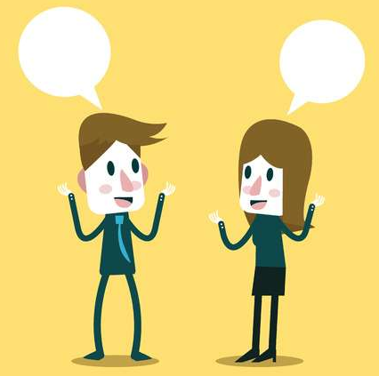
Intuition - Grade model similar to humans
. .
Person 1: That’s great. Have you won any? If yes, whats the secret behind your success? Person 2: Yes, I have won three of them. Mastering the strokes, footwork and of course complete control of the shuttlecock, especially dribbling at the net does the trick for me.
.
.

Slide 6

Human - Understands based on Intuition
Computer - Just Sequence of numbers

Slide 7
So, to represent words ...

Slide 8
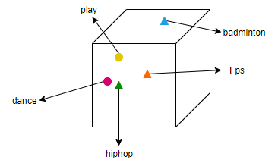
Word Space Models
A word-space model is a spatial representation that derives the meaning of words by plotting these words in an n-dimensional geometric space.
Used for various downstream tasks like information filtering and retrieval, document indexing, relevancy ranking, media monitoring, or text clustering.

Slide 9
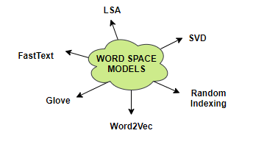
Few Types of Word Space models
Notes:
For our experiment we have used the Word2Vec model.

Slide 10
Now,
How do we infer that the machine is knowledgeable ?
Notes:
Our method will be explained in awhile. Before which let us have a look at the previous work.

Slide 11
Previous Work
Assess the quality of the model by its performance on various evaluation schemes like on some downstream task or by examining the intrinsic qualities of the model.
But these are task independent and not very general and performs good only for that specific model.
BLESS - Analyzing the semantic relations between the words.
Semantic Topology - Converting it to a topological model to test if a model is specifically competent with respect to some topic of interest.

Slide 12
Think..
On how to relate any word with a topic ?

Slide 13
Word Categories
Topic specific word
Only an expert will know it.
Example: Lavani belongs only to dance
Notes:
We have come up with 5 categories to relate a word with a topic.

Slide 14
General word with specific meaning
Novice and expert know it but in different context.
Example: Alley
Space between buildings - Novice
But is specific for Badminton - Expert

Slide 15
Word widely related to specific topic
Novice will have an idea about it but an expert will know more about it.
Example: Shuttlecock
used while playing badminton - novice
has exactly 16 feathers and used to play badminton - expert

Slide 16
Erroneously related words to a topic by novice
Example: basketball - badminton are sport to novice
but expert distinguishes it.

Slide 17
Words that are names
Common words - not very good indicators
Uncommon words- very good indicators of knowledge
Example: Zlatan related to football

Slide 18
Method
Trained a Word2Vec model on Wikipedia dataset
Parameters: 400 dimensions, window size of 5, minimum count of 5
Two models: Expert and Novice
Chose four different topics to run our tests on

Slide 19
Method
Metric method
Word Frequency
Similarity - Distance between vectors
Ranking - Most similar words from a given word
New Word Appearances
New words
Position change

Slide 20
Results
Some examples of the behavior of words in the different categories
Tables with words representing different topics
Metrics to measure difference

Slide 21
Topic specific words
Word | Expert Freq | Novice Freq | Expert Sim | Novice Sim | Expert Rank | Novice Rank
Yonex | 232 | 118 | 0.441 | 0.373 | 25 | 90
CBT | 1326 | 751 | 0.602 | 0.517 | 21 | 69
Dabke | 87 | 53 | 0.452 | 0.385 | 140 | 450

Slide 22
General word with specific meaning
Word | Expert Freq | Novice Freq | Expert Sim | Novice Sim | Expert Rank | Novice Rank
Halo | 9094 | 6296 | 0.243 | 0.183 | 1360 | 7401
Reinforcement | 7731 | 7541 | 0.244 | 0.195 | 7732 | 19723
Rally | 45041 | 44913 | 0.130 | 0.070 | 90136 | 242166

Slide 23
Widely known topic word
Word | Expert Freq | Novice Freq | Expert Sim | Novice Sim | Expert Rank | Novice Rank
Folkdance | 48 | 34 | 0.472 | 0.388 | 92 | 413
Gameplay | 29454 | 27174 | 0.377 | 0.335 | 40 | 90
Antidepressant | 1769 | 1209 | 0.430 | 0.379 | 283 | 660

Slide 24
Erroneously related word
Word | Expert Freq | Novice Freq | Expert Sim | Novice Sim | Expert Rank | Novice Rank
Dodgeball | 555 | 554 | 0.297 | 0.452 | 285 | 32
Gun | 147404 | 146138 | 0.285 | 0.322 | 404 | 118
Freud | 10409 | 9911 | 0.490 | 0.478 | 104 | 89

Slide 25
Word that is a name
Word | Expert Freq | Novice Freq | Expert Sim | Novice Sim | Expert Rank | Novice Rank
Hidayat | 334 | 271 | 0.245 | 0.156 | 1245 | 21764
Carmack | 810 | 559 | 0.287 | 0.208 | 376 | 3234
Saina | 155 | 106 | 0.282 | 0.200 | 412 | 5043

Slide 26
New words in Neighbourhood
Neighbourhood - 200 nearest words
Topic | New words | Position change
Badminton | 103 | 95
Dance | 53 | 143
Psychotherapy | 45 | 148
Shooter | 60 | 135

Slide 27
Discussion
Novice model not novice enough
A single word space model tested
One dataset tested
Hard to filter knowledge

Slide 28
Future work / Reflections
Run the tests on a different dataset
Try with multiple models with different knowledge levels.
Pre-processing the data prior to training

Slide 29
Questions ?

