Slide 1

Final Report
Virtual Internship
30-September-2022

Slide 2
Team Member Details
Name – Suhas Yogeshwara
Email – Suhas.gys1996@gmail.com
Country – Germany
College – SRH University of Applied Sciences Berlin
Specialization – Data Science

Slide 3
Objective
Problem Statement:
One of the challenge for all Pharmaceutical companies is to understand the persistency of drug as per the physician prescription. To solve this problem ABC pharma company approached an analytics company to automate this process of identification.
ML Problem:
With an objective to gather insights on the factors that are impacting the persistency, build a classification for the given dataset.
Target Variable: Persistency Flag

Slide 4
Profit Analysis
Data Exploration
Dataset – Healthcare
Data – 3424 rows x 69 columns
Size – 899 kb
Type – Excel (.csv)
NULL values – N/A
Outliers – N/A
Assumptions:
The race and ethnicity columns are irrelevant to the main objective of the project.
The risk factor to be mainly focused regardless of their Age.

Slide 5
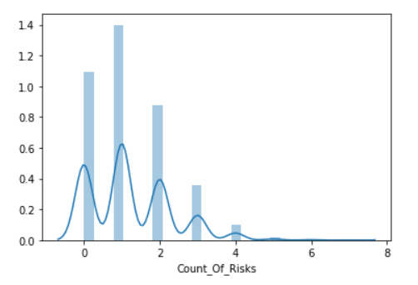
Count of risks

Slide 6
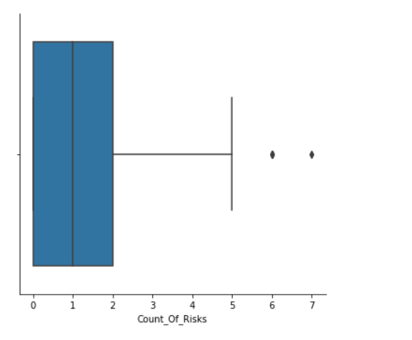
Count of Risks

Slide 7
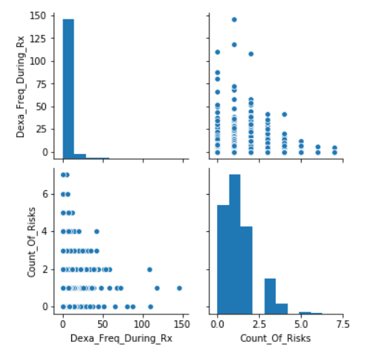
Count of risks

Slide 8
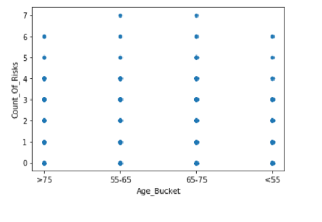
Count of Risks Based on Age Factor

Slide 9
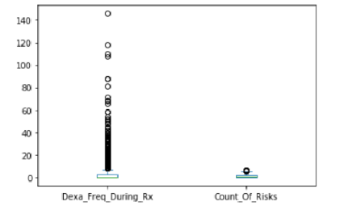
Persistency dependent on Dexa Frequency

Slide 10
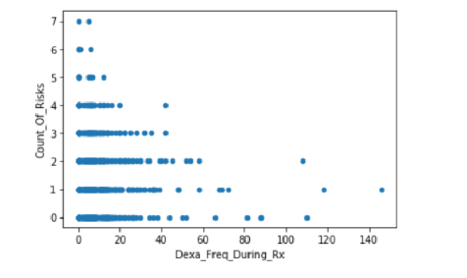
Persistency dependent on Dexa Frequency

Slide 11
Recommendations
The representations shows that the risk counts are very high for the numerical 1 and 2 with the persistency level is not followed as per the doctor prescription.
the other risk factors like sugar, blood pressure also may vary and would lead to major health problem.
Persistency is dependent on the dexa_frequency factor and with the older once have a higher risks if medication is not followed.
Linear Model would the increase of risk factor based on Dexa_Frequency.

Slide 12
Thank You

