Slide 1

EDA Presentation
Virtual Internship
16-September-2021

Slide 2
Team Member Details
Name – Suhas Yogeshwara
Email – Suhas.gys1996@gmail.com
Country – Germany
College – SRH University of Applied Sciences Berlin
Specialization – Data Science

Slide 3
Objective
Problem Statement:
One of the challenge for all Pharmaceutical companies is to understand the persistency of drug as per the physician prescription. To solve this problem ABC pharma company approached an analytics company to automate this process of identification.
ML Problem:
With an objective to gather insights on the factors that are impacting the persistency, build a classification for the given dataset.
Target Variable: Persistency Flag

Slide 4
Profit Analysis
Data Exploration
Dataset – Heathcare
Data – 3424 rows x 69 columns
Size – 899 kb
Type – Excel (.csv)
NULL values – N/A
Outliers – N/A
Assumptions:
The race and ethnicity columns are irrelevant to the main objective of the project.
The risk factor to be mainly focused regardless of their Age.

Slide 5
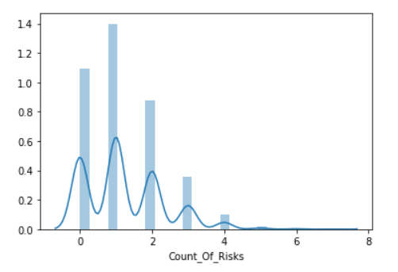
Count of risks

Slide 6
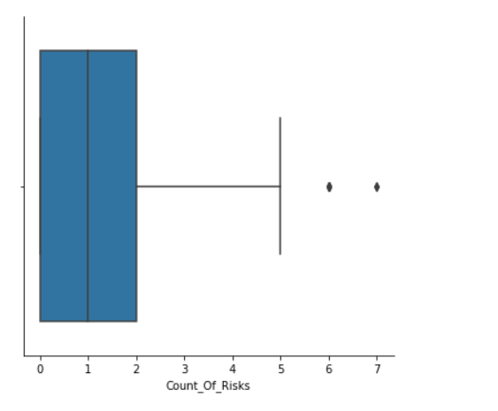
Count of Risks

Slide 7
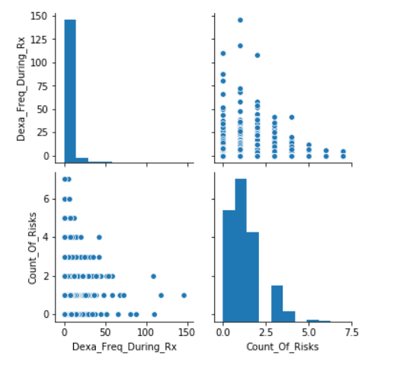
Count of risks

Slide 8
Recommendations
The representations shows that the risk counts are very high for the numerical 1 and 2 with the persistency level is not followed as per the doctor prescription.
the other risk factors like sugar, blood pressure also may vary and would lead to major health problem.
Logistic Regression Model is recommended for the problem as the solution requires only Persistent or non-persistent.

Slide 9
Thank You

