Slide 1
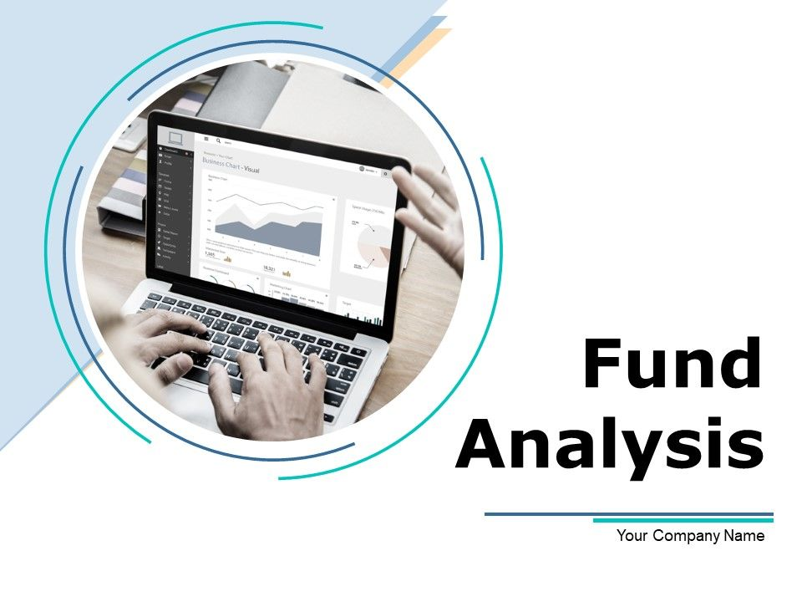
Suhas Prasanna Murthy

Slide 2
Use Case :
Generate a price reconciliation report that shows difference between the price on EOM date from the reference date vs the price in the fund report .
Create a view which gives a report as to which was the best performing fund for equities every month and the cumulative profit and loss for that fund for equities.
Assumption :
Assume that the Reference data is already available in the DB.
Developer updates the necessary details into the yaml file , predefines the DB table structure to load the data from the files .
File format , separator & date in the filename doesn’t change , if we get a format which is different from the current files , process will throw an exception and exit.
Number of columns , position of the columns , name of the columns in the data doesn’t change dynamically. If these change process will throw an exception.
A cleanup job cleans up the files after successful processing of the data into the DB

Slide 3
Implementation
Install the required python packages from requirement.txt
The main script performs the following functions
Creates a DB connection (Postgres)
Create a table based on the DDL provided in the yaml file if the table is not present in DB.
Read the files from a source location and load into the database table .
Schema check is performed . Date , Fund name and Filename is extracted by parsing .
Main script call the modules to refresh the View from the yaml file.
Recon report and the Funds report which are created as view are extracted into csv files from the program and stored into a location defined in config.yaml file.
GitHub link for the code :
https://github.com/Suhasp02/DE_Assesment.git

Slide 4
Implementation
Database view scripts are written after the analysis and the same is saved in view_scripts in the Git repo.
TestScriptFunctions.py has test cases written to test the DB connection , different funds loaded , splitting of the file names. Due to time constraint currently it is not done by following best coding practices(Parameterization) and covers only minimal test cases due to time constraint

Slide 5
Orchestration Recommendation :Airflow
Why Use Airflow for Python Orchestration?
Scheduling: Schedule Python scripts to run at specific times or intervals.
Workflow Management: Define dependencies between tasks for complex workflows.
Scalability: Manage and scale large workflows efficiently.
Monitoring and Logging: Monitor workflow progress and access logs for debugging.
User Interface: User-friendly interface for workflow management and visualization.

Slide 6
Opportunities for Further Enhancement/Improvements
A cleanup job cleans up the files after successful processing of the data into the DB
Dynamic handling of schema evolution .
Creation of the UDF to handle any possible date formats.
Containerization of the solution and implement it on Docker etc.
More test cases and scenarios can be included in testing, currently it is not done by following best coding practices(Parameterization) and covers only minimal test cases due to time constraint .
The reporting views can be exposed to any BI solution to create visualizations .
Apache Airflow can be used orchestration of the process.

