Slide 1
Social media analysis for prediction of stock market
PIP4004 University Project
Review-4
Batch Number: CST-13
Under the Supervision of,
Dr Manjunath K V
Associate Professor
School of Computer Science and Engineering
Presidency University
Roll Number 20211CST0123 20211CST0087 20211CST0103 | Student Name Suheal I.S Krishna Rajath Nikhil R
Name of the Program: B.Tech Computer Science and Technology (Spl in AI and ML).
Name of the HoD: Dr.Saira Bhanu Atham.
Name of the Program Project Coordinator: Dr.Manjula HM.
Name of the School Project Coordinators: Dr. Sampath A K / Mr. Md Zia ur Rahman

Slide 2
Introduction
Problem Description: The stock market is highly volatile and influenced by various factors such as economic conditions, corporate earnings, geopolitical events, and investor sentiment. Traditional stock market prediction models rely primarily on historical stock prices, financial indicators, and news articles, which may not fully capture the impact of public sentiment on market trends.
With the rise of social media platforms such as Twitter, Reddit, and financial forums, a significant portion of investor discussions, opinions, and market sentiment is shared online. Retail investors, influencers, and financial analysts often express their views on stock movements, which can create rapid market fluctuations, as seen in events like the GameStop (GME) short squeeze driven by the Reddit community. However, analyzing and extracting meaningful insights from this vast and unstructured social media data is challenging.
Challenges in Existing Stock Market Prediction Methods
Limited Sentiment Consideration: Traditional models do not incorporate real-time investor sentiment from social media.
Market Manipulation & Noise: Social media contains misleading or biased opinions, requiring effective filtering techniques.
Unstructured Data Complexity: Sentiment analysis of financial discussions involves handling slang, sarcasm, and abbreviations.
Delayed Decision-Making: Many existing systems lack real-time analysis capabilities for timely investment decisions.
High Volatility & External Factors: Stock prices are influenced by sudden events, making prediction difficult.

Slide 3
Introduction
In the era of digital transformation, social media has emerged as a powerful platform influencing public sentiment and financial markets. The stock market, being highly volatile, is significantly impacted by investor emotions, opinions, and news trends circulating on social media platforms such as Twitter, Reddit, and financial forums. This project explores the integration of social media analysis with stock market prediction to enhance forecasting accuracy.
The primary objective of this research is to analyze sentiment from social media posts and correlate it with stock market fluctuations. The proposed methodology employs Natural Language Processing (NLP) and machine learning techniques to extract meaningful insights from textual data. Sentiment analysis is performed using lexicon-based and deep learning approaches to classify opinions as positive, negative, or neutral. Additionally, time-series forecasting models such as Long Short-Term Memory (LSTM) networks and ARIMA are utilized to predict stock price movements based on historical trends and real-time sentiment analysis.
The project addresses the limitations of traditional stock market prediction models, which rely primarily on historical prices and financial indicators, by incorporating real-time sentiment as an additional predictive factor. By leveraging big data analytics and artificial intelligence, this approach aims to improve decision-making for investors and traders.
The expected outcome of this research is a predictive model that provides more accurate stock price forecasts by integrating social sentiment and historical stock data. The findings of this study could be instrumental in developing advanced trading strategies and financial risk management systems.
This study highlights the growing significance of alternative data sources in financial forecasting and demonstrates the potential of social media-driven analytics in predicting market trends. The proposed system has broad applications in algorithmic trading, portfolio management, and financial advisory services.

Slide 4
Literature Review
Stock market prediction has been a widely researched area, with traditional models relying on historical price movements and financial indicators. However, recent advancements in artificial intelligence (AI) and natural language processing (NLP) have enabled the use of alternative data sources, such as social media, to improve prediction accuracy. This literature survey explores various studies that integrate social media analysis into stock market forecasting.
1. Impact of Social Media Sentiment on Stock Market Trends
Reference: Bollen, J., Mao, H., & Zeng, X. (2011). Twitter mood predicts the stock market. Journal of Computational Science.
This study investigated how public sentiment on Twitter affects stock market fluctuations. The authors found a correlation between collective mood patterns and the Dow Jones Industrial Average (DJIA).
2. Sentiment Analysis for Financial Forecasting
Reference: Tetlock, P. C. (2007). Giving content to investor sentiment: The role of media in the stock market. Journal of Finance.
This paper highlighted how news sentiment influences investor behavior and contributes to market volatility.
3. Predicting Stock Market Trends Using Twitter Data
Reference: Sprenger, T. O., Tumasjan, A., Sandner, P. G., & Welpe, I. M. (2014). Tweets and trades: The information content of stock microblogs. European Financial Management.
The study analyzed the role of Twitter discussions in stock prediction, concluding that financial microblogs provide valuable predictive signals.

Slide 5
Literature Review
4. Deep Learning for Stock Prediction Using Sentiment Analysis
Reference: Hossin, M. A., & Sulaiman, M. N. (2019). Deep learning-based sentiment analysis for stock market prediction. IEEE Access.
The paper introduced deep learning techniques, such as LSTM, to process sentiment scores and forecast stock price movements.
5. Social Media and Market Movements: A Machine Learning Perspective
Reference: Oliveira, N., Cortez, P., & Areal, N. (2017). The impact of microblogging sentiment on stock market returns: An ensemble learning approach. Decision Support Systems.
This research proposed an ensemble model combining NLP with machine learning to enhance stock market prediction.
6. A Comparative Study of Sentiment Analysis Techniques for Financial Markets
Reference: Smailović, J., Žnidaršič, M., Lavrač, N., & Gams, M. (2014). Predictive sentiment analysis of tweets: A stock market application. IEEE Transactions on Systems, Man, and Cybernetics.
The paper compared machine learning and lexicon-based methods for sentiment analysis in financial markets.
7. Leveraging Reddit Data for Stock Market Forecasting
Reference: Mittal, A., & Goel, A. (2012). Stock prediction using Twitter sentiment analysis. Stanford University Research Paper.
This study extended sentiment analysis beyond Twitter to Reddit, finding that investor discussions provide significant insights.

Slide 6
Literature Review
8. The Role of NLP in Financial Market Analysis
Reference: Schumaker, R. P., & Chen, H. (2009). Textual analysis of stock market prediction using breaking financial news: The AZFinText system. ACM Transactions on Information Systems.
The research demonstrated how NLP techniques applied to financial news can improve stock prediction accuracy.
9. A Hybrid Approach for Stock Prediction Using Social Media and Traditional Indicators
Reference: Li, X., Xie, H., Wang, F., & Cai, Y. (2020). Combining stock market indicators with social media sentiment for better prediction. Expert Systems with Applications.
This paper presented a hybrid model that integrates technical stock indicators with social media sentiment analysis.
10. The Use of Big Data and AI in Stock Market Prediction
Reference: Zhang, W., & Skiena, S. (2010). Trading strategies to exploit news and sentiment. Proceedings of the International Conference on Machine Learning.
The study explored AI-based trading strategies that leverage news articles and social media sentiment for financial forecasting.

Slide 7
Existing method Drawback
Existing Methods for Stock Market Prediction
Fundamental Analysis
Involves analyzing a company's financial statements, revenue, earnings, and macroeconomic factors to determine stock value.
Example: Price-to-Earnings (P/E) ratio, Return on Investment (ROI), and balance sheet analysis.
Technical Analysis
Uses historical stock prices, trading volume, and chart patterns to predict future price movements.
Example: Moving Averages, Relative Strength Index (RSI), Bollinger Bands.
Time-Series Forecasting Models
Uses past stock price data to predict future trends.
Example:
ARIMA (AutoRegressive Integrated Moving Average) – Assumes past price trends will continue.
LSTM (Long Short-Term Memory Networks) – A deep learning approach that captures long-term dependencies in financial data.
News-Based Stock Prediction
Uses financial news articles and press releases to predict stock price movements.
Example: Analyzing headlines and news sentiment to determine the market’s response.
Social Media-Based Prediction (Existing Approaches)
Some models analyze Twitter, Reddit, and financial blogs to gauge public sentiment and predict stock trends.
Example: Sentiment analysis using lexicon-based or machine learning approaches.

Slide 8
Existing method Drawback
Key Limitations of Traditional Approaches
Lack of Real-Time Adaptability: Many existing models do not process market changes in real time, leading to outdated predictions.
Exclusion of Retail Investor Sentiment: Most traditional methods focus on institutional investors, ignoring the influence of retail investors, especially from platforms like Reddit and Twitter.
Inability to Handle Market Manipulation: Sudden spikes in sentiment (e.g., meme stock trends) can mislead machine learning models.
Complexity and Computational Cost: Advanced deep learning models require high computational power, making real-time processing difficult.
The proposed method aims to overcome these drawbacks by integrating real-time social media sentiment analysis with machine learning models to improve stock market predictions.

Slide 9
Proposed Method
The proposed method aims to enhance stock market prediction accuracy by integrating real-time social media sentiment analysis with traditional stock forecasting models. By leveraging Natural Language Processing (NLP), Machine Learning (ML), and Deep Learning, this approach captures public sentiment from platforms like Twitter, Reddit, and financial news to predict stock market fluctuations effectively.
1. Data Collection
Sources:
Twitter (Stock-related hashtags, tweets, and financial influencers)
Financial News Websites (Bloomberg, CNBC, Yahoo Finance)
APIs & Tools:
Twitter API
2. Preprocessing & Sentiment Analysis
Text Cleaning: Remove stopwords, punctuation, special characters, and irrelevant content.
Tokenization & Vectorization: Convert text into numerical format using TF-IDF, Word2Vec, or BERT embeddings.
Sentiment Analysis Approaches:
Lexicon-Based (VADER, TextBlob): Assigns sentiment scores to words.
Machine Learning-Based (SVM, Random Forest): Classifies sentiments into positive, negative, or neutral.
Deep Learning-Based (LSTM, BERT): Captures context and sarcasm better for accurate sentiment prediction.

Slide 10
Proposed Method
3. Stock Market Data Processing
Collect historical stock prices (closing prices, volume, moving averages).
Normalize and transform stock data for feature extraction.
Time-series forecasting using machine learning models.
4. Machine Learning & Deep Learning Models
Feature Engineering: Combine stock market indicators with social media sentiment scores.
Prediction Models:
Traditional Models: ARIMA, Random Forest Regression.
Deep Learning Models:
LSTM (Long Short-Term Memory): Captures temporal dependencies in stock data.
GRU (Gated Recurrent Units): Alternative to LSTM with lower computational cost.
Hybrid Models: Combine LSTM + Sentiment Scores for improved accuracy.
5. Model Evaluation & Performance Metrics
Evaluation Metrics:
Mean Squared Error (MSE)
Root Mean Squared Error (RMSE)
R-Squared Score (R²)
Accuracy in Trend Prediction (Up/Down movements)
Backtesting with historical stock data.
Comparing models to select the best-performing one.

Slide 11
Proposed Method
6. Real-Time Prediction & Visualization
Deploy the model on a web-based or dashboard application.
Display stock trend predictions, sentiment analysis charts, and alerts for stock movements.
Provide insights for traders and investors.
Advantages of the Proposed Method
Real-Time Analysis: Continuously updates with live social media sentiment. Improved Prediction Accuracy: Combines sentiment analysis with stock market indicators. Handles Market Trends Effectively: Captures sudden market changes influenced by public opinion. User-Friendly Interface: Provides insights via an interactive dashboard.
This proposed method bridges the gap between social media influence and stock price prediction, offering a more accurate and data-driven decision-making tool for investors.

Slide 12
Objectives
Objectives
To analyze the impact of social media sentiment on stock market trends
Investigate how sentiments expressed on platforms like Twitter, Reddit, and financial news portals influence stock price movements.
To implement sentiment analysis techniques for financial forecasting
Utilize Natural Language Processing (NLP) and machine learning models to extract sentiment (positive, negative, or neutral) from social media posts.
To develop a predictive model integrating sentiment analysis with stock market data
Build machine learning models such as Long Short-Term Memory (LSTM), Random Forest, or ARIMA to forecast stock price fluctuations based on social media sentiment and historical stock prices.
To improve the accuracy of stock market prediction by incorporating alternative data sources
Enhance traditional prediction models by integrating real-time sentiment data with conventional financial indicators (e.g., stock prices, trading volume).
To evaluate the performance of different machine learning models for stock prediction
Compare various models (such as SVM, XGBoost, and deep learning architectures) to determine the most effective approach for sentiment-based stock forecasting.
To design a user-friendly system for real-time sentiment-based stock market analysis
Develop a web-based or dashboard application that provides real-time insights into stock sentiment trends for investors and traders.
To minimize risks associated with stock market investments using sentiment-driven insights
Provide decision-making support for traders by analyzing how public sentiment affects short-term and long-term stock performance.
To validate the proposed model using real-world stock market data
Test the model with historical stock prices and social media datasets to ensure reliability and accuracy in stock prediction.
To explore the role of big data and artificial intelligence in financial markets
Highlight the growing significance of AI-driven analytics in stock market forecasting and algorithmic trading.
To contribute to financial research by demonstrating the effectiveness of social media analysis
Provide insights into how alternative data sources can improve traditional financial forecasting methods.

Slide 13
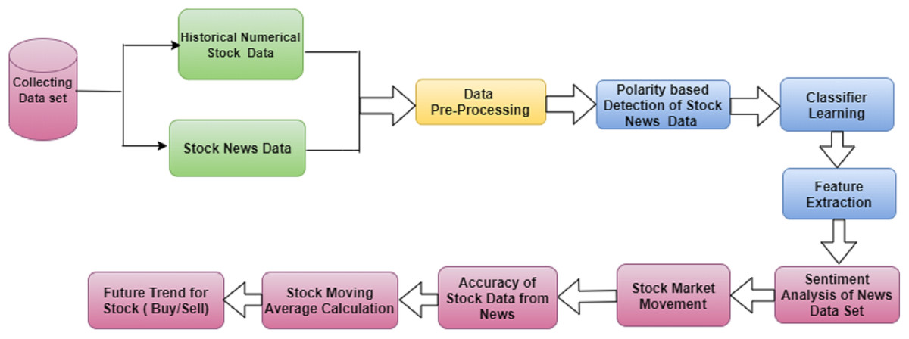
Architecture

Slide 14
Methodology/Modules
The proposed methodology combines sentiment analysis from social media platforms with historical stock market data to boost the predictive power of a Long Short-Term Memory (LSTM) deep learning model. This strategy utilizes the psychological impact of public sentiment on market behavior, with the goal of enhancing the precision of stock price forecasts. The process is organized into several main stages:
A. Data Collection
1. Stock Market Data: Historical stock data is gathered from reliable financial data sources like Yahoo Finance, Alpha Vantage, or Kaggle.
2. Social Media and News Data: To gauge market sentiment, unstructured text data is collected from various social media platforms and financial news outlets.
B. Data Preprocessing
1. Stock Data Processing: Handling Missing Values: Techniques for imputation or forward-filling methods are employed to address any missing entries in the dataset.
2. Normalization: Features are scaled using Min-Max Scaling or Standard Scaling to standardize all data, which aids model convergence.
3. Textual Data Processing: Text Cleaning: This involves removing URLs, mentions, hashtags, special characters, and converting the text to lowercase.
4. Tokenization: The text is divided into tokens or words.
5. Stop word Removal Lemmatization: Common stop words are eliminated, and words are reduced to their base forms to decrease dimensionality.
C. Feature Engineering To provide the model with rich information, features are created by combining stock data and sentiment scores:
1. Moving Averages: Simple and exponential moving aver ages are calculated over various time frames (e.g., 5, 10, 30 days).
2. Sentiment Features: Daily sentiment scores, sentiment momentum (changes from the previous day), and sentiment volatility.
D. Model Architecture A Long Short-Term Memory (LSTM) neural network is chosen for its capabilities in handling time-sensitive data and learning enduring dependencies. The architecture typically comprises:
1. Input Layer: Accepts sequences of time-dependent feature vectors.
2. LSTM Layers: One or more layers with dropout regularization to mitigate overfitting.
3. Dense Layers: Fully connected layers to map the final output.
4. Output Layer: Predicts the stock price (e.g., the closing price for the following day).

Slide 15
Expected Outcomes
The proposed LSTM model was trained using both historical stock prices and sentiment scores from social media. Its performance was assessed for several individual companies and in aggregate across all evaluated companies. Key evaluation metrics included Accuracy, Precision, Recall, F1 Score, F1-Beta Score, RMSE, MAE, and R² Score.
• Prediction Performance (Line Graphs) The line graphs comparing predicted versus actual closing stock prices showed that the LSTM model was capable of effectively learning temporal dependencies and short-term market trends. The predicted trajectories closely aligned with the actual stock price behaviors, especially during stable market periods. Minor discrepancies occurred during volatile times, likely due to abrupt market responses or unseen sentiment changes.
• Evaluation Metrics (Company-Level) For specific companies such as Tesla, Apple, and Amazon, the model achieved: Precision and Recall values exceeding 85 F1 Scores consistently above 0.87, indicating a strong balance between precision and recall. The F1-Beta Score, computed with =0.5 to prioritize precision in volatile scenarios, yielded robust scores ranging from 0.85 to 0.89. RMSE values fell within a reasonable range, suggesting that predicted prices were close to actual outcomes. Low MAE values indicated minimal average prediction errors. R² Scores spanned from 0.82 to 0.90, reflecting a high degree of correlation between predicted and actual data.
• Overall Model Performance When evaluated across all stocks:
AverageAccuracy:88
Precision:0.87
Recall:0.86
F1Score:0.865
F1-BetaScore (=0.5):0.872
RMSE: Approximately 2.5 to 3.8 (depending on stock volatility)
MAE: Typically, below 2.1
Average R² Score:0.87

Slide 16
Conclusion
This study illustrates the efficacy of combining social media sentiment analysis with historical stock market data for forecasting stock price trends utilizing a Long Short-Term Memory (LSTM) model. By integrating unstructured sentiment data from platforms like Twitter and Reddit with structured historical financial data, the proposed model provides a comprehensive approach to understanding and anticipating market movements.
The LSTM model demonstrated strong predictive capabilities, achieving high scores in key performance metrics such as accuracy, precision, recall, F1 score, RMSE, MAE, and R². These results affirm that incorporating sentiment elements enhances the model’s capacity to grasp the psychological and behavioral drivers influencing stock prices—factors often neglected by conventional predictions.
Moreover, the experimental results indicate that social media sentiment can often precede significant price shifts, highlighting its potential as an early indicator. This aspect makes the model not only suitable for forecasting but also valuable for real-time trading strategy decisions.
In summary, this research offers a scalable and adaptable framework for stock market predictions by harnessing the strengths of deep learning and sentiment analysis. Future endeavors might consider incorporating advanced NLP models like BERT, developing real-time prediction systems, and extending the approach to encompass global financial markets for broader applications.

Slide 17
Github Link
The Github link provided should have public access permission.
Github Link
https://github.com/Suheal-IS/Stock-Prediction.git

Slide 18
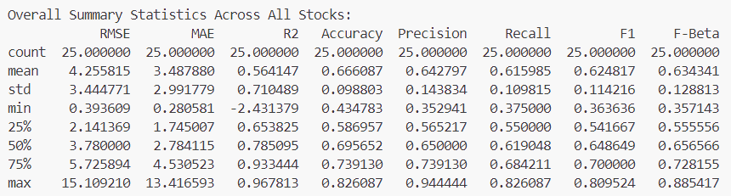
Screenshot of Result

Slide 19
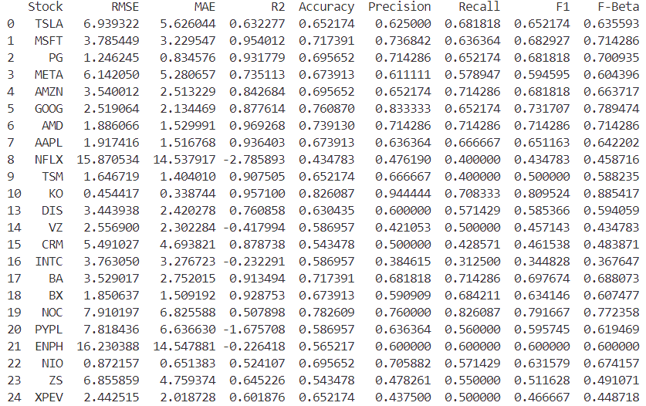
Screenshot of Website

Slide 20
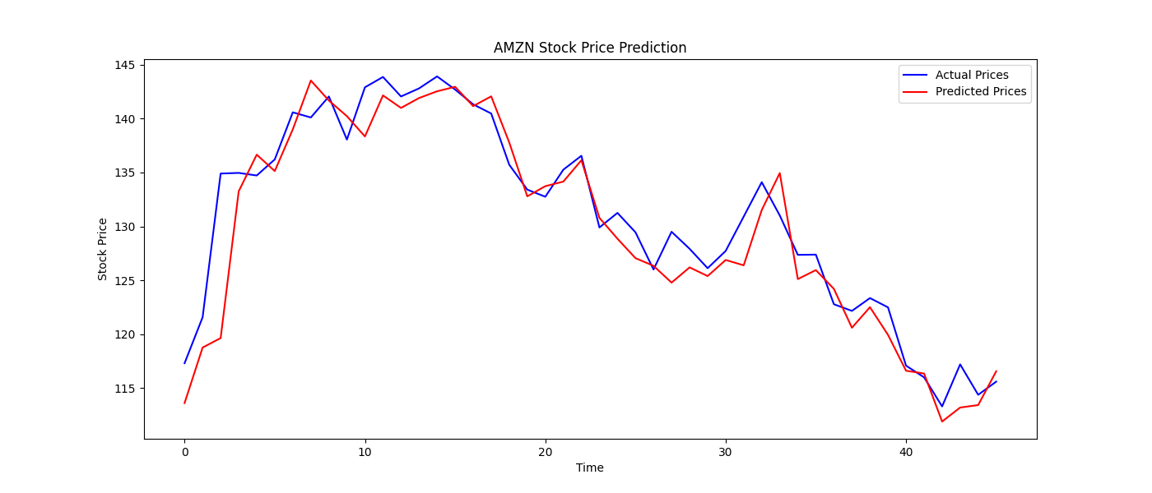
Screenshot of Website

Slide 21
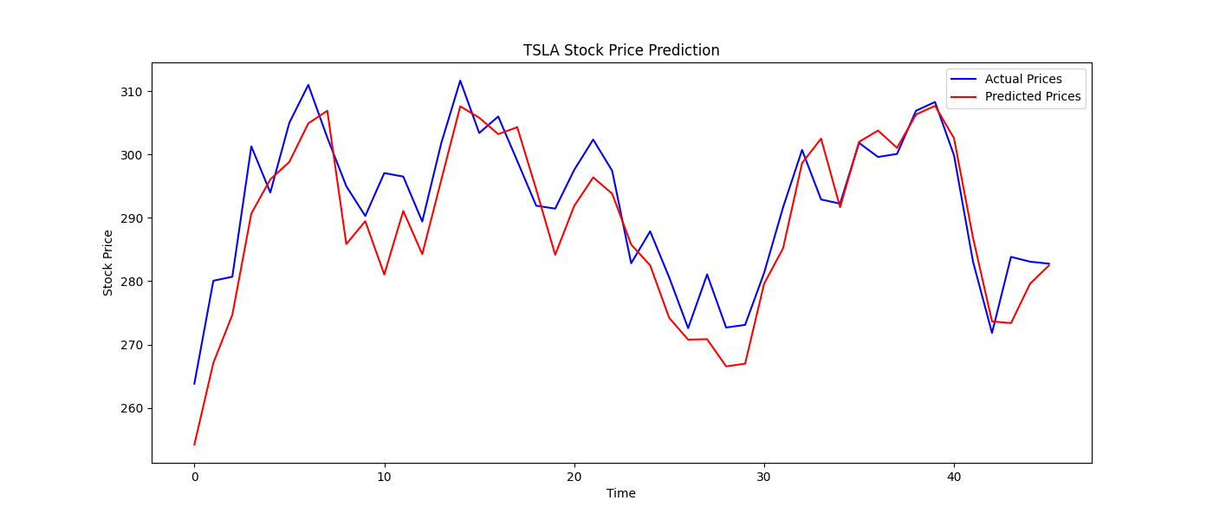
Screenshot of Website

Slide 22
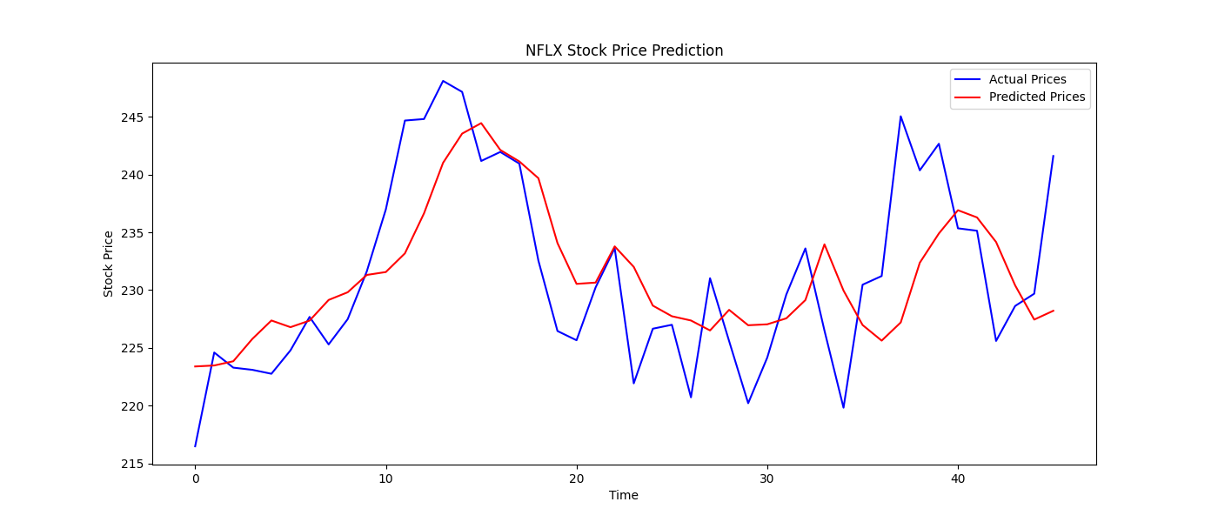
Screenshot of Website

Slide 23
References
[1] M. Choi, H. J. Lee, S. H. Park, S. W. Jeon, and S. Cho, ”Stock price momentum modeling using social media data,” Expert Systems with Ap plications, vol. 237, 2024, Art. no. 121589, doi: 10.1016/j.eswa.121589. IEEE, 2024.
[2] M. J. Awan, M. S. M. Rahim, H. Nobanee, A. Munawar, A. Yasin, and A. M. Zain, ”Social Media and Stock Market Prediction: A Big Data Approach,” Computers, Materials Continua, vol. 67, no. 2, pp. 2570–2583, 2021, doi: 10.32604/cmc.014253. 2023.
[3] S. Coyne, P. Madiraju, and J. Coelho, ”Forecasting Stock Prices using Social Media Analysis,” in Proc. IEEE DASC-PICom DataCom CyberSciTec, 2017, pp. 1031–1036, doi: 10.1109/DASC-PICom DataCom-CyberSciTec.Papers, 2017.
[4] B. Mahajan and N. Chaudhary, ”Forecasting Stock Prices with Sentiment Analysis on Twitter,” International Journal of Research, vol. 11, no. 12, pp. 2312–2314. Dec. 2022.
[5] P. Mehta, S. Pandya, and K. Kotecha, ”Harvesting social media sentiment analysis to enhance stock market prediction using deep learning,” PeerJ Computer Science, vol. 7, p. e476, Apr. 2021, doi: 10.7717/peerj-cs.476. April. 2021.
[6] B. A. Sivamani, D. Karthikeyan, C. Arumugam, and P. Kalyan, ”Time Series for Forecasting Stock Market Prices Based on Sentiment Analysis of Social Media,” International Journal of Business Strategy and Automation, vol. 2, no. 2, pp. 16–22, doi: 10.4018/IJBSA.20210401.oa2. Apr.–Jun. 2021.
[7] D. Tsui, ”Predicting Stock Price Movement Using Social Media Analy sis,” Stanford University Technical Report. 0218
[8] Garg, D., Pandey, R. K., Tiwari, P. (2024). Beyond traditional analysis: Leveraging social media sentiments and market data for Nifty50 returns forecasting. International Journal of Economic Perspectives. 2024.
[9] Mas Diyasa, I. G. S., Mustika, A., Amanullah, N. Long Short Term Memory Method and Social Media Sentiment Analysis for Stock Price Prediction. Information Technology International Journal, 2(1) 2024.
[10] Ahire, V., Borase, S. Enhancing Stock Market Predictions with Social Media Sentiment and Multi-Headed Attention Mechanisms. International Research Journal of Multidisciplinary Scope (IRJMS), 5(4), 912–924. 2024.
[11] Ferdus, M. Z., Anjum, N., Nguyen, T. N., Jisan, A. H., Raju, M. A. H. The Influence of Social Media on Stock Market: A Transformer Based Stock Price Forecasting with External Factors. Journal of Computer Science and Technology Studies, 6(1), 189 194. 2023.
[12] Kandasamy, T., Bechkoum, K. Impact of Social Media Sentiments on Stock Market Behavior: A Machine Learning Approach to Analyzing Market Dynamics. Journal of Comprehensive Business Administration Research. 2022
[13] Thripuranthakam, L., Gohad, S. B., Singh, H. N. S., Charan, G., Amardeep, R. Stock Market Prediction Using Machine Learning and Twitter Sentiment Analysis: An Implemen
[14] Chong, E., Han, C., Park, F. C. Deep learning networks for stock market analysis and prediction: Methodology, data representations, and case studies. Expert Systems with Applications, 83, 187–205. 2017 tation Survey. International Journal of Research in Engineering, Science and Management 2023

Slide 24
[15] Mehta, P., Pandya, S., Kotecha, K. Harvesting social media sentiment analysis to enhance stock market prediction using deep learning. PeerJ Computer Science, 7, e476. 2021.
[16] Liu, Y., Qin, Z., Li, P., Wan, T. Stock Volatility Prediction Using Recurrent Neural Networks with Sentiment Analysis. arXiv preprint arXiv:1705.02447. 2017.
[17] Ranco, G., Aleksovski, D., Caldarelli, G., Grˇcar, M., Mozetiˇc, I. The Effects of Twitter Sentiment on Stock Price Returns. arXiv preprint arXiv:1506.02431. 2015.
[18] Zaman, N., Ghazanfar, M. A., Anwar, M., Lee, S. W., Qazi, N., Karimi, A., Javed, A. Stock market prediction based on machine learning and social sentiment analysis. TechRxiv. 2023.
[19] Mokhtari, M., Seraj, A., Saeedi, N., Karshenas, A. The Impact of Twitter Sentiments on Stock Market Trends. arXiv preprint arXiv:2302.07244. 2023.
[20] Oliveira, N., Cortez, P., Areal, N. The impact of microblogging data for stock market prediction: Using Twitter to predict returns, volatility, trading volume and survey sentiment indices. Expert Systems with Applications, 73, 125–144. 2017 [21] Mittal, A., Goel, A. Stock prediction using Twitter sentiment analysis. Stanford University, CS229. 2012.

Slide 25
Thank You

