Slide 1
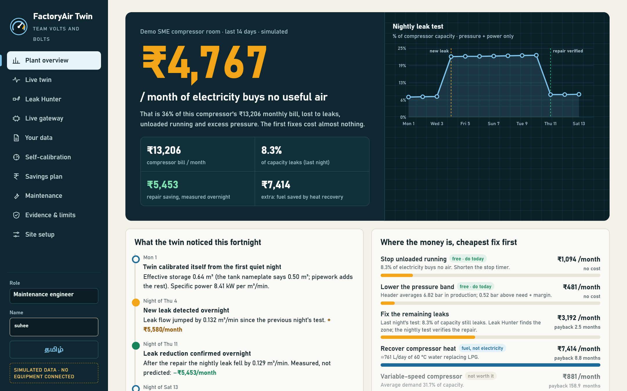




Vishwakarma Application ID
VK26-IITI-AHM-0210
FactoryAir Twin
+
→
→
pressure
power
twin
saving
Team Volts and Bolts
Track: ______________________
Team members: ______________________
Institution: ______________________
Faculty mentor: ______________________
Working software prototype: plant overview
Stage 2 · Design Development · October 2026 · figures from simulation unless marked real data

Slide 2







Small factories pay for compressed air they never use
Leaks hiss away day and night; no meter shows it
20–30%
of compressor output is often lost to leaks
US DOE sourcebook [1]
~10%
of industrial electricity makes compressed air
US DOE sourcebook [1]
compressor
36%
machines
of the demo plant's compressor bill buys no useful air
FactoryAir Twin, simulated
Who suffers: MSME foundries, machine shops, textile and packaging units with one or two 5–30 kW compressors, an owner, one technician and no energy manager.
Core innovation: a nightly load/unload leak test on pressure + power that teaches the twin each plant — no flow meter.
Team ID VK26-IITI-AHM-0210 · Track ______________________
FactoryAir Twin · VK26-IITI-AHM-0210 · Problem context

Slide 3










Today's options are too rare, too costly or brand-locked
Annual leak survey
Inline flow meter
Maker's monitoring
Electricity bill
Once a year. Leaks return in weeks; the repair is never checked.
Pipe cutting and a shutdown. Says how much, not where.
Only that brand's newer machines. Mixed rooms left out.
A month late. Cannot tell production from waste.
FactoryAir Twin
Clip-on, any brand
Tests every night
Finds the zone
Prices it in ₹
Verifies the repair
FactoryAir Twin · VK26-IITI-AHM-0210 · Problem context

Slide 4




Before: one failed coupling costs money for weeks unseen
Thu 14:24
Same day
~30 days
Months
After repair
A hose coupling fails in the assembly bay
Air hisses out; the compressor loads more often
The bill rises; the owner blames an old machine
Maybe the annual survey finds it
Nobody checks the fix held
Quantified inefficiency · demo plant, 14-day twin (simulated)
₹5,580
22.5%
8.3%
~30 days
per month added by the one failed coupling
of compressor capacity leaking on the worst night
of electricity spent running unloaded (₹1,094/month)
before the bill gives the first signal
FactoryAir Twin · VK26-IITI-AHM-0210 · User journey

Slide 5






After: found overnight, located at lunch, verified next night
23:00–05:00
06:00
Lunch break
Same day
Next night
Nightly leak test on pressure + power
Alert: +₹5,580/month
Leak Hunter: Bay 2 = 58%
Ticket, repair done
Saving measured, not promised
1 night
~15 min
new leak
repaired
to detect, vs ~30 days
to locate the zone
₹5,453
₹7,414
repair saving, measured overnight
LPG saved by heat recovery
FactoryAir Twin · VK26-IITI-AHM-0210 · User journey

Slide 6




System block diagram: two signals in, a verified saving out
mA / mV
I²C
Wi-Fi
Sensing
Electronics
Firmware (1 Hz)
Twin software
4–20 mA pressure on the gauge port
Clip-on CT on one phase
Machine-on contact
ADS1115 16-bit ADC
ESP32-S3, Wi-Fi
24 V → 5 V, microSD
mA → bar, CT → kW
Drop invalid frames
Batch → REST / MQTT, SD spool
Validate + sensor health
Rules + ML + self-calibration
Leak Hunter, tickets, report
Read-only by design. No flow meter, nothing cut or shut down, and no output stage: the node physically cannot command the compressor. Everything after the ADC already runs today as the virtual edge node.
FactoryAir Twin · VK26-IITI-AHM-0210 · System architecture

Slide 7
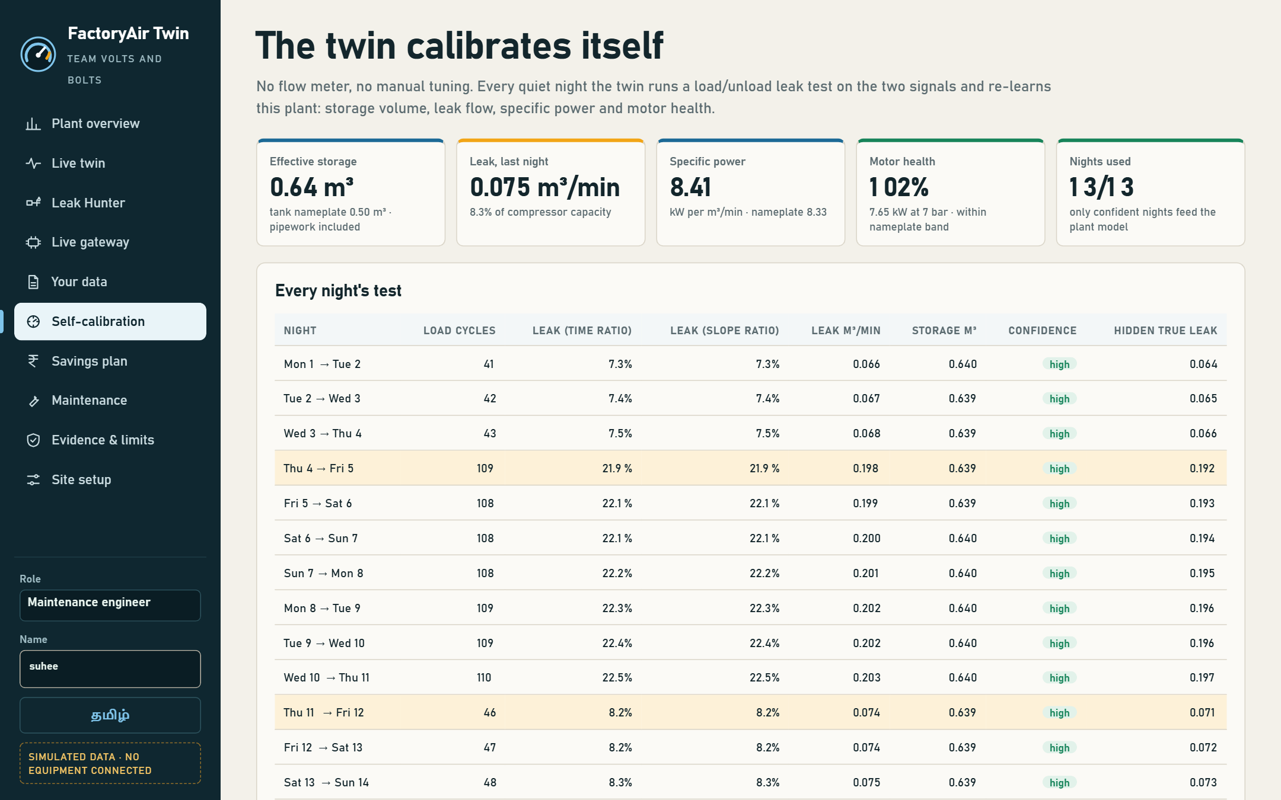

Target specifications and hardware selection
Parameter | Target | Selected hardware / protocol
Sampling | 1 Hz | ESP32-S3 + ADS1115 (860 SPS)
Pressure | 0–16 bar, ±0.5 % FS | 4–20 mA transmitter, 165 Ω shunt
Motor power | 0–30 A RMS | SCT-013-030 split-core CT
Data link | 10-frame batches | Wi-Fi REST; MQTT optional
Buffer | 72 h offline | microSD spool, replay
Enclosure | IP65, DIN rail | PC/ABS box, PG glands
Cost / site | < ₹10,000 | ≈ ₹6,100 indicative
Self-calibration screen: storage, leak and specific power learned from pressure + power
1.8%
30/30
1 night
mean leak error on 30 unseen plants (target ±10%)
plants within ±10% · storage error 1.9%
from a new leak to an alert (14-day twin)
FactoryAir Twin · VK26-IITI-AHM-0210 · System architecture

Slide 8








Mechanical design: a sealed box and a safe pressure tap
Enclosure layout (concept, not CAD)
Enclosure
Pressure fittings
Mounting
PC/ABS IP65
Brass G¼, ≥ 16 bar
Steel DIN rail
24 V PSU
5 V buck
ESP32 + ADC
non-conductive, light, ≈ ₹700
over 2× the 7.4 bar band
on the panel wall, off the vibrating frame
microSD
Stress analysis: no load-bearing part at Stage 2; pressure parts are rated fittings. Stage 3 adds a bracket vibration check.
PG7 glands
Pressure tap (concept)
Gauge port
→
G¼ tee
→
Ball valve
→
Transmitter
ADD: screenshot of the team's enclosure CAD model (isometric + exploded, feature tree visible)
FactoryAir Twin · VK26-IITI-AHM-0210 · CAD & mechanical

Slide 9







Electronics connections and bill of materials
Pressure transmitter
4–20 mA loop
165 Ω shunt
→ ADS1115 A0
Component (qty 1 each) | ≈ ₹
ESP32-S3 DevKitC | 800
ADS1115 ADC module | 350
4–20 mA transmitter 0–16 bar | 1,800
SCT-013-030 CT | 450
Shunt, TVS, fuses | 150
24 V PSU + 5 V buck | 1,100
microSD + 16 GB card | 400
IP65 box, glands, rail | 700
G¼ tee + ball valve | 350
Total (indicative) | 6,100
CT SCT-013-030
30 A : 1 V
ADS1115
A1–A3 differential
Machine-on contact
to GND
ESP32-S3
SDA 8 · SCL 9 · GPIO 7
24 V PSU → 5 V buck
microSD · CS GPIO 10
Wi-Fi → /api/edge/ingest every 10 s; same frames the software emulator sends today
All parts sold by Indian online distributors; confirm prices and lead times with quotes.
FactoryAir Twin · VK26-IITI-AHM-0210 · Electronics & BOM

Slide 10
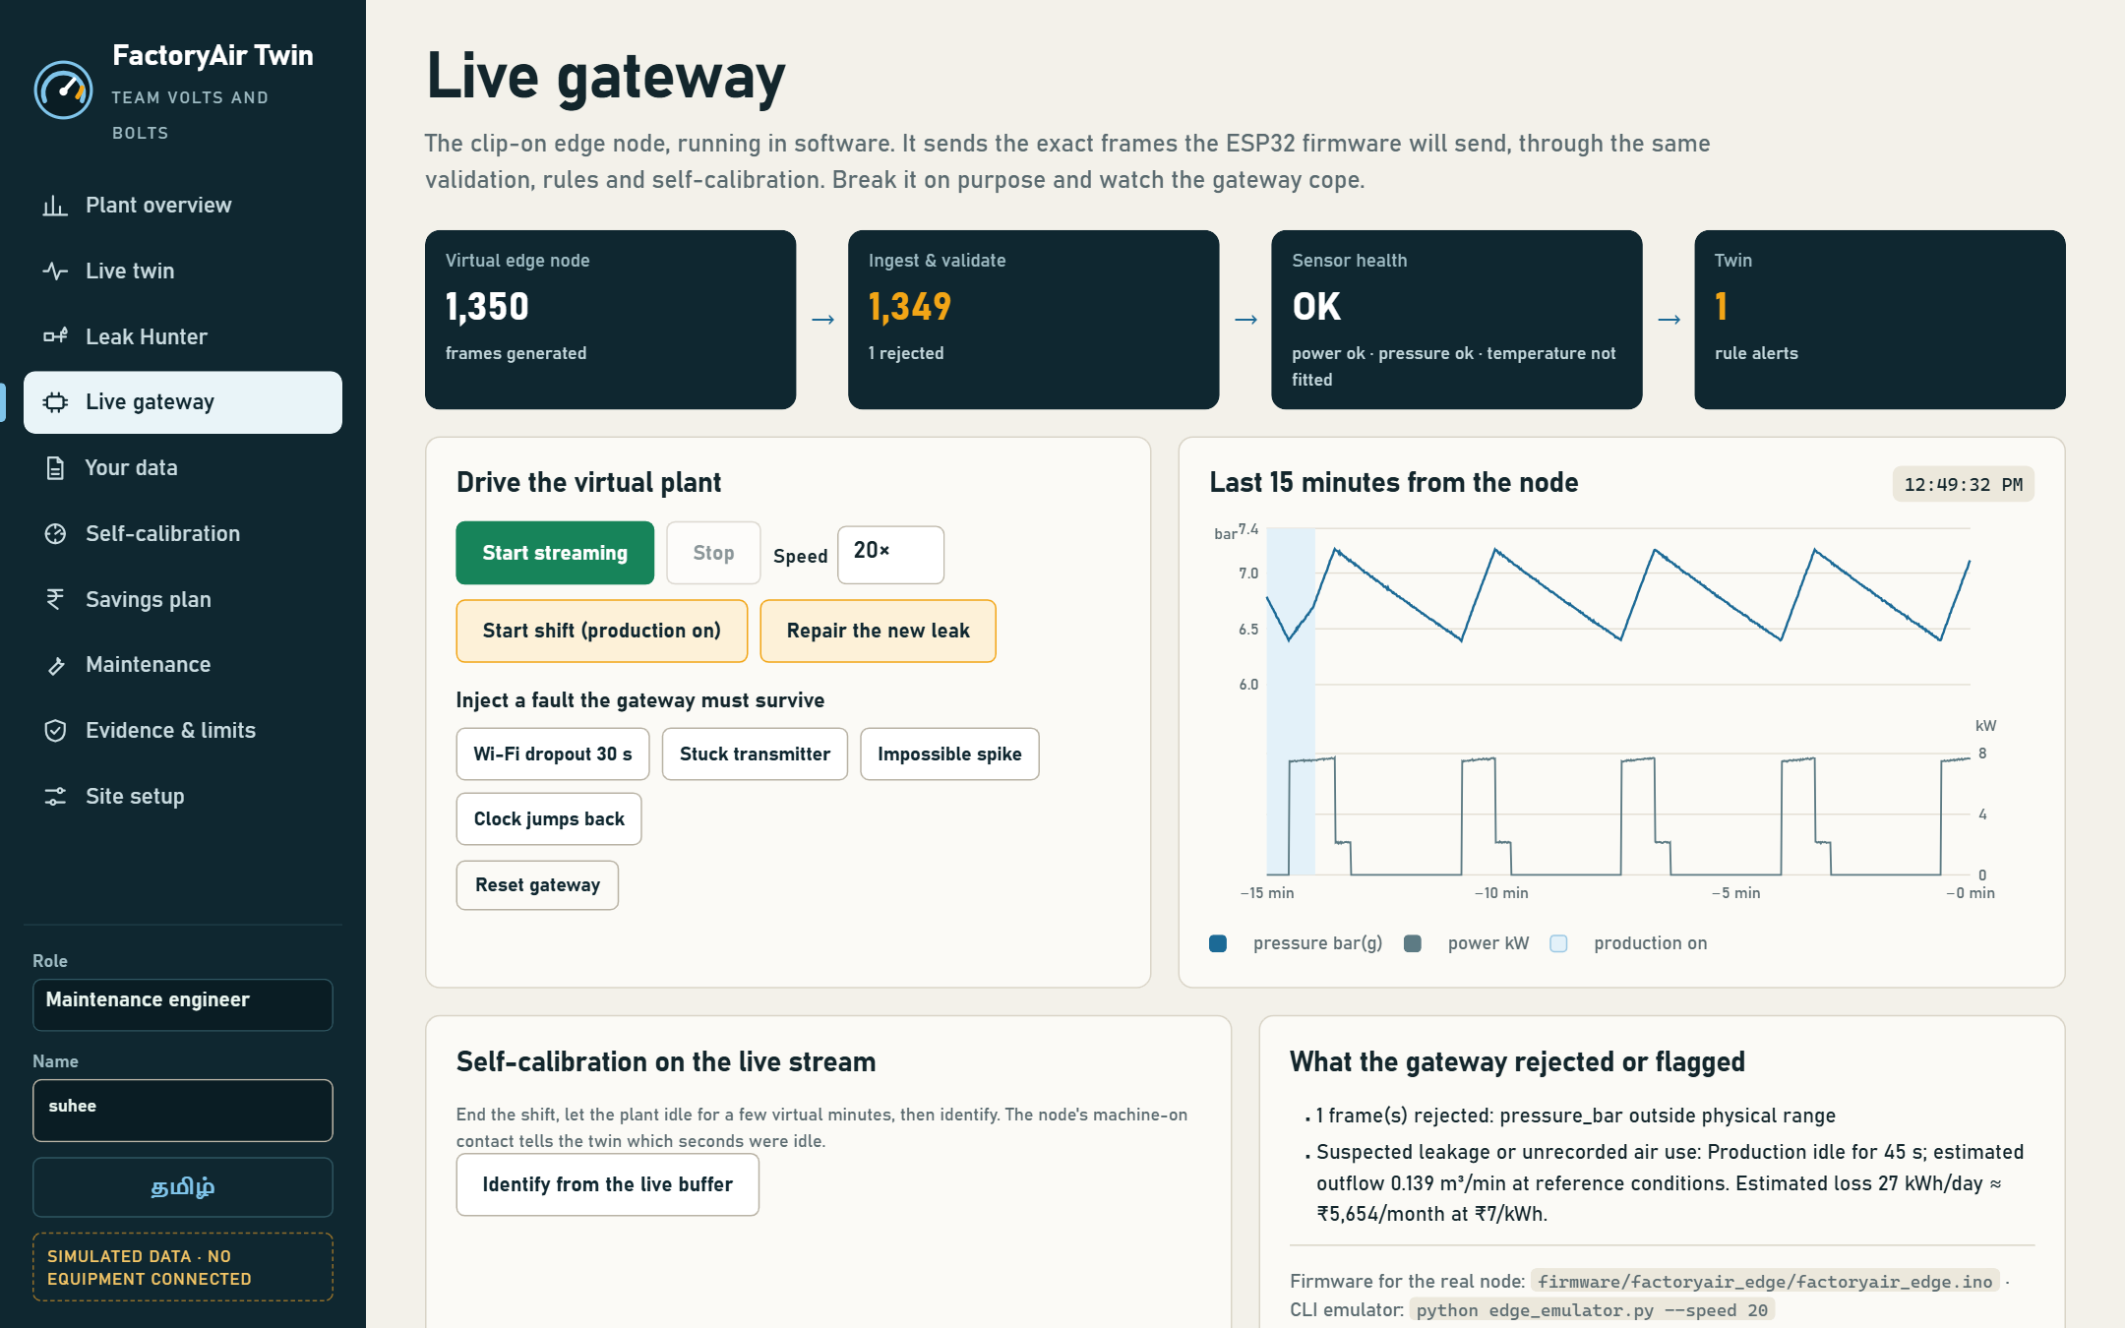
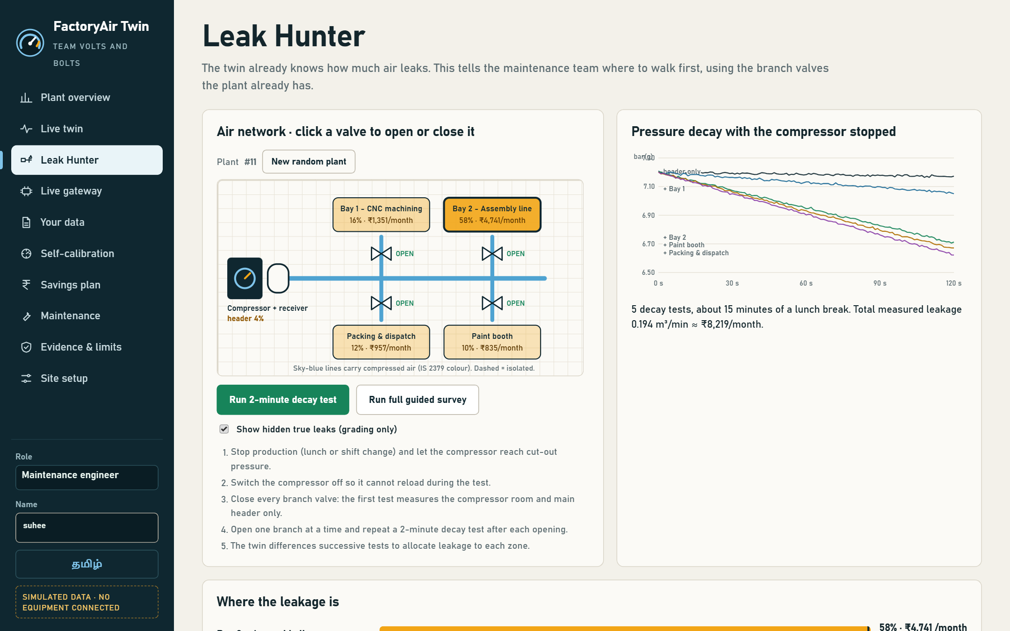




Maker journey: working software, built and tested by the team
ADD: lab photo, team with ID badges
ADD: review photo with faculty mentor
Live gateway: edge node streaming firmware frames
Leak Hunter: Bay 2 carries 58% of the leakage
Repository
124 tests
Firmware
Real files
github.com/Suheerthan/
FactoryAirTwin
every slide number reproduced by code
factoryair_edge.ino + wiring README
Python source, sample logger data
FactoryAir Twin · VK26-IITI-AHM-0210 · Maker journey

Slide 11

Stage 1 → Stage 2: what we learned and changed
Real data: AI failed, physics worked
MetroPT-3 (real): the synthetic AI flagged 0 windows (AUC 0.58); the physics duty test put all 4 documented-leak nights in the top 7 of 159 (AUC 0.988)
30 minutes → 14 days
Two-week twin with shifts and nights caught the new leak the same night
"Where is it?"
Leak Hunter allocates leakage by zone, then verifies the repair
No hardware budget
Mean error 1.8% · storage 1.9% · all 30 within ±10% (simulated)
Virtual edge node + firmware + CSV upload run the full pipeline today
ADD: faculty sign-off (name, department, college)
FactoryAir Twin · VK26-IITI-AHM-0210 · Maker journey

Slide 12




Safety by design: read-only, clip-on, fail-quiet
No output stage
Clip-on CT
Isolated tap
Sealed + fused
cannot start, stop or reload the compressor
no mains conductor opened
ball valve, fittings rated > 2× pressure
IP65 box, fused 24 V supply
Failure mode | Hazard | Built-in protection
Transmitter open loop / drift | Wrong leak figure | < 3.6 mA frames dropped; stuck and range checks first
Wi-Fi dropout | Lost data | 72 h SD spool; gaps flagged
Clock jump / bad frame | Corrupt history | Ingest rejects them (tested live)
False leak alarm | Wasted labour | Two estimators must agree; weak nights graded down
Wrong nameplate FAD | Biased ₹ | Shown openly; Stage 3 pump-up test
Standards considered
IEC 61010-1, 61010-2-032
IEC 60529 (IP65)
ISO 11011 (air audits)
IS 2379 (pipe colours)
FactoryAir Twin · VK26-IITI-AHM-0210 · Safety & hazard mitigation

Slide 13




Four-month plan to a field-tested prototype
Nov 2026
Dec 2026
Jan 2027
Feb 2027
Build: assemble node, flash firmware, bench-test vs gauge + clamp meter
Integrate: enclosure CAD + fit-out, college compressor install
Validate: MSME pilot vs manual leak-down + ultrasonic walk
Prove: site recalibration, repair a found leak, verify overnight
Stage 3 commitment: demonstrated live on this dashboard
A working edge node on a real compressor
A nightly leak index from real data
One leak located, repaired and verified overnight
FactoryAir Twin · VK26-IITI-AHM-0210 · Roadmap

Slide 14





Engineering bottlenecks we hit in simulation
A leak looks like demand
Nameplate is not the truth
Synthetic AI does not transfer
Daytime data cannot separate production air from leaks.
3% low delivery biased estimates by ~3%.
MetroPT-3: 0 windows flagged, AUC 0.58. The physics test scored 0.988.
No quiet hours
Valves are not perfect
Field data is messy
24×7 plants give the nightly test no window.
Seeping valve seats blur the zone split.
Dropouts, stuck sensors, spikes, clock jumps.
FactoryAir Twin · VK26-IITI-AHM-0210 · Technical challenges & risks

Slide 15
Backup solutions for each risk
Risk
Primary solution
Fallback
Leak vs demand
Test only in idle windows via the machine-on contact
Weekend leak-down test
Nameplate bias
One-time pump-up test measures real FAD
Show the bias band on every ₹
AI transfer gap
Physics sets all ₹: AUC 0.988 on real MetroPT-3 nights
Per-site model recalibration
No quiet hours
Lunch-break tests; decay-only mode
Isolation during planned stops
Seeping valves
Survey both directions and compare
Ultrasonic walk in the top zone
Already verified in simulation: the repeat valve survey measured ₹4,276/month vs ₹4,741 predicted (−9.8%, 92% repair efficacy).
FactoryAir Twin · VK26-IITI-AHM-0210 · Technical challenges & risks

Slide 16
References and sources
[1] U.S. Department of Energy & Compressed Air Challenge, Improving Compressed Air System Performance: A Sourcebook for Industry (3rd ed.).
[2] ISO 11011:2013, Compressed air — Energy efficiency — Assessment.
[3] Bureau of Energy Efficiency (India), Energy Efficiency in Electrical Utilities, Chapter 3: Compressed Air System.
[4] Veloso, B. et al., "The MetroPT dataset for predictive maintenance", Scientific Data 9, 764 (2022); UCI Machine Learning Repository, MetroPT-3 (id 791).
[5] IEC 61010-1, IEC 61010-2-032 (measurement equipment, current clamps); IEC 60529 (IP code).
[6] IS 2379, Pipelines — Identification colour code (Bureau of Indian Standards).
[7] Data sheets: Espressif ESP32-S3, Texas Instruments ADS1115, YHDC SCT-013 series.
Images: screenshots of the team's own software; diagrams drawn by the team; icons from the open-source Tabler Icons set (MIT licence).
FactoryAir Twin · VK26-IITI-AHM-0210 · References

