Slide 1

Vishwakarma Application ID
VK26-IITI-AHM-0210
FactoryAir Twin
A self-calibrating digital twin that finds, locates, prices and verifies compressed-air waste using only the two signals a small factory already has: header pressure and motor power.
Team Volts and Bolts
Track: ______________________
Team members: ______________________
Institution: ______________________
Faculty mentor: ______________________
Working software prototype: plant overview screen
Stage 2 · Design Development · October 2026 · all figures from simulation unless marked real data

Slide 2
Small factories pay for compressed air they never use
Project overview
Problem statement
Leaks, unloaded running and excess pressure waste a large share of compressor electricity. Nobody sees it: there is no flow meter on the line, the bill arrives a month later, and an air leak makes no smoke or smell.
Title: FactoryAir Twin
Team ID: VK26-IITI-AHM-0210
Track: ______________________
Core innovation
Target beneficiary
A nightly load/unload leak test on header pressure and motor power that teaches the twin each plant's own storage volume, leak flow and specific power — so it can find, locate and verify leaks with no flow meter.
MSME units — foundries, machine shops, textile and packaging plants — running one or two 5–30 kW screw compressors, with an owner and one maintenance person and no energy manager.
20–30%
~10%
36%
of compressor output is often lost to leaks
of industrial electricity makes compressed air
of the demo plant's compressor bill buys no useful air
Reads only. It never sends a command to the compressor.
US DOE sourcebook [1]
US DOE sourcebook [1]
FactoryAir Twin, simulated
FactoryAir Twin · VK26-IITI-AHM-0210 · Problem context

Slide 3
Today's options are too rare, too costly or brand-locked
Option a small plant has today | What it needs | What it misses
Annual ultrasonic leak survey | A consultant visit | A snapshot once a year. New leaks run unseen for months; no one checks the repair held.
Inline flow meter | Pipe cutting and a shutdown | Says how much air flows, not where it leaks or what it costs.
Compressor maker's connected monitoring | That brand's newer machine | Older and mixed-brand compressor rooms — most small plants — are left out.
Watching the electricity bill | Nothing | Arrives a month late and cannot separate production from waste.
FactoryAir Twin | Two clip-on signals, any brand | Tests every night, finds the zone, prices it in ₹, and measures the repair the next night.
The gap: nobody measures waste continuously, cheaply and on any compressor — so it stays invisible until the bill.
FactoryAir Twin · VK26-IITI-AHM-0210 · Problem context

Slide 4
Before: one failed coupling costs money for weeks unseen
Thu, 14:24
Same day
~30 days
Months
After repair
A hose coupling fails in the assembly bay
The compressor quietly loads more often. No alarm, no flow meter
The electricity bill rises. The owner blames an old machine
Maybe the annual survey finds it, maybe not
Nobody measures whether the fix held
Quantified inefficiency in the demo plant (14-day twin, simulated)
₹5,580
22.5%
8.3%
~30 days
a month added by the one failed coupling
of compressor capacity leaking at the worst night
of electricity spent running unloaded (₹1,094/month)
until the bill is the first signal: the leak costs a full month before anyone looks
FactoryAir Twin · VK26-IITI-AHM-0210 · User journey

Slide 5
After: found overnight, located at lunch, verified next night
23:00–05:00
06:00
Lunch break
Same day
Next night
Nightly leak test on pressure + power
Alert to the maintenance group: +₹5,580/month
Leak Hunter: 5 valve tests, ~15 min → Bay 2 = 58%
Ticket raised, repair done
Saving measured, not promised
Quantified efficiency (simulated)
new leak (Thu 4)
repaired (Thu 11)
Detection
next morning
vs ~30 days
Locating the zone
~15 min
5 decay tests
Repair saving
₹5,453/mo
measured overnight
Zone ticket
₹4,276/mo
measured vs ₹4,741 predicted
Heat recovery
₹7,414/mo
LPG displaced, 8.8-month payback
New flow meters
0
pressure + power only
FactoryAir Twin · VK26-IITI-AHM-0210 · User journey

Slide 6
System block diagram: two signals in, a verified saving out
Mechanical & sensing
Electronics & power
Firmware logic (1 Hz)
Twin software (laptop, offline)
4–20 mA pressure transmitter, 0–16 bar, on the existing gauge port behind a ball valve
Split-core CT on one motor phase: clip-on, no cable opened
Optional machine-on dry contact
ADS1115 16-bit ADC, 165 Ω 0.1 % shunt
ESP32-S3 controller, Wi-Fi
24 V DIN supply → 5 V buck
microSD buffer · no output stage
Read loop current → bar; CT RMS → kW
Drop invalid frames (open loop, no clock)
Batch 10 frames → REST / MQTT
Spool to SD offline, replay oldest-first
Ingest & validate → sensor health
Rules + Isolation Forest + Random Forest
Nightly self-calibration (leak, volume, kW per m³/min)
Leak Hunter · advisors · tickets · owner report
Architecture rationale: a clip-on CT and a gauge-port transmitter instead of a flow meter, so nothing is cut or shut down. Everything after the ADC is software, so today's virtual edge node already exercises the full pipeline the hardware will feed. The node has no output stage at all: it physically cannot command the compressor.
FactoryAir Twin · VK26-IITI-AHM-0210 · System architecture

Slide 7
Target specifications and hardware selection
Parameter | Target specification | Selected hardware / protocol
Sampling | 1 Hz pressure and power | ESP32-S3 + ADS1115 at 860 samples/s
Header pressure | 0–16 bar(g), ±0.5 % full scale | 4–20 mA transmitter, 165 Ω 0.1 % shunt
Motor power | 0–30 A per phase, RMS | SCT-013-030 split-core CT, RMS over 10 mains cycles
Data link | Batches of 10 frames, read-only | Wi-Fi REST to /api/edge/ingest; MQTT optional
Offline buffer | 72 h at 1 Hz | microSD spool, replayed oldest-first
Enclosure & supply | IP65, DIN rail | PC/ABS box, PG glands, 24 V DIN PSU → 5 V
Cost per site | under ₹10,000 | ≈ ₹6,100 indicative bill of materials
Software targets, tested
1.8%
mean leak error on 30 random plants the twin had never seen (target ±10%)
30/30
plants within ±10% · storage error 1.9%, specific power 2.2%
1 night
All software results are from simulation; field accuracy is a Stage 3 deliverable.
from a new leak to an alert, in the 14-day plant twin
FactoryAir Twin · VK26-IITI-AHM-0210 · System architecture

Slide 8
Mechanical design: a sealed box and a safe pressure tap
Enclosure layout (concept, not CAD)
Part | Options weighed | Choice and reason
Enclosure | Aluminium · ABS · PC/ABS | PC/ABS IP65: non-conductive near mains, light, ≈ ₹700
Pressure fittings | Push-fit nylon · brass · SS304 | Brass G¼ rated ≥ 16 bar: over 2× the 7.4 bar band, relief-protected
Mounting | Magnet · screws · DIN rail | Steel DIN rail on the panel wall: away from compressor vibration
24 V PSU
5 V buck
ESP32-S3 + ADS1115 carrier
microSD
Stress analysis: no load-bearing structure at Stage 2. The only pressure-retaining parts are off-the-shelf fittings rated above twice the working pressure. Stage 3 adds a vibration check of the bracket next to the compressor.
PG7 glands: CT, transmitter, contact
Pressure tap (concept)
ADD: screenshot of the team's enclosure CAD model (isometric + exploded view, feature tree visible)
Gauge port
G¼ tee
Ball valve
Transmitter
FactoryAir Twin · VK26-IITI-AHM-0210 · CAD & mechanical

Slide 9
Electronics connections and bill of materials
Connection diagram (wiring plan)
Component | Qty | ≈ ₹
ESP32-S3 DevKitC | 1 | 800
ADS1115 16-bit ADC module | 1 | 350
4–20 mA transmitter 0–16 bar | 1 | 1,800
SCT-013-030 split-core CT | 1 | 450
165 Ω 0.1 % shunt, TVS, fuses | 1 | 150
24 V DIN PSU + 5 V buck | 1 | 1,100
microSD module + 16 GB card | 1 | 400
IP65 box, glands, DIN rail | 1 | 700
G¼ brass tee + ball valve | 1 | 350
Total (indicative) |  | 6,100
Pressure transmitter
4–20 mA, 24 V loop
165 Ω shunt
0.66–3.30 V
CT SCT-013-030
30 A : 1 V
ADS1115
A0 · A1–A3 diff.
Machine-on contact
dry, to GND
ESP32-S3
GPIO8 SDA · GPIO9 SCL
GPIO7 contact · GPIO10 SD CS
24 V PSU → 5 V buck
microSD (SPI)
Sourcing: every part is sold by Indian online electronics and pneumatics distributors; prices and lead times to be confirmed with vendor quotes before ordering.
FactoryAir Twin · VK26-IITI-AHM-0210 · Electronics & BOM

Slide 10
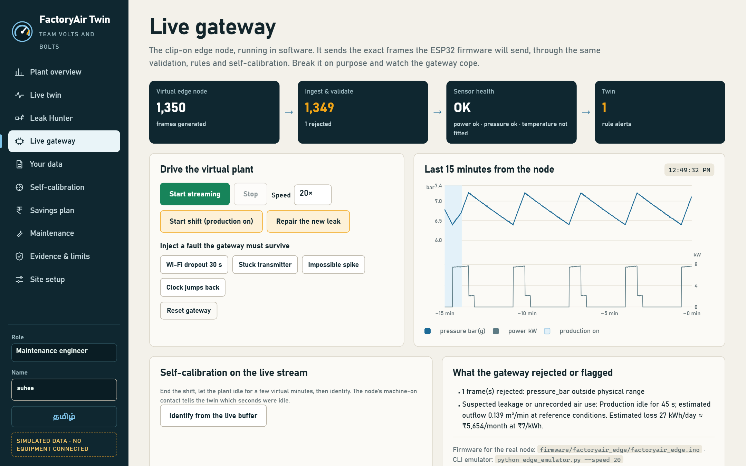
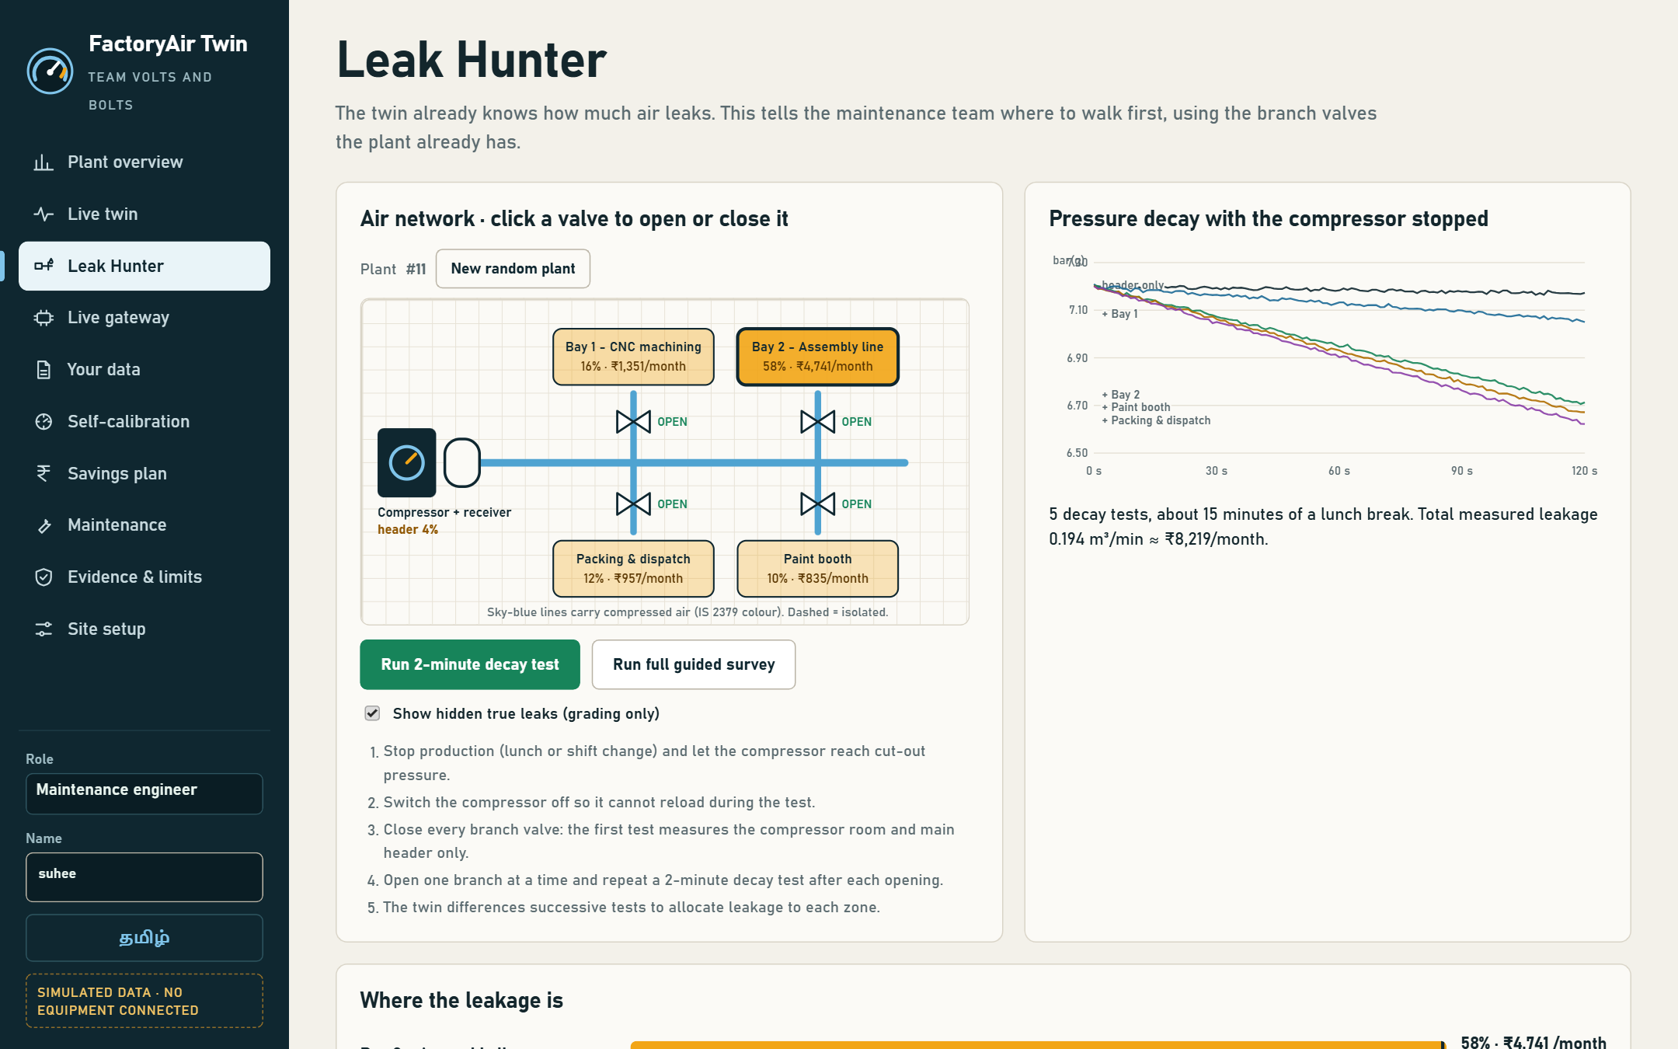
Maker journey: working software, built and tested by the team
ADD: lab photo of team members with ID badges
ADD: joint review photo with faculty mentor
Live gateway: virtual edge node streaming real firmware frames, one impossible spike rejected
Leak Hunter: guided valve survey finds Bay 2 carries 58% of the leakage
Repository: github.com/Suheerthan/FactoryAirTwin
Native files: Python source, firmware/factoryair_edge/factoryair_edge.ino, firmware/README.md (wiring, BOM), test suite
Evidence: 124 automated tests pass · every number on these slides is reproduced by the code · commit timestamps show Stage 2 work
FactoryAir Twin · VK26-IITI-AHM-0210 · Maker journey

Slide 11
Stage 1 → Stage 2: what we learned and changed
1
Real data humbled the AI
On 1.5 million real MetroPT-3 readings the synthetic anomaly threshold flagged 0 windows (AUC 0.58). So money figures now come from a physics test that learns each plant.
2
30 minutes → 14 days
A two-week plant twin with shifts, nights and Sundays runs the leak test every night and caught the new leak the same night.
3
"Where is it?"
Leak Hunter uses the plant's own branch valves to allocate leakage by zone, then verifies the repair with a repeat survey.
4
No hardware budget
Mean error 1.8% · storage volume 1.9% · all 30 within ±10% (simulated)
Virtual edge node, ESP32 firmware and CSV upload: the full pipeline runs today without the box.
ADD: faculty sign-off line (name, department, college)
FactoryAir Twin · VK26-IITI-AHM-0210 · Maker journey

Slide 12
Safety by design: read-only, clip-on, fail-quiet
No output stage
Failure mode | Hazard | Built-in protection
Transmitter open loop / drift | Wrong leak figure | < 3.6 mA frames dropped; stuck-signal and range checks before any scoring
Wi-Fi dropout | Lost data | 72 h SD spool; gaps flagged by sensor health
Clock jumps / bad frame | Corrupt history | Ingest rejects non-increasing time and impossible values (tested)
False leak alarm | Wasted labour | Two independent estimators must agree; low-confidence nights are graded down
Wrong nameplate FAD | Biased ₹ | Shown openly; Stage 3 pump-up test calibrates FAD once
Unauthorised change | Bad settings | Role-gated API: operators cannot change calibration
The node has no relay or analogue output: it cannot start, stop or reload the compressor.
Clip-on current sensing
No mains conductor is opened; the CT's built-in burden avoids open-secondary voltage.
Isolated pressure tap
Transmitter sits behind a ball valve on a fitting rated above 2× working pressure.
Fused, sealed supply
Fused 24 V DIN supply inside an IP65 box with glands.
Standards considered: IEC 61010-1 and IEC 61010-2-032 (measurement equipment, current clamps) · IEC 60529 (IP65) · ISO 11011 (compressed-air energy assessment) · IS 2379 (pipe colour coding, used in the UI)
FactoryAir Twin · VK26-IITI-AHM-0210 · Safety & hazard mitigation

Slide 13
Four-month plan to a field-tested prototype
Month 1 · Nov 2026
Month 2 · Dec 2026
Month 3 · Jan 2027
Month 4 · Feb 2027
Build
Integrate
Validate
Prove
Order parts, assemble node on a breadboard
Flash firmware; bench-test against a calibrated gauge and clamp meter
Enclosure CAD and print/fit-out
Install on a college workshop compressor; stream to the twin
Pilot at one MSME unit
Compare nightly test with a manual leak-down test and an ultrasonic walk
Recalibrate on site data; one-time FAD pump-up test
Repair a found leak and verify the saving overnight
Stage 3 commitment: a working edge node on a real compressor, a nightly leak index from real data, one located and repaired leak with its saving measured — demonstrated live on the same dashboard shown here.
FactoryAir Twin · VK26-IITI-AHM-0210 · Roadmap

Slide 14
Engineering bottlenecks we hit in simulation
A leak looks like demand
Nameplate is not the truth
With no flow meter, extra production air and a leak raise the same signal. Daytime data alone cannot separate them.
A machine delivering 3% below nameplate biased leak and storage estimates by about 3% in the 14-day twin.
Synthetic AI does not transfer
No quiet hours
MetroPT-3: 0 real windows flagged by the synthetic threshold, AUC 0.58. Good on simulation is not good in the field.
Plants running 24×7 never idle, so the nightly test has no window.
Valves are not perfect
Field data is messy
Leak Hunter assumes tight valve seats; seeping valves blur the zone split.
Wi-Fi drops, stuck transmitters, impossible spikes and clock jumps. The Live gateway injects all four; each one must be caught before any scoring.
FactoryAir Twin · VK26-IITI-AHM-0210 · Technical challenges & risks

Slide 15
Backup solutions for each risk
Risk | Primary solution | Fallback
Leak vs demand | Test only in idle windows (night, lunch) using the machine-on contact | Weekend leak-down test scheduled from the dashboard
Nameplate bias | One-time pump-up test at install to measure real FAD | Show the bias band openly on every ₹ figure
AI transfer gap | Physics self-calibration sets all ₹ figures; ML only ranks anomalies | Per-site recalibration of the anomaly model (recalibrate.py)
No quiet hours | Short lunch-break tests + decay-only mode with known volume | Branch-valve isolation during planned stops
Seeping valves | Two-direction survey (open-up and close-down) and compare | Repeat the decay test; ultrasonic walk in the top zone
Already verified in simulation: Leak Hunter's repeat-survey check measured ₹4,276/month against ₹4,741 predicted (−9.8%, explained by 92% repair efficacy).
FactoryAir Twin · VK26-IITI-AHM-0210 · Technical challenges & risks

Slide 16
References and sources
[1] U.S. Department of Energy & Compressed Air Challenge, Improving Compressed Air System Performance: A Sourcebook for Industry (3rd ed.).
[2] ISO 11011:2013, Compressed air — Energy efficiency — Assessment.
[3] Bureau of Energy Efficiency (India), Energy Efficiency in Electrical Utilities, Chapter 3: Compressed Air System.
[4] Veloso, B. et al., "The MetroPT dataset for predictive maintenance", Scientific Data 9, 764 (2022); UCI Machine Learning Repository, MetroPT-3 Dataset (id 791).
[5] IEC 61010-1 and IEC 61010-2-032 (safety of measurement equipment and hand-held current clamps); IEC 60529 (degrees of protection, IP code).
[6] IS 2379, Pipelines — Identification colour code (Bureau of Indian Standards).
[7] Component data sheets: Espressif ESP32-S3, Texas Instruments ADS1115, YHDC SCT-013 series.
Images: all screenshots are of the team's own FactoryAir Twin software; diagrams drawn by the team. No third-party images used.
FactoryAir Twin · VK26-IITI-AHM-0210 · References

