Slide 1


CONSUMER GOODS
AD-HOC ANALYSIS

Slide 2
Task
This document delivers a thorough analysis of key business metrics based on specific ad-hoc requests.
It includes market analysis, highlighting the regions where specific customers operate.
Product trends are evaluated, including growth in unique products and segment-specific performance.
Customer behavior insights are provided, identifying key customers and their purchasing trends.
Channel performance is analyzed to determine sales contributions and identify high-performing channels.
The findings aim to support data-driven strategies and informed decision-making.

Slide 3
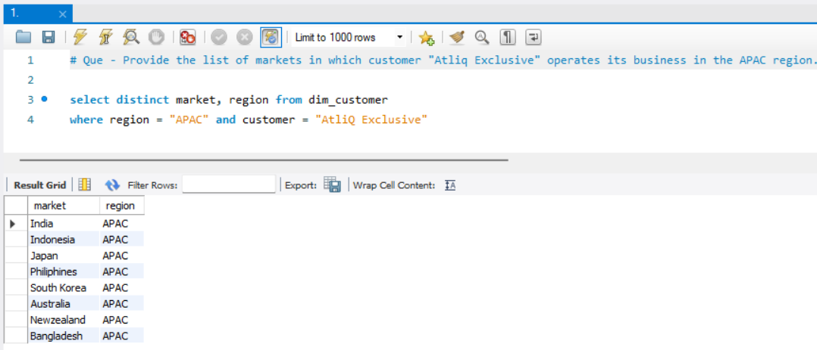
Que.1 – Provide the list of markets in which customer “AtliQ Exclusive” operates its business in the APAC region
Query
Output
Result - There are total eight markets in which AtliQ Exclusive operates its business in APAC region

Slide 4
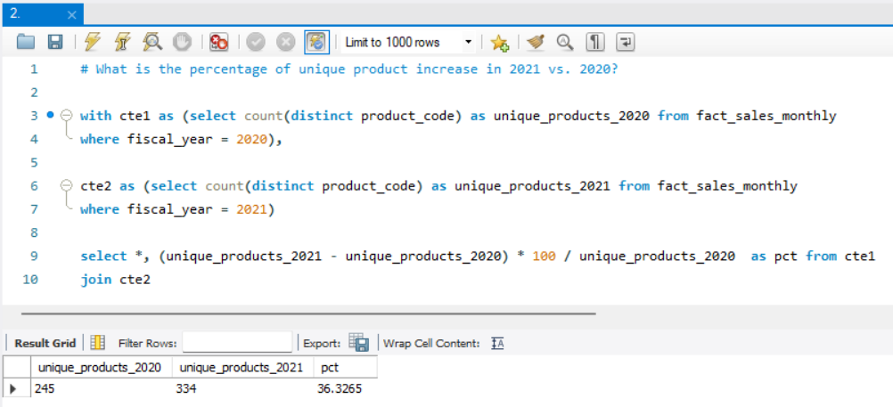
Que.2 – What is the percentage of unique products increase in 2021 vs 2020?
Query
Output
Result – In 2020 total unique product count were 245, In 2021 it increase to 334.
So, 36.3 % of unique product increase from 2020 to 2021. Which is impressive for business.

Slide 5
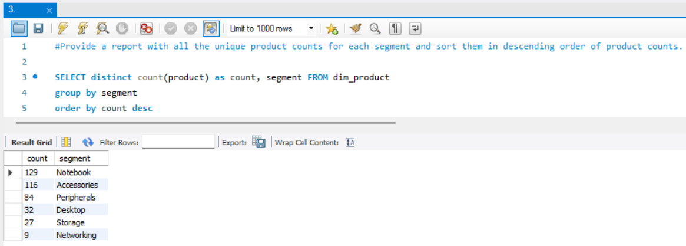
Que.3 – Provide a report with all the unique product counts for each segment and sort them in descending order of product counts
Query
Output
Result – The Notebook segment showed exceptional performance, emerging as the top-selling category. In contrast, segments like Desktop, Storage, and Networking recorded relatively low sales. AtliQ Hardware should consider investigating these underperforming segments for potential improvement.

Slide 6
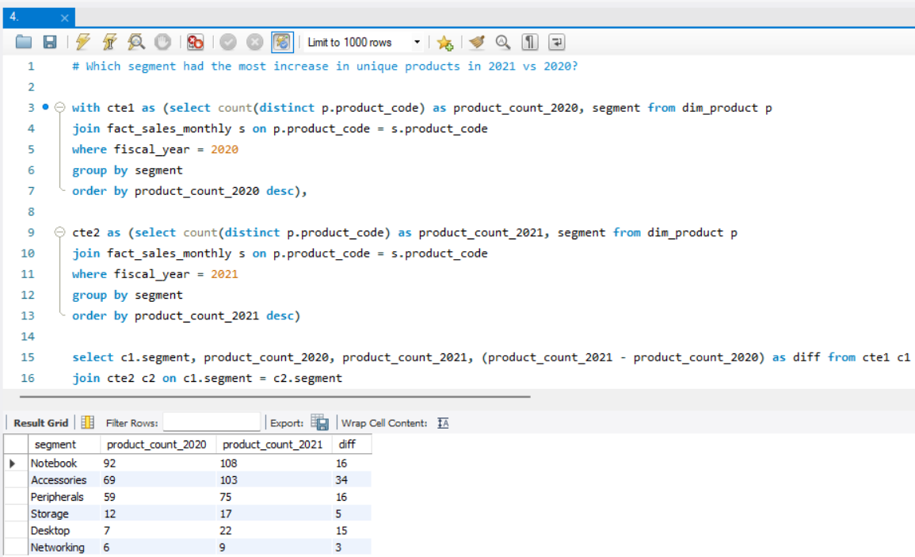
Que.4 – Which segment had the most increase in unique products in 2021 vs 2020?
Query
Output
Accessories led growth, making it a strong candidate for continued investment.
Notebook and Peripherals showed solid performance, indicating stable demand.
Networking saw no growth — needs review for potential issues.
Storage and Desktop showed limited growth; may need targeted strategies to boost performance.

Slide 7
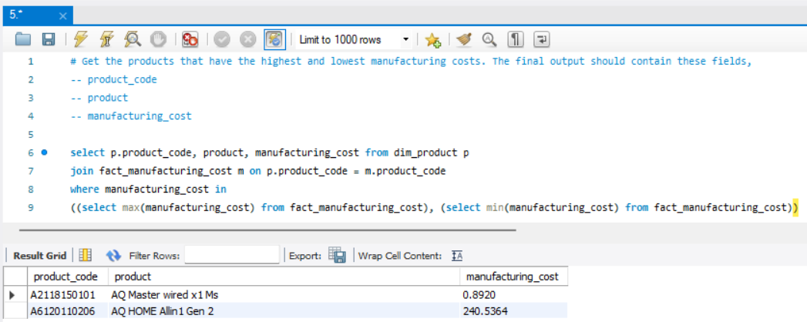
Que.5 – Get the products that have the highest and lowest manufacturing costs
Query
Output
Result - There’s a significant cost gap, suggesting differences in product complexity. Useful for cost control and pricing strategies.

Slide 8
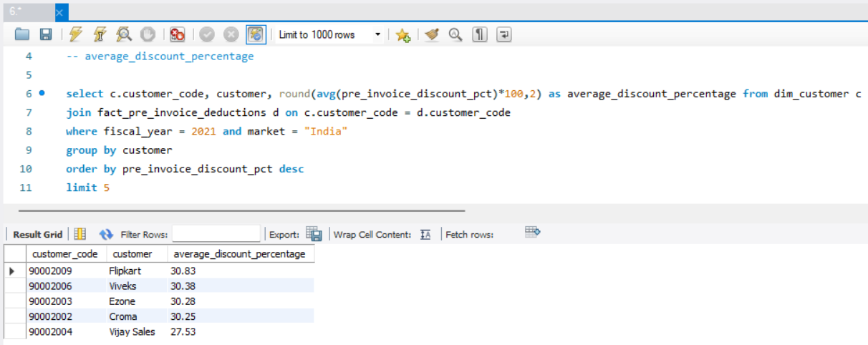
Que.6 – Generate a report which contains the top 5 customers who received an average high pre_invoice_discount_pct for the fiscal year 2021 and in the Indian market
Query
Output
Result – Top retail customers like Flipkart and Croma receive high discounts, indicating strong buying power or strategic partnerships. Monitoring these can help manage margins and negotiation strategies.

Slide 9
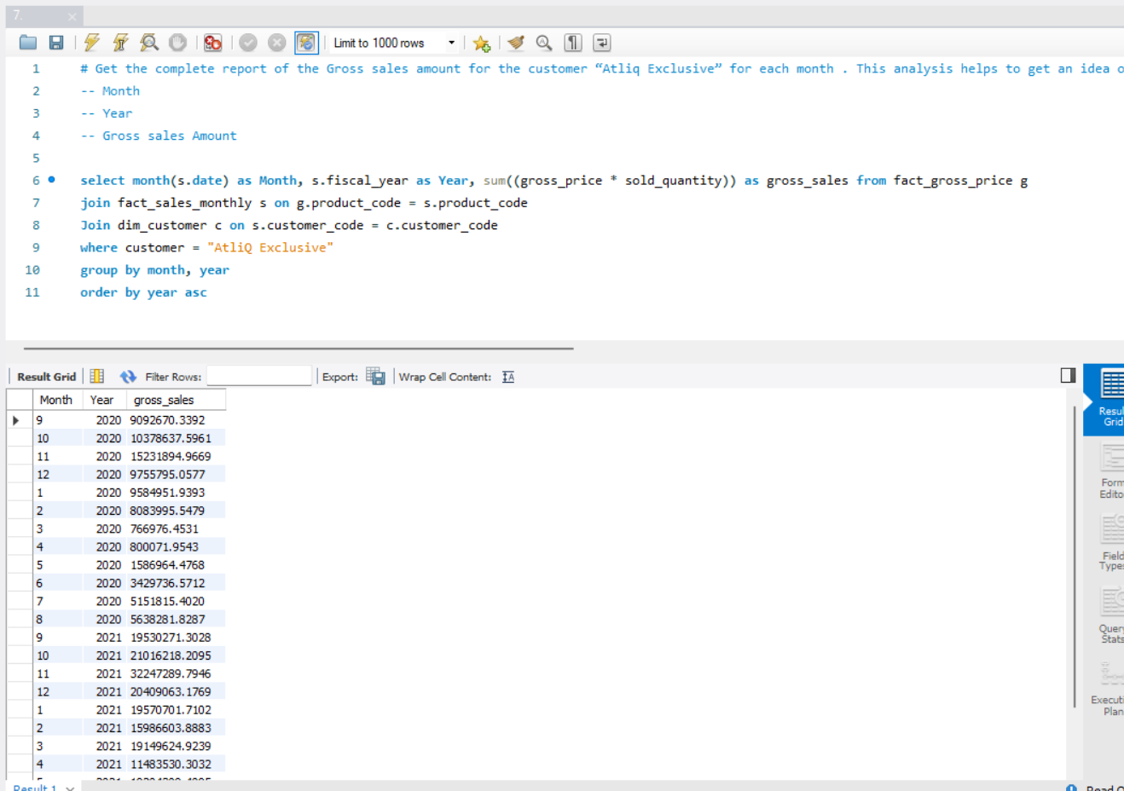
Que.7 – Get the complete report of the Gross sales amount for the customer “Atliq Exclusive” for each month
Query
Output
Result – Consistent sales spikes around October–December suggest strong seasonal demand. This pattern can guide inventory planning and marketing strategies ahead of peak months.

Slide 10
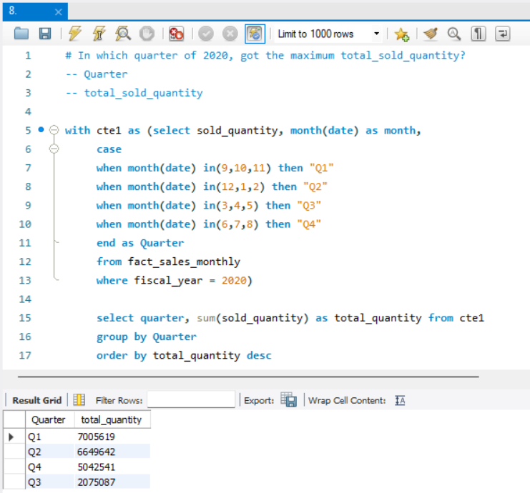
Que.8 – In which quarter of 2020, got the maximum total_sold_quantity?
Query
Output
Result – Q1 2020 led in sales volume, possibly driven by post-holiday inventory restocking or seasonal demand surges. Q3 shows a noticeable dip and may indicate a low sales season or external market factors.

Slide 11
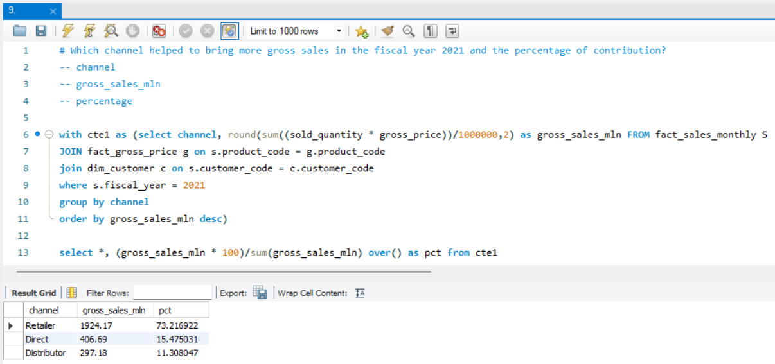
Que.9 – Which channel helped to bring more gross sales in the fiscal year 2021 and the percentage of contribution?
Query
Output
Result – Retailer channel was the top contributor, generating over 73% of the total gross sales.

Slide 12
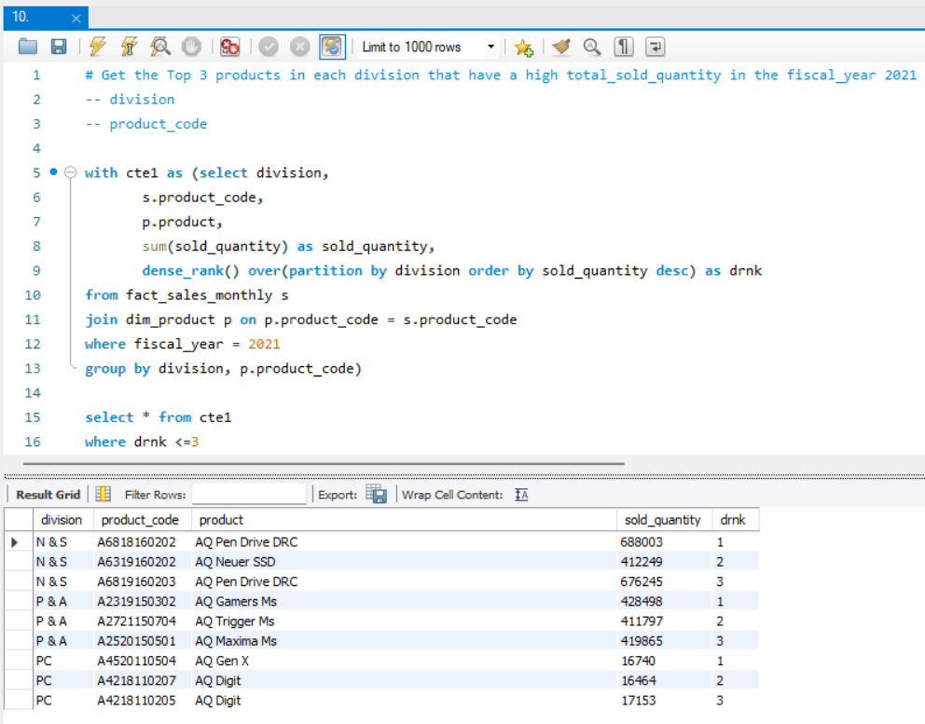
Que.10 – Get the Top 3 products in each division that have a high total_sold_quantity in the fiscal_year 2021
Query
Output
N & S Division: "AQ Pen Drive DRC" is a standout, appearing twice in the top three.
P & A Division: Strong performance from "AQ Gamers Ms" variants.
PC Division: Lower quantities overall, dominated by "AQ Digit" products.

Slide 13
Summary
The task was to analyze various business metrics related to sales, products, customers, and channels based on the data provided in the request document. Here’s what I did:
Identifying Customer Markets: Provided a list of markets where "Atliq Exclusive" operates in the APAC region.
Analyzing Unique Product Growth: Calculated the percentage increase in unique products from 2020 to 2021, including detailed counts for both years.
Segment-Wise Product Count: Generated a report showing the unique product counts per segment and sorted them in descending order.
Segment Product Growth Analysis: Identified the segment with the most increase in unique products from 2020 to 2021, detailing the counts and differences.
Manufacturing Cost Insights: Pinpointed the products with the highest and lowest manufacturing costs.
Top Customers Report: Listed the top 5 customers with the highest average pre-invoice discount percentage in 2021 within the Indian market.
Monthly Sales for "Atliq Exclusive": Compiled a monthly report of gross sales for "Atliq Exclusive" to analyze performance trends.
Best Quarter Analysis: Identified the quarter in 2020 with the highest total sold quantity.
Channel Contribution Analysis: Determined the channel with the highest gross sales in 2021 and calculated its percentage contribution.
Top Products in Divisions: Identified the top 3 products in each division based on total sold quantity for the fiscal year 2021.

