Slide 1
Module 2 js

Slide 2
agenda
Introduction
Basics concepts
Hands on

Slide 3

Introduction

Slide 4
What is js?
JavaScript was initially created to “make web pages alive”.
JavaScript is a cross-platform, object-oriented scripting language used to make webpages interactive (e.g., having complex animations, clickable buttons, popup menus, etc.).

Slide 5
Why is it called JavaScript?
When JavaScript was created, it initially had another name: “LiveScript”. But Java was very popular at that time, so it was decided that positioning a new language as a “younger brother” of Java would help.
But as it evolved, JavaScript became a fully independent language with its own specification called ECMAScript, and now it has no relation to Java at all.

Slide 6
Hello world!
Let’s move into programming world

Slide 7
Hello, world!
The browser is a good choice for running JS code.
We’ll keep the amount of browser-specific commands (like alert) to a minimum so that you don’t spend time on them if you plan to concentrate on another environment (like Node.js*).
We’ll focus on JavaScript in the browser in the next module.

Slide 8
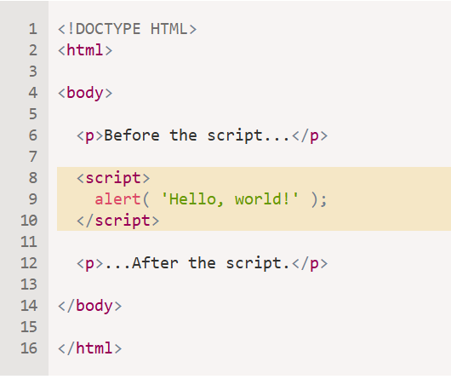
Let’s code
HelloWorld program

Slide 9


Slide 10
Thank you
Mr Suhel Khan, IC
Asst Professor, PUB

