Slide 1
Online Grocery Shopping Analysis
DATA 603 Final Project Report
Suhetu Ring (SS13214)
Mohan Brahma Harsha Vanga (HI77773)
Sravya Pamula (DP51938)

Slide 2

Project Description
Huge demand and potential for online ecommerce. Companies have been leveraging data analysis to understand customer behavior, market trends, and machine learning for product recommendations.
In this project, we analyzed online grocery shopping data to gain insights about customer purchase and market trends.
Further we built a product recommender system that recommends products for a given user based on the available order history and similar user ratings.

Slide 3
Data Source
An online grocery shopping dataset is taken from Kaggle for the project. This can be found at: https://www.kaggle.com/yasserh/instacart-online-grocery-basket-analysis-dataset
The dataset consists of 5 CSV files, each file describing a different aspect of the data including aisles, departments, orders, products and order behavior.
Size of the dataset is 1.28 GB with around 3.4 Million user transactions recorded. However, after merging the data files in Spark, the size of the dataframe is 3.6+ GB.

Slide 4
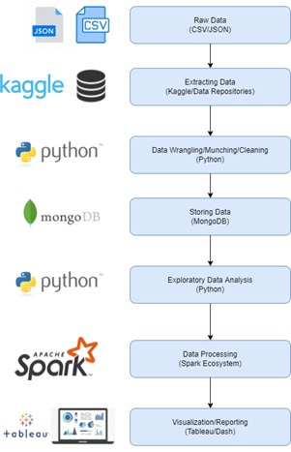
BIG Data Architectural Diagram

Slide 5




Technical Tools Used
Python
MongoDB
Apache Spark
Tableau

Slide 6
Implemented Steps
Import CSV files to MongoDB
Import data from MongoDB to Spark
Perform Exploratory Data Analysis (Last stage mentioned in the Progress Report)
Build a Recommender System based on the user purchase history and similar user ratings
Create visualizations using Tableau
*All the tasks mentioned above are implemented and there are no tasks left according to the proposal and the progress report that are yet to be implemented.*

Slide 7
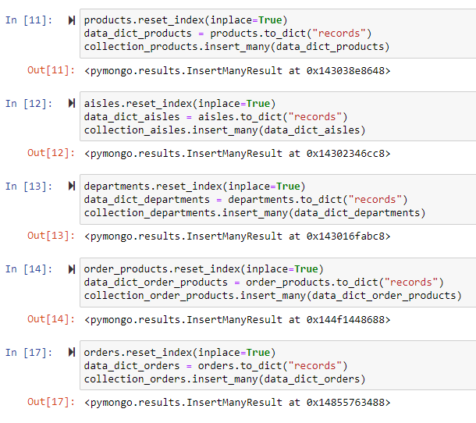
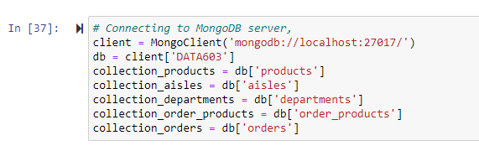
Importing data to MongoDB
Data in the form of 5 CSV files are imported to MongoDB using Pymongo library.

Slide 8
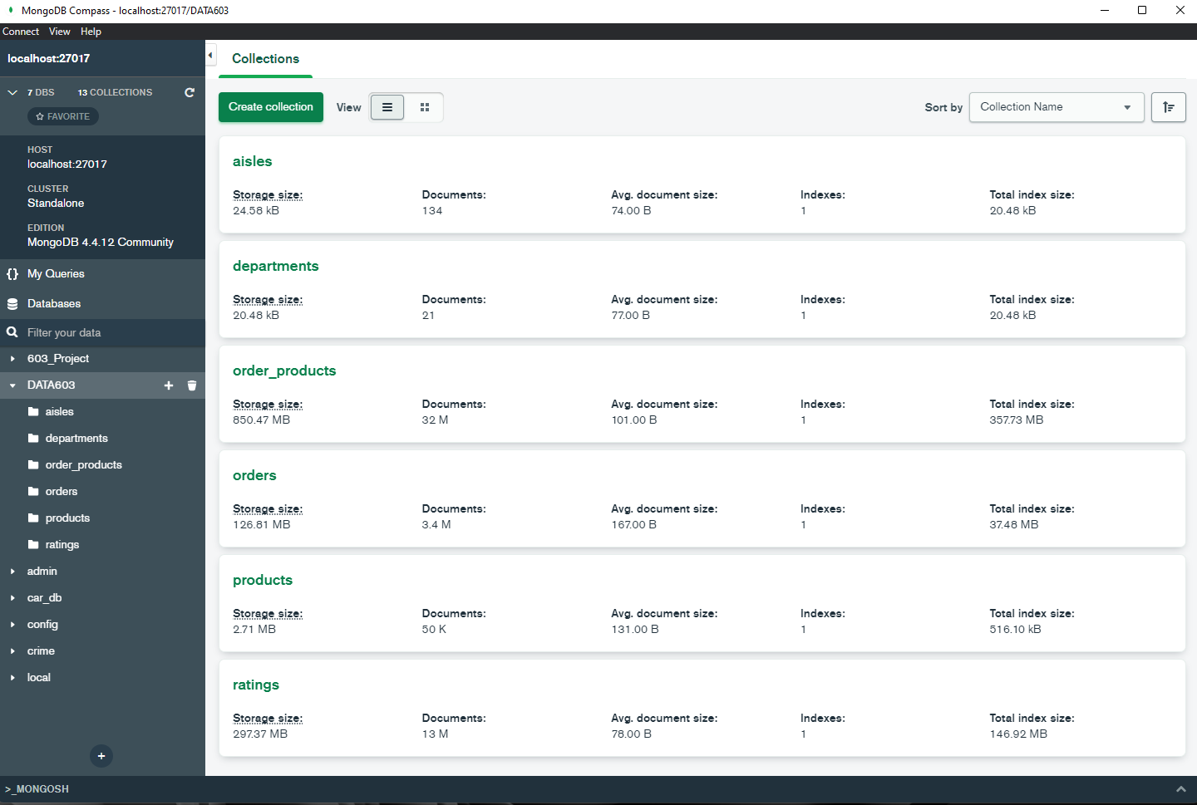
Database in MongoDB

Slide 9
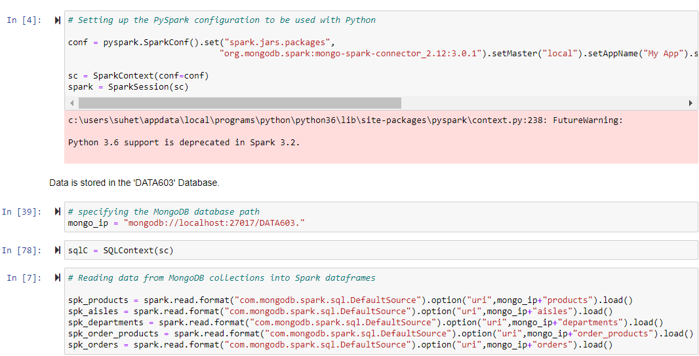
Import data from MongoDB to Spark

Slide 10
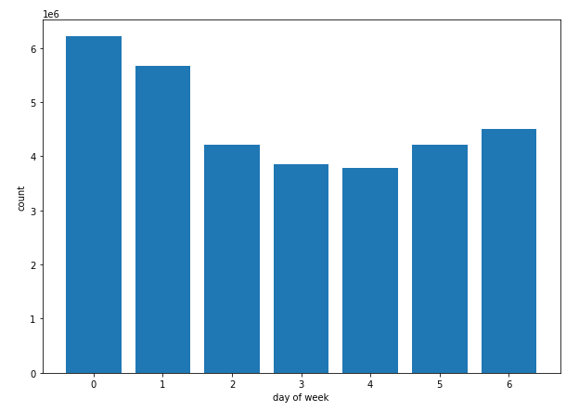
Exploratory Data Analysis
Data is stored in a spark data frame named groceries. Spark data frame commands are used to perform analysis. Some trends of customer purchase behavior are identified.
Which day of the week most orders are placed? Sunday seems to be the day most orders are placed.

Slide 11
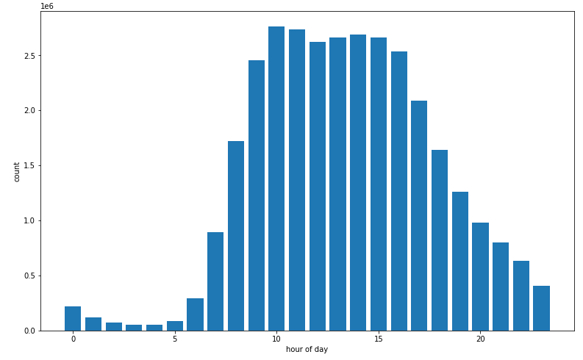
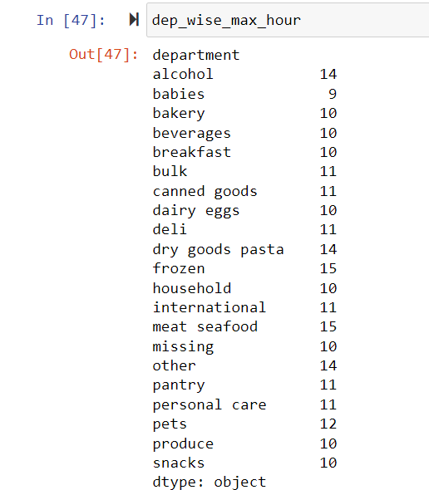
Which hour of the day seems to be most busy?
As expected, the number of orders increases during the day and most orders are placed around 10 am.
Which hour of the day the different departments are busy?
Departments such as bakery, breakfast, dairy eggs
and produce are most busy at 10 am.
This can help the business stock up and place
more staff during these hours in the respective departments.

Slide 12
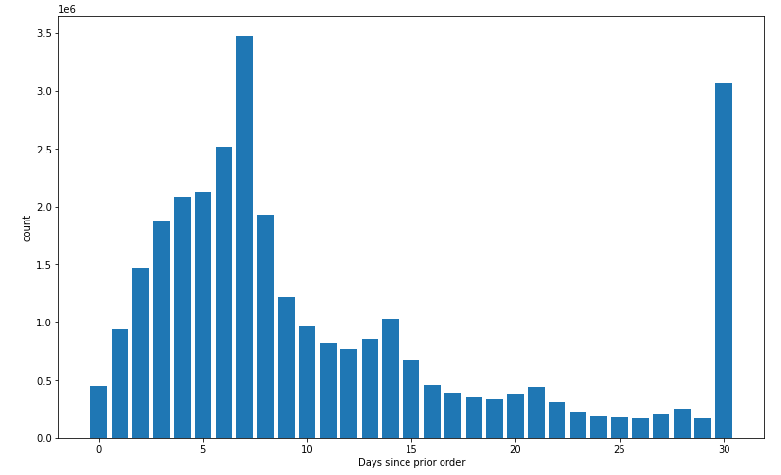
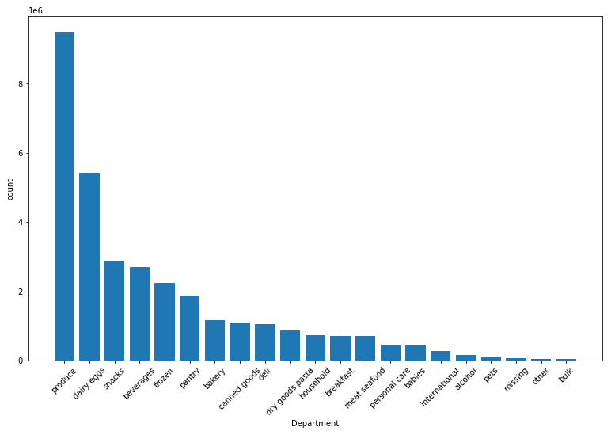
What is the frequency of customer orders?
Most people ordered 7 and 30 days prior.
Which products have more priority for the customers?
The produce department is the most ordered. The next most ordered is the dairy-eggs department.

Slide 13
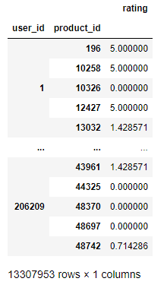
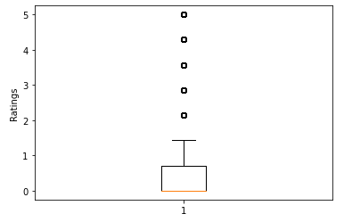
Recommender System
Generate user ratings for products
Groupby user ID and product ID
Count the rows to get the number of times a product was ordered by the user
This count gives the importance of a product for a user, thereby corresponds to user ratings.
Scale this count to a range of 0 to 5

Slide 14
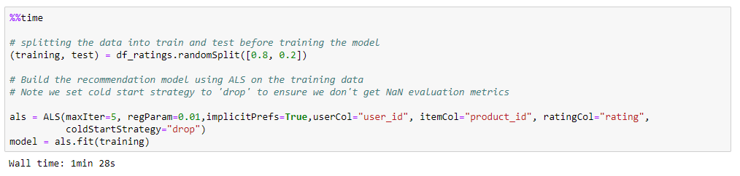
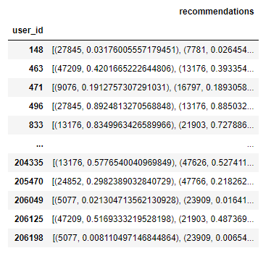
Collaborative filtering
Here we will be using the Alternating Least Squares method provided by Spark MLlib to get product recommendations.
Given a user U, similar users are found based on the given ratings. Using the ratings for an item I by these similar users, rating for the item I that user U might give is predicted. These predicted ratings are used to give recommendations.

Slide 15
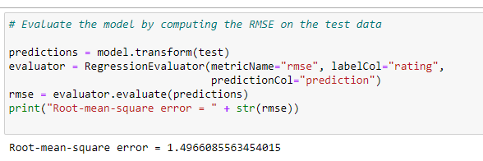
Evaluating the Recommender System
Root mean squared error (RMSE) was used as the evaluation metric to evaluate model performance as shown below. We got a RMSE score of ~1.49. This score can range from 0 to infinity and lower the RMSE score, the better the model. Hence, we believe that our model is performing well.

Slide 16
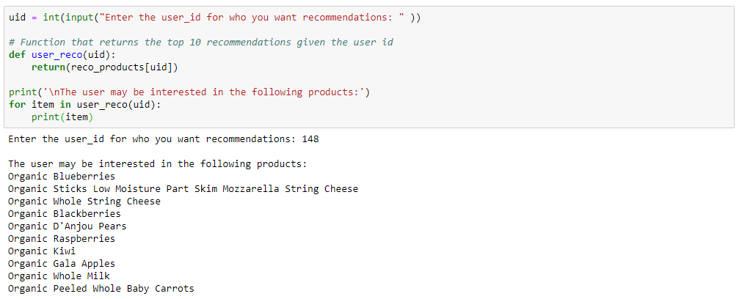
Interpretable results
Defined a function that gives top 10 product recommendations for given user interactively.

Slide 17
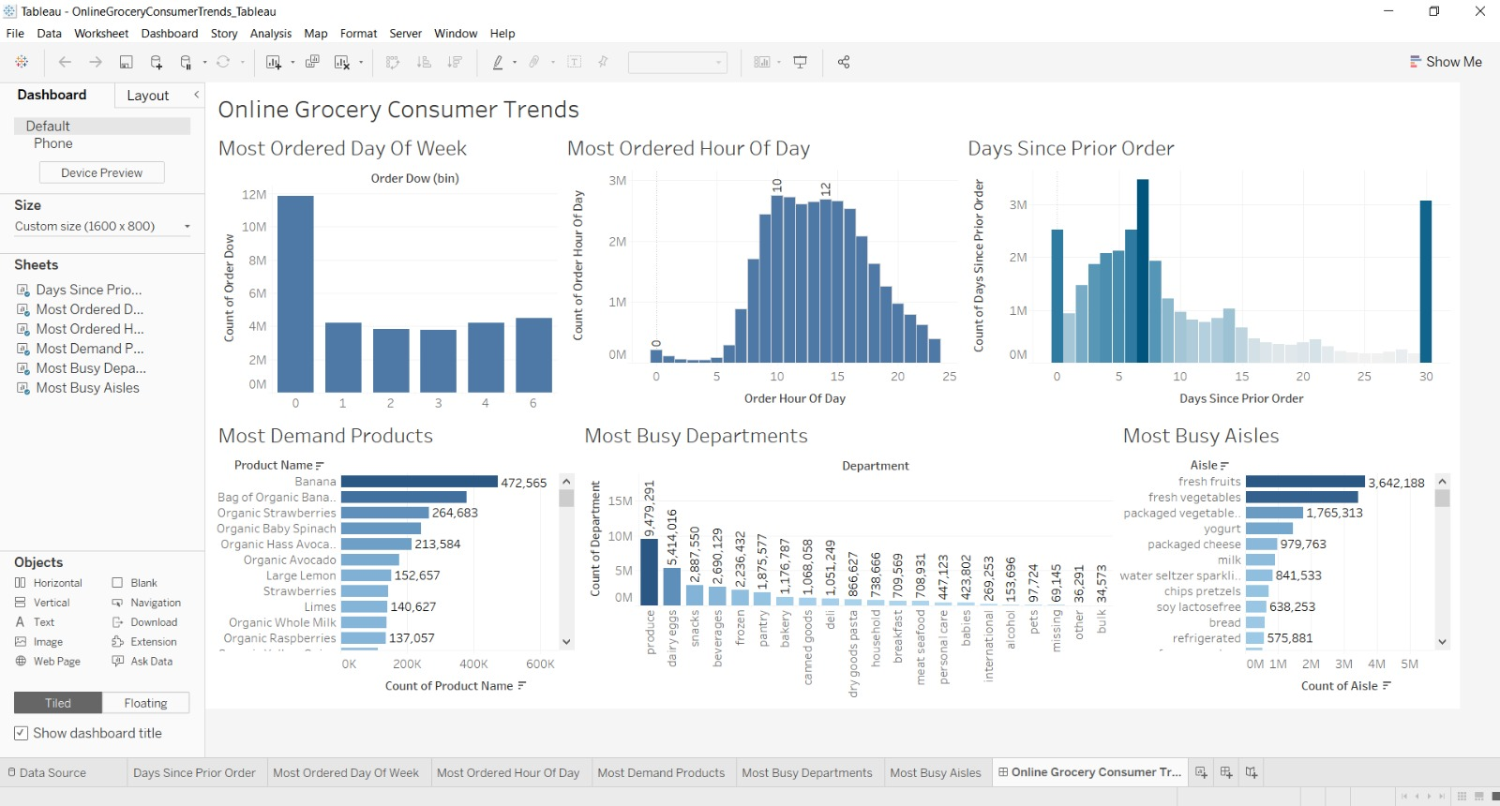
Working with Tableau

Slide 18
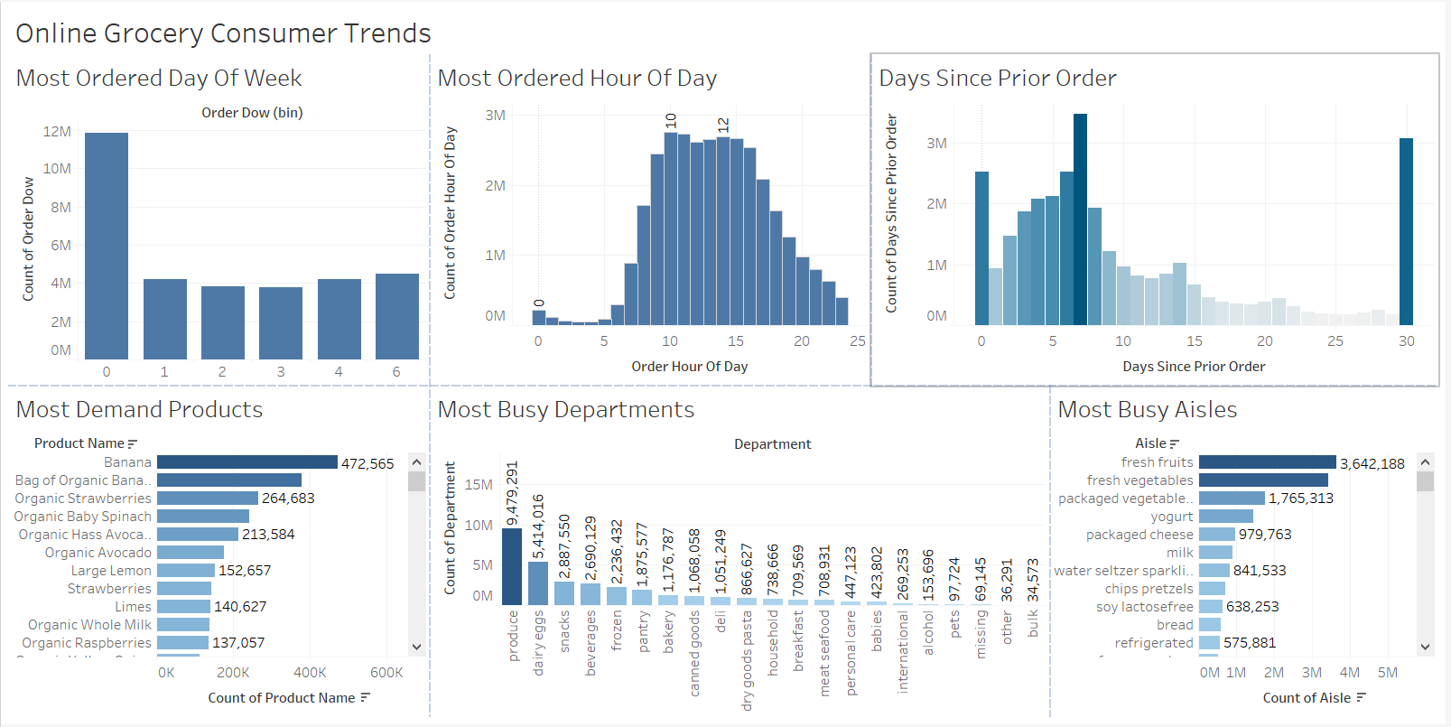
Tableau Dashboard

Slide 19
Conclusion
Consumer trends were identified by performing EDA on the data using PySpark and SparkSQL
A rating system was developed to generate user ratings for the available products
Based on these ratings, a recommender system was built using the Collaborative filtering method in Spark MLlib
A dashboard of consumer trends was built on Tableau
Following are the tools and technologies we learnt through this project:
Importing and storing data on MongoDB
Connecting MongoDB with Spark
Using PySpark and SparkSQL for data analysis
Using Spark MLlib for performing Machine Learning on Big Data
Building a recommender system
Using Tableau for data visualization

Slide 20
References
S. (2021, December 13). Upload a Pandas DataFrame to MongoDB - Analytics Vidhya. Medium. https://medium.com/analytics-vidhya/how-to-upload-a-pandas-dataframe-to-mongodb-ffa18c0953c1
Read from MongoDB — MongoDB Spark Connector. (2022). MongoDB. https://www.mongodb.com/docs/spark-connector/master/python/read-from-mongodb/
Datasets and SQL — MongoDB Spark Connector. (2022). MongoDB. https://www.mongodb.com/docs/spark-connector/master/scala/datasets-and-sql/
Collaborative Filtering - RDD-based API - Spark 3.2.1 Documentation. (2022). Apache. https://spark.apache.org/docs/latest/mllib-collaborative-filtering.html#examples
Abraham, L. (2021, December 15). Building a Recommendation System with Spark ML and Elasticsearch. Medium. https://towardsdatascience.com/building-a-recommendation-system-with-spark-ml-and-elasticsearch-abbd0fb59454
Real Python. (2021, June 5). Build a Recommendation Engine With Collaborative Filtering. https://realpython.com/build-recommendation-engine-collaborative-filtering/
Rackaitis, T. (2021, December 22). Evaluating Recommender Systems: Root Means Squared Error or Mean Absolute Error? Medium. https://towardsdatascience.com/evaluating-recommender-systems-root-means-squared-error-or-mean-absolute-error-1744abc2beac#:%7E:text=Recommender%20System%20accuracy%20is%20popularly,scale%20as%20the%20original%20ratings

