Slide 1
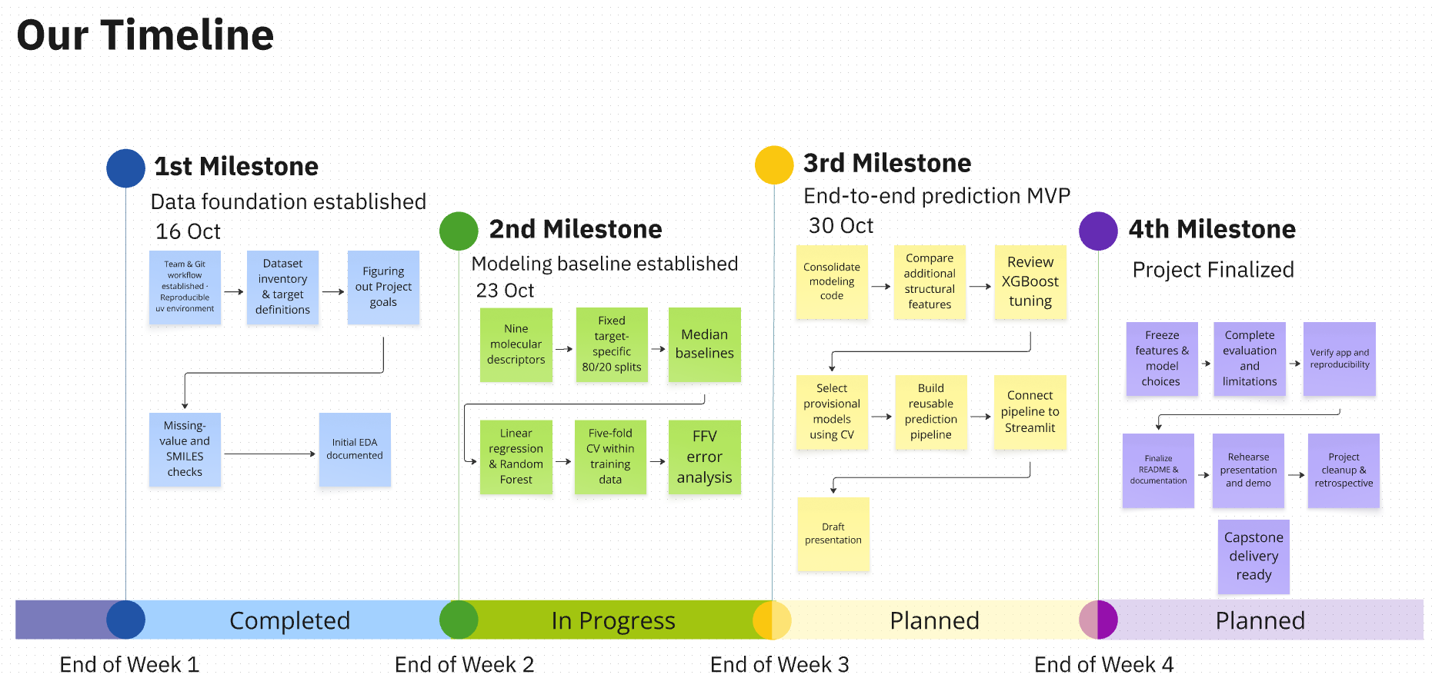
Data-Driven Materials Informatics:
Machine Learning for sustainable Polymer Property Prediction
Team Polymind 😎

Slide 2
Five targets with very different amounts of data
Tg
Glass transition temperature · °C
Where the amorphous polymer changes from glassy to rubbery
FFV
Fractional free volume · dimensionless
Share of volume not occupied by chains; governs gas permeability
Tc
Thermal conductivity · W/(m·K)
How well heat is transported through the material
ρ
Density · g/cm³
Mass per volume; reflects atom masses and chain packing
Radius of gyration · Å
Average spatial size of a polymer chain
No polymer has all five labels
→ one separate model per target. Tg, Density and Rg have only ~500–600 labels each.
Rg
Labels from molecular-dynamics simulations · Kaggle NeurIPS Open Polymer Prediction 2025 (train.csv)
Polymer Property Prediction · Mohamed & Suhmi
2
Notes:
Five properties, all from MD simulations. FFV is labelled for 88% of polymers, the others for only 6-9%. No row has all five, so we train one model per target and treat the small targets (Tg, Density, Rg) carefully with cross-validation.

Slide 3
Structure–property expectations vs. what our model uses
Target | Expected structural drivers | Top descriptors in our model* | Consistent?
Tg | ↑ backbone stiffness (rings, aromatics), bulky side groups, polarity / H-bonding · ↓ flexible linkages, long side chains | NumRings 0.40 · MolLogP 0.16 | ✓ chain stiffness
FFV | Packing efficiency: ↑ rigid, bulky, contorted units · ↓ strong interchain interactions | TPSA 0.24 · MolLogP 0.24 | ✓ polarity → packing
Tc | Interchain interactions (H-bonding, polarity), backbone stiffness | MolLogP 0.57 | ~ plausible, to verify
Density | Heavy atoms (F, Cl, Br, S), packing efficiency; inverse to FFV (Spearman −0.50) | MolLogP 0.25 · MolWt 0.22 | ~ no mass-per-atom feature yet
Rg | Repeat-unit size, chain stiffness | MolWt 0.33 · MolLogP 0.20 | ✓ chain size
Next (?): add chemistry-motivated descriptors; rotatable bonds (flexibility), Fsp³, aromatic-atom share, halogen / heavy-atom counts, size-normalised ratios.
* Random-forest feature importance using our 9 RDKit descriptors; importance shows what the model uses, not causation.
Polymer Property Prediction · Mohamed & Suhmi
3
Notes:
Feature importances largely match textbook structure-property relationships: ring count drives Tg (stiffness), MolWt drives Rg (size), polarity descriptors drive FFV (packing). Tc dominated by MolLogP is plausible as a proxy for interchain interactions but needs checking. For Density we lack a mass-per-atom descriptor, which motivates the chemistry-driven feature set we test next.

Slide 4
Nine simple descriptors already cut the error by 34–48%
Current features: 9 RDKit descriptors of the repeat unit
Size
MolWt mass of the repeat unit
HeavyAtomCount atoms excluding hydrogen
NumAtoms graph atoms incl. * attachment points
Rigidity
NumRings rings in the structure
NumAromaticRings aromatic rings
How we evaluate
MAE per target, compared with a median baseline; 5-fold cross-validation on the training data.
Goal ≥ 40%: met for FFV, Tc, Density; not yet for Tg, Rg.
Caveat: not yet a fair model comparison — all models use default settings, and many differences are within fold-to-fold variation. Final model choice after tuning all models.
Polarity & H-bonding
NumHDonors H-bond donors
NumHAcceptors H-bond acceptors
MolLogP lipophilicity (octanol–water)
TPSA topological polar surface area
Best of linear regression, random forest and XGBoost per target (Tg: linear regression; FFV, Rg: random forest; Tc, Density: XGBoost). MolWt describes the repeat unit, not the full chain.
Polymer Property Prediction · Mohamed & Suhmi
4
Notes:
Our current features are nine RDKit descriptors calculated from the repeat-unit SMILES, grouped into size, rigidity and polarity / H-bonding. We compared linear regression, random forest and XGBoost with five-fold cross-validation and measure MAE relative to a median baseline. The best model per target reduces the error by 34 to 48 percent. We reach our 40 percent goal for FFV, Tc and Density, but not yet for Tg and Rg, which are also small datasets. Since the learning curves flatten, richer features are our next step.

