Slide 1
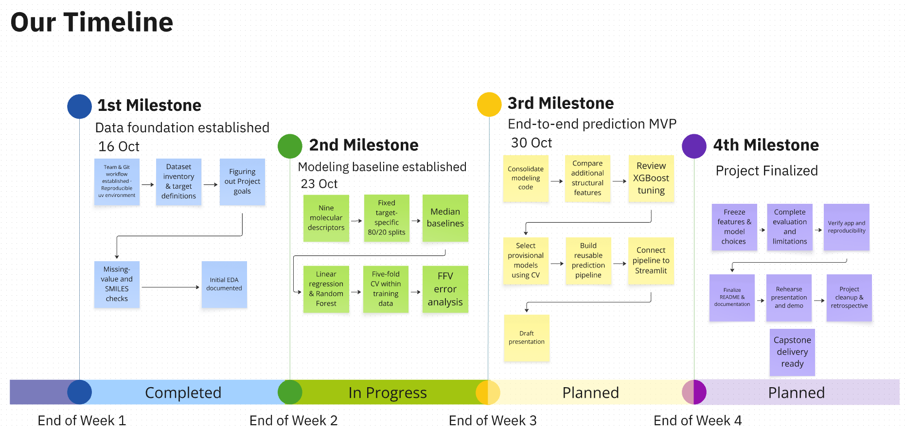
Data-Driven Materials Informatics:
Machine Learning for sustainable Polymer Property Prediction
Team Polymind 😎

Slide 2
Coach feedback: four suggestions, all tested
Coach suggestion | What we did | Result
1. Extract more chemistry from SMILES (H-bond donors/acceptors, substituted groups) | 22 new descriptors: 10 functional groups counted in backbone vs. side chain, largest side group, backbone unsaturation, H-bonding per atom | ~ Small gain: error reduction +0 to +2 points
2. Use more features | Feature sets from 9 up to 1,067 features (descriptors + Morgan fingerprints) | ✓ Best: 43 descriptors + fingerprints
3. Fill missing targets, only if the model is precise enough (metric now: MAE) | Measured MAE per target with tuned models, in the unit of each property | ✗ Errors still large (Tg ±47 °C) → gaps not filled; MAE threshold to agree
4. One model for all 5 targets | Multi-task neural network that skips missing values instead of filling them | ✓ Works; helps Tg, Tc, Rg vs. separate networks
MAE = mean absolute error, in the unit of the property. Error reduction = 1 − MAE / MAE of always predicting the median (higher is better). All numbers from 5-fold cross-validation.
Polymer Property Prediction · Mohamed & Suhmi
2
Notes:
The coach gave us four suggestions and we tested all of them. One: more chemical features. We added 22 functional-group descriptors that also say whether a group sits in the backbone or a side chain, for example ester in PET's backbone versus PMMA's side chain. The gain was small, which tells us this information was mostly captured already. Two: more features in general. The best results come from 43 descriptors plus fingerprints. Three: fill in missing targets, but only if the model is precise enough. The coach first said R² of 0.9, and has now corrected that to MAE, the average error in the unit of each property. So all results today are shown as MAE. The errors are still large, for example Tg is off by about 47 degrees on average, so we did not fill any gaps. We would like to agree on an MAE threshold with the coach. Four: one model for all five properties. We built it without filling gaps, which I'll show in a moment.

Slide 3
Our features: from 9 to 43 descriptors
Original 9 (start)
Size, polarity, rings
MolWt mass of the repeat unit
NumAtoms, HeavyAtomCount size
NumRings, NumAromaticRings rings
NumHDonors, NumHAcceptors H-bonding
MolLogP hydrophobicity
TPSA polar surface area
+12 chemistry (set B)
Flexibility, composition, backbone
NumRotatableBonds chain flexibility
FractionCSP3, AromaticAtomFraction aliphatic vs. aromatic
Halogen, S, Si counts heavy atoms, Si–O backbones
MolWt, MolLogP, TPSA per heavy atom size-independent mass and polarity
BackboneLength atoms in the main chain
BackboneRingFraction rings in the backbone vs. pendant
SideChainFraction share of atoms outside the backbone
+22 functional groups (set B+)
Where a group sits matters
Ester, carbonate, amide, imide, urethane, ether, siloxane, sulfone each counted in backbone and in side chain (16)
Hydroxyl, nitrile side chain only (2)
LargestSideGroup long side chains plasticise
BackboneUnsaturation C=C in the main chain
H-donors, H-acceptors per heavy atom H-bonding density
Example: PET has its ester in the backbone, PMMA in the side chain
Feature set B+ = all 43 descriptors. Optionally + 1,024 Morgan fingerprint bits (local atom neighbourhoods up to two bonds). Backbone = shortest path between the two * attachment points.
Polymer Property Prediction · Mohamed & Suhmi
3
Notes:
Here are all the descriptors we use. We started with nine standard RDKit descriptors for size, polarity and rings. I added twelve chemistry-motivated ones: chain flexibility, aromatic character, heavy elements, size-independent mass and polarity, and backbone features. The backbone is the shortest path between the two attachment points of the repeat unit. Following the coach's suggestion, we added 22 functional-group descriptors. The key idea is location: an ester in the backbone, like in PET, behaves differently from an ester in a side chain, like in PMMA. Optionally we add 1,024 Morgan fingerprint bits.

Slide 4
Where the improvement came from
Takeaways
• The chemistry descriptors gave by far the biggest jump (Density 48% → 70%, Rg 36% → 63%).
• Every later step added only +0 to +7 points.
• All five targets now pass our 40% goal in cross-validation (Tg 47%).
• Supplementary Kaggle data: tested, no gain (FFV +1 point, Tg and Tc unchanged).
• Features matter more than model choice.
Error reduction = 1 − MAE / MAE of the median baseline, best model per step, 5-fold cross-validation. Final step: ensemble for Tg, Tc, Density, Rg; tuned XGBoost for FFV.
Polymer Property Prediction · Mohamed & Suhmi
4
Notes:
This chart shows the whole journey per property, now measured with MAE. Because the properties have different units, we show how much smaller the error is than a naive model that always predicts the median. The grey bars are where we started with nine simple descriptors. The biggest jump came from the chemistry descriptors, for density from 48 to 70 percent and for Rg from 36 to 63 percent. After that, every step, the functional groups and fingerprints, fair tuning, the ensemble, added only a few points. In cross-validation, all five properties now pass our 40 percent goal. We also re-tested the supplementary Kaggle data with the tuned models: no real gain. The lesson: good features matter more than the model.

Slide 5
Fair tuning: XGBoost wins, but the gain is small
Target | Random forest, default | XGBoost, default | XGBoost, tuned | Gain from tuning | Tuned XGBoost MAE
Tg | 41% | 41% | 44% | +3 | 49 °C
FFV | 65% | 66% | 69% | +3 | 0.0063
Tc | 66% | 66% | 67% | +1 | 0.025 W/(m·K)
Density | 68% | 72% | 73% | +1 | 0.029 g/cm³
Rg | 64% | 65% | 65% | +0 | 1.37 Å
✓ Answers the open point from the last PM meeting: with the same tuning budget, XGBoost wins for every target.
✓ The default settings were already close to optimal: tuning adds only 0 to 3 points.
Error reduction vs. median baseline (%), 5-fold cross-validation, best of B+ and B+ + D. Tuning: 30 random settings per model, same folds; settings were selected by R² (not yet re-run with MAE).
Polymer Property Prediction · Mohamed & Suhmi
5
Notes:
Last time we noted that only XGBoost had been tuned, so the comparison was not fair. Now both models got the same budget: 30 random settings and the same five folds. XGBoost wins for every target. Tuning itself helped only a little, at most three points, so the defaults were already good. The last column shows the error in real units, for example Tg is off by 49 degrees on average. One honest note: the tuning picked settings by R², because that was the criterion at the time. Picking by MAE might choose slightly different settings, but the gain from tuning is so small that this should not change the picture.

Slide 6
One model for all five targets, without filling the gaps
How it works: the masked loss
Target | Multi-task NN (1 model) | Single-task NN (5 models) | Tuned XGBoost (5 models)
Tg | 43% | 40% | 44%
FFV | 62% | 66% | 69%
Tc | 64% | 62% | 67%
Density | 70% | 69% | 73%
Rg | 63% | 57% | 65%
Polymer | Tg | FFV | Tc | Dens. | Rg
A | – | ✓ | – | – | –
B | – | – | ✓ | ✓ | ✓
C | ✓ | – | – | – | –
• One network, five outputs.
• Each polymer trains only the outputs it has real values for (✓).
• Missing values (–) are skipped, not filled: the model never learns from guesses.
• Learns from the real labels of all five targets at once.
✓ Sharing helps the small targets: Tg +3, Tc +2, Rg +6 points vs. separate networks.
~ FFV loses 4 points; XGBoost is still best overall.
✗ Fingerprints overfit the network (too many inputs for ~500 labels).
Table: error reduction vs. median baseline (%), 5-fold cross-validation. Neural networks: 2 hidden layers (512, 256), not tuned; best feature set per model. Single-task: same architecture, one per target.
Polymer Property Prediction · Mohamed & Suhmi
6
Notes:
This is the model without filling gaps. One network with five outputs. Each polymer only teaches the outputs it really has values for; the missing ones are skipped in the loss, so the network never learns from our own guesses. Compared with the same network trained separately per property, sharing helps the small targets: the error reduction rises by 3 points for Tg, 2 for Tc and 6 for Rg. Tc, density and Rg are mostly measured on the same polymers, so the network can use their relationship. FFV loses a few points, and tuned XGBoost is still best overall, but the network is not tuned yet.

Slide 7
Final check on unseen data: errors 62–73% smaller, Tg 33%
Target | Final model | MAE: median baseline | MAE: starting model | MAE: final model | Error reduction | ≥ 40% goal
Tg | Ensemble | 78.7 °C | 62.6 °C | 52.8 °C | 33% | ✗
FFV | Tuned XGBoost | 0.0214 | 0.0109 | 0.0063 | 71% | ✓
Tc | Ensemble | 0.080 W/(m·K) | 0.039 W/(m·K) | 0.025 W/(m·K) | 69% | ✓
Density | Ensemble | 0.104 g/cm³ | 0.066 g/cm³ | 0.028 g/cm³ | 73% | ✓
Rg | Ensemble | 3.86 Å | 2.87 Å | 1.46 Å | 62% | ✓
• In plain words: density within ±0.03 g/cm³ (about 3%), Rg within ±1.5 Å, Tg within ±53 °C on average.
• Compared with our starting model on the same polymers, the error drops by 16% (Tg) to 58% (Density).
• Lower than cross-validation (Tg 47% → 33%): partly optimism after model selection, partly harder validation sets (the untouched starting model also drops there). Tg remains the hardest property.
Validation subsets = 20% of each target's labels, never used for any decision. MAE = mean absolute error. Error reduction = 1 − MAE / MAE of the median baseline. Ensemble = 50/50 multi-task NN + tuned XGBoost.
Polymer Property Prediction · Mohamed & Suhmi
7
Notes:
This is the one-time final check on data we kept aside from the very beginning, now with MAE, so the errors are in real units. On average, our final models predict density within 0.03 grams per cubic centimetre, about 3 percent, Rg within 1.5 angstrom, and Tg within about 53 degrees. Compared with a naive model that always predicts the median, the error is 62 to 73 percent smaller for four properties, so they reach our 40 percent goal; Tg reaches only 33 percent. Compared with our starting model on the same polymers, the error drops by 16 percent for Tg up to 58 percent for density. The results are lower than in cross-validation. Part of that is normal optimism, because we chose settings on the folds, but the starting model also drops on these validation sets, so they are simply harder. As agreed, we do not change anything after this check.

Slide 8
Conclusions and next steps
What we learned
1. Chemistry-motivated features are the main lever; model choice and tuning add little.
2. Filling gaps is not justified yet: errors are still large (Tg ±53 °C on unseen data).
3. One model for all targets works without filling gaps and helps the small targets.
4. Use case: ranking and screening candidate polymers, not replacing simulations or lab tests.
Next steps
1. Prediction pipeline: SMILES in → five properties out
2. Small demo (enter a polymer, get predictions)
3. Final presentation and LinkedIn write-up
Optional
• Agree on an MAE threshold for gap filling with the coach
• Tune the multi-task network, selecting settings by MAE
• Ask the coach: are FFV values ≥ 0.7 realistic or simulation artefacts?
Polymer Property Prediction · Mohamed & Suhmi
8
Notes:
To sum up: features were the main lever. Filling the gaps is not justified yet, because the errors are still large, especially for Tg; we would like to agree on an MAE threshold with the coach. The one-model-for-all goal is reached in a cleaner way, without filling gaps. The models are useful for ranking and screening candidates. Next we build the prediction pipeline, SMILES in and five properties out, and a small demo for the final presentation.

