Slide 1
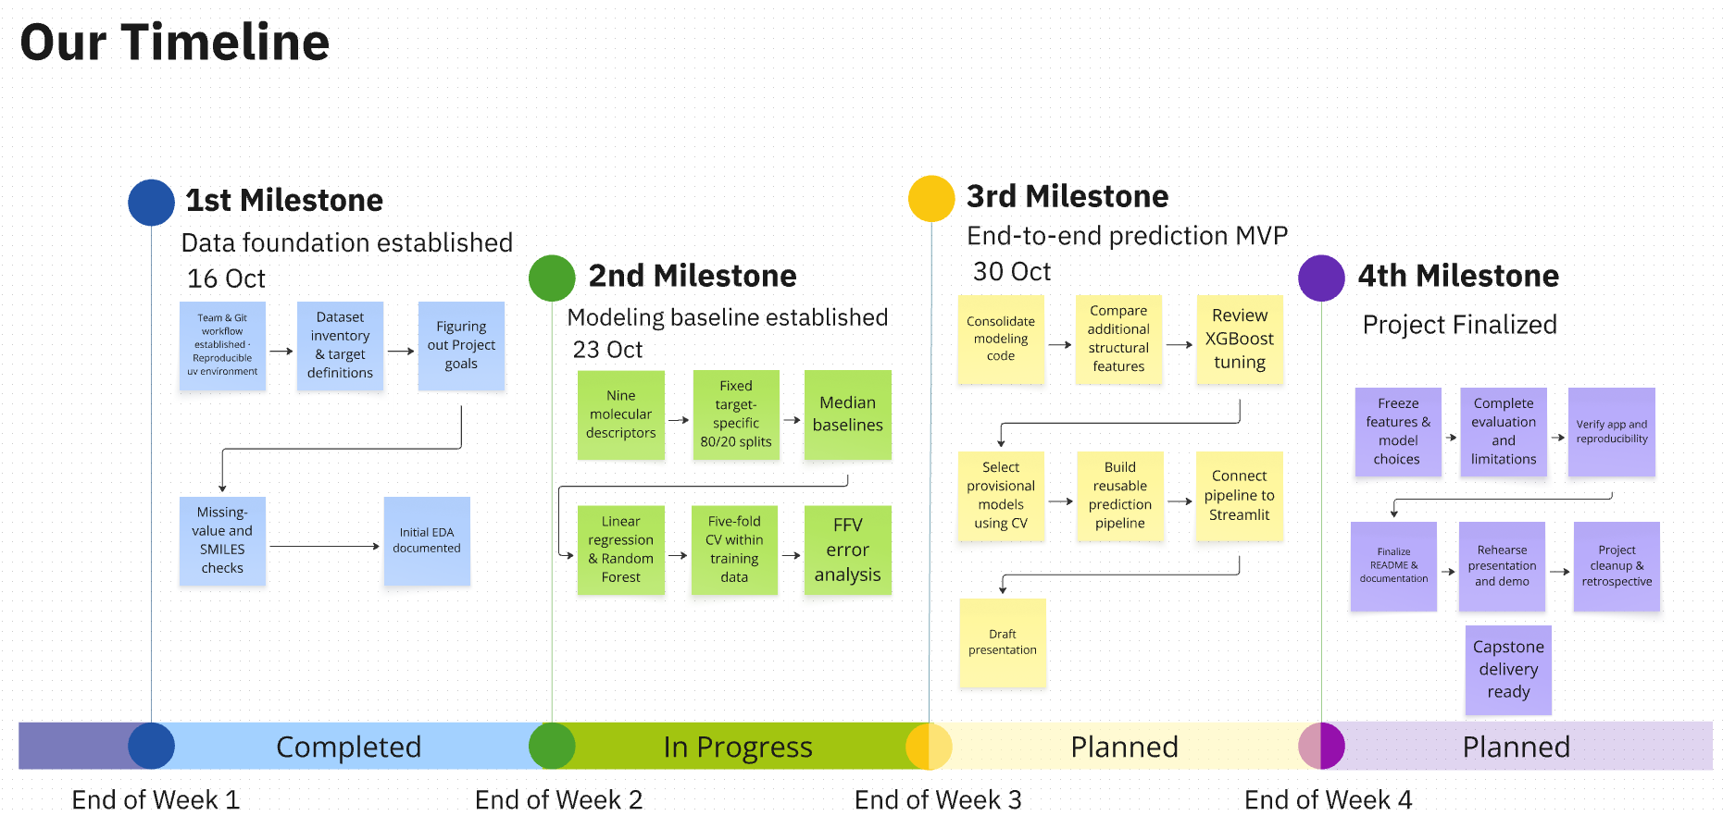
Data-Driven Materials Informatics:
Machine Learning for sustainable Polymer Property Prediction
Team Polymind 😎

Slide 2
Five targets with very different amounts of data
Tg
Glass transition temperature · °C
Where the amorphous polymer changes from glassy to rubbery
FFV
Fractional free volume · dimensionless
Share of volume not occupied by chains; governs gas permeability
Tc
Thermal conductivity · W/(m·K)
How well heat is transported through the material
ρ
Density · g/cm³
Mass per volume; reflects atom masses and chain packing
Radius of gyration · Å
Average spatial size of a polymer chain
No polymer has all five labels
→ one separate model per target. Tg, Density and Rg have only ~500–600 labels each.
Rg
Labels from molecular-dynamics simulations · Kaggle NeurIPS Open Polymer Prediction 2025 (train.csv)
Polymer Property Prediction · Mohamed & Suhmi
2
Notes:
Five properties, all from MD simulations. FFV is labelled for 88% of polymers, the others for only 6-9%. No row has all five, so we train one model per target and treat the small targets (Tg, Density, Rg) carefully with cross-validation.

Slide 3
Adding chemistry to the features: 9 → 21 descriptors
Added descriptor | Chemical motivation
NumRotatableBonds | Chain flexibility
FractionCSP3, AromaticAtomFraction | Aliphatic vs. aromatic character, stiffness
Halogen / S / Si counts | Heavy atoms (density); flexible Si–O backbones
MolWt, MolLogP, TPSA per heavy atom | Size-independent mass and polarity
BackboneLength | Atoms between the two attachment points
BackboneRingFraction | Rings in the backbone vs. pendant rings
SideChainFraction | Share of atoms outside the backbone
How we define the backbone
The SMILES describes one repeat unit; the two * atoms mark where it connects to its neighbours.
Backbone = atoms on the shortest path between the two * atoms.
Everything else counts as side chain.
Example: *CC(*)c1ccccc1… (styrene-like)
→ backbone: 2 carbons; the phenyl ring is pendant, so BackboneRingFraction = 0.
Feature set B = original 9 RDKit descriptors + 12 descriptors chosen from polymer structure–property relationships.
Polymer Property Prediction · Mohamed & Suhmi
3
Notes:
Our original nine descriptors could not tell where a ring sits in the polymer. So we added twelve chemistry-motivated descriptors: flexibility, aromatic character, heavy atoms, size-normalised polarity and mass, and backbone features. The backbone is the shortest path between the two attachment points of the repeat unit; for polystyrene, for example, the phenyl ring is pendant, not in the backbone. 18 structures with one, three or four attachment points get no backbone value and are filled with the median during training.

Slide 4
Chemistry descriptors cut the error by 40–70% vs. the baseline
What we tested
Six feature sets, same models, same 5 folds: the original 9, 9 minus redundant counts, B (21), all RDKit descriptors (149 after cleaning), Morgan fingerprints (1,024 bits), B + fingerprints.
Takeaways
• All targets now beat our ≥ 40% goal.
• B gives most of the gain with only 21 interpretable features.
• Fingerprints add only 1–7 points; alone they are weaker than B.
• Removing NumAtoms / HeavyAtomCount does not help.
Error reduction = 1 − MAE / MAE of median baseline · 5-fold cross-validation on the training data · best of random forest and XGBoost, both with default settings.
Polymer Property Prediction · Mohamed & Suhmi
4
Notes:
We compared six feature sets with the same two models and the same five folds. The twelve chemistry descriptors gave the biggest jump: for density and Rg the error reduction went from about 40 to about 70 percent. Adding Morgan fingerprints helps only slightly, and fingerprints alone are weaker, probably because density and Rg depend on global features like mass per atom and chain shape. All five targets now beat our 40 percent goal. These are still default models; fair tuning comes next.

Slide 5
Does the model think like a chemist?
Target | Most important descriptors* | Interpretation
Tg | FractionCSP3 0.32 · BackboneRingFraction 0.22 | Chain stiffness: rings in the backbone matter, not ring count (NumRings 0.40 → 0.07) | ✓
FFV | TPSAPerHeavyAtom 0.26 · BackboneRingFraction 0.17 | Polarity density (packing) and rigid backbones that pack poorly | ✓
Tc | NumRotatableBonds 0.59 | Chain flexibility; MolLogP (0.57 before) was likely a proxy for size and flexibility | ✓
Density | MolWtPerHeavyAtom 0.45 · MolLogPPerHeavyAtom 0.24 | Average atomic mass (halogens, S) and packing | ✓
Rg | SideChainFraction 0.64 | Chain shape: share of atoms outside the backbone | ~
Compared with our first model: both open points from the last meeting are addressed: logP no longer dominates Tc, and a mass-per-atom descriptor now drives density.
* Random-forest feature importance on feature set B (default settings). Importance shows what the model uses, not causation; labels are from MD simulations.
Polymer Property Prediction · Mohamed & Suhmi
5
Notes:
With the new descriptors, the model's choices match textbook structure–property relationships better. For Tg, backbone rings and sp3 content dominate, and the plain ring count lost most of its importance, which supports the backbone-versus-pendant distinction. For thermal conductivity, the number of rotatable bonds replaced logP, so logP was probably standing in for chain size and flexibility. For density, the mass per heavy atom is now the main driver. Rg depends mostly on the side-chain fraction; I marked it with a tilde because I would like a polymer physicist's view on whether that is plausible for these simulations.

Slide 6
Open questions for a chemist, and next steps
Questions we would like your view on
1. Group-contribution methods (e.g. Van Krevelen) predict Tg and density from structural groups. Worth adding as features?
2. Rg is driven by SideChainFraction. Plausible for MD-simulated chains, or an artefact of how the repeat unit is drawn?
3. 18 structures have 1, 3 or 4 attachment points. How should the backbone be defined for them?
4. All labels come from MD simulations. What would you expect to change for experimental values?
Next steps
1. Fair tuning: random forest and XGBoost with the same search budget on feature sets B and B + fingerprints
2. One final evaluation on the untouched validation sets
3. Prediction pipeline: SMILES in → five properties out
4. Results presentation and LinkedIn write-up
Polymer Property Prediction · Mohamed & Suhmi
6
Notes:
These are the points where chemistry expertise would help us most. Then the next technical step is a fair comparison: tuning the random forest and XGBoost with the same budget, followed by one final evaluation on data the models have never seen.

