Slide 1
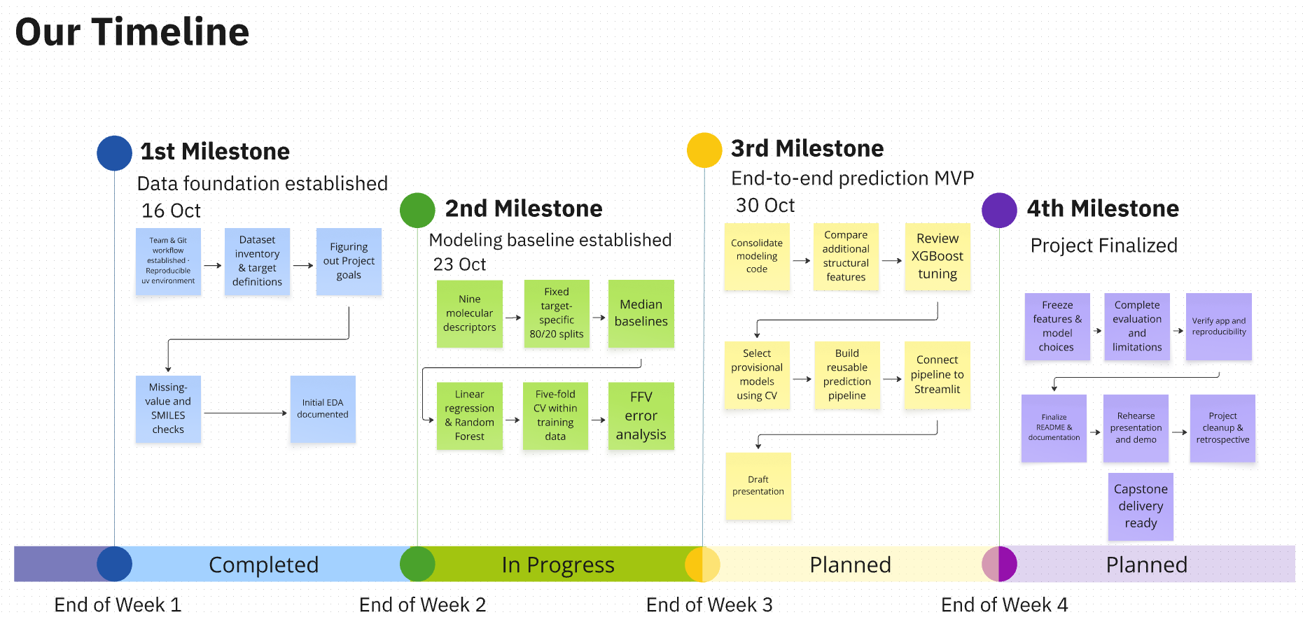
Data-Driven Materials Informatics:
Machine Learning for sustainable Polymer Property Prediction
Team Polymind 😎
Notes:
Hi, we are Team Polymind. Our project: predicting five polymer properties directly from the chemical structure which is in SMILES, using the Kaggle NeurIPS Open Polymer Prediction data. The timeline shows where we are: data foundation and modelling baseline done, now improving the models and building the prediction tool.

Slide 2
Five targets with very different amounts of data
Tg
Glass transition temperature · °C
Where the amorphous polymer changes from glassy to rubbery
FFV
Fractional free volume · dimensionless
Share of volume not occupied by chains; governs gas permeability
Tc
Thermal conductivity · W/(m·K)
How well heat is transported through the material
ρ
Density · g/cm³
Mass per volume; reflects atom masses and chain packing
Radius of gyration · Å
Average spatial size of a polymer chain
No polymer has all five labels
→ one separate model per target. Tg, Density and Rg have only ~500–600 labels each.
Rg
Labels from molecular-dynamics simulations · Kaggle NeurIPS Open Polymer Prediction 2025 (train.csv)
Polymer Property Prediction · Mohamed & Suhmi
2
Notes:
Each repeating unit of polymer is displayed as SMILES (Simplified Molecular Input Line Entry System) is a way to write a molecule’s structure as a single line of text.
Five targets: glass transition temperature, free volume, thermal conductivity, density and radius of gyration. The key challenge: very different amounts of data. FFV has about 7,000 labels, the others only 500 to 700, and no polymer has all five. So we treat each target separately.

Slide 3
Our goal: fill the gaps, but only where we can trust it
Today: 7,973 polymers, none has all five labels
Goal: predict the missing values
Polymer
Tg
FFV
Tc
Dens.
Rg
Tg
FFV
Tc
Dens.
Rg
#1
?
✓
?
?
?
≈
✓
≈
≈
≈
#2
?
✓
?
?
?
≈
✓
≈
≈
≈
#3
✓
?
?
?
?
✓
≈
≈
≈
≈
✓ measured label
? missing (94% for Tg)
≈ model prediction
#4
?
✓
✓
✓
✓
≈
✓
✓
✓
✓
#5
?
✓
?
?
?
≈
✓
≈
≈
≈
#6
?
?
✓
✓
✓
≈
≈
✓
✓
✓
#7
?
✓
?
?
?
≈
✓
≈
≈
≈
#8
✓
✓
?
?
?
✓
✓
≈
≈
≈
Labels
511
7,030
737
613
614
1
Predict all five
from the SMILES of a repeat unit
2
≥ 40% smaller error
than always guessing the median
3
Fill gaps only if reliable
Tg is not there yet
Labels per target in train.csv (7,973 polymers). Error reduction compared with always predicting the median. Illustration: 8 example rows.
Polymer Property Prediction · Mohamed & Suhmi
3
Notes:
Our goal in one picture. Today the table is mostly empty: only 6% of polymers have a Tg value, and no polymer has all five. We want to predict all five properties from the structure, with an error at least 40% smaller than simply guessing the median. Only when a property is predicted reliably enough do we use it to fill the gaps. Tg is not there yet.
So how do we evaluate?

Slide 4
How we evaluate: a frozen test set, choices by cross-validation
1
Frozen validation set
20% of each target's labels, split once (seed 42)
Never used for any choice
Scored once at the end per model version
2
5-fold cross-validation
On the other 80% (training polymers)
Every feature, model and setting chosen here
Same folds for every comparison
3
Metric and goal
MAE in the unit of each property
Error reduction = 1 − MAE / MAE of always predicting the median
Goal: ≥ 40% error reduction
Why: scores on data used for decisions are optimistic. Only the frozen set shows how the model does on polymers it has never seen.
Training sizes after the split: Tg 408 · FFV 5,624 · Tc 589 · Density 490 · Rg 491 polymers.
Polymer Property Prediction · Mohamed & Suhmi
4
Notes:
Before any results, how we evaluate. 20% of each target's data is locked away as a test set and never used for decisions. Every choice is made with 5-fold cross-validation on the rest. Our metric is MAE, and error reduction compared with always guessing the median. Our goal: at least 40%.
“First, the model needs to understand the polymer. How do we turn a SMILES into numbers?”

Slide 5
Our features: from 9 to 43 descriptors
Original 9 (start)
Size, polarity, rings
MolWt mass of the repeat unit
NumAtoms, HeavyAtomCount size
NumRings, NumAromaticRings rings
NumHDonors, NumHAcceptors H-bonding
MolLogP hydrophobicity
TPSA polar surface area
+12 chemistry (set B)
Flexibility, composition, backbone
NumRotatableBonds chain flexibility
FractionCSP3, AromaticAtomFraction aliphatic vs. aromatic
Halogen, S, Si counts heavy atoms, Si–O backbones
MolWt, MolLogP, TPSA per heavy atom size-independent mass and polarity
BackboneLength atoms in the main chain
BackboneRingFraction rings in the backbone vs. pendant
SideChainFraction share of atoms outside the backbone
+22 functional groups (set B+)
Where a group sits matters
Ester, carbonate, amide, imide, urethane, ether, siloxane, sulfone each counted in backbone and in side chain (16)
Hydroxyl, nitrile side chain only (2)
LargestSideGroup long side chains plasticise
BackboneUnsaturation C=C in the main chain
H-donors, H-acceptors per heavy atom H-bonding density
Example: PET has its ester in the backbone, PMMA in the side chain
Feature set B+ = all 43 descriptors. Optionally + 1,024 Morgan fingerprint bits (local atom neighbourhoods up to two bonds). Backbone = shortest path between the two * attachment points.
Polymer Property Prediction · Mohamed & Suhmi
5
Notes:
Features: we started with 9 simple RDKit descriptors and added chemistry-motivated ones: flexibility, composition, functional groups in backbone vs. side chain. Optionally plus Morgan fingerprints.
Did these extra features actually make a difference?

Slide 6
Where the improvement came from
Takeaways
• The chemistry descriptors gave by far the biggest jump (Density 48% → 70%, Rg 36% → 63%).
• Every later step added only +0 to +7 points.
• All five targets now pass our 40% goal in cross-validation (Tg 47%).
• Supplementary Kaggle data: tested, no gain (FFV +1 point, Tg and Tc unchanged).
• Features matter more than model choice.
Error reduction = 1 − MAE / MAE of the median baseline, best model per step, 5-fold cross-validation. Final step: ensemble for Tg, Tc, Density, Rg; tuned XGBoost for FFV.
Polymer Property Prediction · Mohamed & Suhmi
6
Notes:
This was the biggest lesson: chemistry descriptors gave the big jump, for example Density from 48% to 70%. Later steps, tuning and ensembles, only added a few points. Features matter more than the model.

Slide 7
Fair tuning: XGBoost wins, but the gain is small
Target | Random forest, default | XGBoost, default | XGBoost, tuned | Gain from tuning | Tuned XGBoost MAE
Tg | 41% | 41% | 44% | +3 | 49 °C
FFV | 65% | 66% | 69% | +3 | 0.0063
Tc | 66% | 66% | 67% | +1 | 0.025 W/(m·K)
Density | 68% | 72% | 73% | +1 | 0.029 g/cm³
Rg | 64% | 65% | 65% | +0 | 1.37 Å
✓ With the same tuning budget, XGBoost wins for every target.
✓ The default settings were already close to optimal: tuning adds only 0 to 3 points.
Error reduction vs. median baseline (%), 5-fold cross-validation, best of B+ and B+ + D. Tuning: 30 random settings per model, same folds; settings were selected by R² (not yet re-run with MAE).
Polymer Property Prediction · Mohamed & Suhmi
7
Notes:
We compared random forest and XGBoost with the same tuning budget. XGBoost wins for every target, but tuning adds only 1 to 3 points.

Slide 8
One model for all five targets, without filling the gaps
How it works: the masked loss
Target | Multi-task NN (1 model) | Single-task NN (5 models) | Tuned XGBoost (5 models)
Tg | 43% | 40% | 44%
FFV | 62% | 66% | 69%
Tc | 64% | 62% | 67%
Density | 70% | 69% | 73%
Rg | 63% | 57% | 65%
Polymer | Tg | FFV | Tc | Dens. | Rg
A | – | ✓ | – | – | –
B | – | – | ✓ | ✓ | ✓
C | ✓ | – | – | – | –
• One network, five outputs.
• Each polymer trains only the outputs it has real values for (✓).
• Missing values (–) are skipped, not filled: the model never learns from guesses.
• Learns from the real labels of all five targets at once.
✓ Sharing helps the small targets: Tg +3, Tc +2, Rg +6 points vs. separate networks.
~ FFV loses 4 points; XGBoost is still best overall.
✗ Fingerprints overfit the network (too many inputs for ~500 labels).
Table: error reduction vs. median baseline (%), 5-fold cross-validation. Neural networks: 2 hidden layers (512, 256), not tuned; best feature set per model. Single-task: same architecture, one per target.
Polymer Property Prediction · Mohamed & Suhmi
8
Notes:
No polymer has all five labels, so we built one neural network with five outputs that simply skips missing values instead of guessing them. It helps the small targets, and we average it with XGBoost.

Slide 9
Final check on unseen data: errors 65–75% smaller, Tg 33%
Target | Final model | MAE: median baseline | MAE: starting model | MAE: final model | Error reduction | ≥ 40% goal
Tg | Ensemble | 78.7 °C | 62.6 °C | 52.4 °C | 33% | ✗
FFV | Tuned XGBoost | 0.0214 | 0.0109 | 0.0062 | 71% | ✓
Tc | Ensemble | 0.080 W/(m·K) | 0.039 W/(m·K) | 0.023 W/(m·K) | 72% | ✓
Density | Tuned XGBoost | 0.104 g/cm³ | 0.066 g/cm³ | 0.027 g/cm³ | 75% | ✓
Rg | Ensemble | 3.86 Å | 2.87 Å | 1.35 Å | 65% | ✓
In plain words: density within ±0.03 g/cm³ (about 3%), Rg within ±1.4 Å, Tg within ±52 °C on average.
Compared with the starting model on the same polymers, the error drops by 16% (Tg) to 60% (Density).
Not yet included: external Tg data and Chemprop (slides 12–14). They get one final check after integration.
Validation subsets = 20% of each target's labels, never used for any decision. Final models use 73 descriptors + fingerprints. Ensemble = 50/50 multi-task NN + tuned XGBoost.
Polymer Property Prediction · Mohamed & Suhmi
9
Notes:
Final check on the locked test set with our final models: errors 65 to 75% smaller than the baseline for four targets. Tg reaches 33%, below our goal. Scores are lower than in cross-validation, which is expected. The newest experiments are not in here yet; they get one final check after integration.
Good results are only useful if people can use them. So what runs behind our tool?

Slide 10
The demo runs five saved models through one interface
Target | Model | Structure representation
Tg | Random forest | Morgan 1,024 + 21 descriptors
FFV | Random forest | Morgan 1,024
Tc | XGBoost | 21 descriptors
Density | XGBoost | 21 descriptors
Rg | Random forest | Morgan 1,024
Our current working version
One function returns all five properties
Fixed, saved and documented, with its own holdout check (backup slide)
Simple, robust models per target
Next
Swap in the improved models once they are verified on the same split
Separate model per target. Morgan fingerprints: radius 2, chirality enabled. Full settings: backup slides.
Polymer Property Prediction · Mohamed & Suhmi
10
Notes:
This is our current working version behind the demo: one saved model per target, random forest or XGBoost, on 21 descriptors and/or Morgan fingerprints. One function returns all five properties. Next, we test our improved models on the same data as these models. If they are better, they replace them in the tool

Slide 11
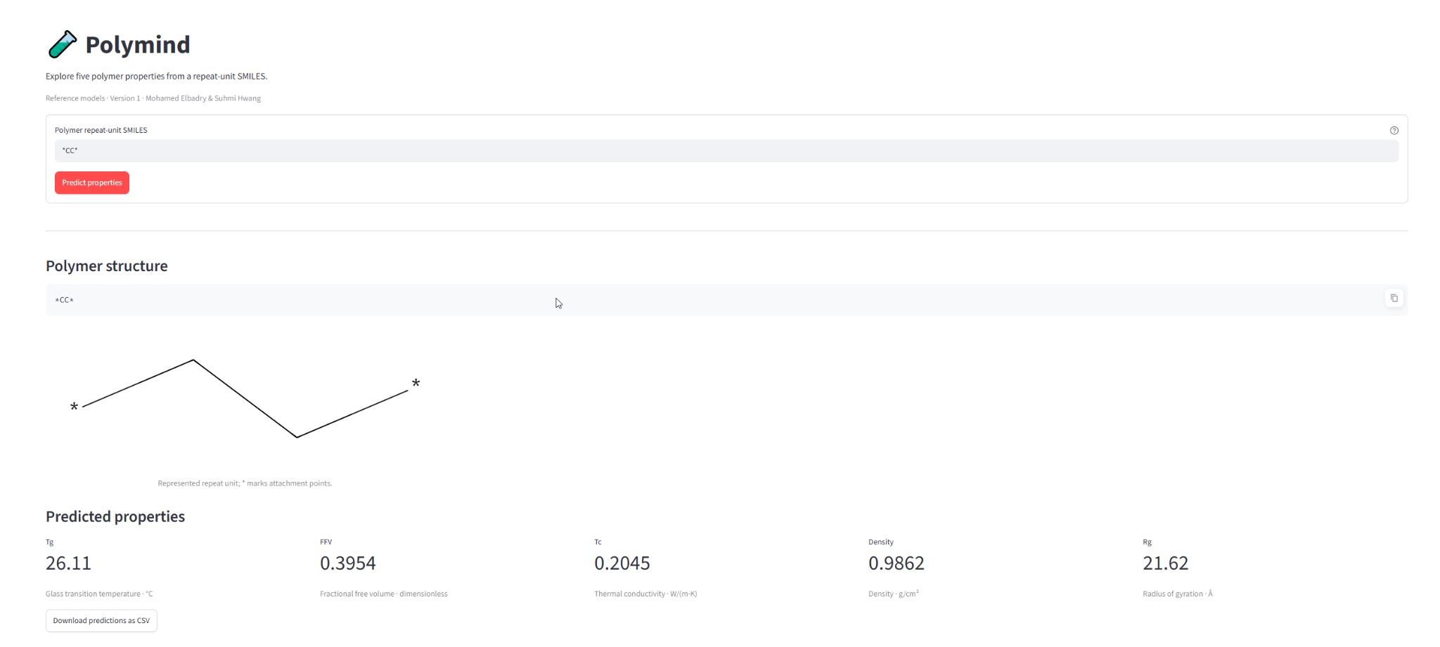
From model to tool: SMILES in, five properties out
Use case: rank and pre-screen candidate polymers before simulations or lab tests, not replace them.
Polymind Streamlit demo, example *CC* (polyethylene). Model estimates, not experimental measurements.
Polymer Property Prediction · Mohamed & Suhmi
11
Notes:
Here is the tool: enter a SMILES, for example polyethylene, and get all five properties. [Optional: show the live demo.] The use case is screening and ranking candidates before simulations or lab tests, not replacing them.

Slide 12
Why Tg is the hardest target: noisy labels and extremes
±30 °C
same polymer, different literature sources: label noise
0.69
slope of predicted vs. true Tg: predictions pulled to the mean
Tested, no gain
Clustering (coach's suggestion): weak clusters (silhouette 0.13); per-cluster models not better
Removing suspicious labels (9 fully aromatic polymers with Tg < 0 °C): 48.2 → 47.9 °C
Focusing on extremes (weights, MAE objective, less regularisation): no gain
Pretrained Uni-Mol embeddings: worse (Tg 52.1 vs 48.2 °C)
→ The limit is information, not the model: we need more Tg data.
61 / 60 °C
error for the lowest / highest Tg fifth (middle: 34 °C)
58 vs 38 °C
error for polymers unlike vs. like the training data
Tg error analysis, 5-fold cross-validation on the 408 Tg training polymers (notebook 08).
Polymer Property Prediction · Mohamed & Suhmi
12
Notes:
So why is Tg so hard? The same polymer can have Tg values 30 degrees apart in different sources: the labels are noisy. Predictions are pulled to the mean, and errors are largest at the extremes and for unfamiliar polymers. We tried clustering, removing suspicious labels and more; nothing helped. The limit is information, so we need more data.

Slide 13
More data helps Tg: external dataset cuts the error 48 → 44 °C
7,367
LAMALAB curated
experimental Tg
7,231
reliable entries
(quality flags)
7,225
unique structures
7,194
after removing all
overlaps with our data
Tg cross-validated MAE (°C, lower is better)
Checks
Tg in K → °C; experimental values
Overlap removed by normalised structure (+ similarity ≥ 0.95 to validation polymers)
Source flag absorbs a ~20 °C offset between datasets
Validation set untouched; experimental, not yet integrated
Our data only (408 polymers)
48.2
+ external data with source flag
44.9
+ half weight for external rows, retuned XGBoost
44.1
Source: Kunchapu & Jablonka, LAMALAB curated Tg dataset, Zenodo 15210035, CC-BY 4.0. Error reduction 45.6% → 50.2% (5-fold CV).
Polymer Property Prediction · Mohamed & Suhmi
13
Notes:
So we added external data: a curated experimental Tg dataset from LAMALAB with about 7,200 polymers after cleaning and removing every overlap with our data. With a flag for the data source, the Tg error drops from 48 to 44 degrees in cross-validation. This is an experimental result and not yet in our current models.

Slide 14
Latest experiments: what helped and what did not
Experiment | Target | Result (5-fold CV) | Verdict
External Tg data (LAMALAB) | Tg | MAE 48.2 → 44.1 °C; error reduction 46% → 50% | ✓ clear gain
Graph neural network (Chemprop) + XGBoost | FFV | Error reduction 72% → 77% (MAE 0.0058 → 0.0048) | ✓ clear gain
Graph neural network (Chemprop) + XGBoost | Tc | Error reduction 67% → 69% | ~ within noise
Chain + 3D shape descriptors (73 in total) | all | +0 to +3 points | ~ small gain
XGBoost re-tuned for MAE | all | Only FFV changed (+1.6 points) | ~ small gain
Pretrained Uni-Mol embeddings | all | Worse for every target | ✗ no gain
Interaction, size and packing descriptors | Tg, Rg, Density | No change (information already covered) | ✗ no gain
Kaggle supplementary data | Tg, FFV, Tc | Mostly duplicates of our data; no gain | ✗ no gain
All results on training polymers only; the validation set was not rescored. Experimental results, not yet in the current models.
Polymer Property Prediction · Mohamed & Suhmi
14
Notes:
Overview of our latest experiments. Two clear gains: external Tg data, and a graph neural network, Chemprop, which helps FFV, where we have lots of data. Several ideas did not help, like pretrained Uni-Mol embeddings or the Kaggle supplementary data. Negative results tell us where the limits are.

Slide 15
Where we stand and what comes next
Target | Best model so far (CV) | Error reduction
Tg | XGBoost + external data | 50% (44.1 °C)
FFV | Chemprop + XGBoost | 77%
Tc | Chemprop + XGBoost | 69%
Density | Tuned XGBoost | 79%
Rg | Multi-task NN + XGBoost | 69%
Next steps
Review and verify the external-data Tg model together
Integrate the new Tg (and FFV) model with its feature calculation into the prediction interface
One final check of the updated models on the frozen validation set
Finalise demo, documentation and final presentation
All five targets pass the 40% goal. Features and data matter more than the model; Tg is limited by label noise.
Best = lowest 5-fold CV MAE on the training polymers. Holdout results of the final models: slide 9.
Polymer Property Prediction · Mohamed & Suhmi
15
Notes:
Where we stand: all five targets pass our 40% goal in cross-validation, Tg is still the weakest. Next: verify the new Tg model together, integrate it into the prediction tool, do one final check on the locked test set, and finish the demo and documentation. Thank you, happy to take questions.

Slide 16
Backup: settings of the five saved models
Target | Algorithm | Fixed configuration
Tg | Random forest | 200 trees, max_features 0.6, min_samples_leaf 2
FFV | Random forest | 200 trees, default settings
Tc | XGBoost | 500 trees, learning_rate 0.05, max_depth 4
Density | XGBoost | 500 trees, learning_rate 0.05, max_depth 4
Rg | Random forest | 200 trees, default settings
All models: seed 42. XGBoost subsample 0.8 and colsample_bytree 0.8. Full settings: models/polymind_v1/manifest.json.
Polymer Property Prediction · Mohamed & Suhmi
16
Notes:
Backup: exact settings of the five saved models.

Slide 17
Backup: holdout metrics of the five saved models
Target | n | MAE | RMSE | R² | MAE: median baseline
Tg | 87 | 45.9 °C | 58.8 °C | 0.67 | 79.6 °C
FFV | 1,419 | 0.0079 | 0.0121 | 0.80 | 0.0199
Tc | 145 | 0.034 W/(m·K) | 0.049 W/(m·K) | 0.69 | 0.074 W/(m·K)
Density | 123 | 0.034 g/cm³ | 0.074 g/cm³ | 0.72 | 0.092 g/cm³
Rg | 124 | 1.84 Å | 2.81 Å | 0.67 | 4.12 Å
Measured on the shared reference split, a different holdout set than slide 9, so the numbers are not directly comparable.
Source: results/08_selected_model_validation/. Random holdout results, not leaderboard scores.
Polymer Property Prediction · Mohamed & Suhmi
17
Notes:
Backup: full holdout metrics of the five saved models, on the shared split.

