Slide 1



Garbage Classification

Slide 2

Learning Objectives
To understand the significance of waste segregation and how AI can help automate it.
To explore how deep learning, specifically transfer learning, can be used to classify garbage into categories like plastic, metal, paper, etc.
To learn how to prepare and augment an image dataset for a deep learning pipeline.
To implement a complete image classification model using a pre-trained EfficientNetV2B2 architecture.
To evaluate the model performance and understand how such systems can aid in real-world recycling systems.
GOAL
Source :
www.freepik.com/

Slide 3



Tools and Technology used
Python – Used as the core programming language for writing, executing, and organizing all parts of the project — from data preprocessing to training, evaluation, and deployment.
Google Colab – Provided the cloud-based development environment with free GPU access, which significantly reduced training time and supported seamless integration of code, outputs, and visualizations.
TensorFlow & Keras – Used for building and training the deep learning model. TensorFlow handles backend computation and GPU acceleration, while Keras provides a high-level API to define, compile, and train the model efficiently.
EfficientNetV2B2A – powerful pre-trained convolutional neural network used as the base model for transfer learning. It provides high accuracy with lower resource consumption and is ideal for image classification tasks like garbage categorization.
continued →

Slide 4




Tools and Technology used
Scikit-learn – Employed for performance evaluation, especially for generating classification reports and confusion matrices to understand how well the model is performing across each class.
ImageDataGenerator – Used to preprocess and augment image data during training. It rescales pixel values and applies transformations like zooming and rotation to improve model generalization.
Matplotlib & Seaborn – These libraries were used to visualize training metrics such as accuracy and loss, and to plot confusion matrices for performance interpretation.
Gradio – Used to build an interactive user interface for the model. It allows real-time testing by uploading garbage images and getting predictions in a web-based demo format — no manual coding needed for frontend.

Slide 5
Methodology
Dataset Preparation – The dataset was organized into training and validation directories, each containing subfolders for garbage categories such as cardboard, glass, metal, paper, plastic, and trash. Images were automatically labeled based on these folder names.
Data Augmentation – “ImageDataGenerator” was used to rescale pixel values and apply transformations like rotation, zoom, and flipping. This enhanced model robustness by creating diverse image variations from limited data.
Model Initialization with EfficientNetV2B2 – The “EfficientNetV2B2” model was loaded with include_top=False to use it as a feature extractor. This pre-trained network (on ImageNet21K) provided high-quality feature maps while reducing training time.
Custom Classification Head – Custom layers were added on top of EfficientNet:
“GlobalAveragePooling2D” to flatten the feature maps
A fully connected “Dense” layer with ReLU activation
A “Dropout” layer to prevent overfitting
Final “Dense” layer with softmax for multiclass classification
continued →

Slide 6
Methodology
Model Compilation – The model was compiled using the “Adam optimizer” and “categorical crossentropy” loss function, with accuracy as the primary metric.
Model Training – The model was trained using .fit() over multiple epochs. Both training and validation accuracy/loss were recorded to monitor performance and overfitting.
Evaluation & Visualization – Model performance was evaluated using training curves, confusion matrix, and classification report. These were visualized with “Matplotlib”, “Seaborn”, and “Scikit-learn”.
Real-Time Prediction with Gradio – A simple and clean Gradio interface was built for testing. Users can upload images, and the model returns the predicted garbage category instantly via a web-based UI.

Slide 7
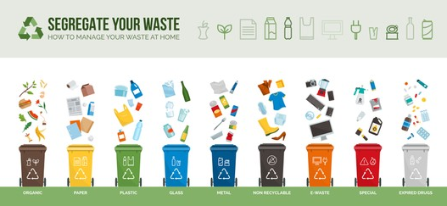
Problem Statement:
With the increasing volume of waste generated daily, proper garbage segregation has become a critical challenge in modern waste management systems. Manual sorting methods are labor-intensive, inconsistent, and pose health hazards to workers. This often results in improper disposal, contamination of recyclables, and increased landfill usage. Additionally, the lack of scalable solutions for real-time classification hinders the efficiency of recycling initiatives. To address this, there is a strong need for an intelligent, automated system that can accurately classify waste materials based on images, reducing human effort and promoting effective recycling at the source.

Slide 8
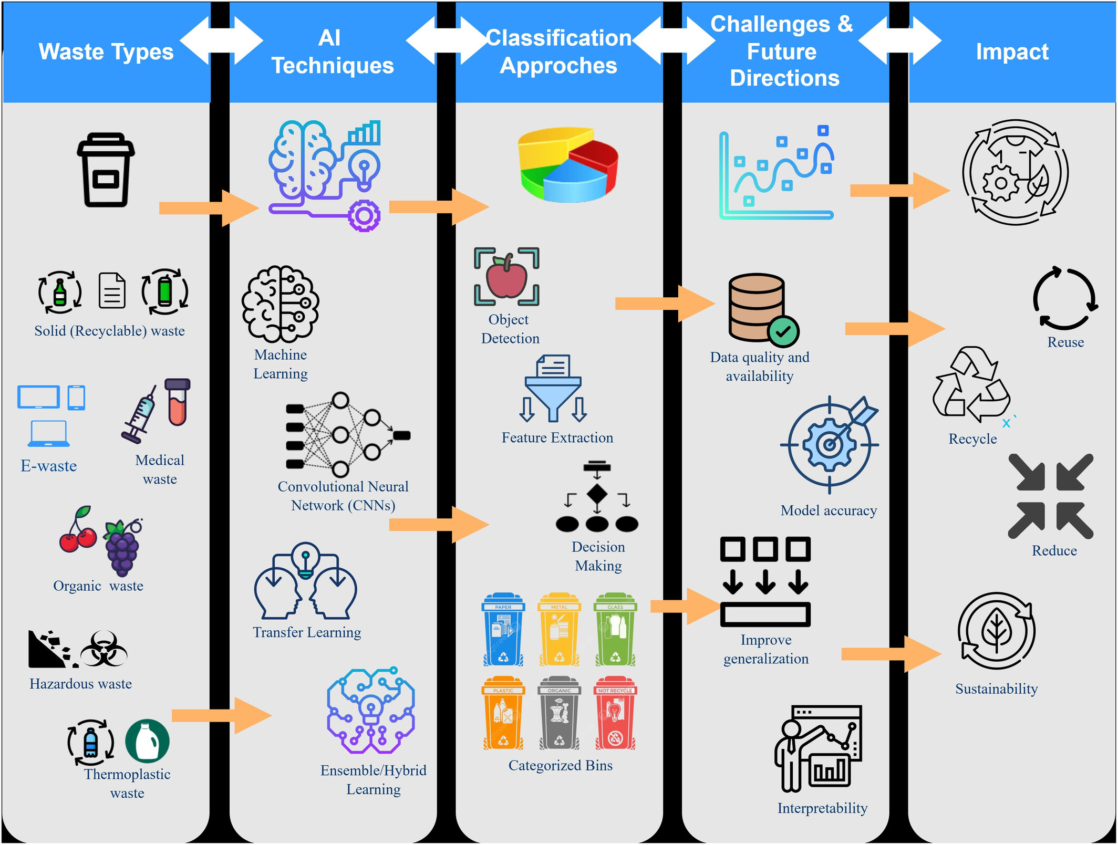
Solution:
Developed a deep learning model using EfficientNetV2B2 for garbage image classification.
Used transfer learning to reduce training time and improve accuracy on a limited dataset.
Trained the model to recognize multiple waste categories such as plastic, paper, metal, and glass.
Used ImageDataGenerator for real-time augmentation to improve generalization.
Integrated a Gradio interface to enable real-time image-based predictions in a user-friendly format.
The system can be deployed in smart bins or recycling stations to automate sorting.

Slide 9
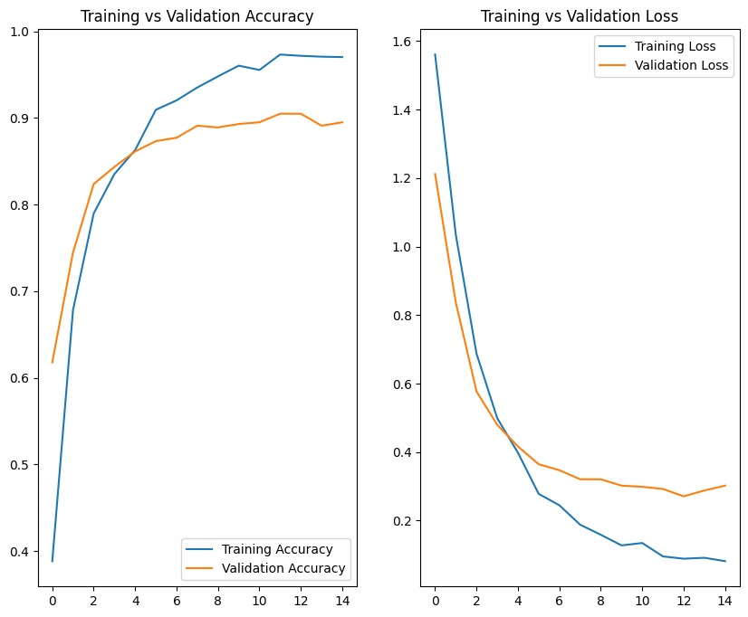
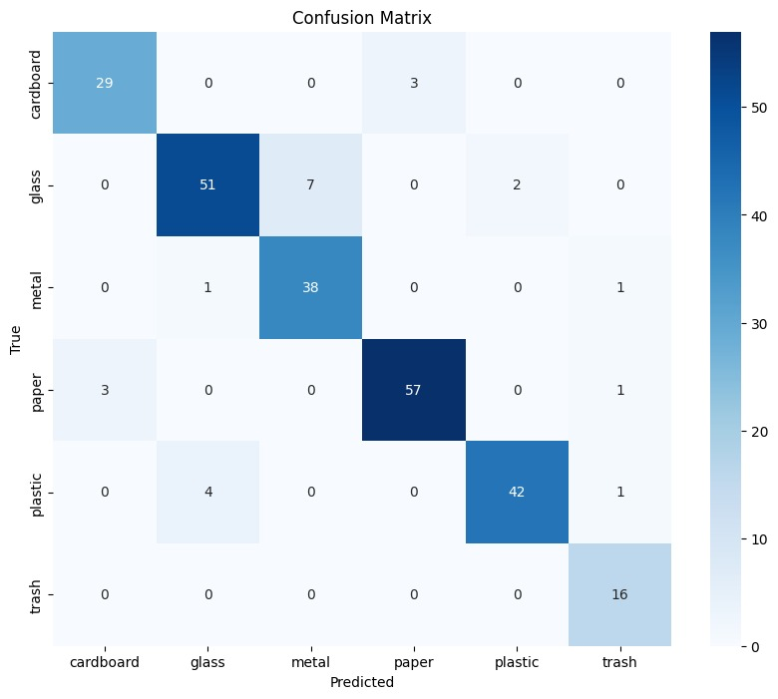
Screenshot of Output:

Slide 10
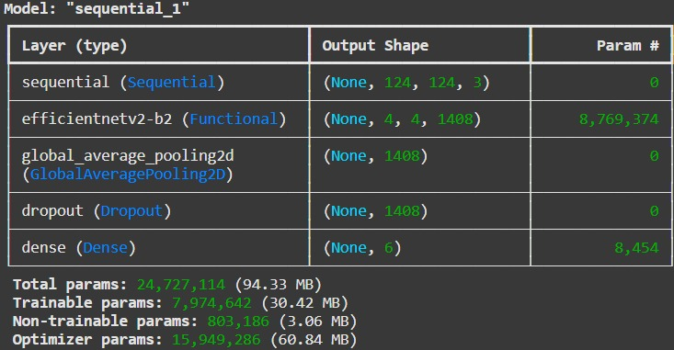
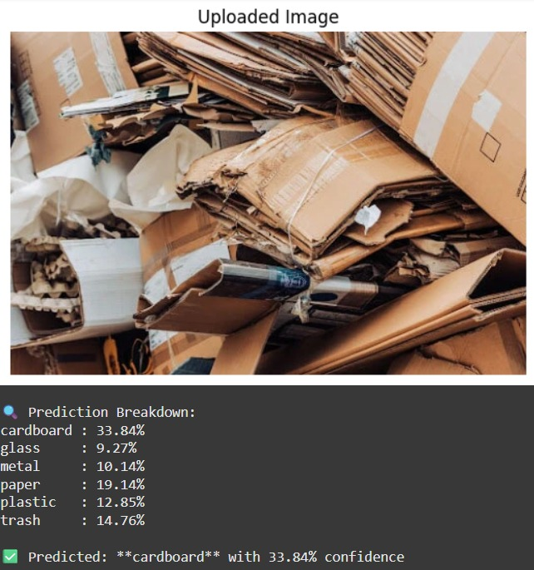
Screenshot of Output:

Slide 11
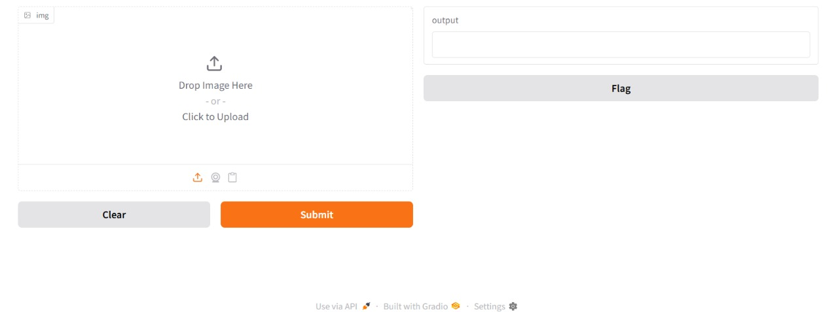
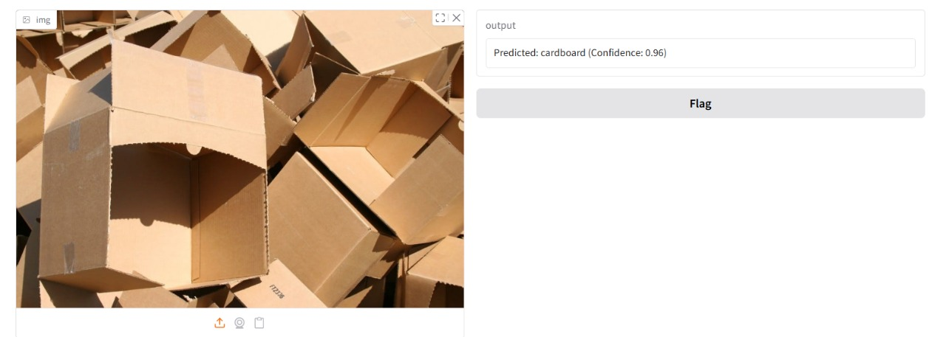
Screenshot of Output:

Slide 12
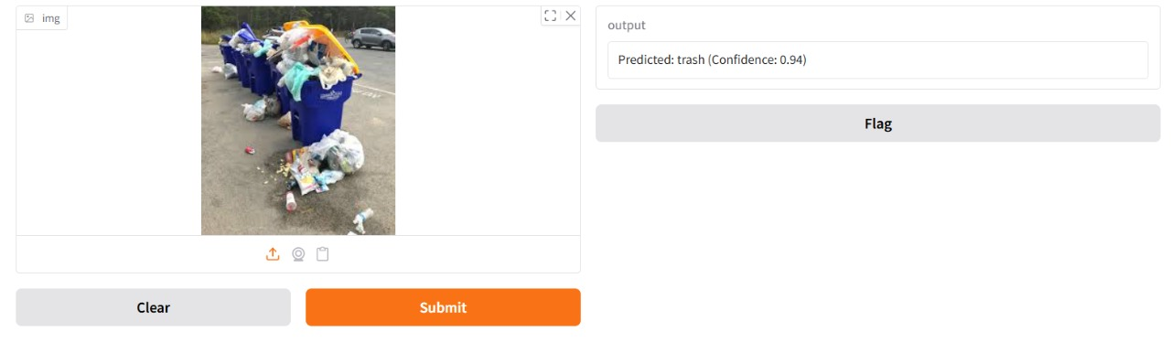
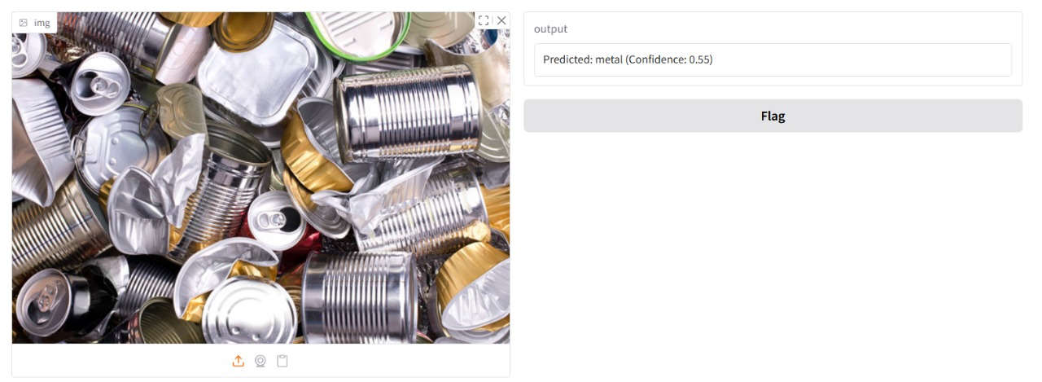
Screenshot of Output:

Slide 13
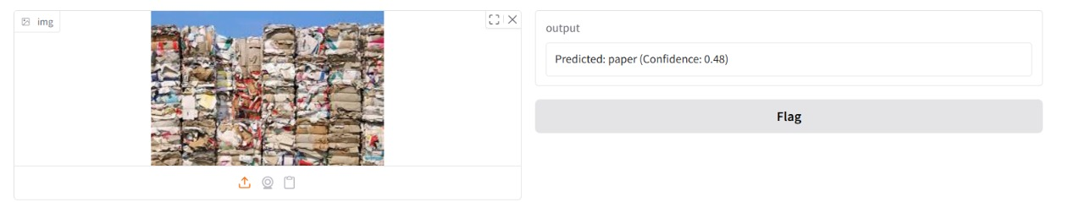
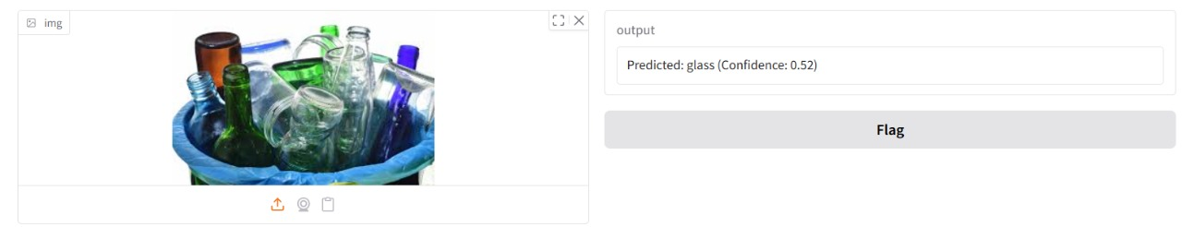
Screenshot of Output:

Slide 14
Conclusion:
The project successfully demonstrates how deep learning and transfer learning can be applied to the real-world challenge of garbage classification. By leveraging the power of EfficientNetV2B2, the model achieved high accuracy in identifying various categories of waste, including plastic, paper, glass, metal, cardboard, and trash.
Real-time deployment was made possible through an intuitive Gradio interface, allowing users to interact with the model by uploading images for instant predictions. The use of advanced data augmentation and evaluation techniques ensured that the model generalized well to unseen data.
This solution highlights the potential of AI in promoting sustainable and automated waste management, offering practical value in smart cities, recycling systems, and environmental initiatives.
Project Repository
Thank you!

