Slide 1



Department of Electronics & Communication Engineering
Design of Low Power And Automated BIST Architecture
1DS21EC209 Suhruth S K
1DS21EC203 Skanda P Bhatta
1DS21EC234 Vinay K
1DS21EC060 Dabbadi Om Prakash
Dr. Deepa N P
Associate Professor

Slide 2
Overview of the presentation
Introduction
Problem Statement and Objectives
Literature Review
Proposed Methodology with Block Diagrams
Implementation process
Results and Discussion
Conclusion
Advantages / Applications
References
Dept. of ECE, DSCE

Slide 3
INTRODUCTION
.
Built-In Self-Test (BIST) is a design technique that enables a system or circuit to automatically perform diagnostic tests on itself, instead of relying on external testing tools or human intervention.
BIST enabled system generates its own test patterns, runs tests and evaluates the results internally. This not only reduces the cost and time required for testing but also improves the reliability of the device by enabling continuous self-checks throughout its operational life.
In VLSI circuits, built in self test (BIST) is used for automated testing of the circuit that generates test patterns only when a fault is detected.
Dept. of ECE, DSCE

Slide 4
An LFSR, or Linear Feedback Shift Register, is a fundamental digital component that is able to create pseudo-random sequences.
LFSRs are typically employed in Built-In Self-Test (BIST) circuits to check for any faults present within the testing circuit.
Power gating is a technique used in integrated circuit design to reduce power consumption, by shutting off the current to blocks of the circuit that are not in use. The power gate size must be selected to handle the amount of switching current at any given time.
Dept. of ECE, DSCE

Slide 5
PROBLEM STATEMENT
Standard BIST methods can consume significant power, especially in systems with many components or large test patterns, which leads to inefficiencies in energy-sensitive devices.
Our main challenge is to Design a Built-In Self-Test (BIST) system for digital circuits that minimizes power consumption while maintaining high fault coverage thus, excluding the need to create an external testing circuit.
Dept. of ECE, DSCE

Slide 6
OBJECTIVE
Our main objective is to Design a Built-In Self-Test (BIST) system for digital circuits that minimizes power consumption and simplifies testing thus, excluding the need to create an external testing circuit.
Power Reduction During Testing- Power gating helps to reduce dynamic power dissipation by turning off idle blocks of the circuit during BIST operations. This is especially important when testing large systems where some parts may remain unused during test mode.
Test Efficiency -Efficiency in BIST not only means consuming less power but also detecting and locating the faults present. A low-power BIST typically involves optimized test patterns and procedures that reduce the time taken for the tests, increasing the efficiency of the overall verification process.
Dept. of ECE, DSCE

Slide 7
LITERATURE REVIEW
Paper No. | Paper title | Year of publication | Methodology used | Concept from this paper used in our project
1 | Realization of Built-In Self Test Enabled Memory(RAM) using VHDL,IEEE. | 2020 | Design of BIST for test pattern generator and comparator for output analysis. | Basic Idea about BIST and it’s architecture.
2 | Identification of Stuck-at-faults of full adder using BIST as testing device. | 2022 | Design of BIST circuit for full adder using comparator for output analysis. | Working of the output Analyzer with respect to the test pattern generator and the BIST controller circuit.
Dept. of ECE, DSCE

Slide 8
3 | Low Power LFSR for BIST applications, IEEE. | 2018 | Design of low power,low latency and high speed LFSR as test pattern generator for BIST applications. | To implement the LFSR as part of an BIST module that generates patterns directly on-chip.
4 | Sleep Transistor Design and Implementation | 2021 | Power gating involves selective disconnection of specific components of a circuit when not in use. The power gating technique is implemented by using sleep transistors. | Adding NMOS as the sleep transistor instead of PMOS helps reduce the total area occupied by the circuit.
5 | Improved Power Gating Technique for Leak age Power Reduction | 2019 | In fine-grain power gating the sleep transistor is implemented in every logic cell of the circuit. It is also easier to shut off individual blocks or cells without shutting off the power to other cells that are operating. | Fine-grain power gating adds a sleep transistor to every cell it can increase the area significantly
Dept. of ECE, DSCE

Slide 9
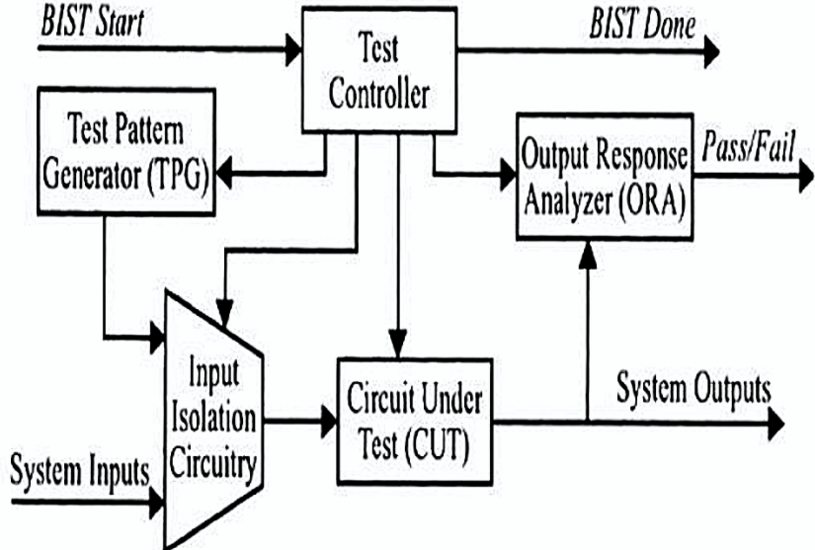
BLOCK DIAGRAM
Figure : General BIST Architecture
Dept. of ECE, DSCE

Slide 10
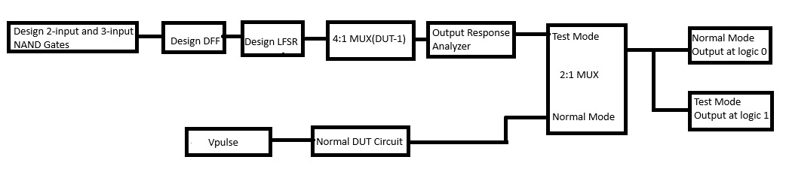
PROPOSED METHODOLOGY
Figure: Proposed Architecture using 4:1 MUX as DUT1
Dept. of ECE, DSCE
9

Slide 11
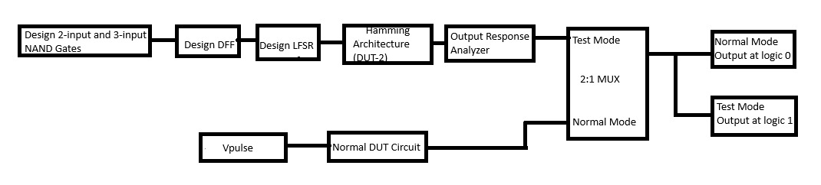
Figure: Proposed Architecture using Hamming Architecture as DUT2
Dept. of ECE, DSCE

Slide 12
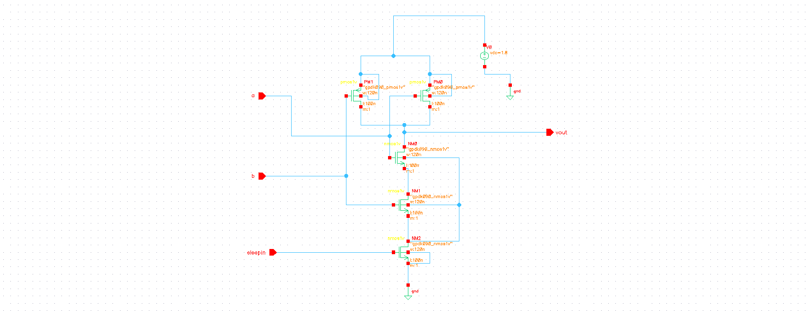
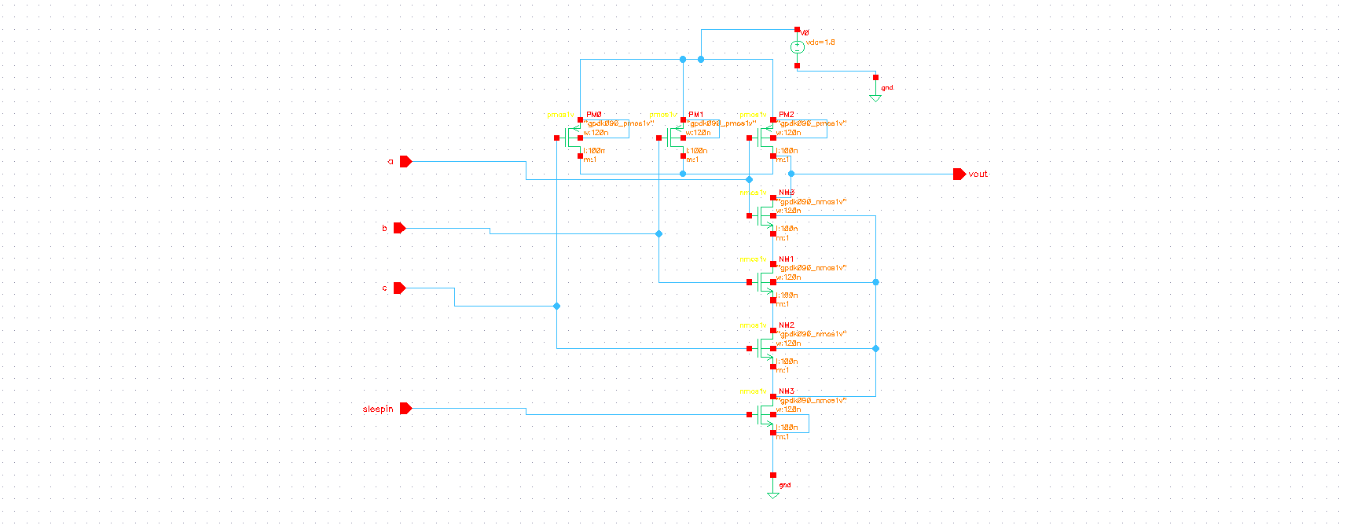
Implementation of 2 I/P and 3 I/P NAND Gates
Schematic of 2-input NAND gate
Schematic of 3-input NAND gate
The sleepin transistor controls the leakage currents by enabling sleep mode at idle. It cuts off the power supply when it is not needed which reduces dynamic power consumption (during active switching).
When active: The sleepin transistor is turned off to high resistance state, allowing the power gating transistor to completely isolate the block from the power supply.
When in sleep mode: The sleep-in transistor is turned on, creating a path to ground for the leakage currents, and thus reducing the leakage power. consumed by the idle circuit block.
Dept. of ECE, DSCE

Slide 13
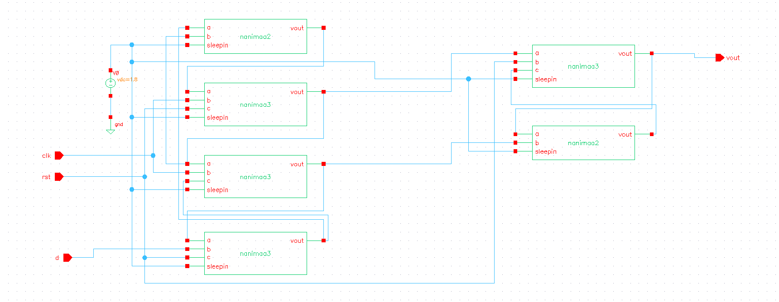
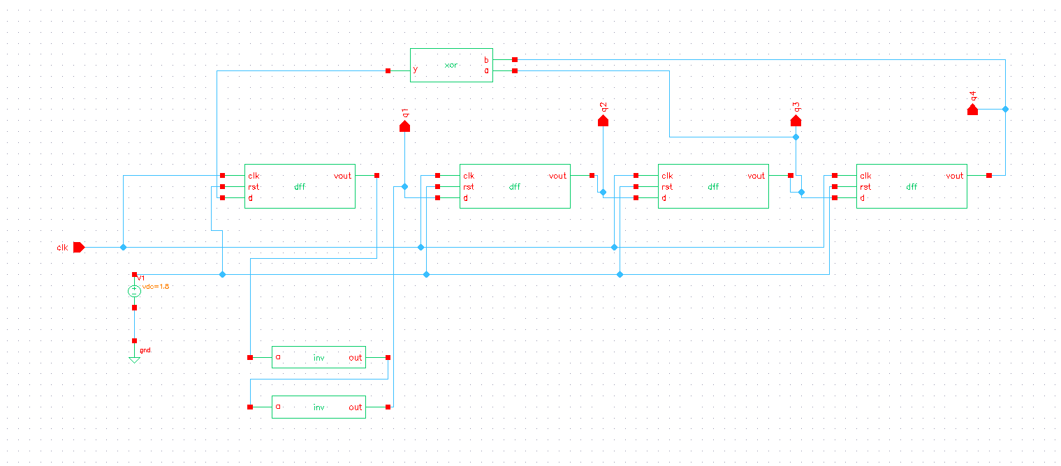
4-Bit LFSR as TPG
4-Bit Linear Feedback Shift Register) Schematic as TPG:
Schematic of D flip-flop with Fine Grain Power Gating:
The D flipflops used are made of Nand2 and Nand3 gateswhich are designed using FGPG (fine grain power gating) technique and hence uses less power compared to conventional D flipflops.
LFSR block is used to generate random sequence according to the feedback function. The standard polynomial taken is 1+x³+x⁴. Generated random sequence is provided as the input to the DUT.
Dept. of ECE, DSCE

Slide 14
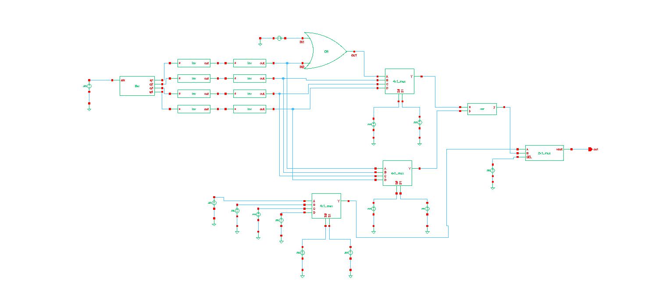
4:1 MUX as DUT 1
4:1 MUX is used as the DUT for BIST, the goal is to perform a self-diagnostic test to ensure that the MUX functions correctly by receiving test patterns generated by LFSR as inputs and comparing the results with expected outcomes. A buffer circuit is used additionally because it can be used for prevention of glitches, noise reduction, ensuring correct data propagation. According to the inputs given to the select lines, one of the input signals (I0, I1, I2, I3) is given as the output of the mux. A type of fault called stuck-at 1 fault is added to one of the inputs of another mux circuit wherein, that particular input is always one irrespective of the signal provided to it.

Slide 15
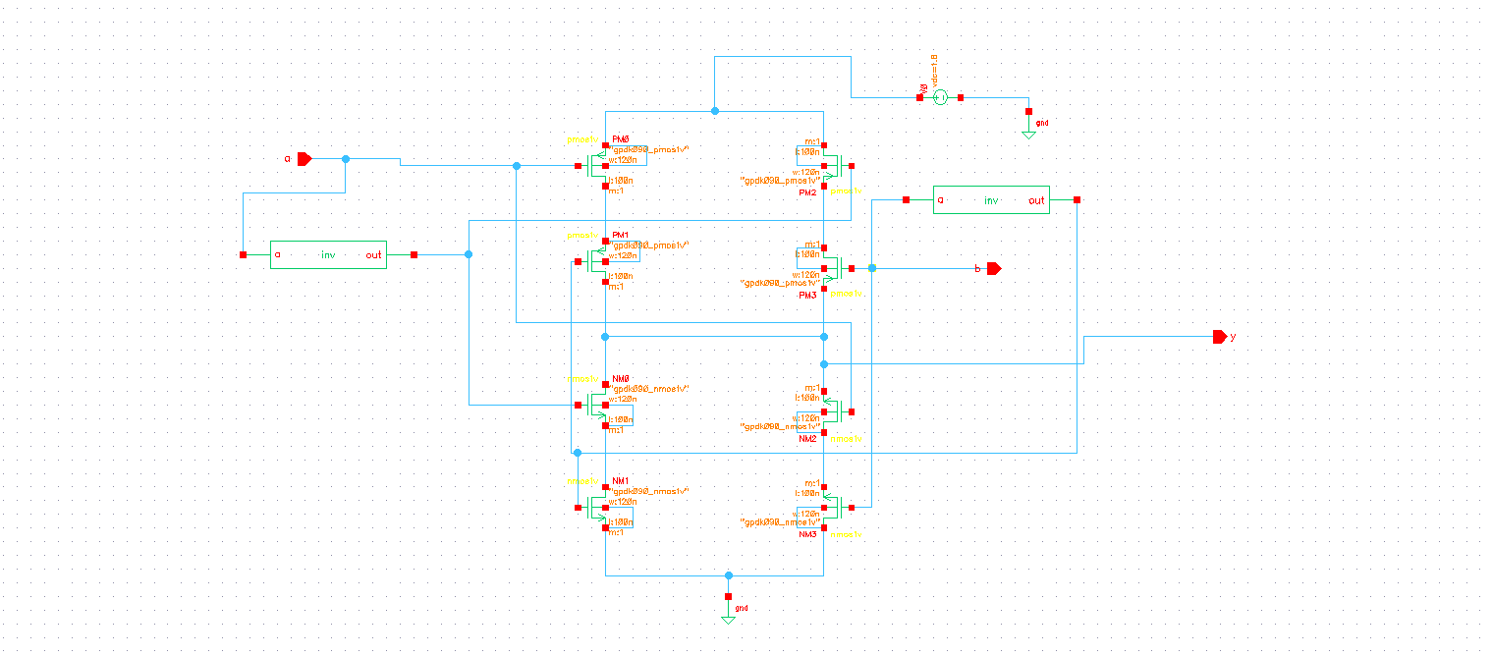
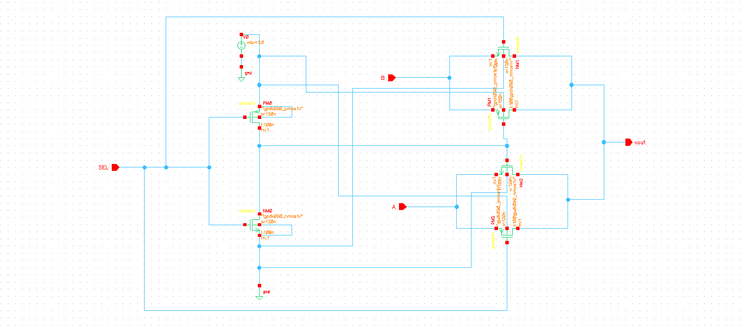
ORA and BIST Controller
ORA (XOR gate) Schematic:
Bist Controller (2x1 MUX) Schematic:
A comparator is used as the ORA for the given BIST logic. It compares the component with fault(supposedly) and the faultless component and returns the output.
There are two modes in BIST controller: normal mode and test mode. 2:1 MUX is used as the BIST Controller for the given circuit. At logic 0, the circuit resumes normal operation. A logic 1, the circuit enters testing mode to test for various faults.
Dept. of ECE, DSCE

Slide 16
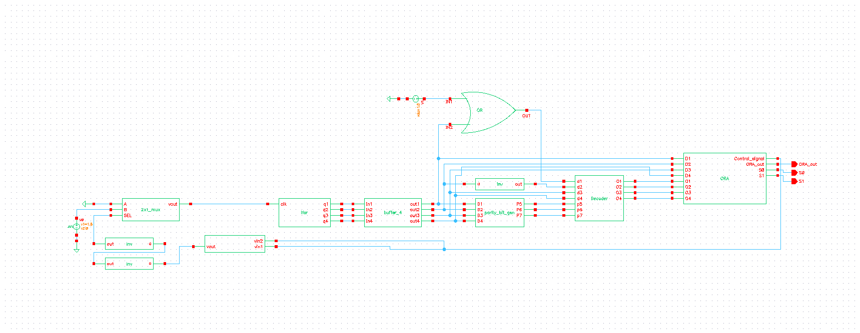
BIST Architecture using Hamming as DUT2
Dept. of ECE, DSCE

Slide 17
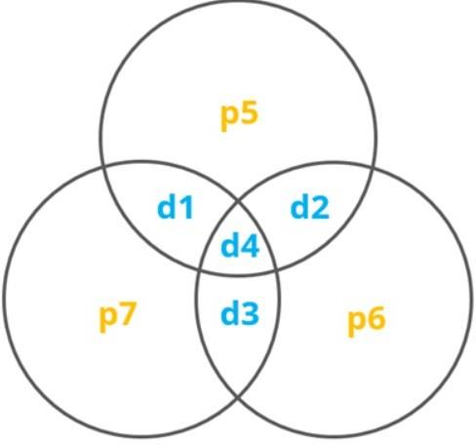
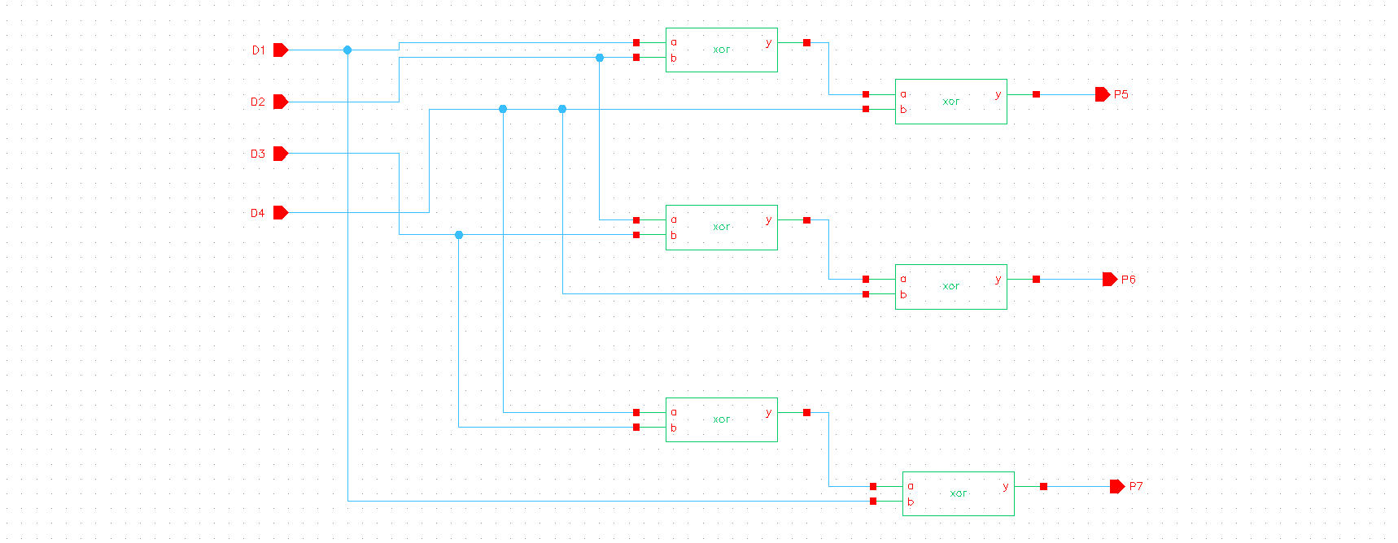
DUT2-Hamming Encoder
Encoding map:
Parity Bit Generator Schematic:
Three parity bits are mapped and added to the data block. In the configuration, each circle has a parity bit chosen so that the number of bits in each circle is odd. P5 = D1^D2^ D4, P6 = D2^ D3^D4, P7 = D1^D3^D4
Once the parity bits are generated, message bits along with parity bits are given to the decoder as input. During the transmission of signals from encoder to decoder in real time, there may be error in message bits due to the change in voltage levels because of various environmental factors thus, inverting the bits. We have injected a fault at D2 message bit using an inverter to check whether the decoder is able to retrieve back the original message bits or not.
Dept. of ECE, DSCE

Slide 18
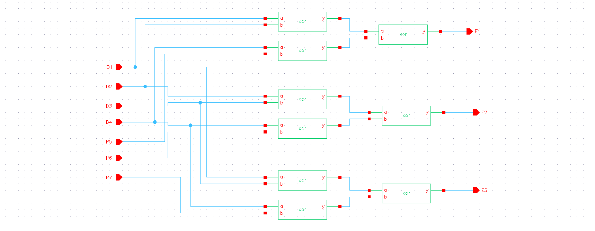
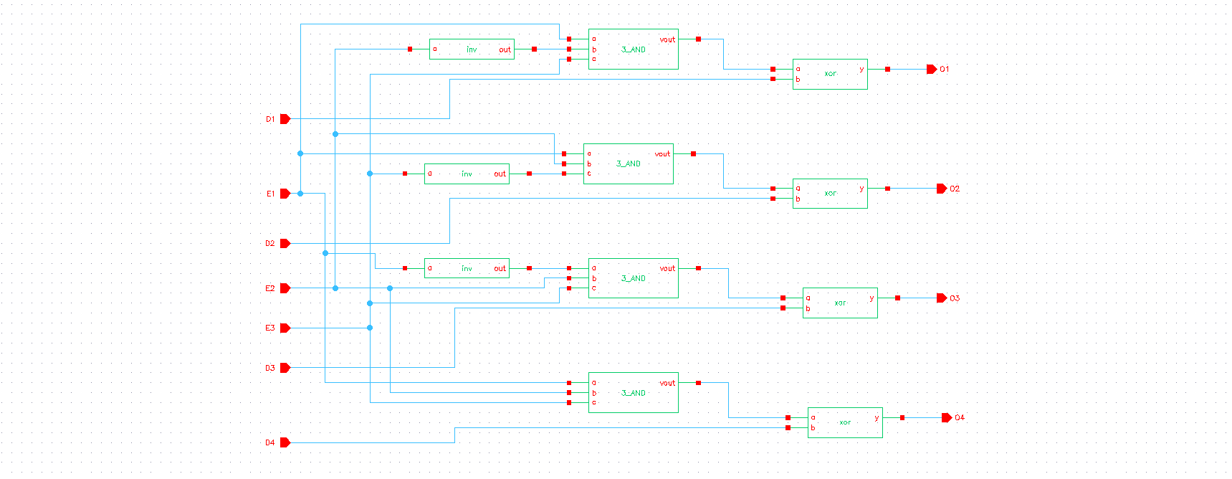
DUT2-Hamming Decoder
Error Bit Checker Schematic:
Error Bit Corrector Schematic:
Error bit checker unit is used to detect error in the 7-bit word. When a received 7-bit word is transmitted, the receiver recalculates the parity bits and compares them with the received parity bits. If no errors occurred, the syndrome will be 000, which indicates that all parity checks are satisfied. If there is an error, the syndrome will be a non-zero binary value. E1 = D1^ D2^D4^P5, E2 = D2^D3^D4^P6, E3 = D1^D3^D4^P7.
Error bit correction unit is used to correct the detected error. If the syndrome is 000, no error is detected. If the syndrome is non-zero, the syndrome vector indicates the position of the erroneous bit. Once the erroneous bit is identified using the syndrome, it can be corrected by flipping the bit at that position. O1=E1.NOT(E2).E3^D1, O2=E1.E2.NOT(E3)^D2, O3=NOT(E1).E2.E3^D3, O4=E1.E2.E3^D4.
Dept. of ECE, DSCE

Slide 19
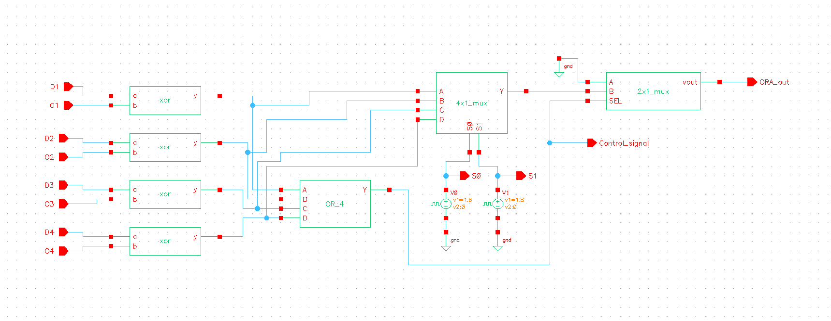
ORA
ORA Schematic:
A comparator is used as the ORA for the given BIST logic. It compares the component with fault(supposedly) and the faultless component and returns the output.
Dept. of ECE, DSCE

Slide 20
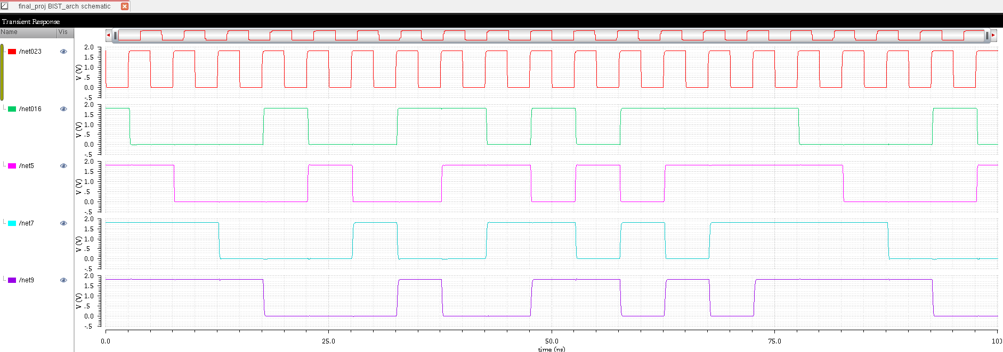
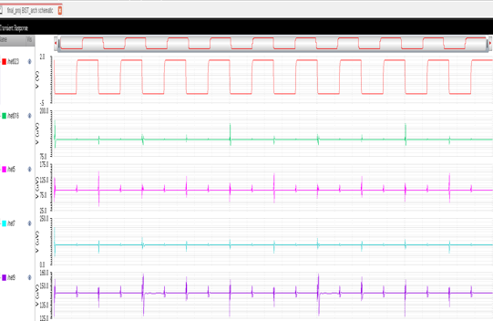
RESULTS
Test Pattern Generator(LFSR) Waveform using the standard polynomial 1+x³+x⁴:
TPG waveform without any fault indicating that no test patterns are generated during normal mode :
Nand Gate (3 input): 287uW
Nand Gate (3 input): 263uW
Dept. of ECE, DSCE

Slide 21
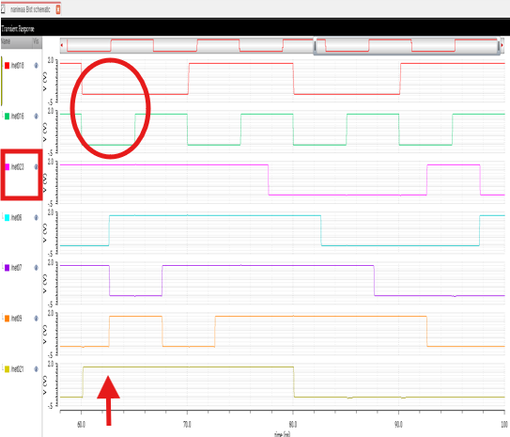
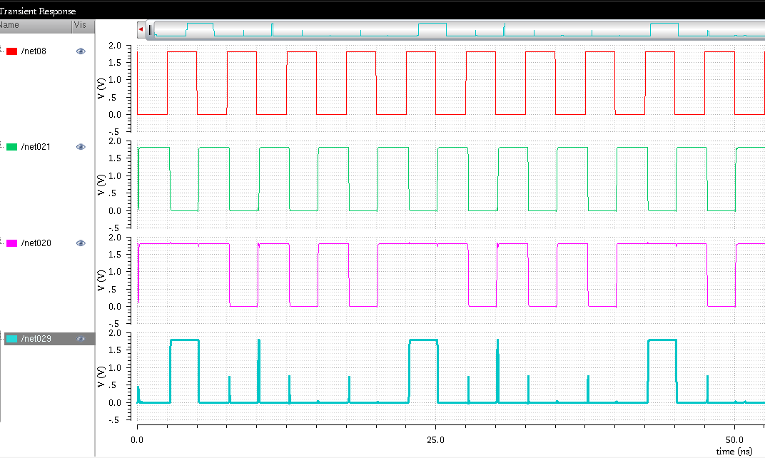
4:1 MUX output using 4 bit LFSR as input:
MUX Output ResponseAnalyzer :
/net05,06,07 and 08 are the outputs from LFSR given to the hamming encoder as message bits.
O1,O2,O3 and O4 are the output message bits. 2nd bit (/net06) is flipped during transmission and 1st bit always remains at logic 1. But O2 and O3 waveforms are inverted.
/out is the BIST ORA output where there is noise every time there is a pulse indicating incorrect decoding.
Dept. of ECE, DSCE

Slide 22
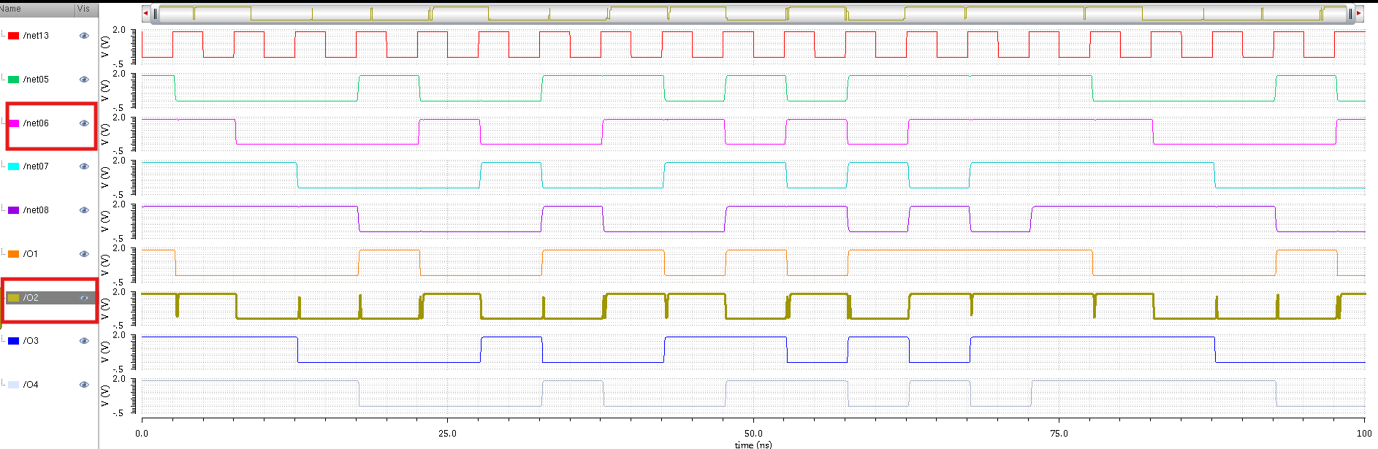
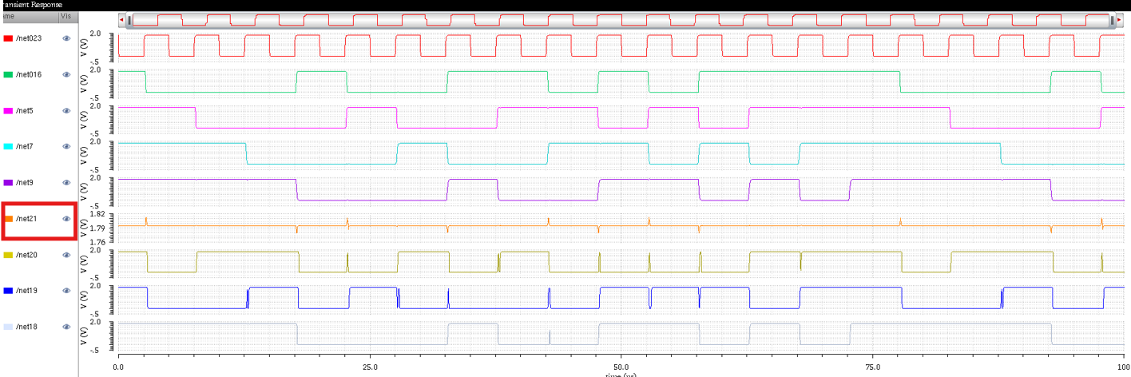
Normal Hamming encoding and decoding architecture waveform:
Hamming encoding and decoding architecture waveform with stuck at 1 fault injected :
/net05,06,07 and 08 are the outputs from LFSR given to the hamming encoder as message bits.
O1,O2,O3 and O4 are the output message bits. 2nd bit (/net06) is flipped during transmission and 1st bit always remains at logic 1. But O2 and O3 waveforms are inverted.
/out is the BIST ORA output where there is noise every time there is a pulse indicating incorrect decoding.
Dept. of ECE, DSCE

Slide 23
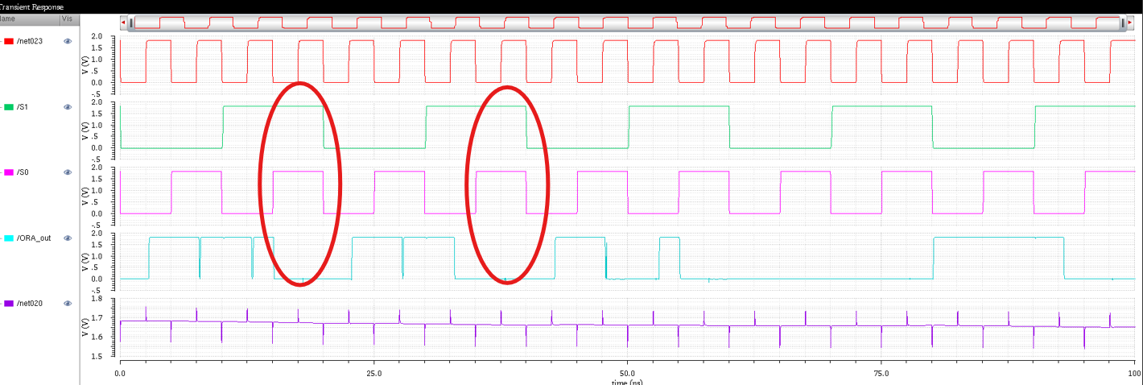
Output Response Analyzer waveform locating the fault, indicating the erroneous bits :
Dept. of ECE, DSCE

Slide 24
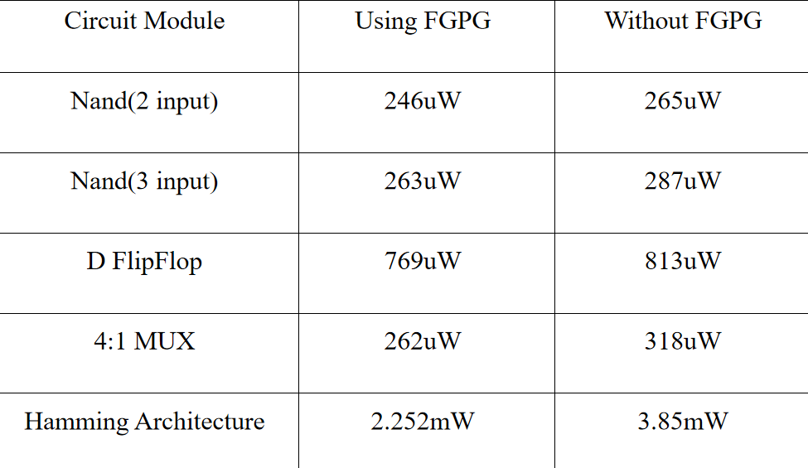
POWER COMPARISON TABLE:
Dept. of ECE, DSCE

Slide 25
CONCLUSION
In this project, we proposed a Built-In Self-Test (BIST) architecture that is both efficient and low-power, designed to enhance the reliability and fault detection capabilities of integrated circuits (ICs) while simultaneously reducing power consumption. A power reduction of 8.3% can be seen when using FGPG in case of D Flip-Flop. This leads to more power reduction in the 4-bit LFSR. There also an observed power reduction of 41.1% using FGPG in case of the Hamming BIST Architecture. A power reduction of 17.6 % is seen in case of 4:1 MUX as DUT1. We illustrated that conventional BIST methodologies can be refined by employing advanced techniques such as pre-determined test pattern generation, and power- efficient fault-detection algorithms. Our proposed architecture reduces the overall power consumption of the circuit without compromising the accuracy of the faults detected during testing.
Dept. of ECE, DSCE

Slide 26
APPLICATIONS AND ADVANTAGES
Applications
Advantages
Integrated Circuit Testing
Fault Detection in Embedded Systems
Memory Testing
Medical Instruments
Space and Aerospace Systems
Field Diagnostics and Remote Monitoring
Cost Efficiency Reduced Testing Expenses
Accelerated Testing Automated and Immediate Testing
Enhanced Reliability and Fault Identification
Expanded Test Coverage and more Extensive Testing
Improved Fault Isolation
Improved Testability of Complex Systems
Adherence to Safety Regulations

Slide 27
REFERENCES
[1] S Jamuna, VK Agrawal International Journal of Engineering Science and Technology “Implementation of BIST structure using VHDL for VLSI circuits”, 2011.
[2] S Jamuna, P Dinesha, K Shashikala “ Design and Implementation of BIST logic for ALU on FPGA”, International Conference on Networking, Embedded and Wireless Systems, 2018.
[3] R.S.Katti, X.Y.Ruan, and H.Khattri,” Multiple-Output Low-Power Linear feedback shift register design,” IEEE Trans.circuitsSyst.I, Vol.53, No.7, pp-1487-1495, July 2006.
[4] Reeba Korah and Neethu Vijayan, “Power Reduction In Logic Circuits Using Power Gating For Deep Sub-Micron CMOS VLSI”, Alliance International Confer- ence on Artificial Intelligence and Machine Learning (AICAAM), April 2019.
[5] Kaijian Shi and David Howard, “Sleep Transistor Design and Implementation – Simple Concepts Yet Challenges To Be Optimum”, 2006 International Symposium on VLSI Design, Automation, and Test.
[6] Rebecca Angela Fernandes and Niju Rajan, "Leakage Power Optimization of Linear Feedback Shift Register (LFSR)" is published in International Journal of In- novative Research in Science, Engineering and Technology, Vol.7, Issue.5, pp. 5486- 5491, May 2018.
Dept. of ECE, DSCE

