Slide 1



Metamong: Detecting Render-Update Bugs in Web Browsers through Fuzzing
Suhwan Song and Byoungyoung Lee
: sshkeb96@snu.ac.kr
: https://suhwansong.github.io/

Slide 2







Rendering process of browsers
append a blue one
HTML
Browser
JavaScript
Browser
Render
Render
Re-do the whole rendering process whenever content is modified

Slide 3


Rendering process of modern browsers
append a blue one
HTML
Browser
JavaScript
Browser
1️⃣
Render
2️⃣
Render-update
Render-update only the changed areas whenever content is modified

Slide 4

Optimization can introduce a bug!
append a blue one
HTML
Browser
JavaScript
Browser
1️⃣
Render
2️⃣
Render-update
Fail to draw the blue one due to the render-update bug

Slide 5



Render-update bug on a real website!
Render-update bug is a bug where a browser incorrectly performs a render-update.
Render-update
Expected Output
Before render-update
Telsa.com
Actual Output
Render-update
Render
Chrome 87 failed to change the car’s color.

Slide 6

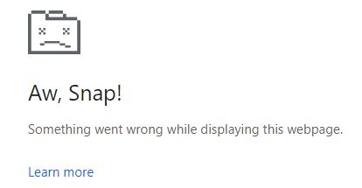

Identifying render-update bugs is challenging
Crash can be detected
Memory Bug
No crash at all…
Render-update Bug

Slide 7

Render-update oracle
append a blue one
HTML
Browser
JavaScript
Test output
Render
Render-update
append a blue one
HTML
Render
checker
JavaScript
Correct output
Delay “Render”
Render
Should be correct because render-update is not executed.

Slide 8


How to skip “render-update”?
Integrate HTML + JS.
Wraps the javascript with <script> tag and append it.
<body>
<p id="target"
style="background: purple">
Example
</p>
</body>
<body>
<p id="target"
style="background: purple">
Example
</p>
</body>
<script>
target.style.background= "blue"
</script>
HTML
Integrator
target.style.background= "blue"
Integrated HTML
Javascript

Slide 9


Metamong workflow
JS Generator
append a blue one
Render
Render-update
HTML Generator
HTML
Browser
JavaScript
Browser
Render
Render checker
Integrator
Integrated HTML
Browser
9

Slide 10
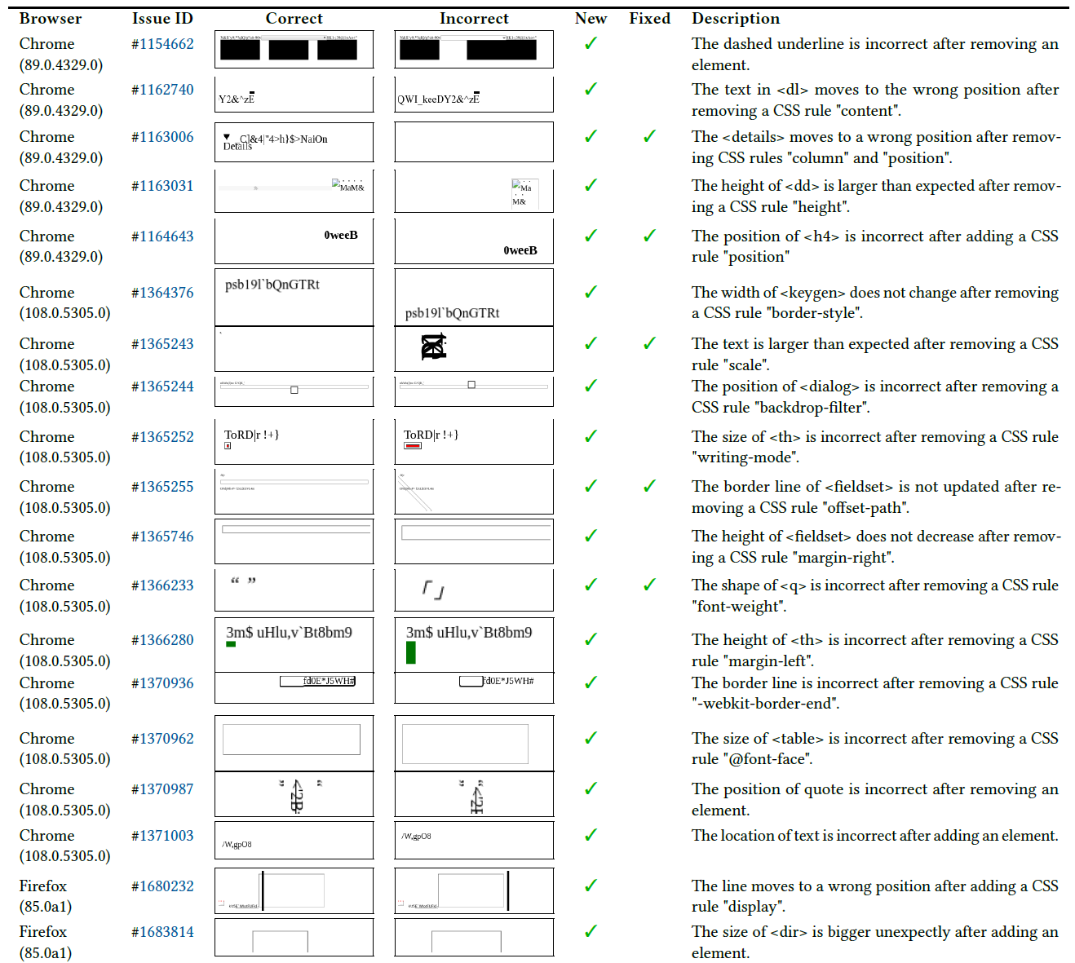
New render-update bugs
We found 19 new render-update bugs without false positive issues
and five of them were fixed.

Slide 11
Conclusion
This paper proposed Metamong, a framework tailored for detecting render-update bugs in web browsers without false positives.
Metamong consists of two key components: a page mutator and a render-update oracle to trigger and detect the render-update bugs.
Metamong has found 19 new bugs in Chrome and Firefox.

