Slide 1





R2Z2: Detecting Rendering Regressions in Web Browsers through Differential Fuzz Testing
Suhwan Song, Jaewon Hur, Sunwoo Kim*, Philip Rogers^, Byoungyoung Lee
^
*
: sshkeb96@snu.ac.kr
: https://suhwansong.github.io/

Slide 2

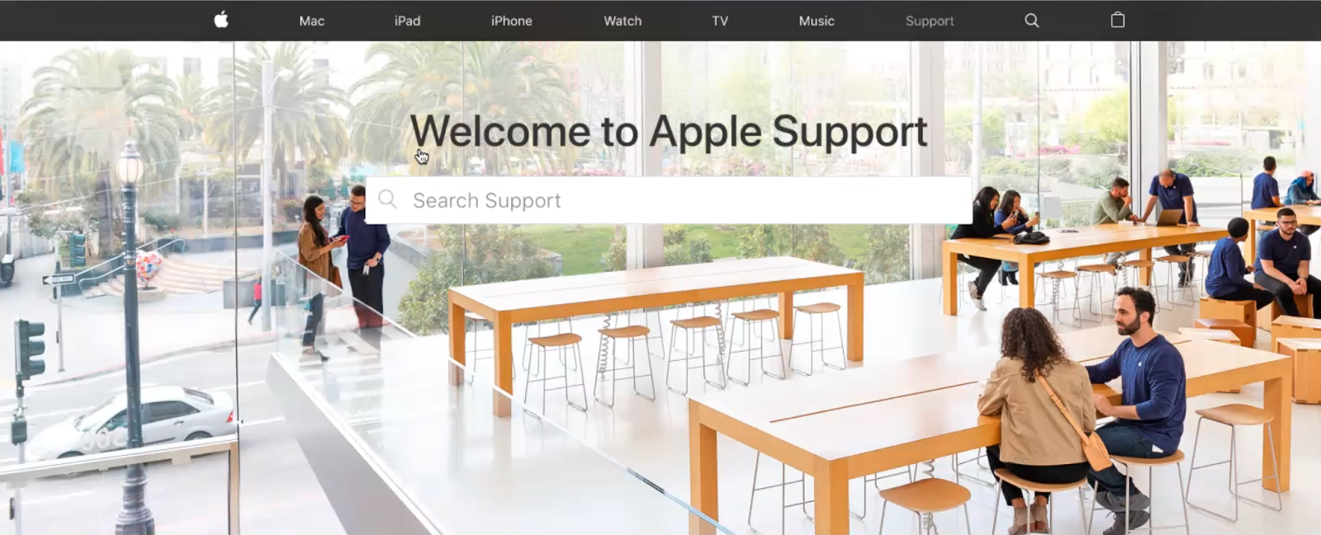

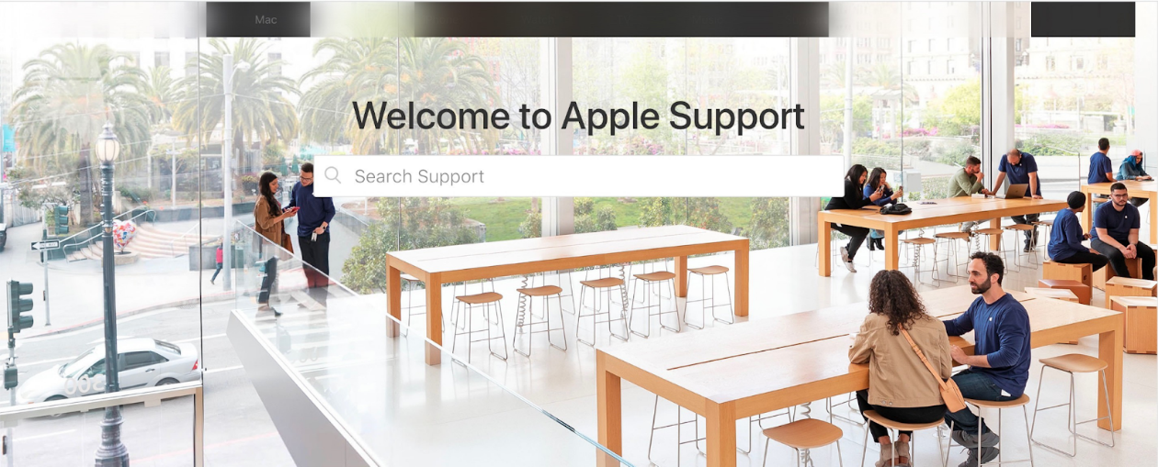
Rendering bug
A rendering bug is a bug when browser fails to correctly render an HTML.
<style>
span {
backdrop-filter: hue-rotate(1deg);
filter:
brightness(0.3);
padding: 60%;
}
</style>
<body>THE EXAMPLE OF RENDERING BUG <span></span>
</body>
Correct (Chrome 85)
Correct (Chrome 79.0.3944)
Example code
Incorrect (Chrome 87)
Incorrect (Chrome 79.0.3945)

Slide 3






Identifying rendering bugs is challenging
Why? Can detect valid & invalid memory region
Memory Corruption
Memory Corruption Oracle
Rendering bug is semantic bug!
Semantic Bug
Rendering Oracle

Slide 4



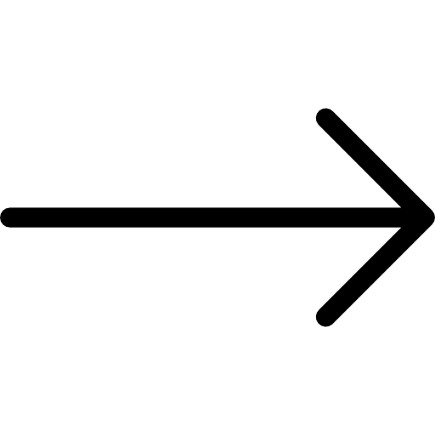





Naïve approach
Differential testing
Final output
Image diff
Bug!
HTML Input
Final output
Rendering bug if two browsers produce different results!

Slide 5

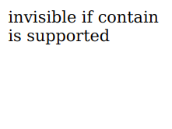
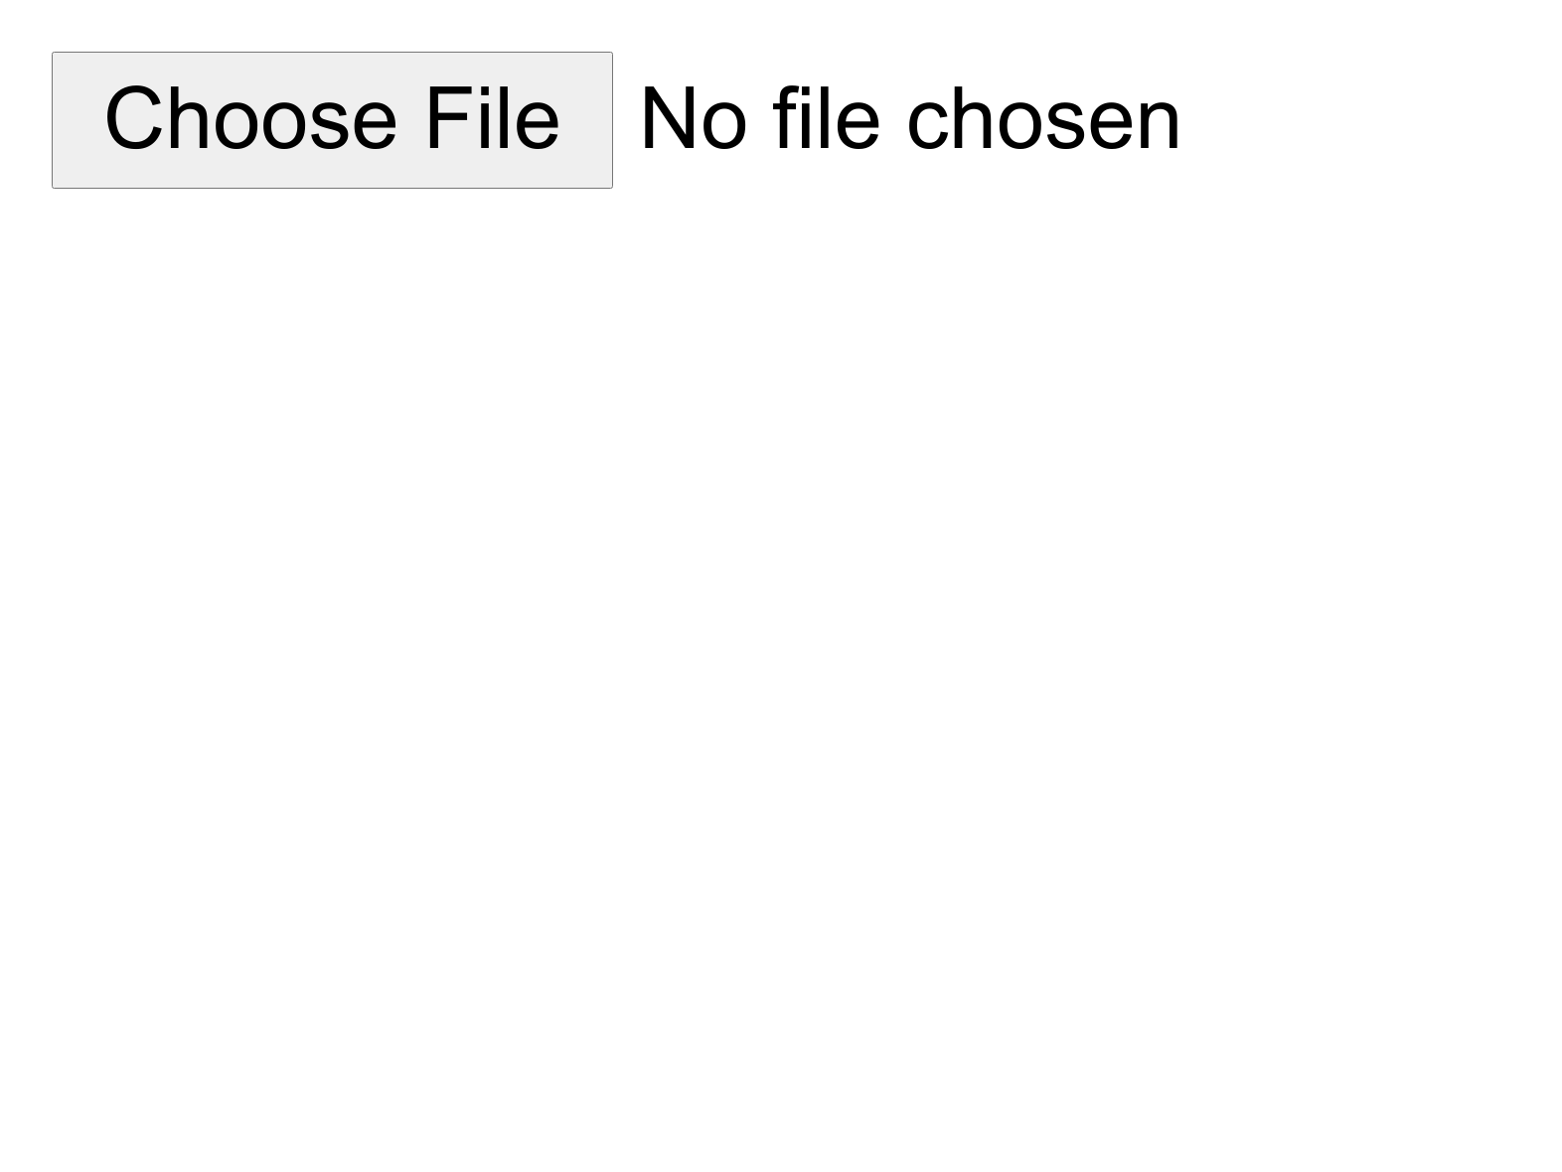
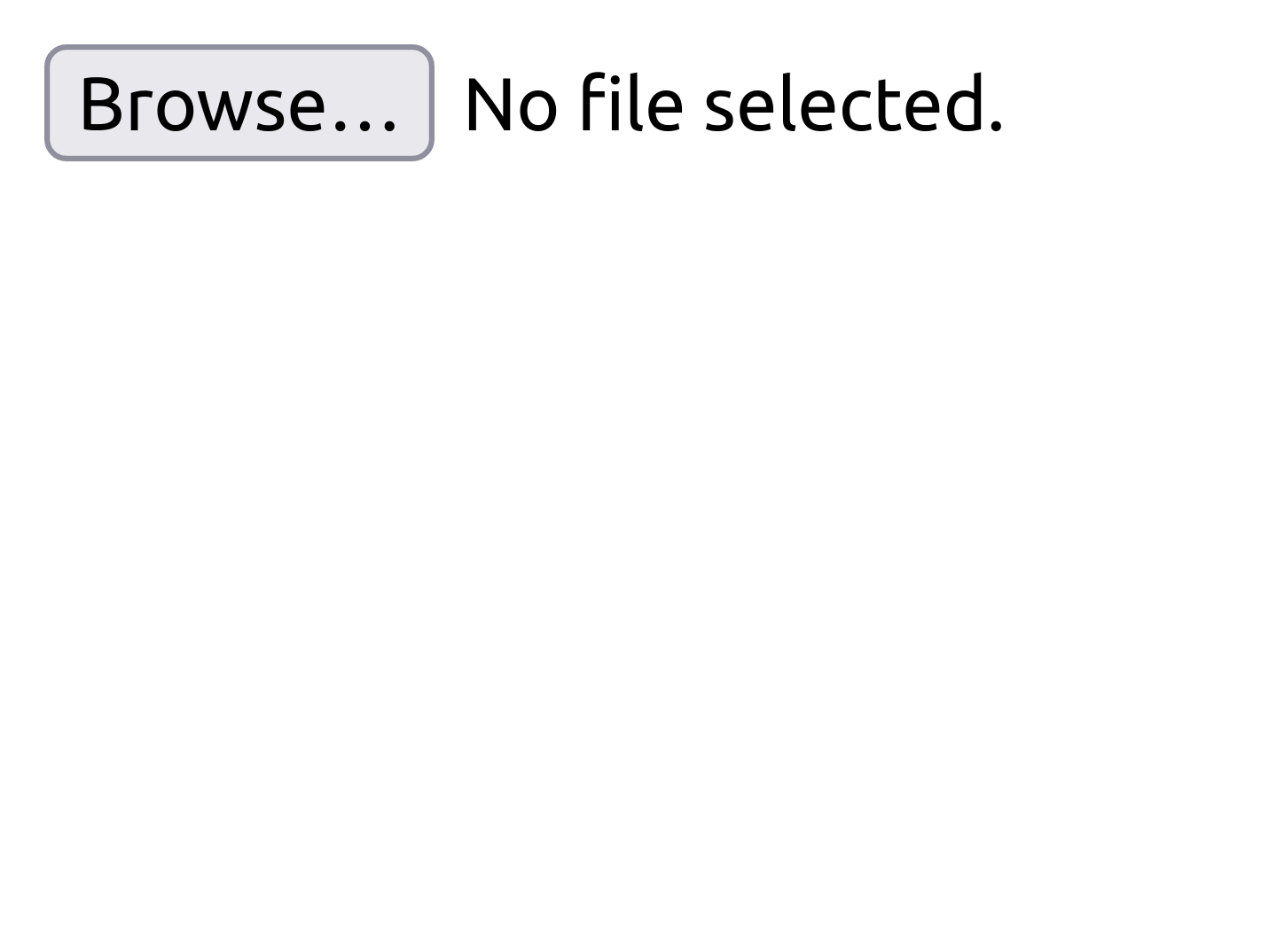



“Image results” are meant to be different
Cross-browser testing alone can generate many false positives due to benign browser incompatibilities
1. Different features
2. Different benign design
CSS contain: strict is supported by Chrome but not Safari.
<input type=“file”> design in Chrome and Firefox are different
<style>
div { contain: strict; }
</style>
<div>invisible</div>
<body>
<input type="file">
</body>
Example code
Chrome
Safari
Example code
Chrome
Firefox

Slide 6











R2Z2 overview
1. Change detector
3. Rendering bug oracle
Interop oracle
Non-feature-update oracle
Oracle bug
4. Rendering pipeline analysis
HTML Input
Candidate bug
DOM
Style
Layout
Paint
2. Bisect analysis
DOM
Style
Layout
Paint
Report
1
2
3
4
5
Bug commit

Slide 7
Change detector
Cross-version differential testing to detect rendering changes between two browser versions
Older chrome
Newer chrome
HTML Input
Candidate bug

Slide 8

Bisect analysis
Binary search to find the bug commit, which first introduces the rendering change.
2
3
1
3
4
5
Commit History
Bug commit

Slide 9


Rendering bug oracle
Filter out false positives by using the candidate bug and its bisected browser version.
Rendering bug oracle
Candidate bug
Interop oracle
Non-feature-update oracle
Oracle bug
Bug commit
WPT test

Slide 10

Our assumption
If two independently-implemented browsers generate the same rendered results ⇒ both produce the correct rendering
independently implemented
Chrome
Firefox
HTML Input

Slide 11


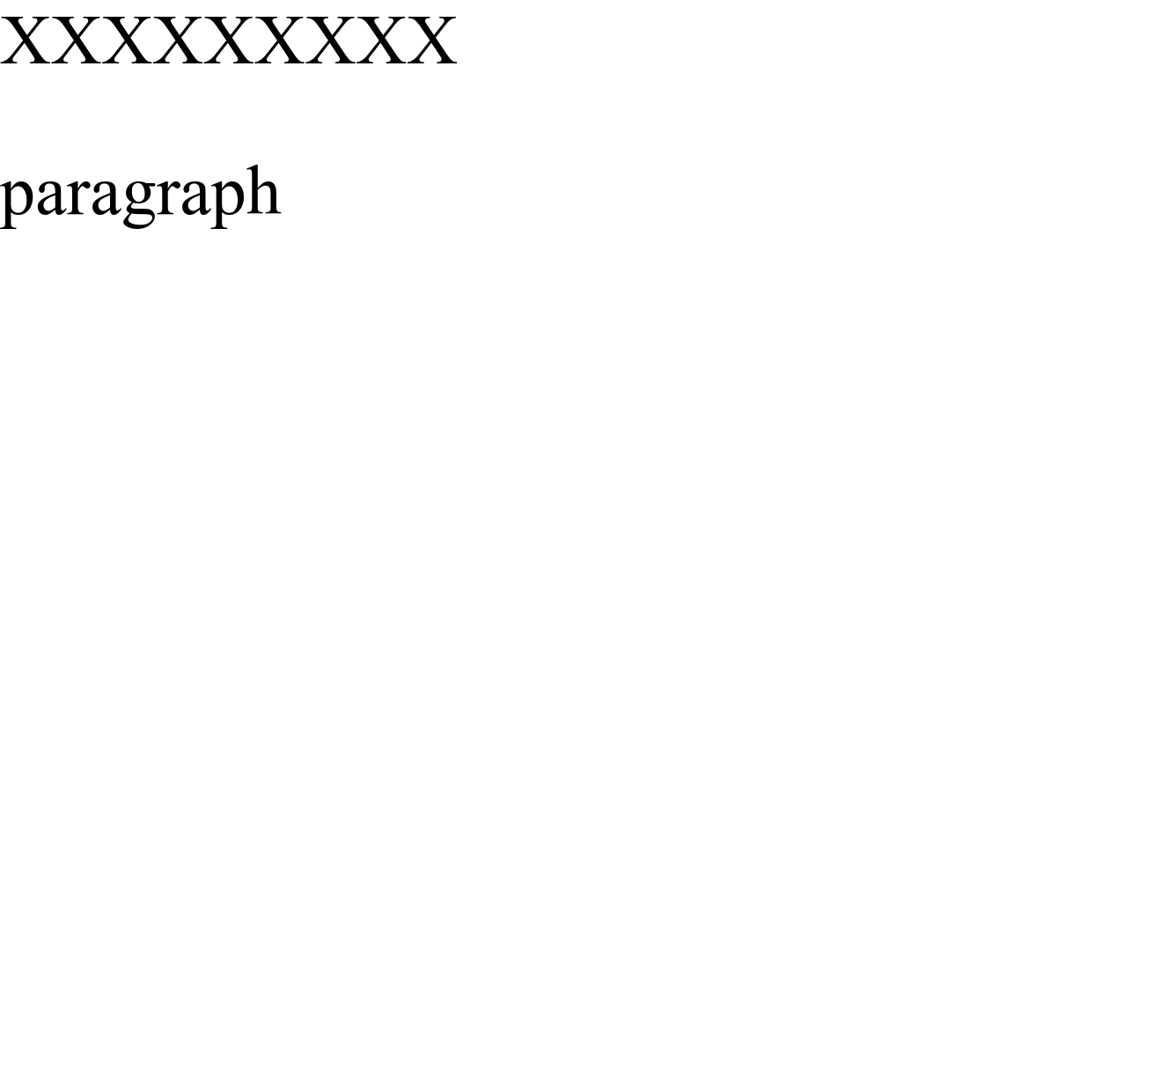
Interop oracle
Assumption: If two independently-implemented browsers generate the same rendered result ⇒ both produce the correct rendering
Case 1: All of three are different.
All are different
Cannot use our assumption
Discard this case
Candidate bug
Interop oracle
Not a bug!
Bug commit

Slide 12

Interop oracle
Assumption: If two independently-implemented browsers generate the same rendered result ⇒ both produce the correct rendering
Case 2: Only is different.
Newer Chrome and Firefox are the same
Both are correct
Older Chrome is wrong
Candidate bug
Interop oracle
Not a bug!
Bug commit

Slide 13
Interop oracle
Assumption: If two independently-implemented browsers generate the same rendered result ⇒ both produce the correct rendering
Case 3: Only is different.
Older Chrome and Firefox are the same
Both are correct
Newer Chrome is wrong
Candidate bug
Interop oracle
Bug!
Bug commit
False positives due to new feature update

Slide 14
Non-feature-update oracle
Remove false positives by using web-platform-test (WPT) tests.
WPT test is a test file that web browser developers may add for code commit to validate the new feature.
Use WPT tests to check whether
bad commit introduces a new rendering feature that is not supported by reference browser.

Slide 15



Non-feature-update oracle
Condition:
Bug commit
Only newer chrome passes WPT test
➔ Firefox does not support this new feature
WPT test
Non-feature-update oracle
Not a bug!

Slide 16
Non-feature-update oracle
Condition:
Newer chrome and Firefox support new feature
➔ Newer chrome introduces bug while implementing new feature
Bug commit
WPT test
Non-feature-update oracle
Bug!

Slide 17
Workflow of rendering bug oracle
Candidate bug
Bug!
WPT test
Bug commit
Interop Oracle
Non-feature-update Oracle

Slide 18


Rendering pipeline analysis
The stage that first introduces the differences is a bug stage!
DOM
Style
Layout
Paint
Oracle bug
DOM
Style
Layout
Paint

Slide 19
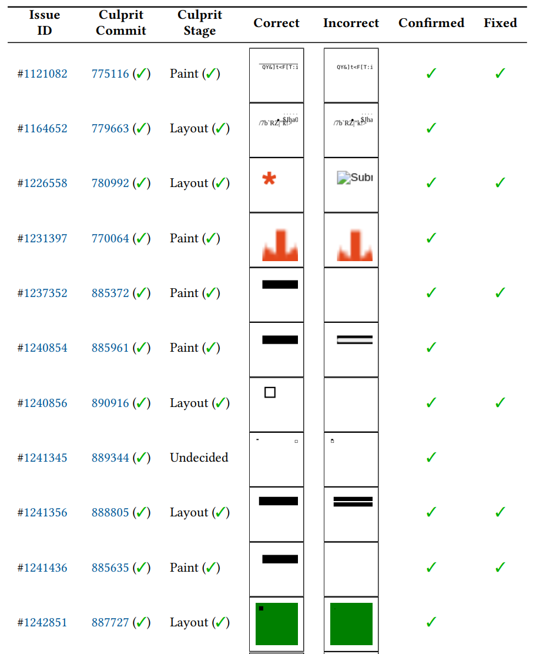
New rendering bugs
We found 11 new rendering bugs and six of them were fixed.

Slide 20
Conclusion
This paper proposed R2Z2, a differential fuzz testing technique to find rendering bugs with low false positive rate (i.e., ~20%).
R2Z2 features the bisect analysis and the rendering pipeline analysis, allowing R2Z2 to spot the bug commit and pipeline stage.
R2Z2 identified 11 new rendering bugs in Chrome.

