Slide 1

OAuth 2.0
Presented by Luca Dal Seno
Matricola n. 901096

Slide 2
What is OAuth?
Developed in 2006, OAuth is an open source protocol used for pubblish and interact with protected resources.
OAuth usually grant third party access to specifi resource while allowing their credential to still being private. How it does that? Separing client and server role in order to access some data. Let’s deep dive!

Slide 3
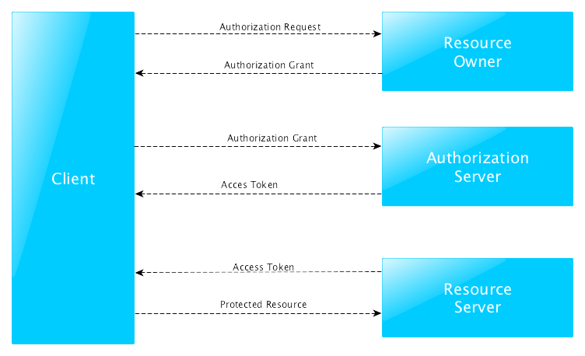
How it works?

Slide 4
How it works?
The protocol defines four roles:
Resource Owner: an entity capable of granting access to a protected resource;
Resource Server: the server hosting the protected resources, capable of accepting and reponding to protected resource requests using access token;
Client: an application making protected resource requests on behalf of the resource owner and with its authorization;
Authorization Server: the server issuing access tokens to the client after successfully authenticating the resource owner and obtaining authorization.

Slide 5
Authorization Grant
Authorization Code: obtained using an authorization server as an intermediary between client and resource owner. Meanwhile the authorization server authorize the resource owner;
Implicit: it a simplified version. An access token is directly released to the client, but the client is not authenticated previously;
Resource Owner Password Credential: it can be used directly ad a grant to obtain an access token;
Client Credentials: they can be used when the authorization scope is limited to the protected resources under the control of the client.

Slide 6
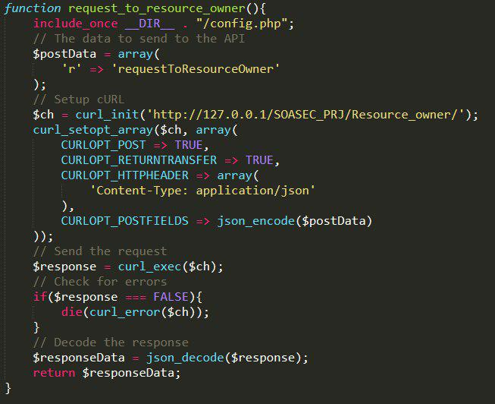
Client
The client, as the diagram says, is responsible for sending a request to the resource owner. The first call it’s the request_to_resource_owner() method which allows to client to send the request via curl and managing the answer back.

Slide 7
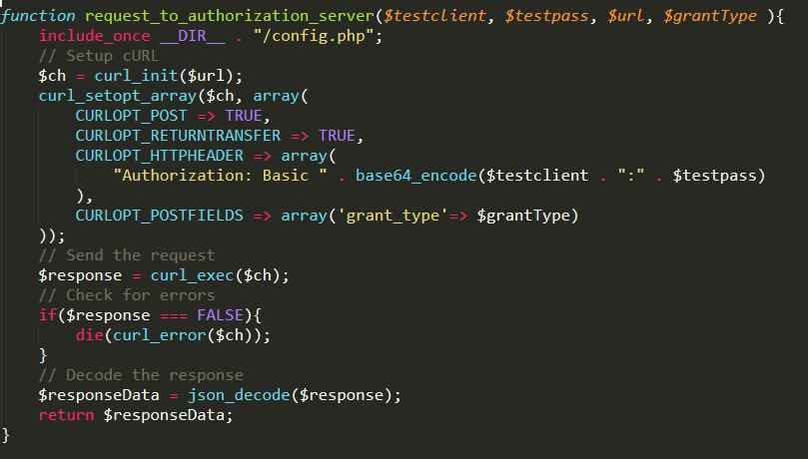
Client
The second call request_to_authorization_server() is made to get the access token to actual get the desired resource. The client has to provide the server, the grant access authorization that just got in the previuos call.

Slide 8
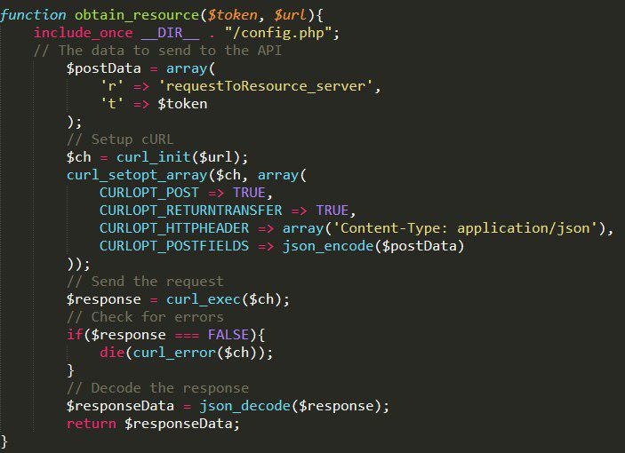
Client
The last call is obtainResource() to actually get the resource back from the resource server.

Slide 9
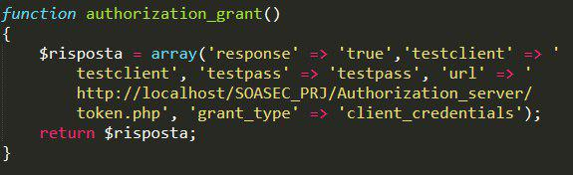
Resource Owner
The main function of the Resource Owner is to release the authorization grant. Here we also provide the next url to follow to generate the token

Slide 10
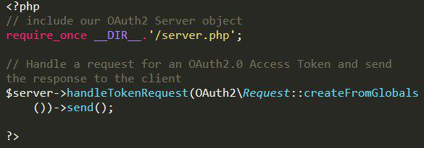
Authorization Server
For this project, the Oauth2-server-php library has been used. This library is responsible for:
Setting the db of the server;
Generating and sending the access token to the client.

Slide 11
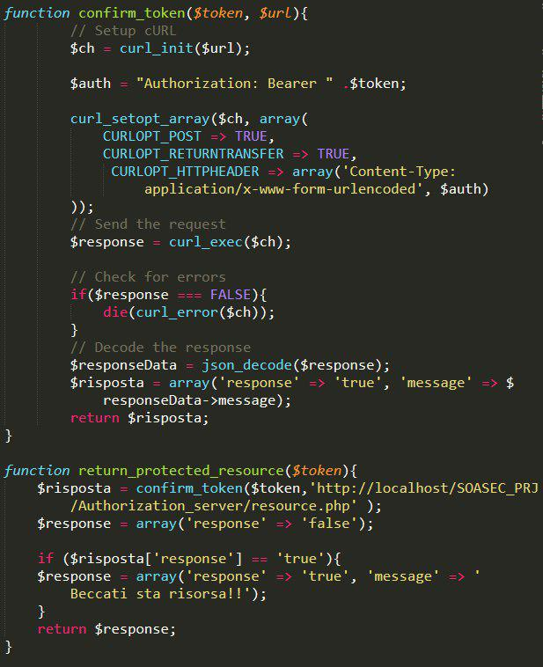
Resource Server
Finally the access token arrives to the resource server which first evaluate the token to be valide, then it return the protected resource asked.

Slide 12
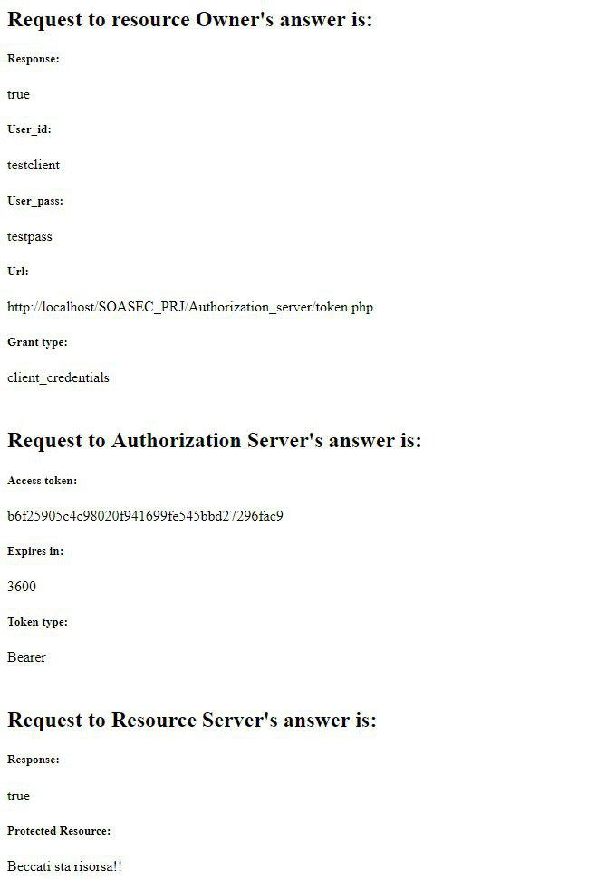
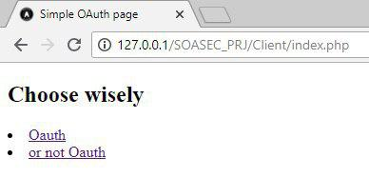
Simple Project Look

