Slide 1

A preliminary guidance to the set up of training dataset and GANSim training (unconditional case)
To be further completed for conditional case
Suihong Song

Slide 2
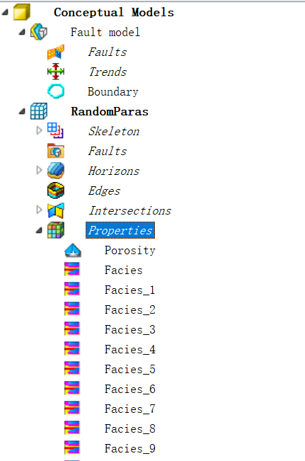
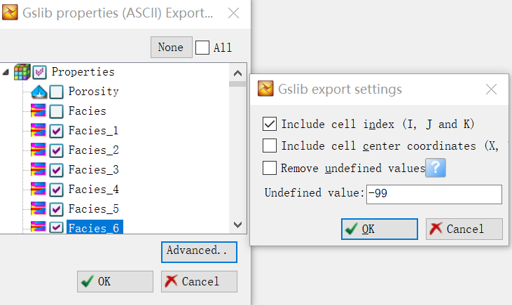
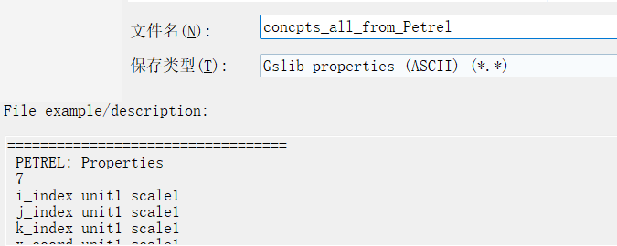
1. Construct 3D conceptual facies models in Petrel and export them
(1) Within in Petrel, build 3D large conceptual facies models using object-based or other methods
(2) Export the facies models using Gslib format: Properties -> Export object -> Gslib properties (format) -> check conceptual models to be exported (in case the exported file becomes too large, conceptual models can be exported into multiple files) -> Advanced (check “Include cell index …”) -> OK

Slide 3
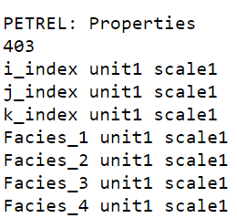
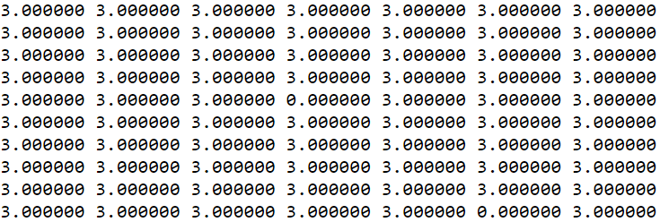
2. Convert exported conceptual model files into int8 format
Conceptual model files exported from Petrel (Gslib format) are large (with decimals, float format) and not convenient to save, transfer, or reopen, so combine (if multiple exported files) and convert them into int8 format, with codes in code file “0_1. Convert conceptual geomodel files (from Petrel) into 1 int8 format.ipynb”.
… …
concpts_all_int8.txt.npy (int format)
Size: 2.98 G
concpts_all_from_Petrel
Exported from Petrel (Gslib float format)
Size: 26.91 G (400 geomodels of 400x400x50 cells)
The int file (“concpts_all_int8.txt.npy”) becomes much smaller.
Delete the original exported conceptual geomodel files; only save the new int8 file.

Slide 4
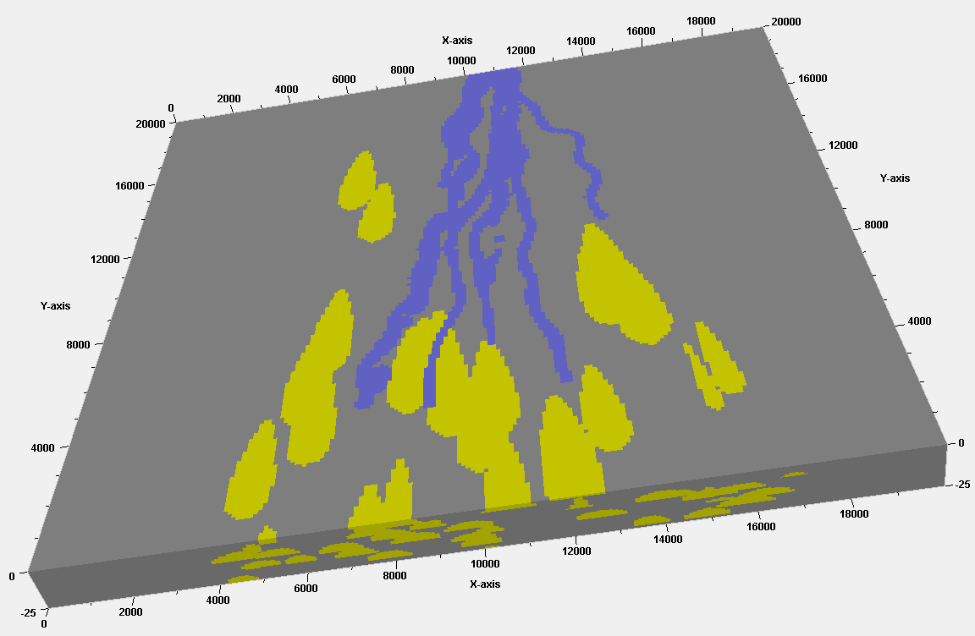
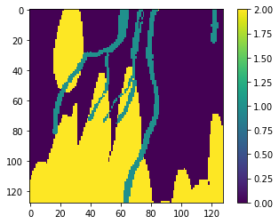
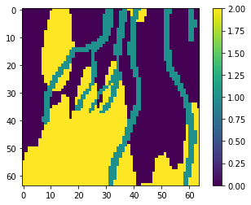
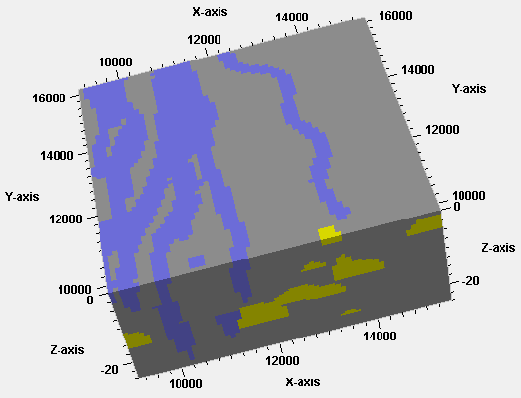
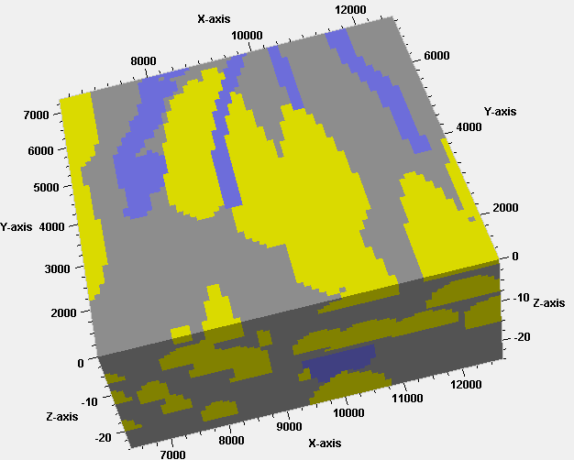
3. Prepare training dataset for GANSim
Crop large conceptual facies models into small patches as the training facies models
Use code “2. PrepareTrainingDatasets_OnlyFaciesModels”:
Downsampling methods (i.e., combine 8 values of fine grid into 1 value of coarse grid):
Average method (average 8 facies codes)
Largest frequency-based method (choose facies code with the largest frequency)
Facies order-based method (e.g., priority: channel > lobe > mud)
Randomly cut
128x128x32
64x64x16
Notes:
Channels can not be truncated (corroded) by lobes.

Slide 5
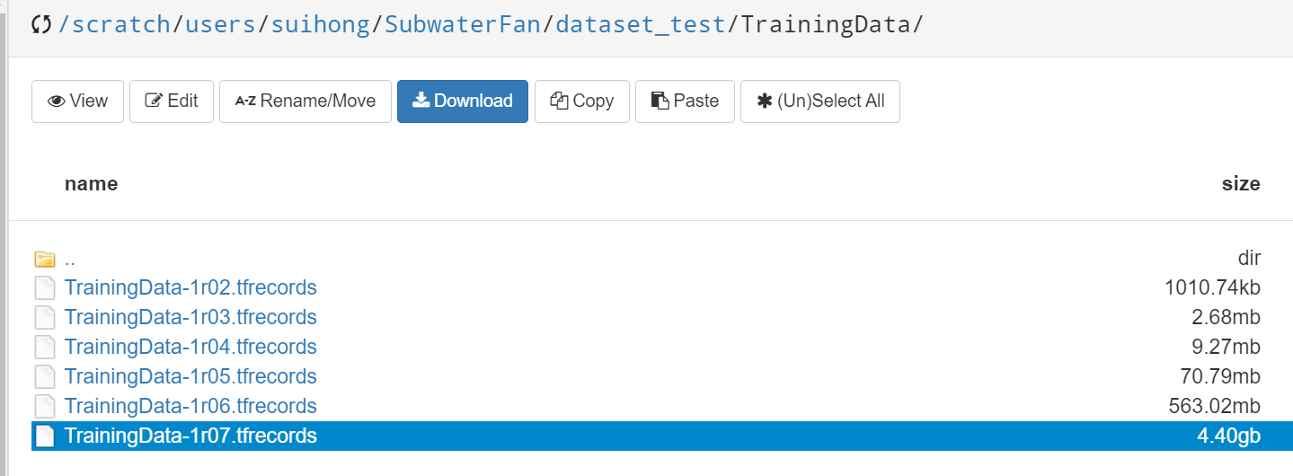
3. Prepare training dataset for GANSim
Training facies models with resolutions of 128x128x32, 64x64x16, 32x32x8, 16x16x4, 8x8x4, 4x4x4
In updated codes (GANSim3D-v2), the generator is set to grow from 4x4x4, so the downsampling of training facies models should stop at 4x4x4

Slide 6
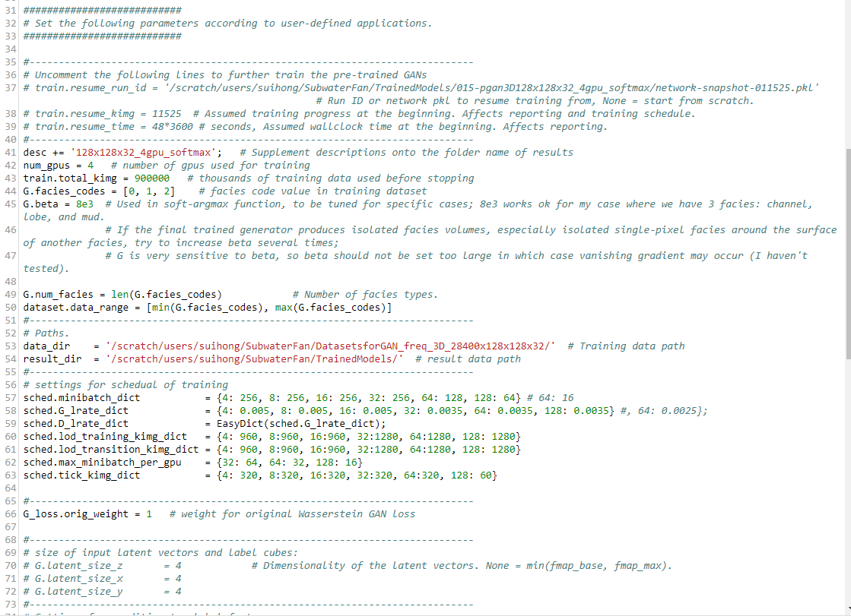
Training facies models with resolutions of 128x128x32, 64x64x16, 32x32x8, 16x16x4, 8x8x4, 4x4x4
4. Set up and train GANSim
(1) Set up training parameters in config.py
Uncomment to further train pre-trained GANs; set path, number of data to start train from, and seconds to pre-trained GANs have used
Set these hyperparameters
For different resolutions, minibatch size, learning rate, number of facies models used to train, after how many facies models a generator is saved
Unit: thousand
Uncomment to set input latent cube size, default is 4x4x4
Notes:
Updated GANSim code version: basic logic keeps the same, only restructure parts of the code to: make it flexible to training facies dimensions, and easier set up for conditioning choices.
Transition from 4 into 8
Every 480 k training facies models, the generator is saved one time.

Slide 7
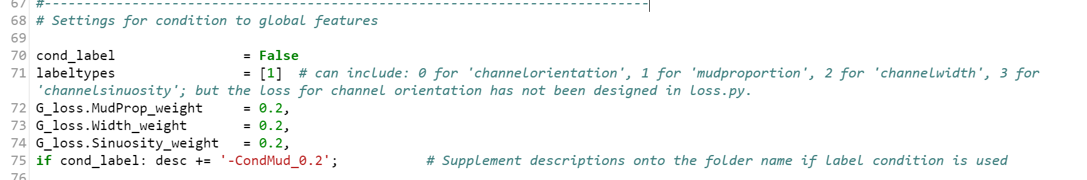
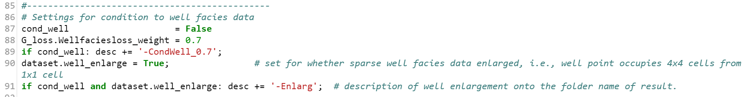
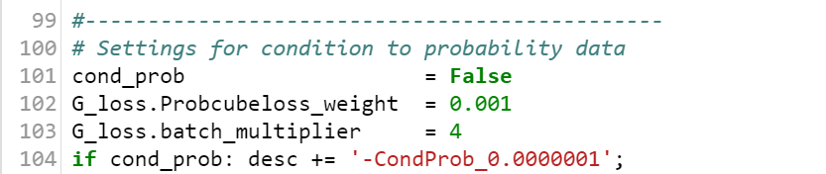
4. Set up and train GANSim
(1) Set up training parameters in config.py
Conditioning: all set False

Slide 8
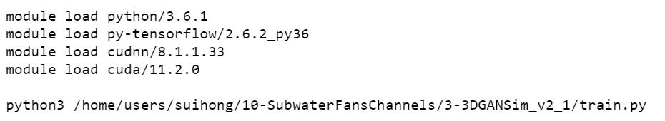
4. Set up and train GANSim
(2) Run train.py
Github code repository: https://github.com/SuihongSong/GANSim3D_v2/tree/main/GANSim3D_v2
Environment:
Notes:
Channels can not be truncated (corroded) by lobes.

Slide 9
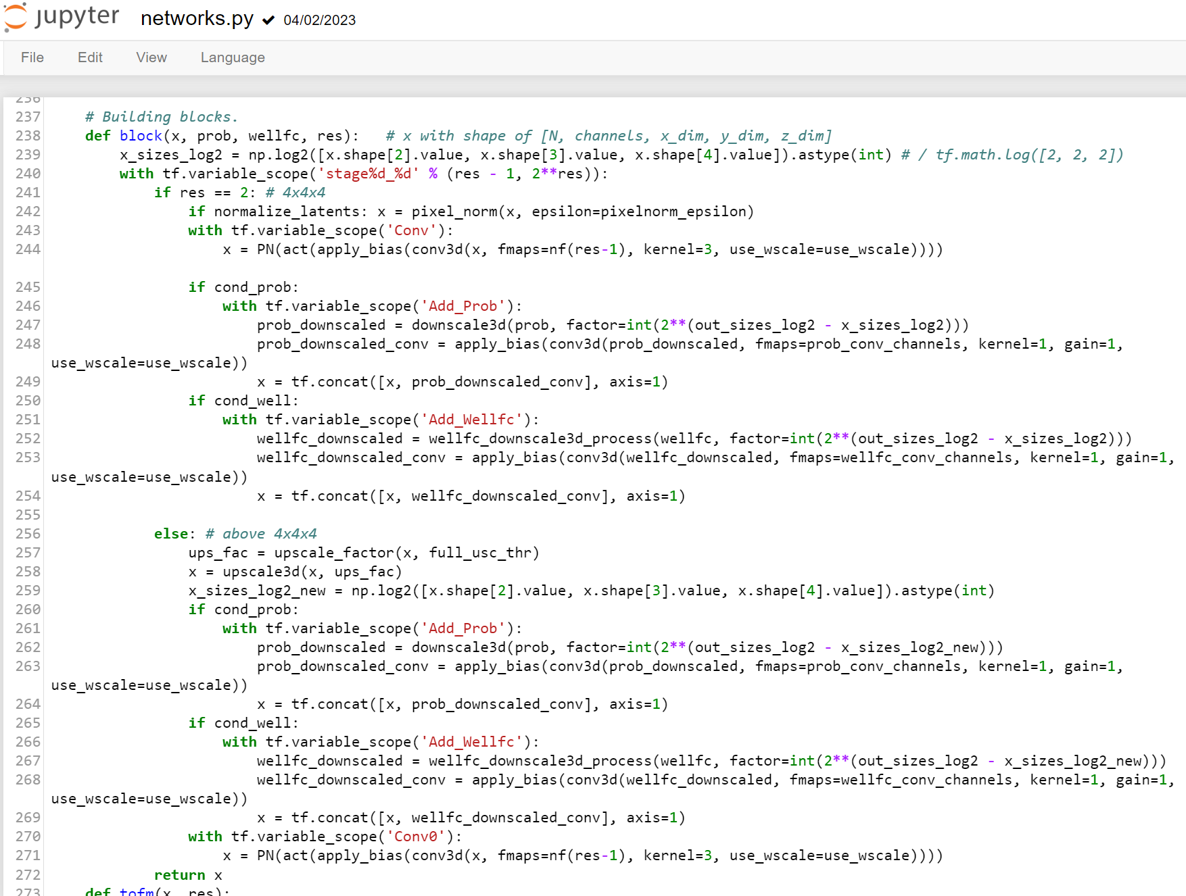
4. Set up and train GANSim
Optional: revise CNN architecture of generator and discriminator
Notes:
Channels can not be truncated (corroded) by lobes.

Slide 10
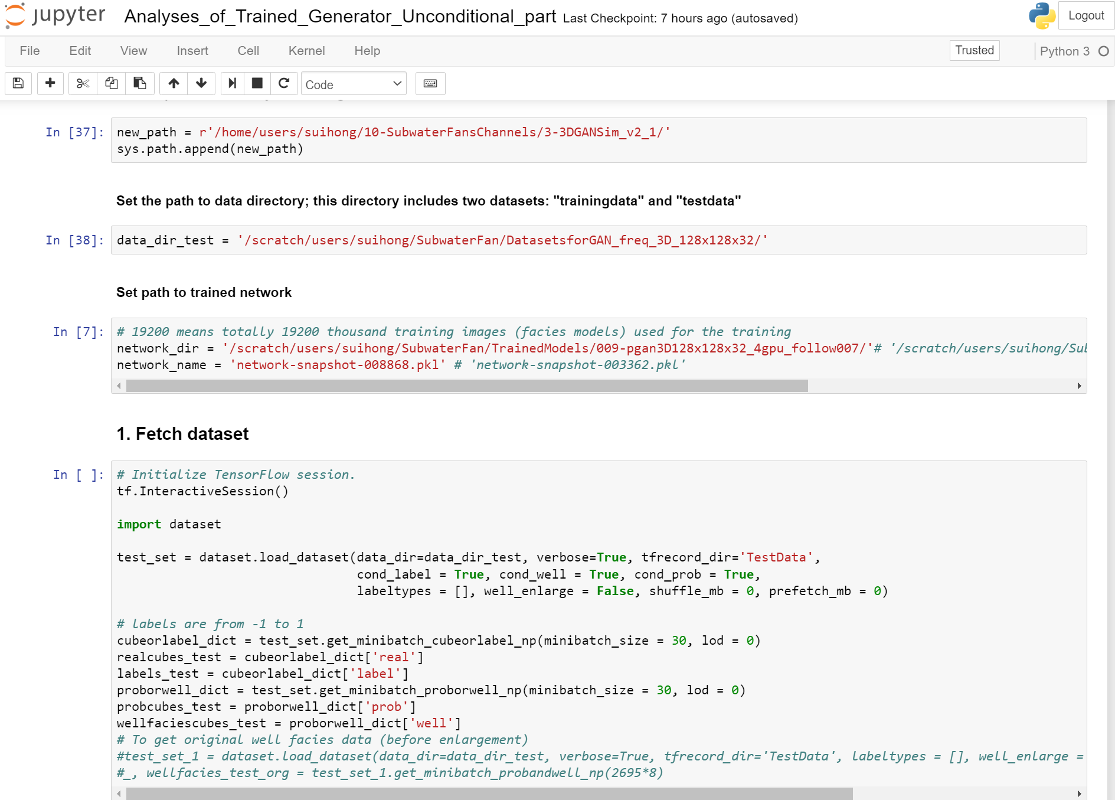
5. Application of trained generator for reservoir simulation
Code file: Analyses_of_Trained_Generator_Unconditional_part
Fetch test dataset to compare with the later generated facies models
Notes:
Channels can not be truncated (corroded) by lobes.

Slide 11
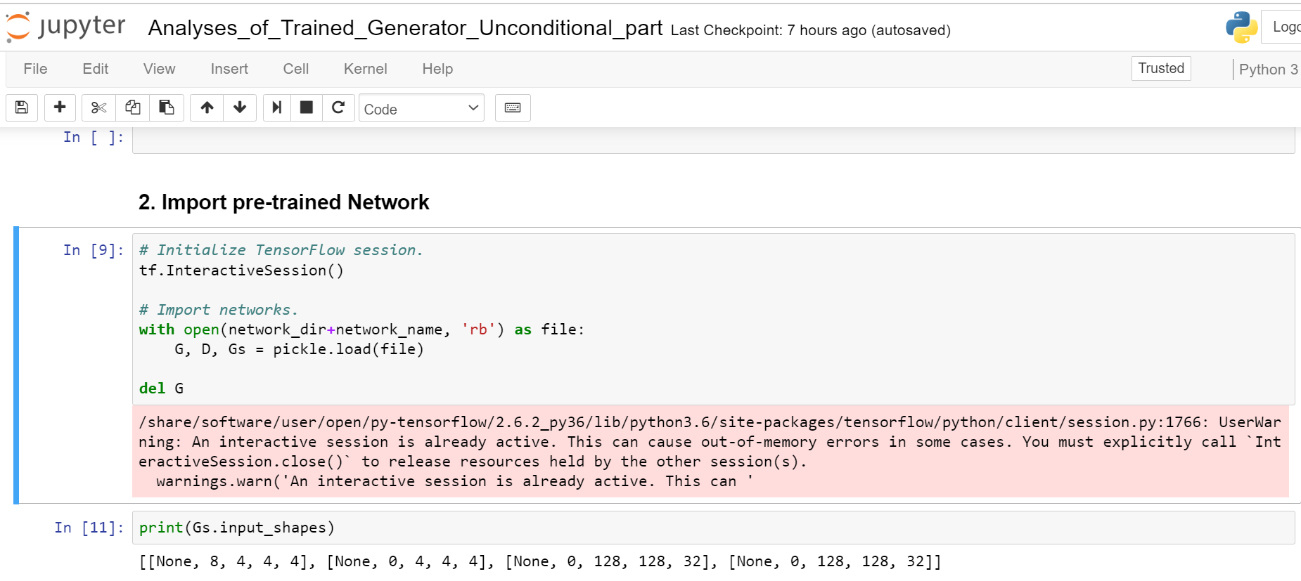
5. Application of trained generator for reservoir simulation
Code file: Analyses_of_Trained_Generator_Unconditional_part
Notes:
Channels can not be truncated (corroded) by lobes.

Slide 12
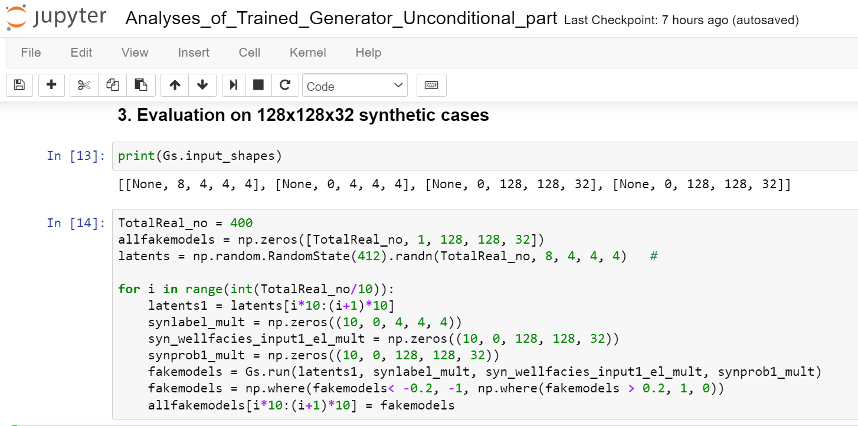
5. Application of trained generator for reservoir simulation
Code file: Analyses_of_Trained_Generator_Unconditional_part
The inputs of the generator include: a latent vector (cube), global feature cubes, well facies data, and probability cubes.
For unconditional case, the second dimensions of global features, well facies data and probability cubes are set as 0, meaning that they don’t provide any information for the generator.
Notes:
Channels can not be truncated (corroded) by lobes.

Slide 13
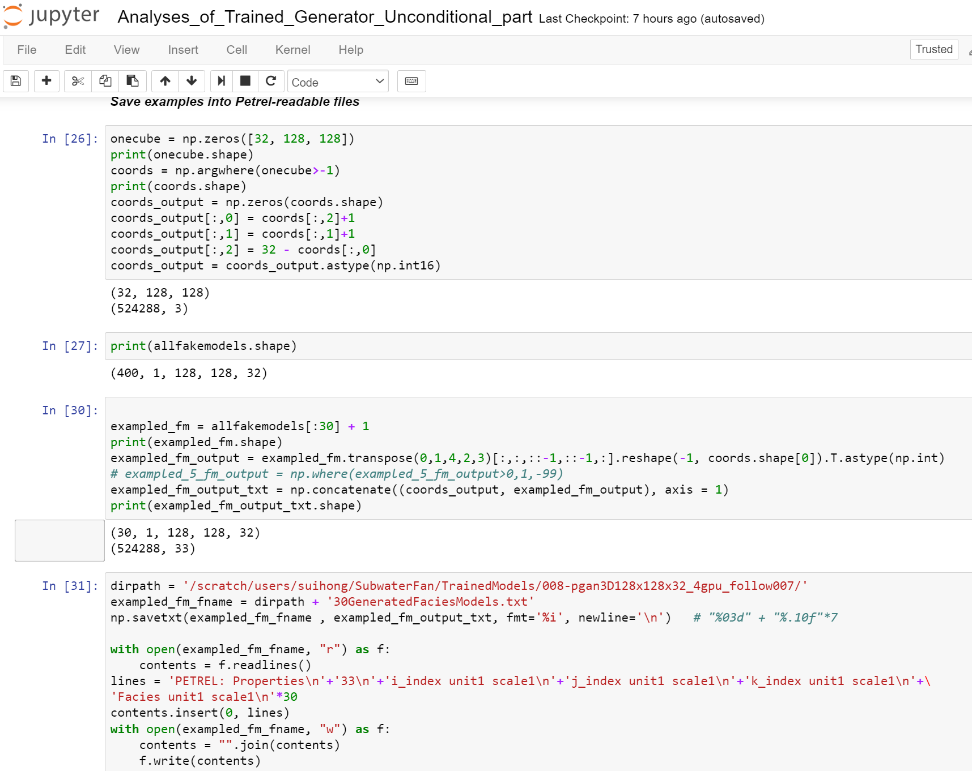
5. Application of trained generator for reservoir simulation
Code file: Analyses_of_Trained_Generator_Unconditional_part
Generated facies models can be saved into Gslib format file which can be imported into Petrel.
Notes:
Channels can not be truncated (corroded) by lobes.

Slide 14
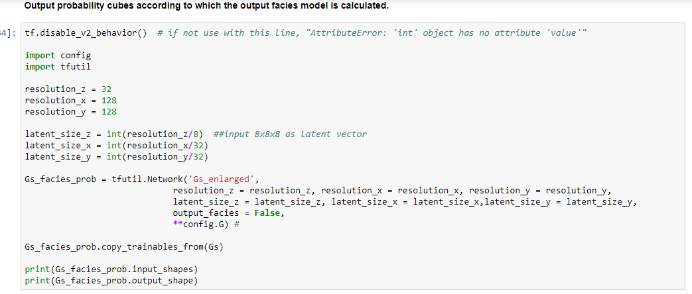
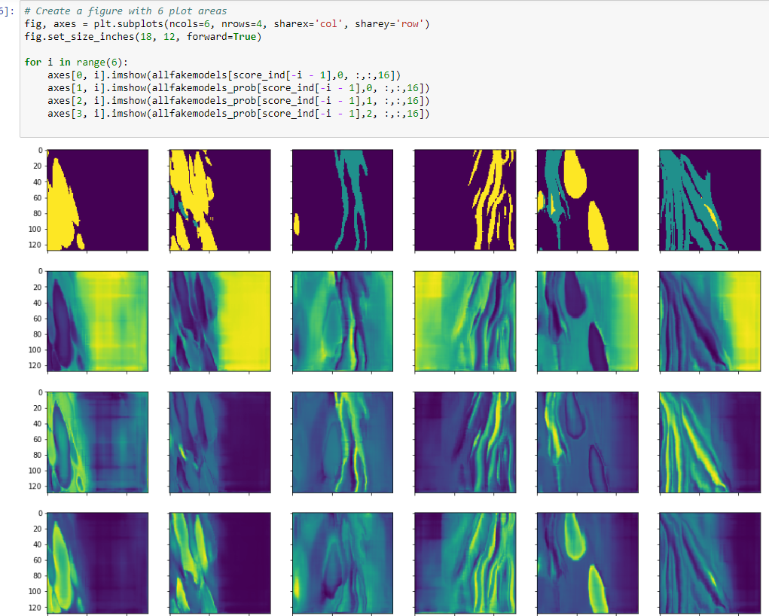
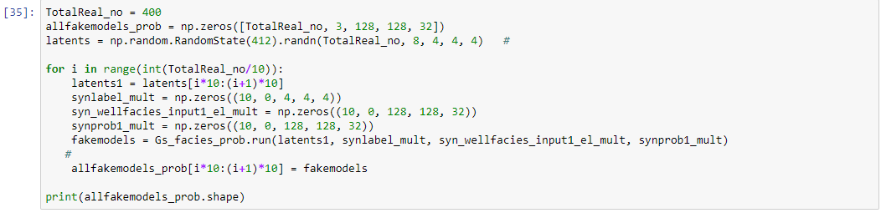
5. Application of trained generator for reservoir simulation
Code file: Analyses_of_Trained_Generator_Unconditional_part
Get the probability cubes of each facies, based on which the final facies model is calculated (with an approximiated argmax function)
Output facies model
Prob of mud
Prob of channel
Prob of lobe
Notes:
Channels can not be truncated (corroded) by lobes.

Slide 15
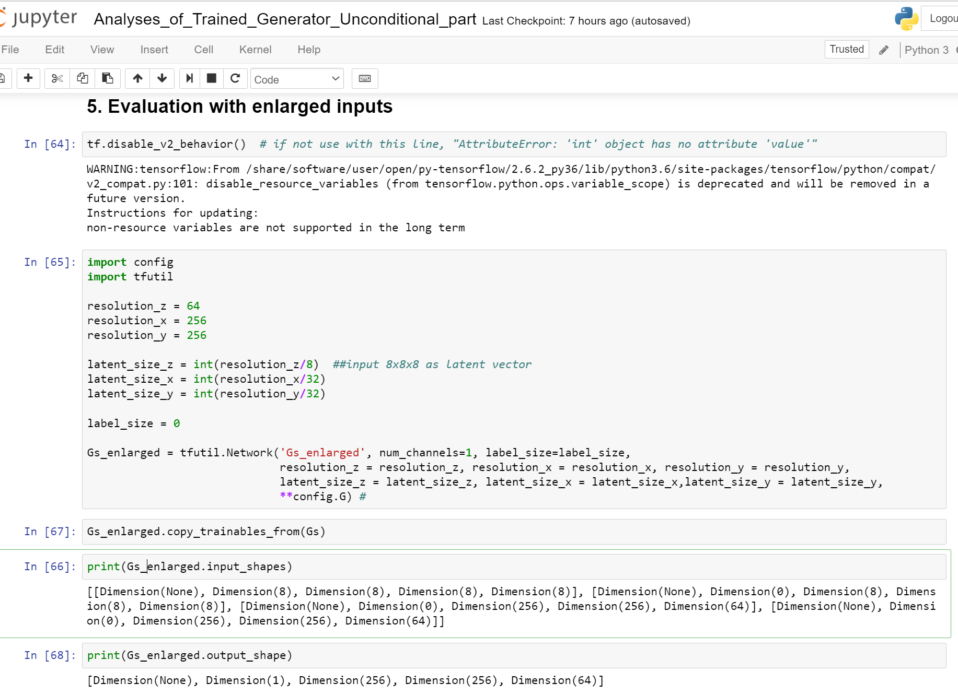
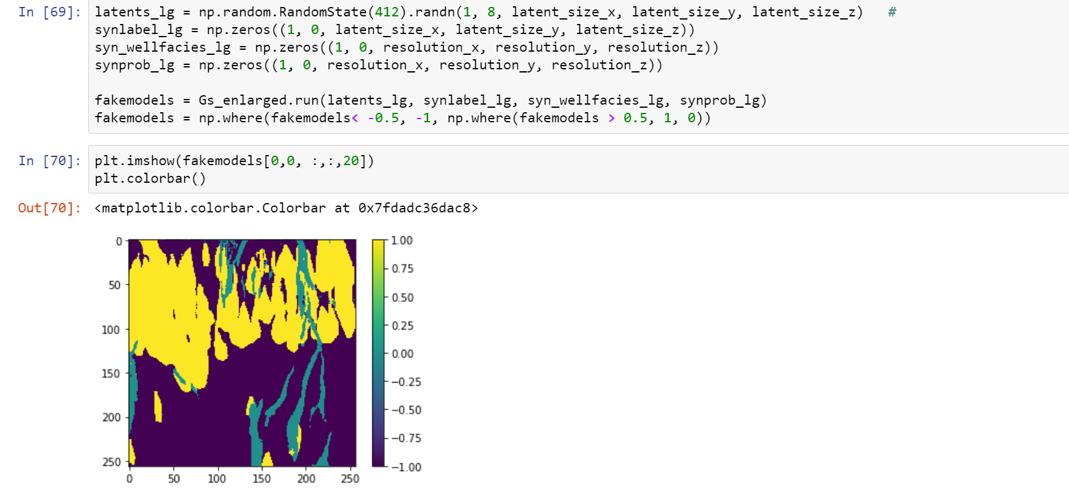
5. Application of trained generator for reservoir simulation
Code file: Analyses_of_Trained_Generator_Unconditional_part
Trained generator can also be used to produce arbitrary size of geomodels, but may be unreasonable for unconditional case.
Notes:
Channels can not be truncated (corroded) by lobes.

Slide 16
Codes
0_1. Convert conceptual geomodel files (from Petrel) into 1 int8 format.ipynb
2. PrepareTrainingDatasets_OnlyFaciesModels
Github code repository: https://github.com/SuihongSong/GANSim3D_v2/tree/main/GANSim3D_v2
Notes:
Channels can not be truncated (corroded) by lobes.

Slide 17
If error reports (e.g., when loading the pretrained generator):
AttributeError: 'int' object has no attribute 'value'
Uncomment line 562 of tfutil.py:
self._build_module_src = self._build_module_src.replace('.value','')
When training, comment line 562 of tfutil.py:
self._build_module_src = self._build_module_src.replace('.value','')

