Slide 1

Physics-informed multi-grid neural operator: theory and an application to porous flow simulation
AGU 2023
Suihong Song, Tapan Mukerji
Stanford University

Slide 2
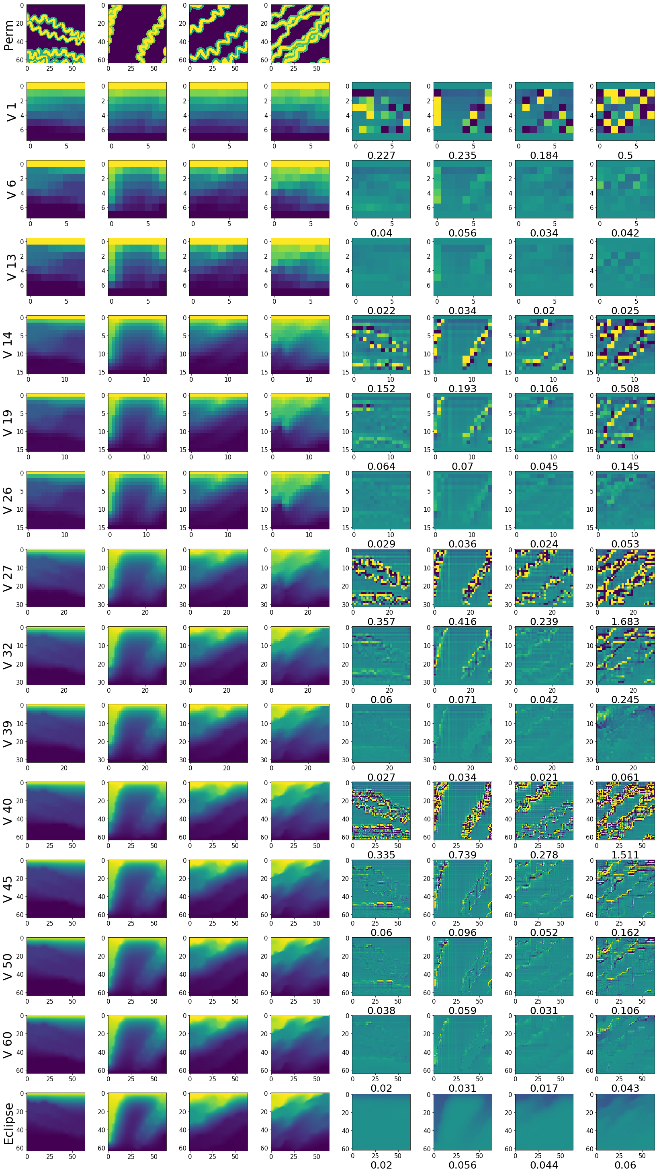
…
Neural networks
as an operator
…
Permeability maps distr.
Pressure maps distr.
Neural operator:
Neural networks representing PDE relations
Map parameter distributions into the solution distribution
Finite operator: discrete inputs/outputs; infinite operator: continuous inputs/outputs
Trained from data-driven, data-driven + physics-informed, or physics-informed

Slide 3
…
Finite multi-grid neural operator
…
Permeability maps distr.
Pressure maps distr.
Propose finite multi-grid neural operator:
No need to obtain outputs for inputs through expensive simulations, for training
Inputs/outputs are discrete, which is common in practical applications
Much more accurate than without multi-grid
10 – 100 times faster than traditional PDE solving when getting similar results

Slide 4
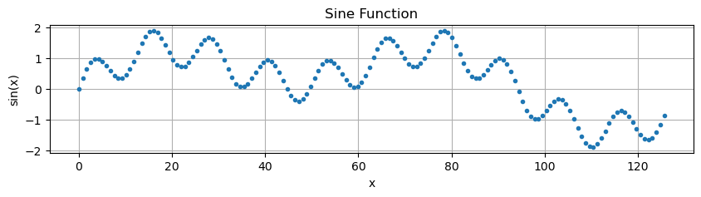


Basic idea of physics-informed multi-grid neural operator
PDE reveals relationship between adjacent points.
Physics-informed loss uses relationship between adjacent points to train neural network.
Points relationship is dominated by high-frequency components, so neural network is inclined to learn high-frequency components.
Know:
$$PDE\left(p_{i},p_{i+1}\right)=0$$
Train NN
$$Loss={𝔼 }_{i}\left[PDE({NN}_{i},{NN}_{i+1})\right]$$
p_{i}
p_{i+1}

Slide 5
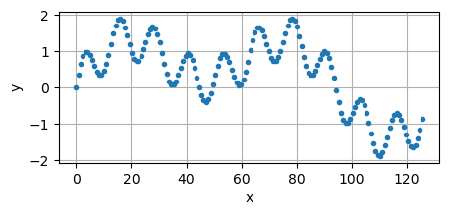
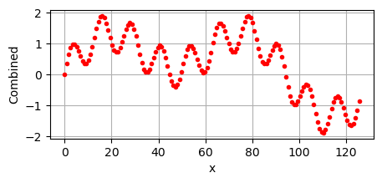
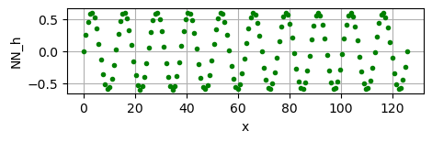
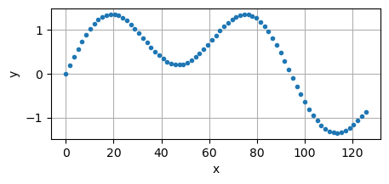
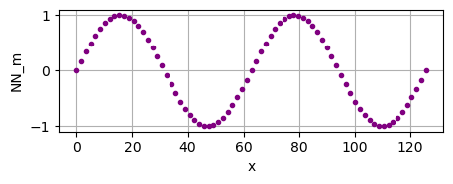
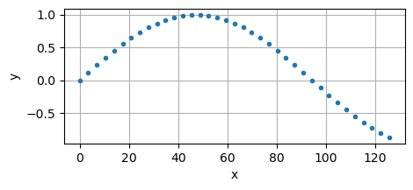
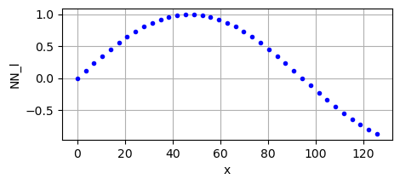
Basic idea of physics-informed multi-grid neural operator
Output
Train NN_{h} to learn high frequency component
Original grid
Coarsen
Train NN_{m} to learn medium frequency component
Medium grid
Combine neural networks
Coarsen
Train NN_{m} to learn low frequency component
Coarse grid

Slide 6
Basic idea of physics-informed multi-grid neural operator
Output
Train NN_{h} to learn high frequency component
V cycle
Original grid
Coarsen
Train NN_{m} to learn medium frequency component
Combine
Medium grid
Coarsen
Train NN_{m} to learn low frequency component
Coarse grid

Slide 7
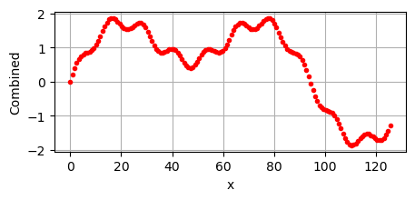
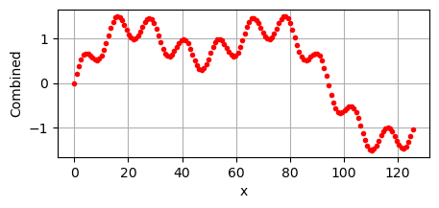
Basic idea of physics-informed multi-grid neural operator
Output 1
Output 2
Output n
Physics-informed multi-grid neural operator
… …
V cycle 1
V cycle 2
V cycle n

Slide 8
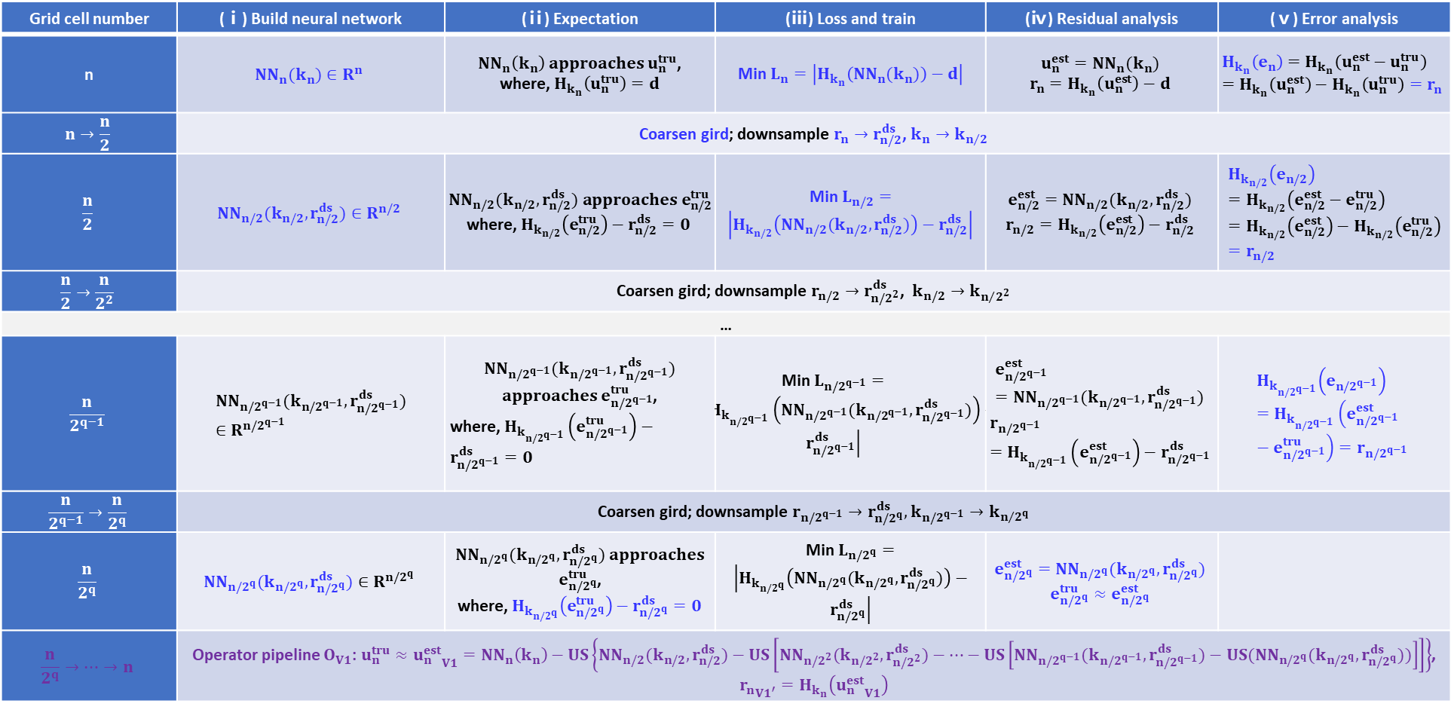
Math derivation
Given PDE $H_{k}\left(u\right)=d$, where $H_{k}$ satisfy linear feature: $H_{k}\left(g_{1}−g_{2}\right)=H_{k}\left(g_{1}\right)−H_{k}\left(g_{2}\right)$, we expect an operator $O(k)$:$H_{k}\left(O(k)\right)=d$
Grid cell number | (ⅰ) Build neural network | (ⅱ) Expectation | (ⅲ) Loss and train | (ⅳ) Residual analysis | (ⅴ) Error analysis
n | $${NN}_{n}(k_{n})∈R^{n}$$ | ${NN}_{n}\left(k_{n}\right) approaches u_{n}^{tru}$, where, $H_{k_{n}}\left(u_{n}^{tru}\right)=d$ | Min $L_{n}=\left|H_{k_{n}}\left({NN}_{n}(k_{n})\right)−d\right|$ | $$u_{n}^{est}={NN}_{n}(k_{n})$$ $$r_{n}=H_{k_{n}}\left(u_{n}^{est}\right)−d$$ | $$H_{k_{n}}\left(e_{n}\right)=H_{k_{n}}\left(u_{n}^{est}−u_{n}^{tru}\right)=H_{k_{n}}\left(u_{n}^{est}\right)−H_{k_{n}}\left(u_{n}^{tru}\right)=r_{n}$$
$$n→\frac{n}{2}$$ | Coarsen gird; downsample $r_{n}→r_{n/2}^{ds}$, $k_{n}→k_{n/2}$
$$\frac{n}{2}$$ | $${NN}_{n/2}(k_{n/2},r_{n/2}^{ds})∈R^{n/2}$$ | ${NN}_{n/2}(k_{n/2},r_{n/2}^{ds}) approaches e_{n/2}^{tru}$ where, $H_{k_{n/2}}\left(e_{n/2}^{tru}\right)−r_{n/2}^{ds}=0$ | Min $L_{n/2}=\left|H_{k_{n/2}}\left({NN}_{n/2}(k_{n/2},r_{n/2}^{ds})\right)−r_{n/2}^{ds}\right|$ | $$e_{n/2}^{est}={NN}_{n/2}(k_{n/2},r_{n/2}^{ds})$$ $$r_{n/2}=H_{k_{n/2}}\left(e_{n/2}^{est}\right)−r_{n/2}^{ds}$$ | $$H_{k_{n/2}}\left(e_{n/2}\right)=H_{k_{n/2}}\left(e_{n/2}^{est}−e_{n/2}^{tru}\right)=H_{k_{n/2}}\left(e_{n/2}^{est}\right)−H_{k_{n/2}}\left(e_{n/2}^{tru}\right)=r_{n/2}$$
$$\frac{n}{2}→\frac{n}{2^{2}}$$ | Coarsen gird; downsample $r_{n/2}→r_{n/2^{2}}^{ds}$, $k_{n/2}→k_{n/{2^{2}}}$
…
$$\frac{n}{2^{q−1}}$$ | $${NN}_{n/2^{q−1}}(k_{n/2^{q−1}},r_{n/2^{q−1}}^{ds})∈R^{n/2^{q−1}}$$ | ${NN}_{n/2^{q−1}}(k_{n/2^{q−1}},r_{n/2^{q−1}}^{ds})$ $approaches$ $e_{n/2^{q−1}}^{tru}$, where, $H_{k_{n/2^{q−1}}}\left(e_{n/2^{q−1}}^{tru}\right)−r_{n/2^{q−1}}^{ds}=0$ | Min $L_{n/2^{q−1}}=\left|H_{k_{n/2^{q−1}}}\left({NN}_{n/2^{q−1}}(k_{n/2^{q−1}},r_{n/2^{q−1}}^{ds})\right)−r_{n/2^{q−1}}^{ds}\right|$ | $$e_{n/2^{q−1}}^{est}={NN}_{n/2^{q−1}}(k_{n/2^{q−1}},r_{n/2^{q−1}}^{ds})$$ $$r_{n/2^{q−1}}=H_{k_{n/2^{q−1}}}\left(e_{n/2^{q−1}}^{est}\right)−r_{n/2^{q−1}}^{ds}$$ | $$H_{k_{n/2^{q−1}}}\left(e_{n/2^{q−1}}\right)=H_{k_{n/2^{q−1}}}\left(e_{n/2^{q−1}}^{est}−e_{n/2^{q−1}}^{tru}\right)=r_{n/2^{q−1}}$$
$$\frac{n}{2^{q−1}}→\frac{n}{2^{q}}$$ | Coarsen gird; downsample $r_{n/2^{q−1}}→r_{n/2^{q}}^{ds},$ $k_{n/2^{q−1}}→k_{n/{2^{q}}}$
$$\frac{n}{2^{q}}$$ | $${NN}_{n/2^{q}}(k_{n/2^{q}},r_{n/2^{q}}^{ds})∈R^{n/2^{q}}$$ | ${NN}_{n/2^{q}}(k_{n/2^{q}},r_{n/2^{q}}^{ds})$ $approaches$ $e_{n/2^{q}}^{tru}$, where, $H_{k_{n/2^{q}}}\left(e_{n/2^{q}}^{tru}\right)−r_{n/2^{q}}^{ds}=0$ | Min $L_{n/2^{q}}=\left|H_{k_{n/2^{q}}}\left({NN}_{n/2^{q}}(k_{n/2^{q}},r_{n/2^{q}}^{ds})\right)−r_{n/2^{q}}^{ds}\right|$ | $$e_{n/2^{q}}^{est}={NN}_{n/2^{q}}(k_{n/2^{q}},r_{n/2^{q}}^{ds})$$ $$e_{n/2^{q}}^{tru}≈e_{n/2^{q}}^{est}$$
$$\frac{n}{2^{q}}→…→n$$ | Operator pipeline $O_{V1}$: $u_{n}^{tru}≈{u_{n}^{est}}_{V1}={NN}_{n}\left(k_{n}\right)−US\left\{{NN}_{n/2}(k_{n/2},r_{n/2}^{ds})−US\left[{NN}_{n/2^{2}}(k_{n/2^{2}},r_{n/2^{2}}^{ds})−⋯−US\left[{NN}_{n/2^{q−1}}(k_{n/2^{q−1}},r_{n/2^{q−1}}^{ds})−US({NN}_{n/2^{q}}(k_{n/2^{q}},r_{n/2^{q}}^{ds}))\right]\right]\right\}$, ${r_{n}}_{{V1}^{′}}=H_{k_{n}}\left({u_{n}^{est}}_{V1}\right)$
Initial V cycle

Slide 9
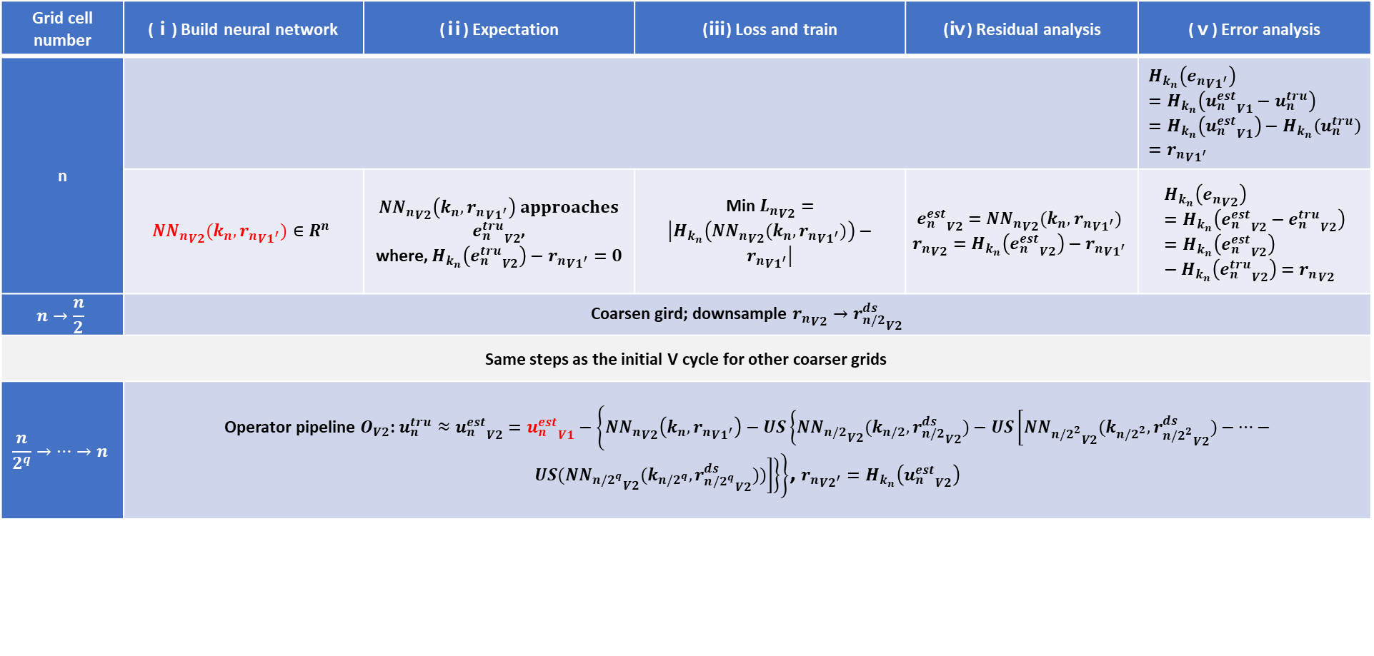
Math derivation
Given PDE $H_{k}\left(u\right)=d$, where $H_{k}$ satisfy linear feature: $H_{k}\left(g_{1}−g_{2}\right)=H_{k}\left(g_{1}\right)−H_{k}\left(g_{2}\right)$, we expect an operator $O(k)$:$H_{k}\left(O(k)\right)=d$
Grid cell number | (ⅰ) Build neural network | (ⅱ) Expectation | (ⅲ) Loss and train | (ⅳ) Residual analysis | (ⅴ) Error analysis
n |  |  |  |  | $$H_{k_{n}}\left({e_{n}}_{{V1}^{′}}\right)=H_{k_{n}}\left({u_{n}^{est}}_{V1}−u_{n}^{tru}\right)=H_{k_{n}}\left({u_{n}^{est}}_{V1}\right)−H_{k_{n}}\left(u_{n}^{tru}\right)={r_{n}}_{{V1}^{′}}$$
 | $${{NN}_{n}}_{V2}(k_{n},{r_{n}}_{{V1}^{′}})∈R^{n}$$ | ${{NN}_{n}}_{V2}\left(k_{n},{r_{n}}_{{V1}^{′}}\right)$ $approaches$ ${e_{n}^{tru}}_{V2}$, where, $H_{k_{n}}\left({e_{n}^{tru}}_{V2}\right)−{r_{n}}_{{V1}^{′}}=0$ | Min ${L_{n}}_{V2}=\left|H_{k_{n}}\left({{NN}_{n}}_{V2}(k_{n},{r_{n}}_{{V1}^{′}})\right)−{r_{n}}_{{V1}^{′}}\right|$ | $${e_{n}^{est}}_{V2}={{NN}_{n}}_{V2}(k_{n},{r_{n}}_{{V1}^{′}})$$ $${r_{n}}_{V2}=H_{k_{n}}\left({e_{n}^{est}}_{V2}\right)−{r_{n}}_{{V1}^{′}}$$ | $$H_{k_{n}}\left({e_{n}}_{V2}\right)=H_{k_{n}}\left({e_{n}^{est}}_{V2}−{e_{n}^{tru}}_{V2}\right)=H_{k_{n}}\left({e_{n}^{est}}_{V2}\right)−H_{k_{n}}\left({e_{n}^{tru}}_{V2}\right)={r_{n}}_{V2}$$
$$n→\frac{n}{2}$$ | Coarsen gird; downsample ${r_{n}}_{V2}→{r_{n/2}^{ds}}_{V2}$
Same steps as the initial V cycle for other coarser grids
$$\frac{n}{2^{q}}→…→n$$ | Operator pipeline $O_{V2}$: $u_{n}^{tru}≈{u_{n}^{est}}_{V2}={u_{n}^{est}}_{V1}−\left\{{{NN}_{n}}_{V2}\left(k_{n},{r_{n}}_{{V1}^{′}}\right)−US\left\{{{NN}_{n/2}}_{V2}(k_{n/2},{r_{n/2}^{ds}}_{V2})−US\left[{{NN}_{n/2^{2}}}_{V2}(k_{n/2^{2}},{r_{n/2^{2}}^{ds}}_{V2})−⋯−US({{NN}_{n/2^{q}}}_{V2}(k_{n/2^{q}},{r_{n/2^{q}}^{ds}}_{V2}))\right]\right\}\right\}$, ${r_{n}}_{{V2}^{′}}=H_{k_{n}}\left({u_{n}^{est}}_{V2}\right)$
Following V cycles

Slide 10
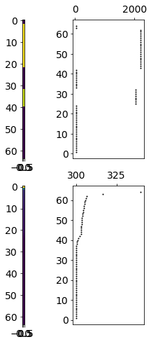
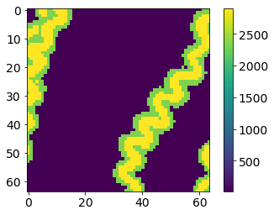
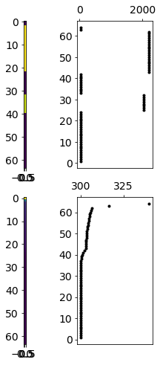
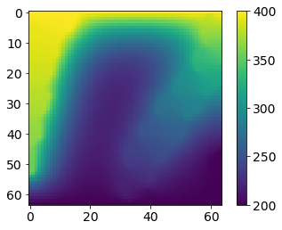
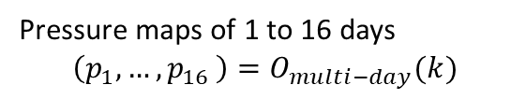
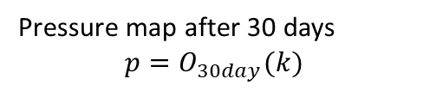
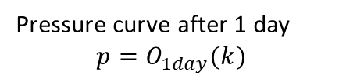
Operator for porous flow simulation
1D case
2D-single time case
2D-multiple time case
mD
k, mD
k, mD
North
Flow
Flow
Flow
A random perm curve
A random perm map
A random perm map
Operator
Operator
Operator
bar
p, bar
1st day
2nd day
…
16th day
Pressure curve after 1 day
$$p=O_{1day}(k)$$
Pressure map after 30 days
$$p=O_{30day}(k)$$
Pressure maps of 1 to 16 days
$$\left(p_{1},{…, p}_{16}\right)=O_{multi−day}(k)$$

Slide 11
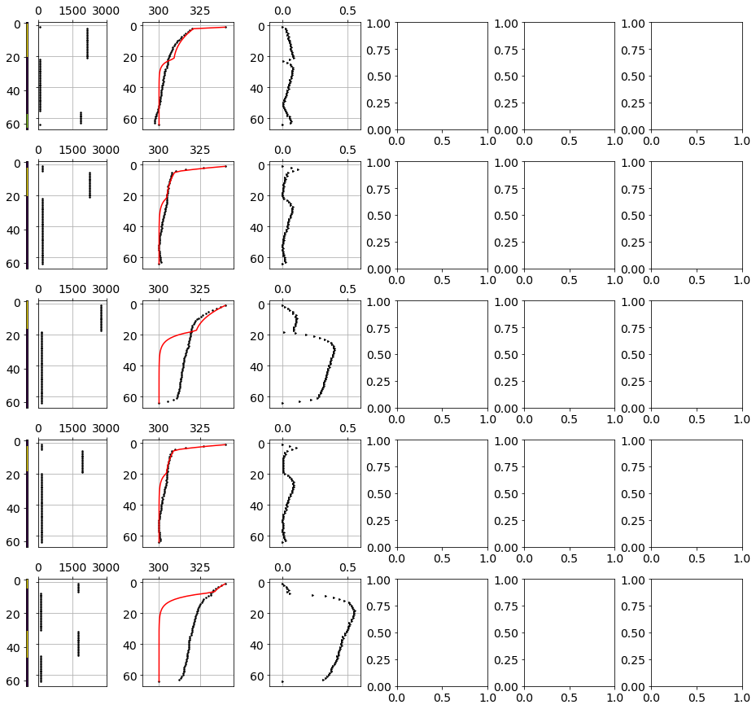
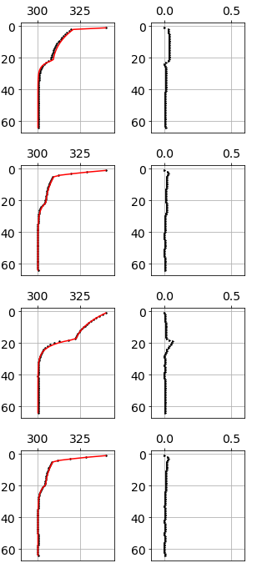
Operator for porous flow simulation
Test perm
Multi-grid neural operator
1D case
mD
Pred. pres.
Rel. error
bar
Ex1
Operator training
Training data: 20 k perm columns
Training time: 610 s (1 A100 GPU)
Ex2
Inference
Accuracy: operator ≈ traditional PDE solver (Eclipse)
Inference time: operator is 100 times faster than traditional solver
Ex3
Ex4
Solver results
Neural operator results

Slide 12
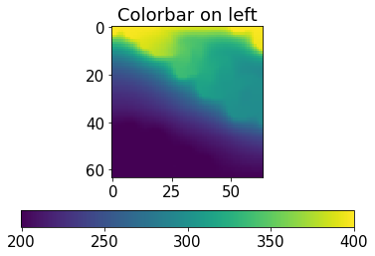
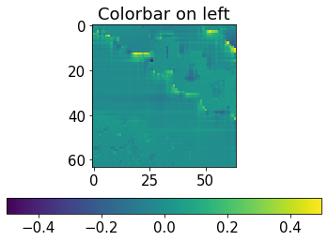
Operator training
Operator for porous flow simulation
Training data: 35 k perm maps
Training time: 5.5 h (1 A100 GPU)
2D-single time case
Inference
Test perm maps
Accuracy: operator > traditional PDE solver, because operator’s average residual (0.028) < solver’s residual (0.055).
Inference time: operator is 100 times faster than traditional solver
Predicted pressure maps
Corresponding residual maps
Operator
Solver
Pressure
Residual

Slide 13
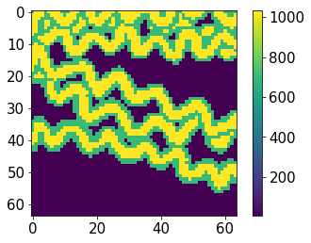
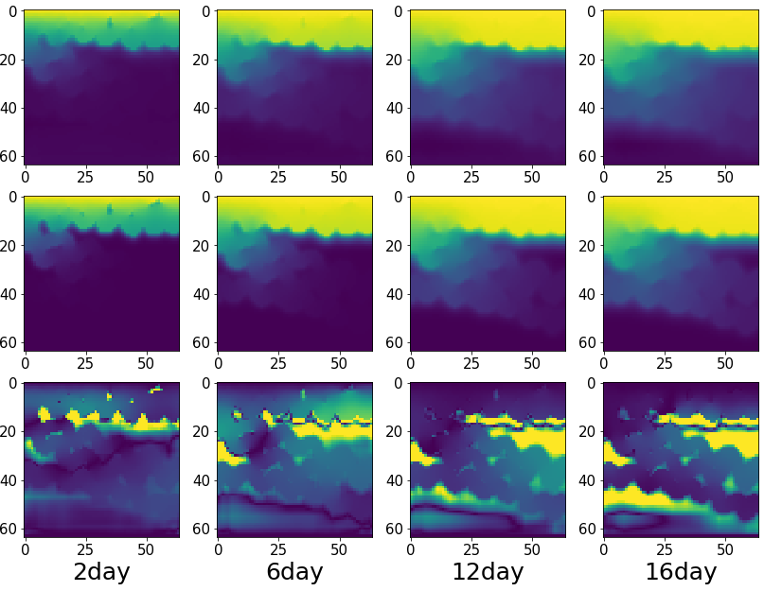
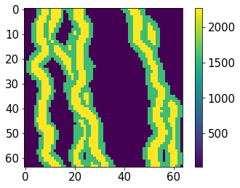
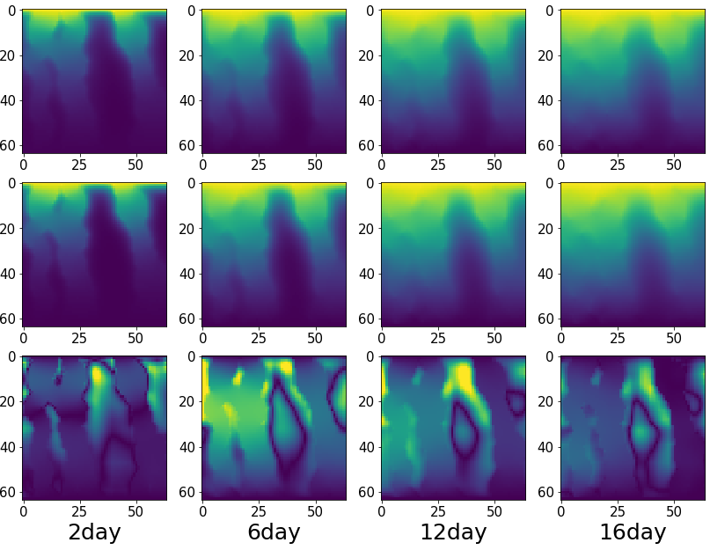
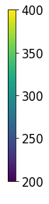
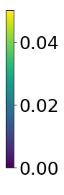
Operator for porous flow simulation
2D-multiple time case
Inference
Operator training
Accuracy: operator ≈ traditional solver
Inference time: operator is 10 - 100 times faster than traditional solver
Training data: 35 k perm maps
Training time: 30.3 h (4 A100 GPU)
Test perm map 1
Test perm map 2
Operator
Predicted pressure maps
Predicted pressure maps
Operator
Solver
Solver
Relative error
Relative error

Slide 14
Takeaways
We propose purely physics-informed multi-grid neural operator, which learns different-frequency components at different grids.
No expensive preparation for input-output data-pairs is required for training the operator.
The operator is verified on flow simulation examples: after training, it produces similar results as traditional PDE solvers but is 10 - 100 times faster than solvers.
Paper and codes will be open accessed very soon at my github: github/SuihongSong

