Slide 1
Multilevel-feedback-queue scheduler
Sara Alqarni

Slide 2
AGENDA
Explanation
Features
​How to use the program
Code

Slide 3
Explanation
This is a program that provides a feedback queue scheduler with many levels. The scheduler accepts the number of processes, as well as their arrival and burst times, as inputs and outputs the waiting time and turnaround time for each. To handle the processes, the scheduler employs two queues with varying time quantums. The processes in the first queue are given an 8-unit time quantum, while the processes in the second queue are given a 16-unit time quantum. The scheduler works by iterating through all the processes and executing each one for the time quantum allotted to its queue or for the process's remaining time, whichever is less.

Slide 4



Features of program
This scheduling algorithm allows different processes to move between different queues.
This algorithm helps in reducing the response time.
It is a flexible Scheduling Algorithm.

Slide 5
How to use the program
The user should determine the number of processes.
Determine the burst time and arrival time.
By entering the number the program will calculate.

Slide 6
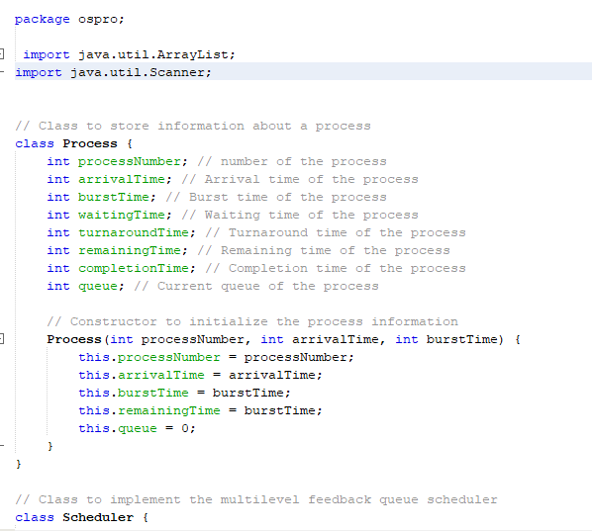
Code [1]:

Slide 7
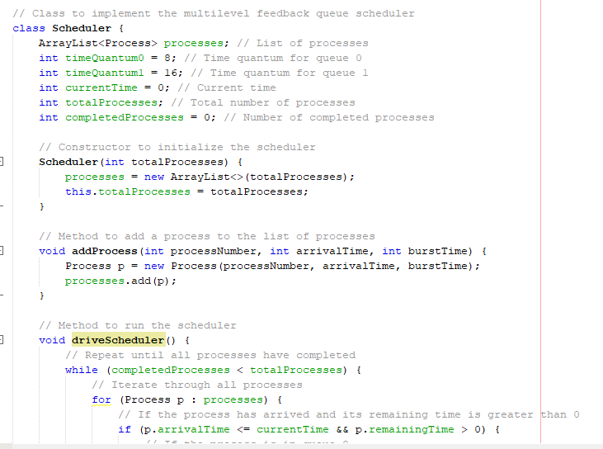
Code [2]:

Slide 8
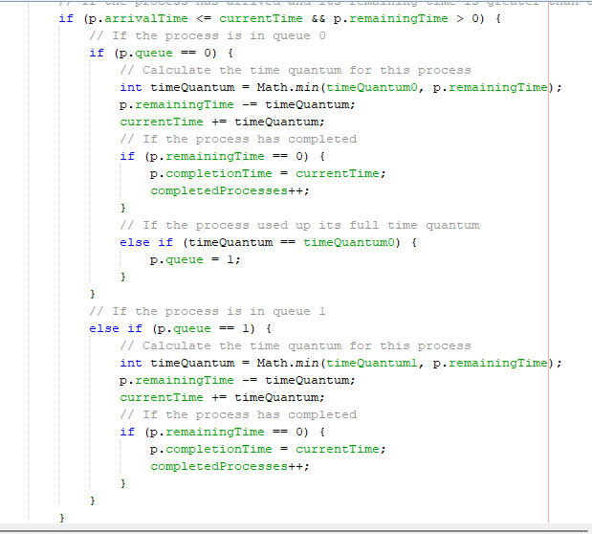
Code [3]:

Slide 9
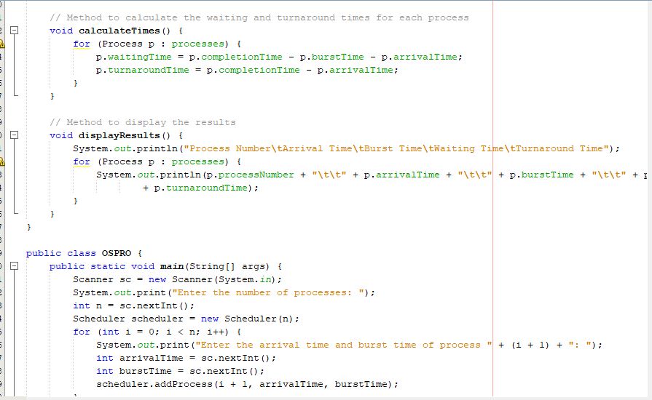
Code [4]:

Slide 10
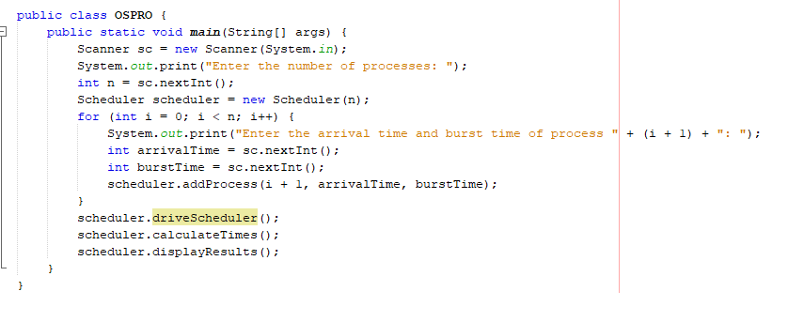
Code [5]:

Slide 11
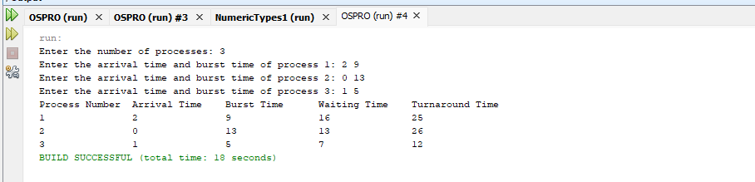
Output:

Slide 12
THANK YOU
Sara Abdulrahman Alqarni

