Slide 1
Probabilistic methods in Open Earth Tools
Ferdinand Diermanse
Kees den Heijer
Bas Hoonhout

Slide 2

Open Earth Tools
Deltares software
Open source
Sharing code for users of matlab, python, R, …
https://publicwiki.deltares.nl/display/OET/OpenEarth

Slide 3
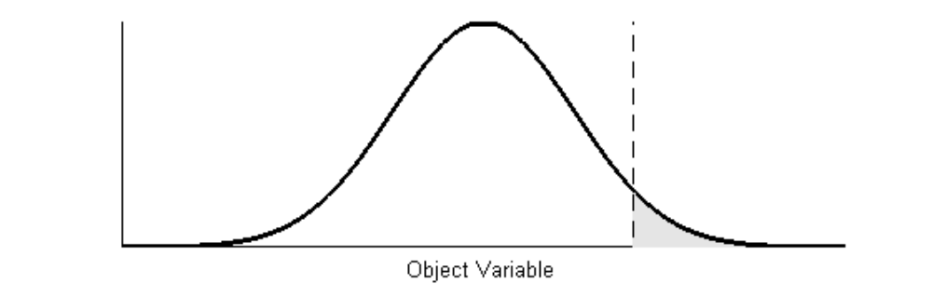
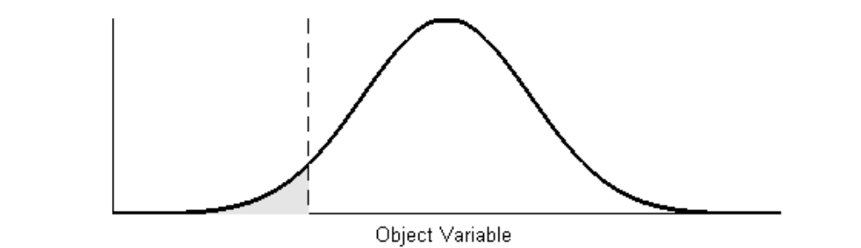
Application: probabilities of unwanted events (failure)
Floods (too much)
Droughts (too little)
Contamination (too dirty)

Slide 4
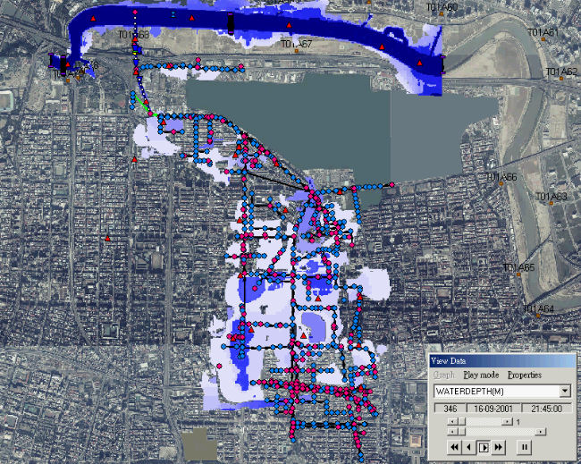
Example application: flood risk analysis
Rainfall
Upstream river
Discharge
Sobek
Sea water
level

Slide 5
General problem definition
X₁
X₂
System/model
Z
.
.
.
“system
variable”
X_{n}
“Boundary
conditions”

Slide 6
Notation
X₁
X₂
System/model
Z
.
.
.
X = (X₁, X₂, …, X_{n})
X_{n}
Z = Z(X)

Slide 7

General problem definition
X₁
?
X₂
complex
.
.
.
model
Z
Time consuming
Probabilistic
analysis
X_{n}
Statistical
analysis

Slide 8
failure domain: unwanted events
x₂
“failure”
Z(x)<0
no “failure”
Z(x)=0
Z(x)>0
x₁
Wanted: probability of failure, i.e. probability that Z<0

Slide 9

Example Z-function
Failure: if water level (h) exceeds crest height (k): Z = k - h

Slide 10
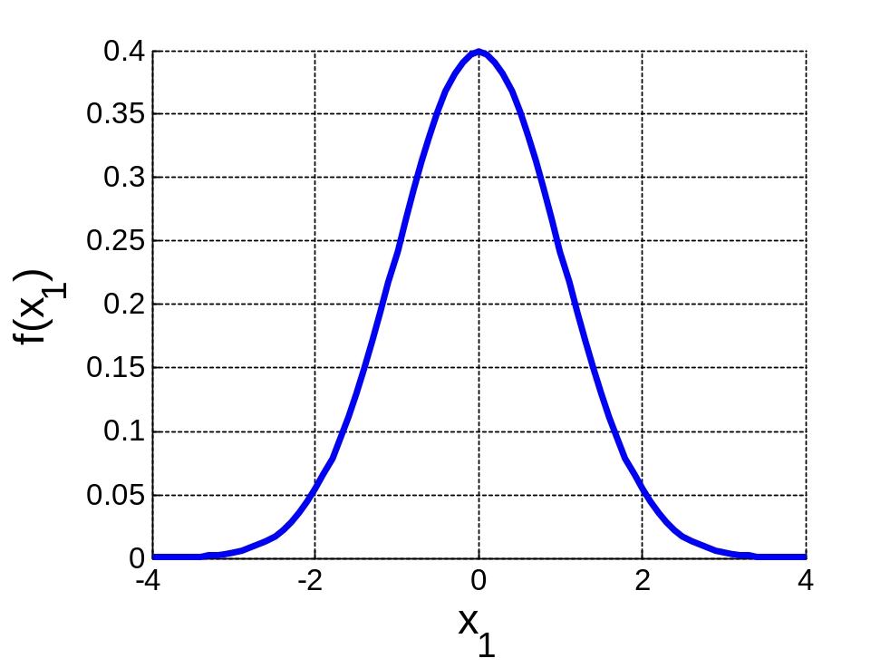
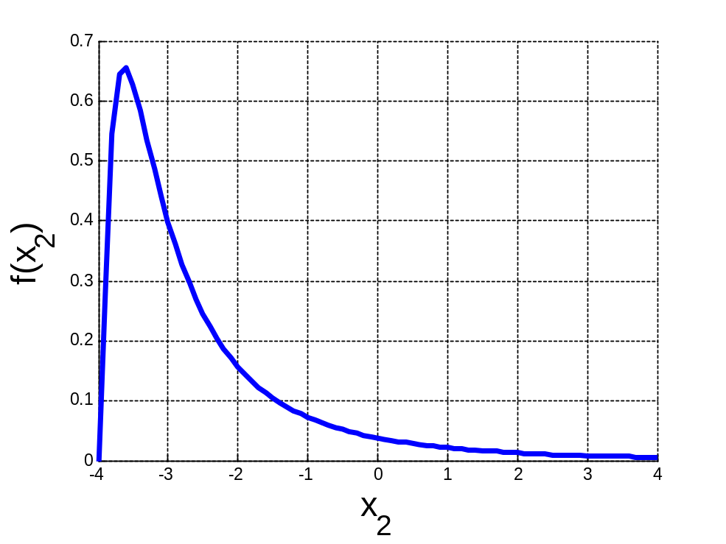
Probability functions of x-variables

Slide 11
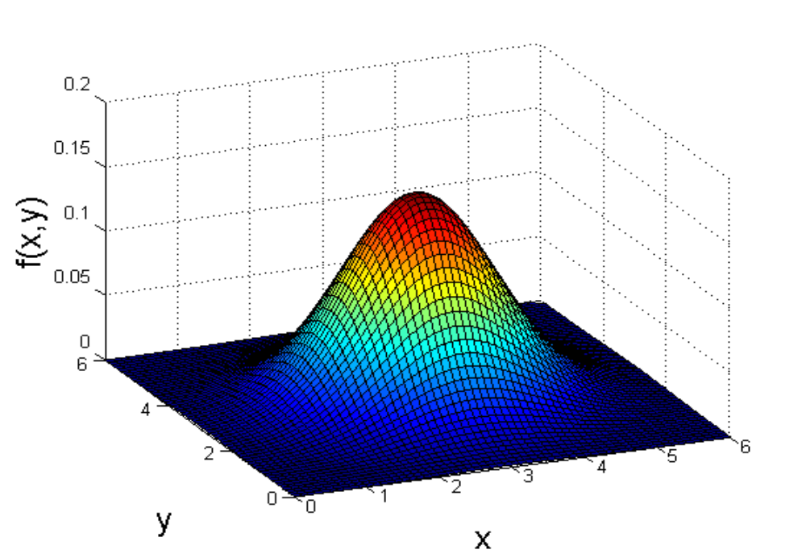
Correlations need to be included
x₂
f(x)
f(x)
x₂
x₁
x₁
Multivariate distribution function

Slide 12
Combination of f(x) and Z(x)
x₂
“failure”
f(x)
Z(x)=C*
no “failure”
x₁

Slide 13
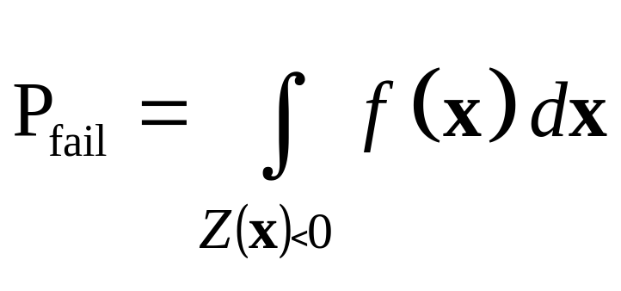
Probability of failure
x₂
f(x)
Z(x)=0
x₁

Slide 14
Problem definition
Problem cannot be solved analytically
Probabilistic estimation techniques are required
Evaluation of Z(x) can be very time consuming

Slide 15
Probabilistic methods in Open Earth Tools
Crude Monte Carlo
Monte Carlo with importance sampling
First Order Reliability Method (FORM)
Directional sampling

Slide 16
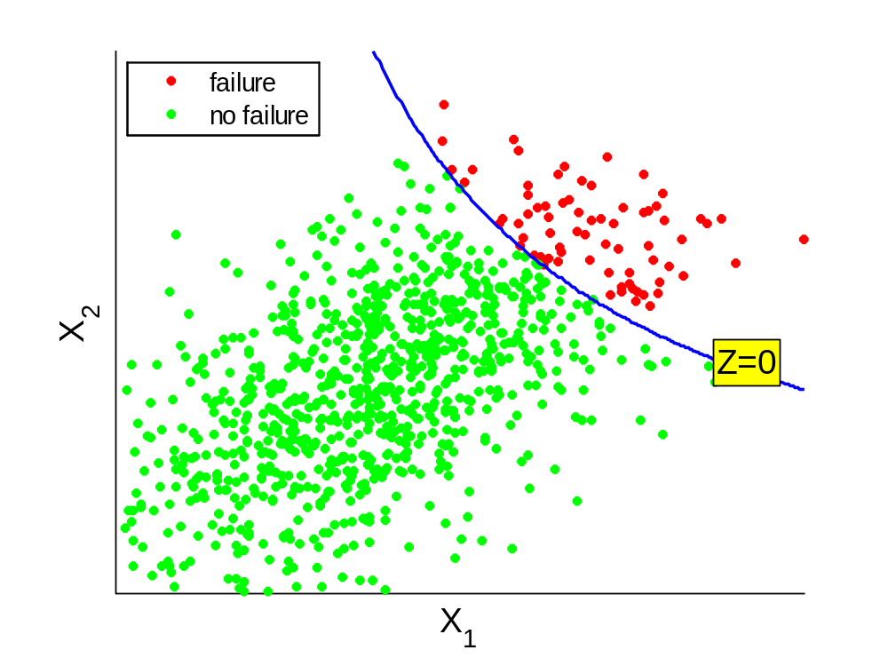
Crude Monte Carlo sampling
Take N random samples of the x-variables
Count the number of samples (M) that lead to “failure”
Estimate P_{f} = M/N

Slide 17
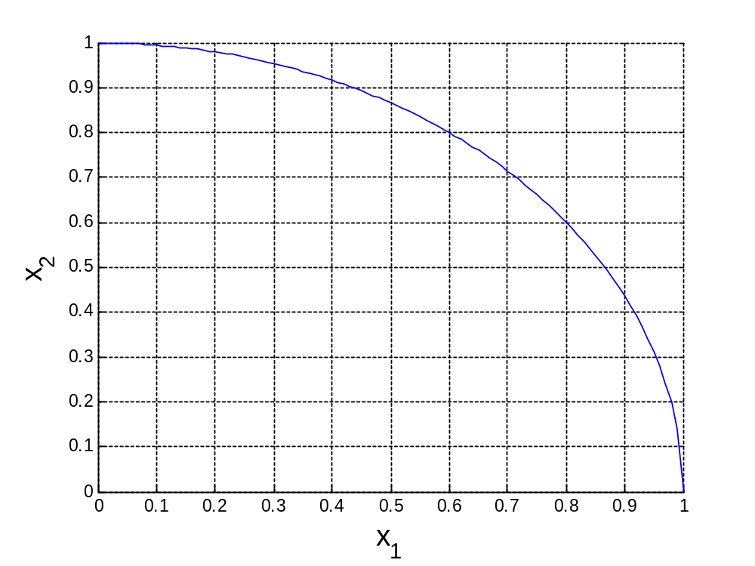
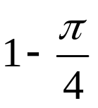


Simple example Crude Monte Carlo: ¼ circle

Slide 18
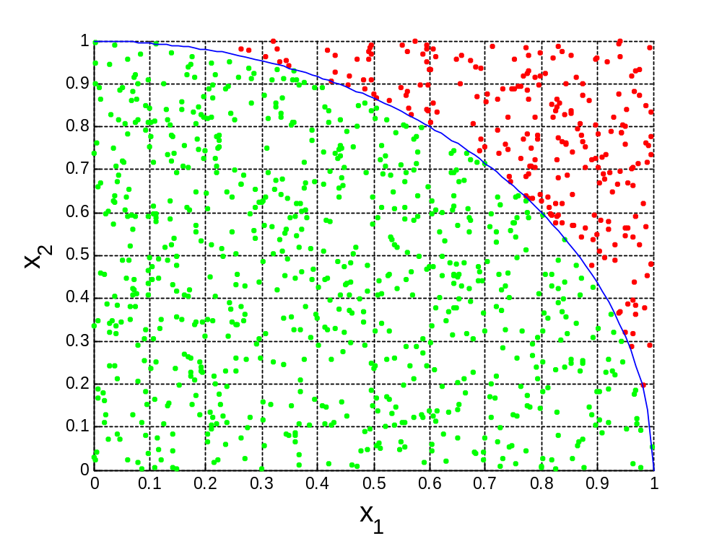
Samples crude Monte Carlo
failure
no failure

Slide 19
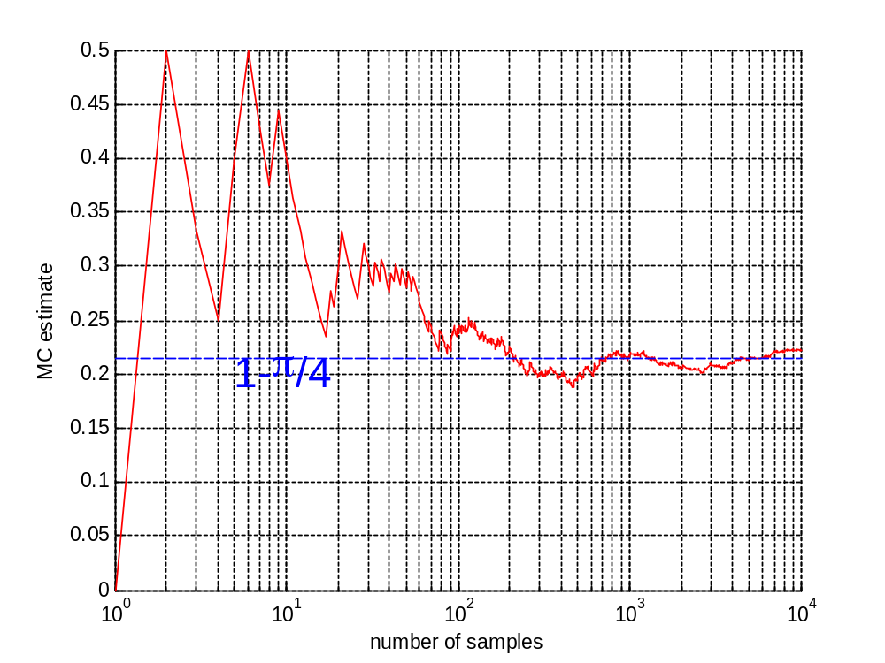
MC estimate

Slide 20
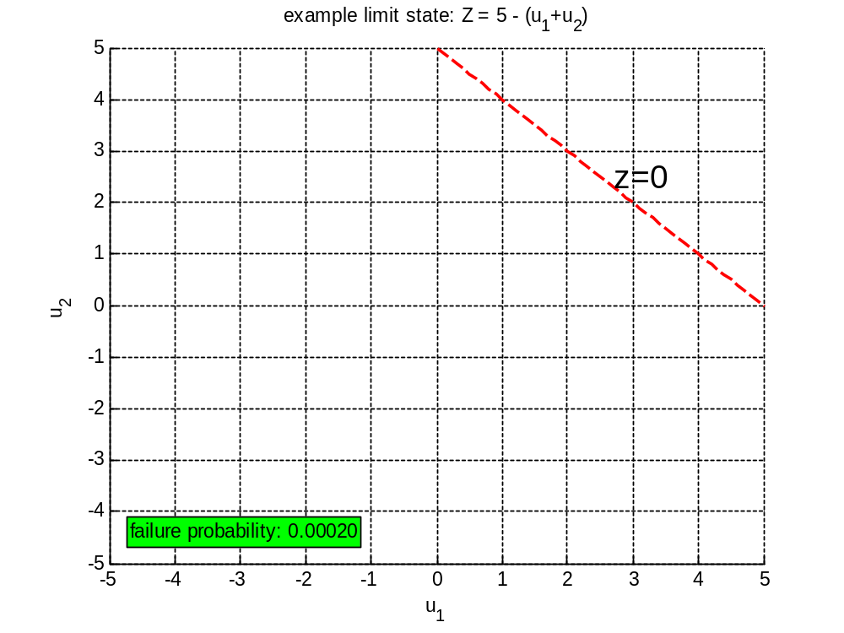
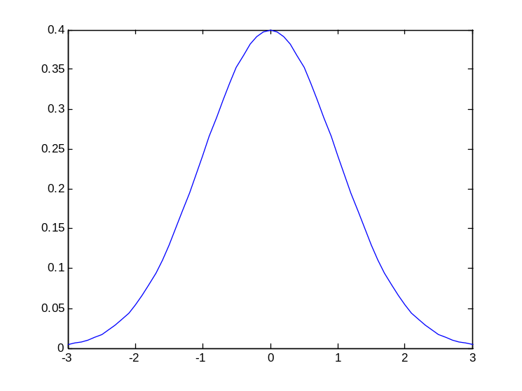
New example: smaller probability of failure
U₁;U₂

Slide 21
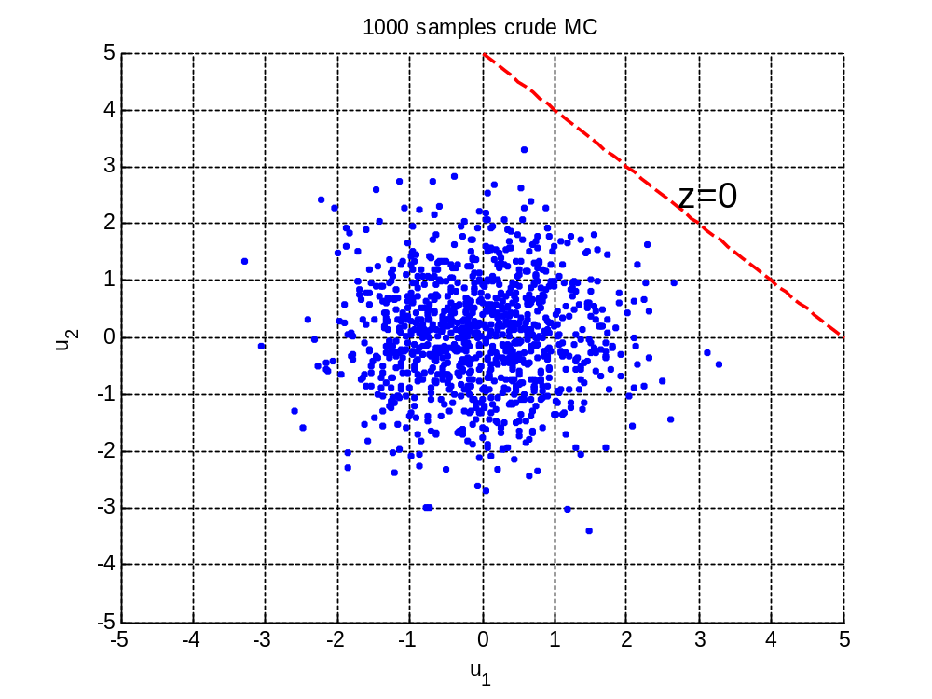
1000 samples

Slide 22
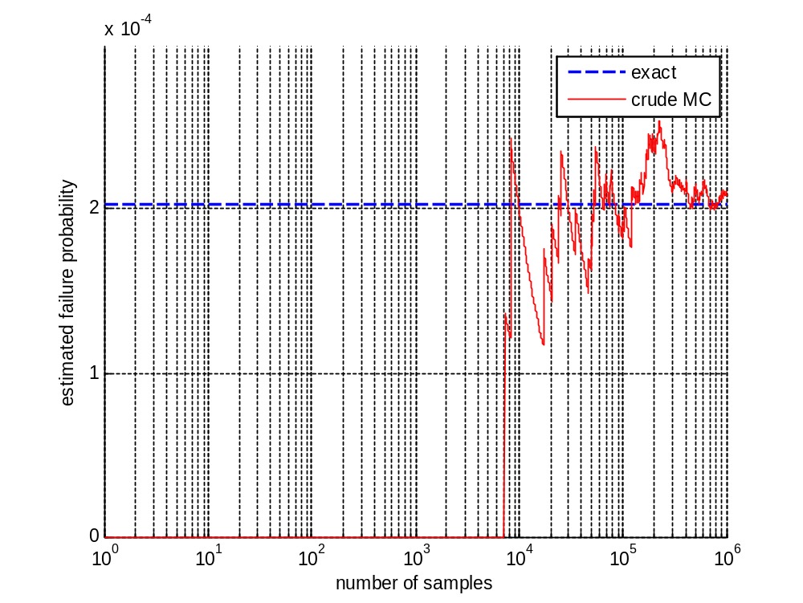
How many samples required?

Slide 23
Crude Monte Carlo
Can handle a large number of random variables
Number of samples required for a sufficiently accurate estimate is inversely proportional to the probability of failure
For small failure probabilities, crude MC is not a good choice, especially if each sample brings with it a time consuming computation/simulation

Slide 24
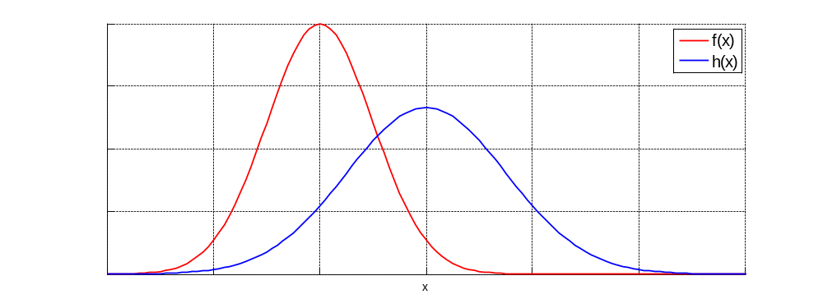
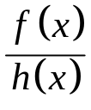
“Smart” MC method 1: importance sampling
Manipulation of probability denstity function
Allowed with the use of a correction:
Potentially much faster than Crude Monte Carlo

Slide 25
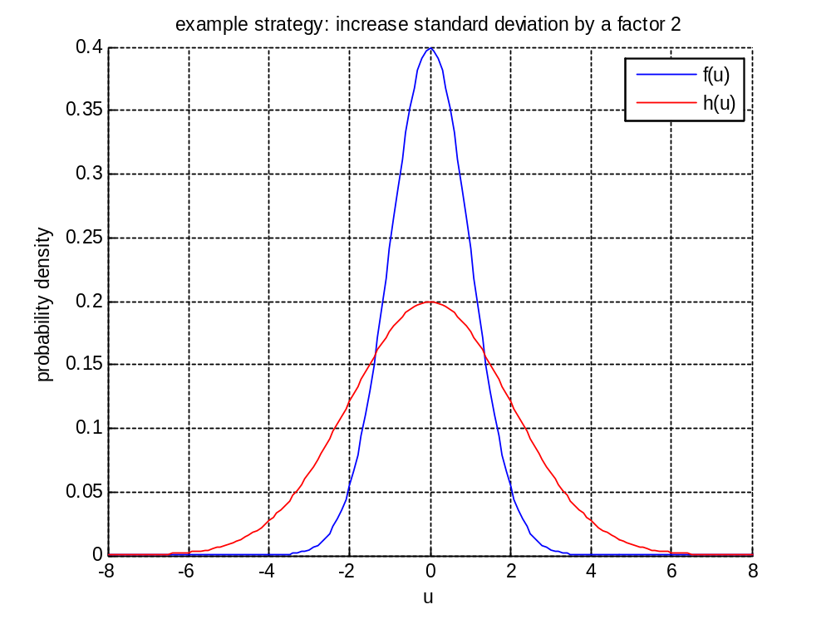
Example strategy: increase variance

Slide 26
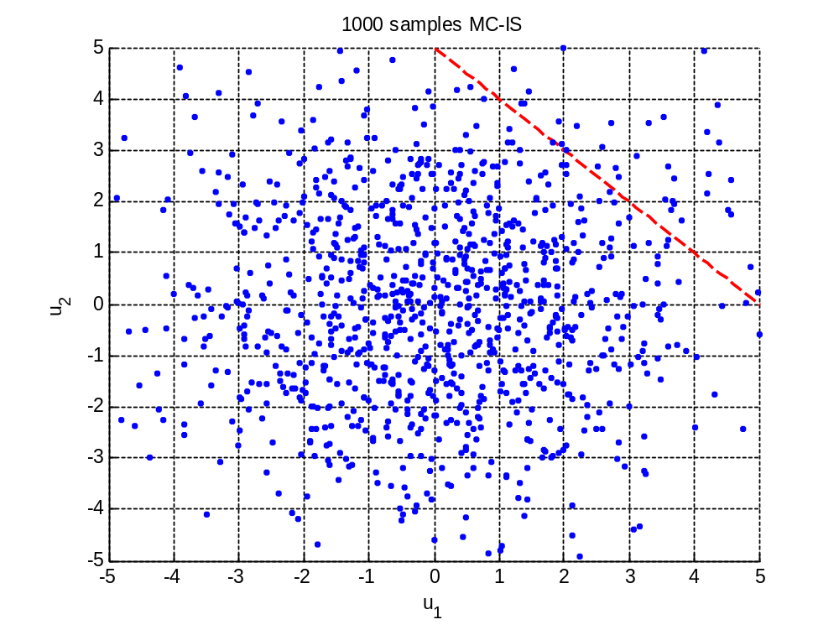
Samples

Slide 27
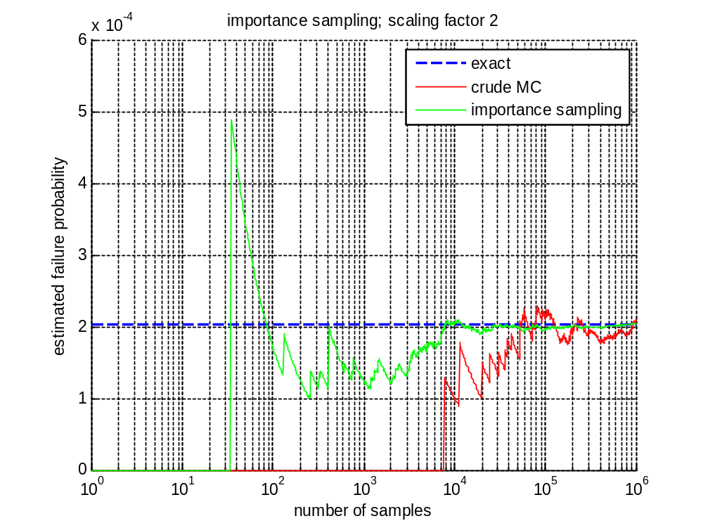
Convergence of MC estimate

Slide 28
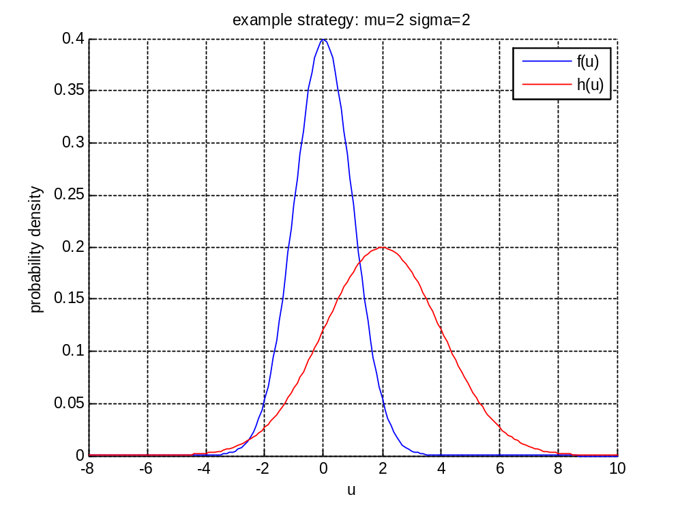
Example strategy 2

Slide 29
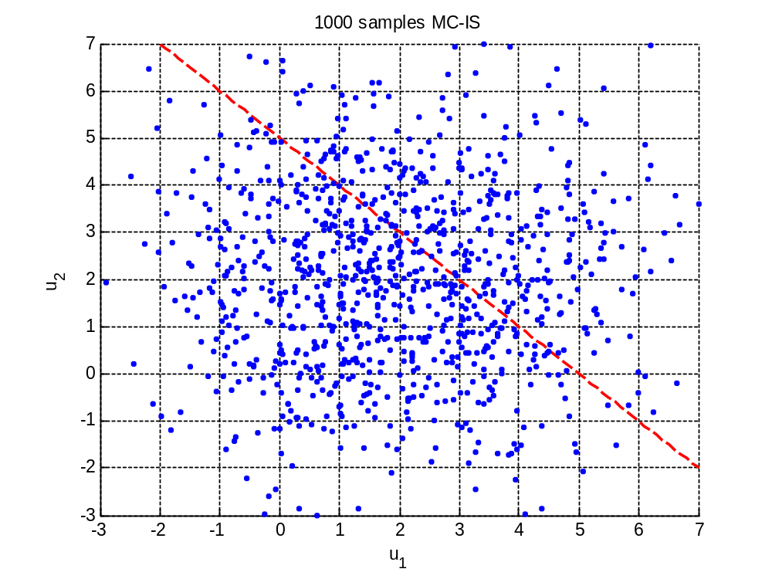
Samples

Slide 30
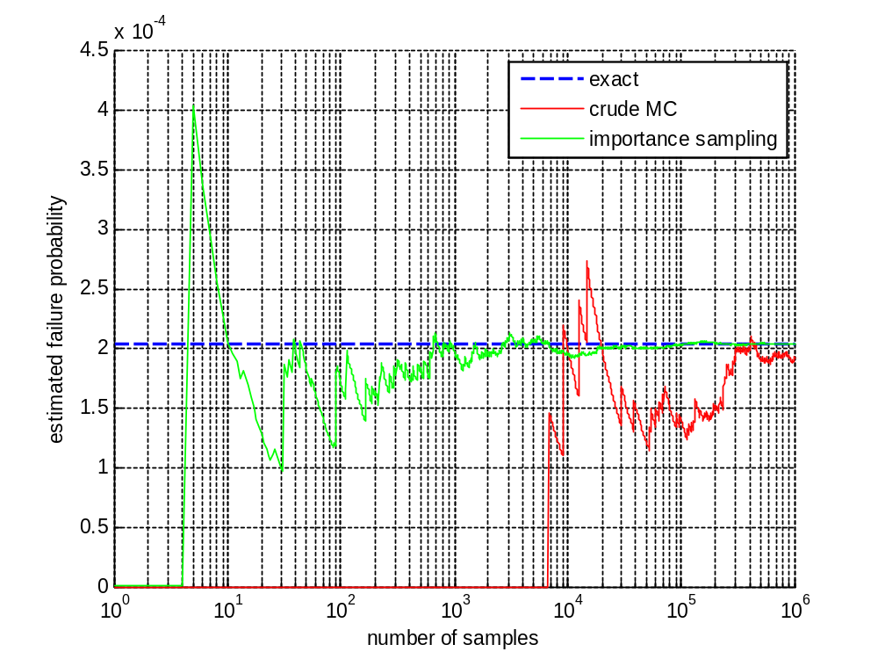
Convergence of MC estimate

Slide 31
Monte Carlo with importance sampling
Potentially much faster than Crude Monte Carlo
Proper choice of h(x) is crucial
Therefore: Proper system knowledge is crucial

Slide 32
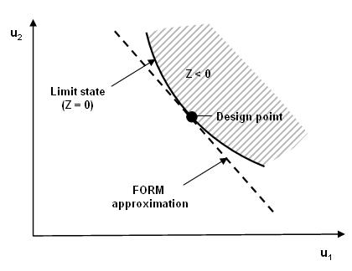
FORM
Design point: most likely combination leading to failure

Slide 33
Method is executed with standard normally distributed variables
f(x)
real world variable X
F(x)
x
Φ(u) = F(x)
φ(u)
transformed normally
distributed variable u
Φ(u )
u

Slide 34
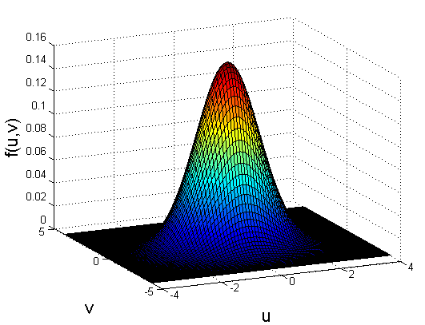
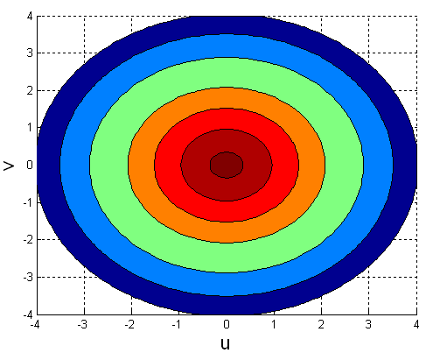
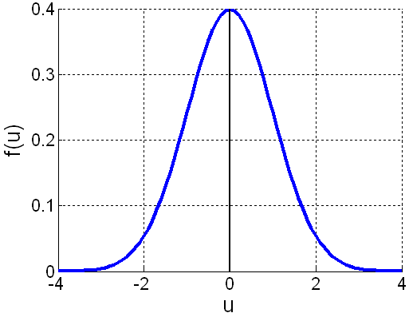
Probability density independent normal values
Probability density decreases
away from origin

Slide 35
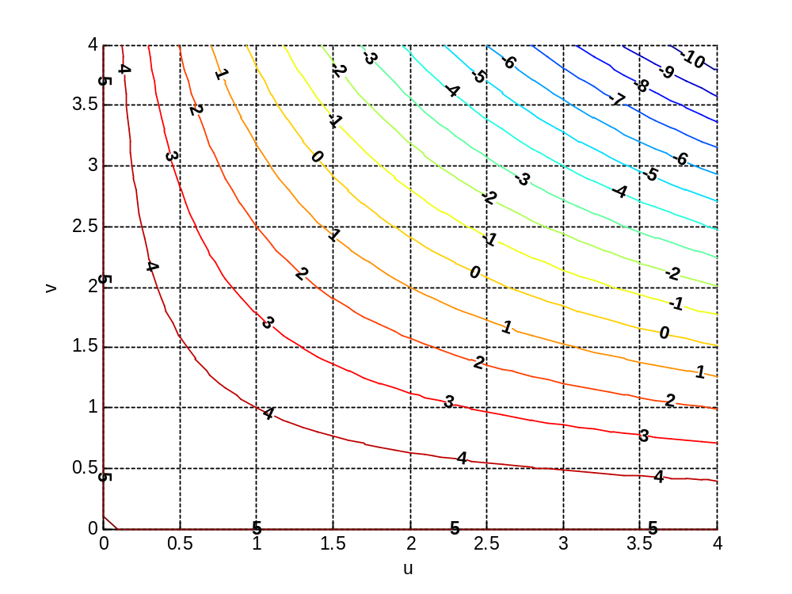
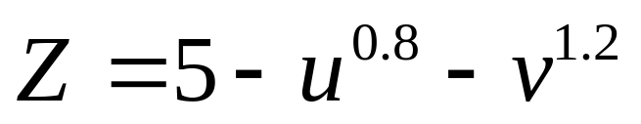
example
u en v standard
normally distributed

Slide 36
Design point
Z=0 & shortest distance to origin

Slide 37
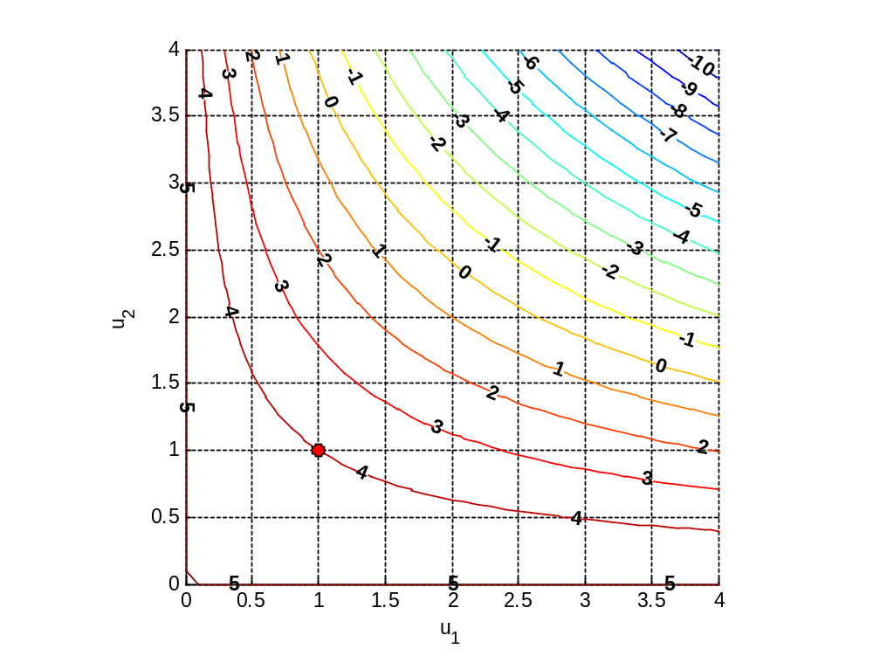
Start iterative procedure

Slide 38
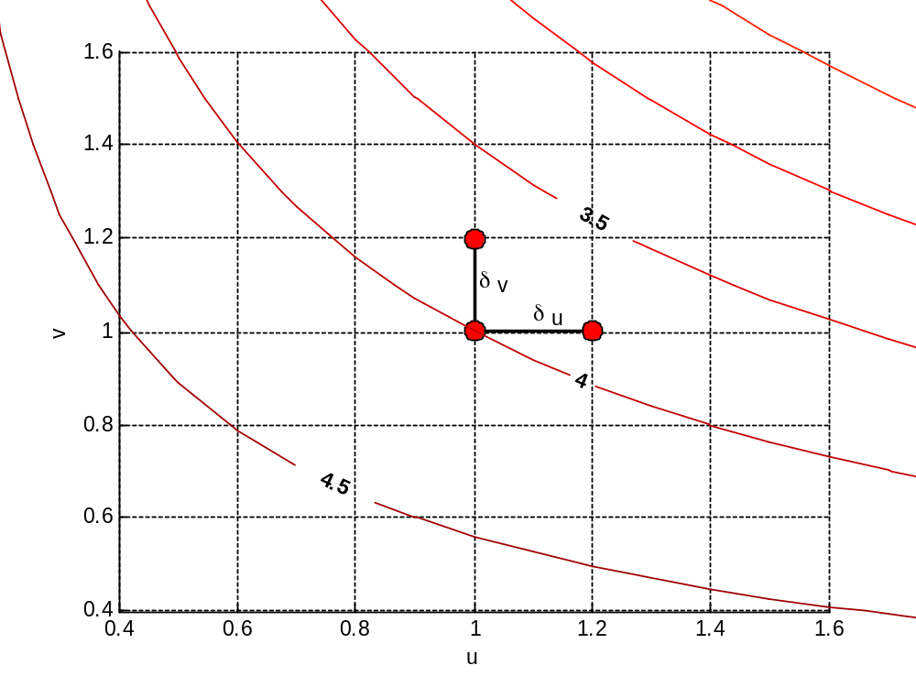
Estimation of derivatives

Slide 39
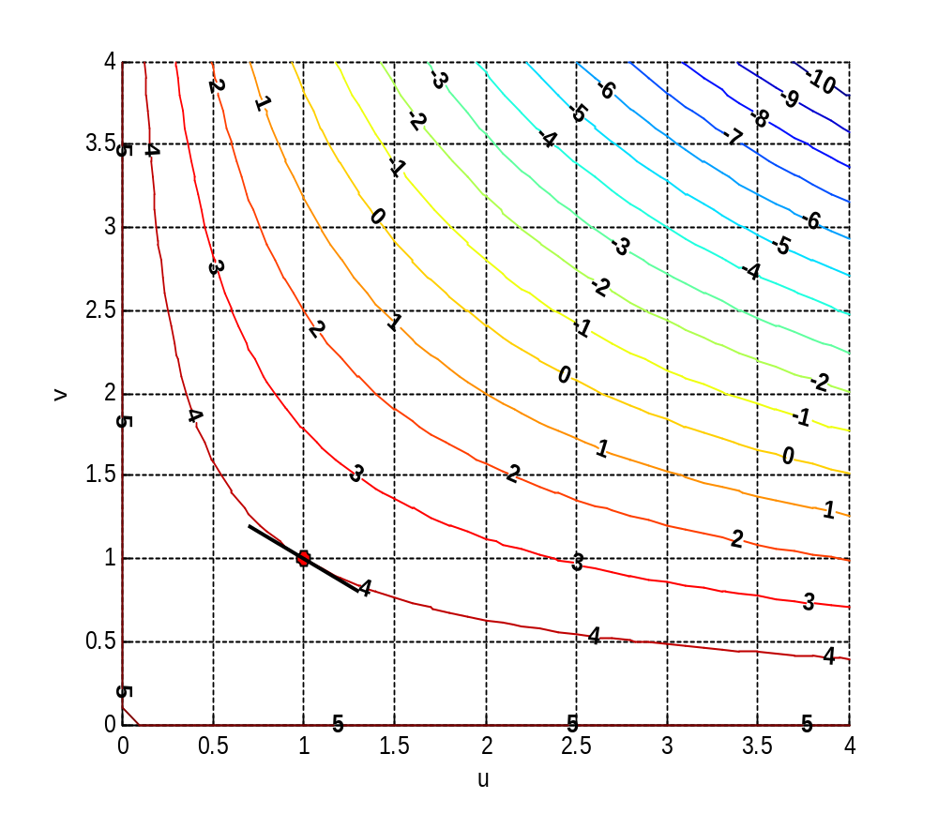
Resulting tangent

Slide 40
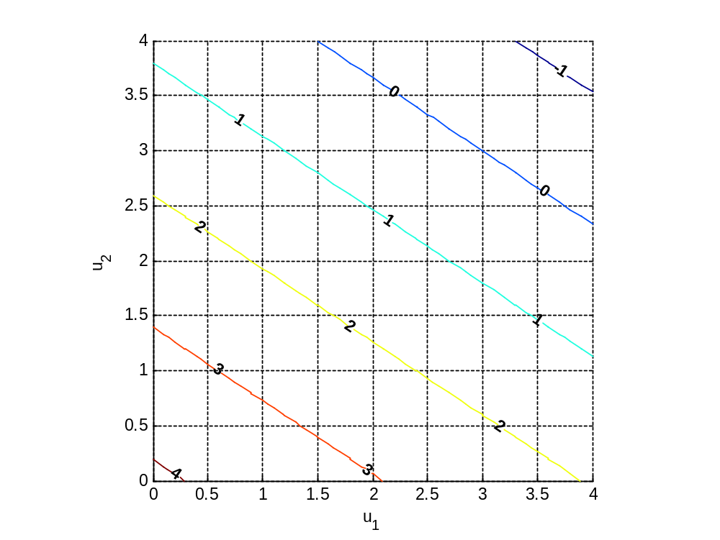
Linearisation of Z-function based on tangent

Slide 41
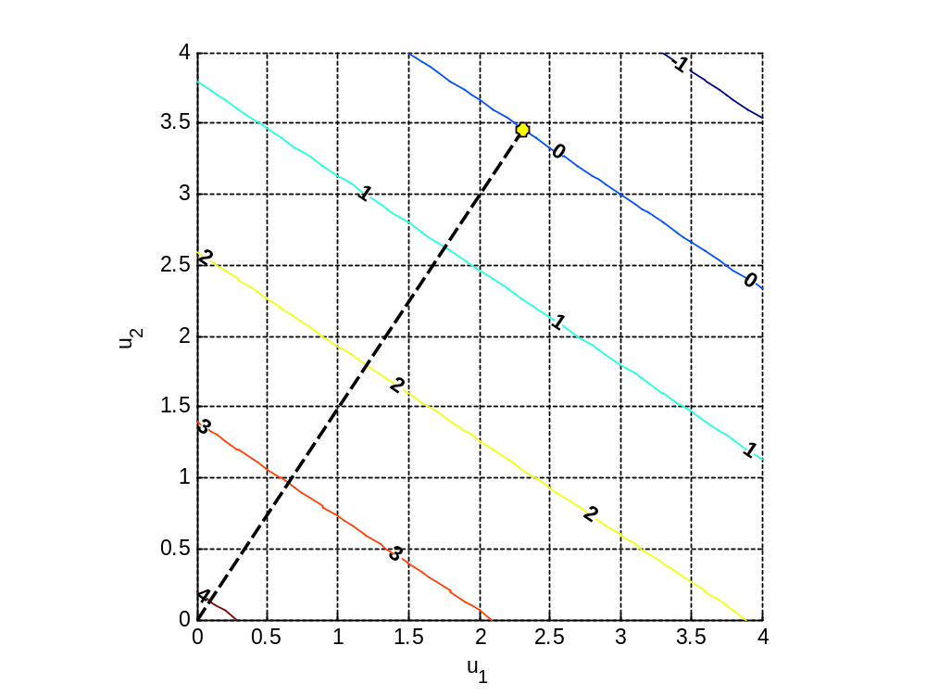
First estimate of design point

Slide 42
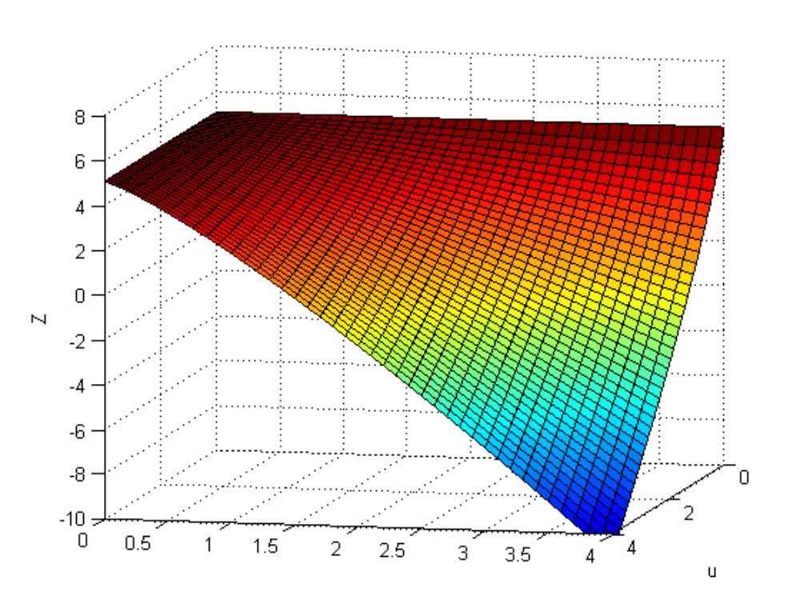
3D view: Z-function

Slide 43
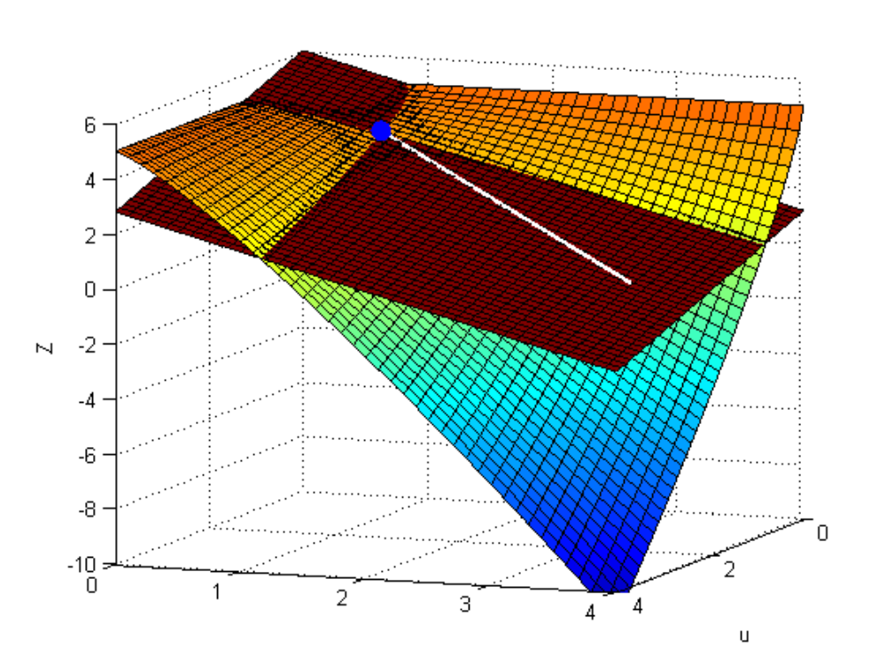
3D view: linearisation of Z-function

Slide 44
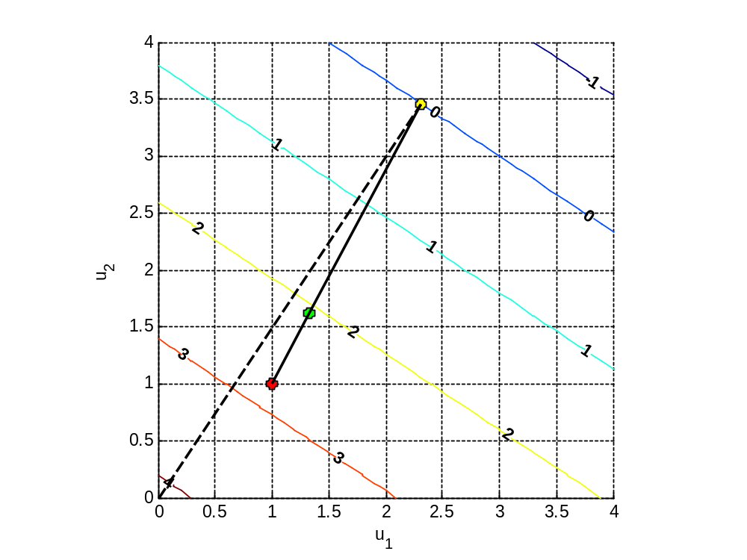
Smaller steps to prevent “accidents” (relaxation)

Slide 45
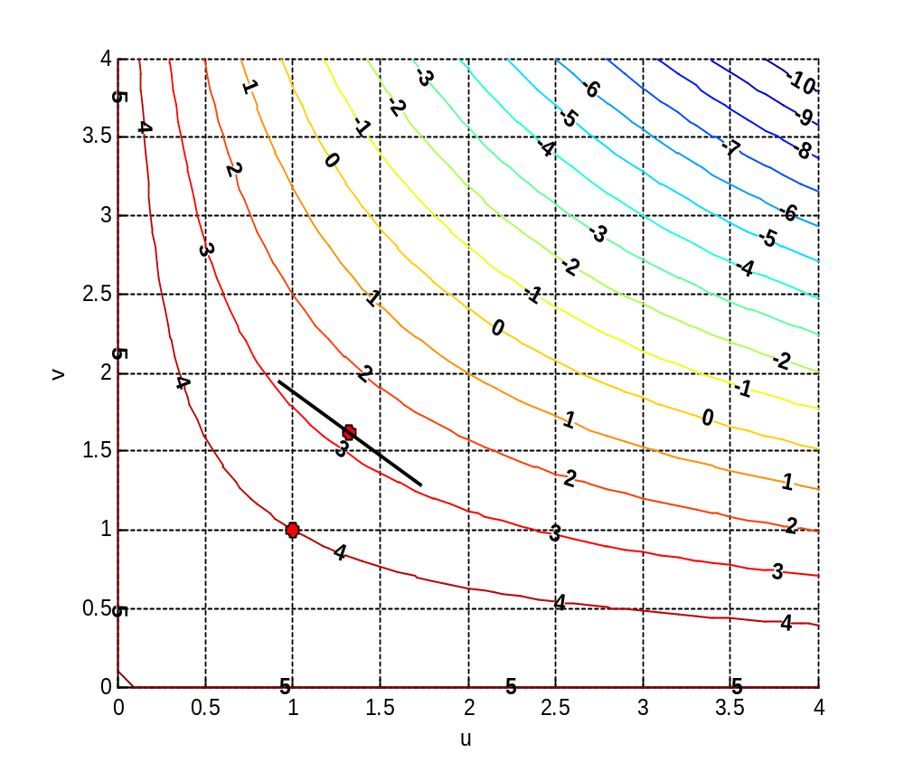
2nd iteration step

Slide 46
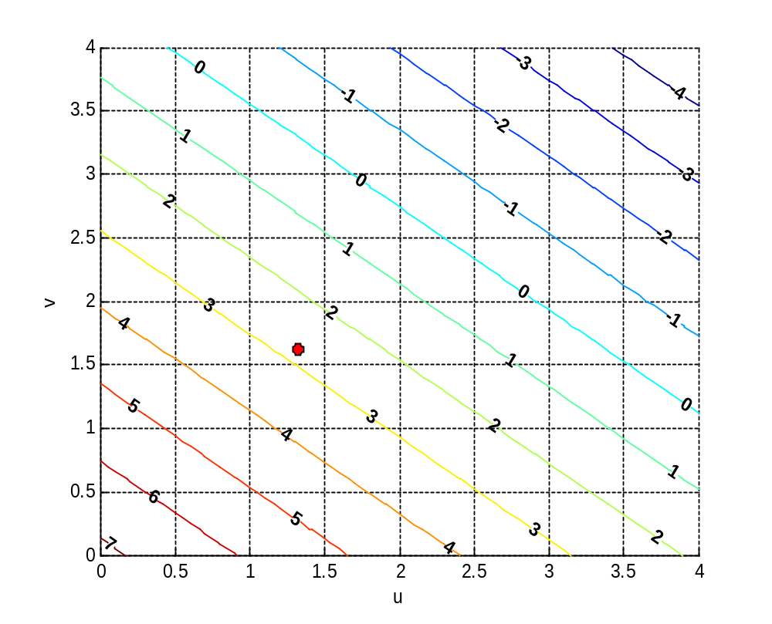
Linearisation in 2nd iteration step

Slide 47
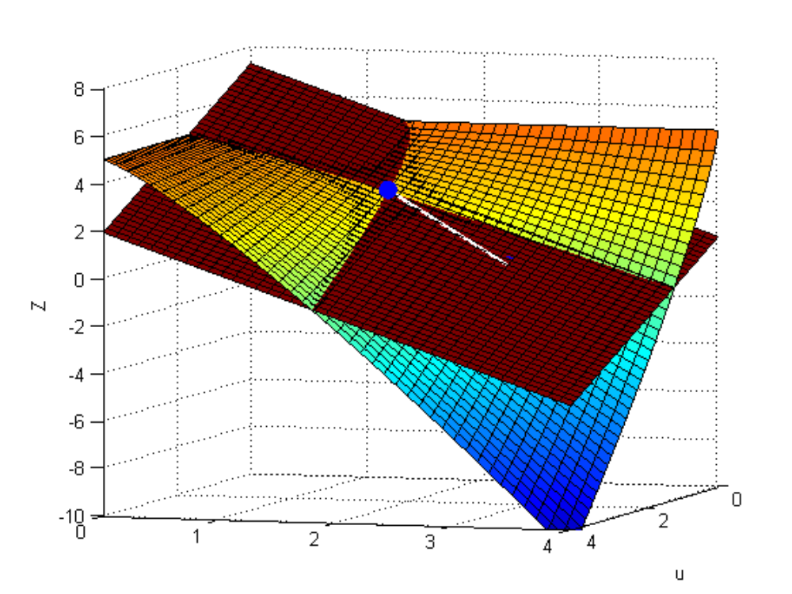
3D view

Slide 48
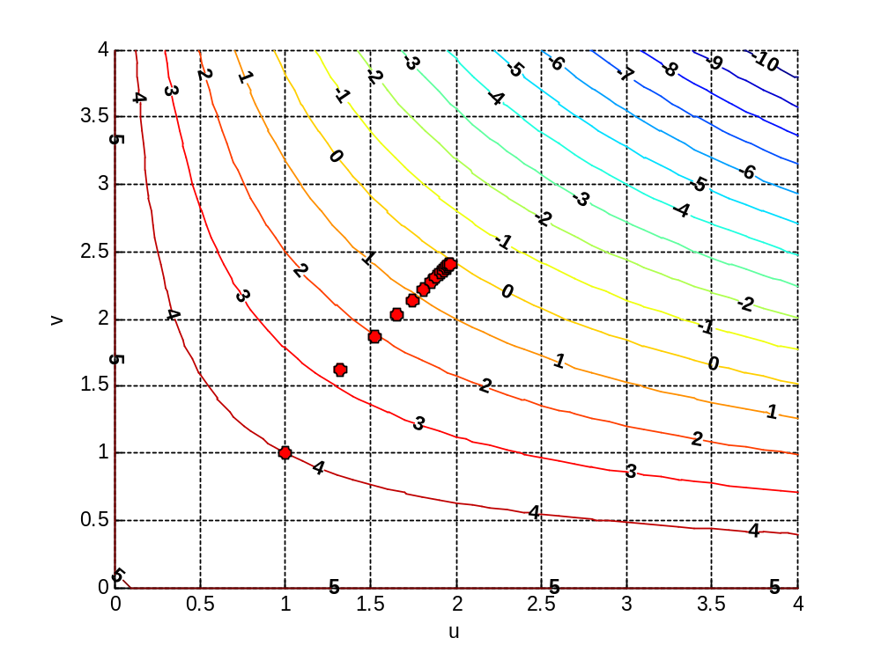
All iteration steps

Slide 49
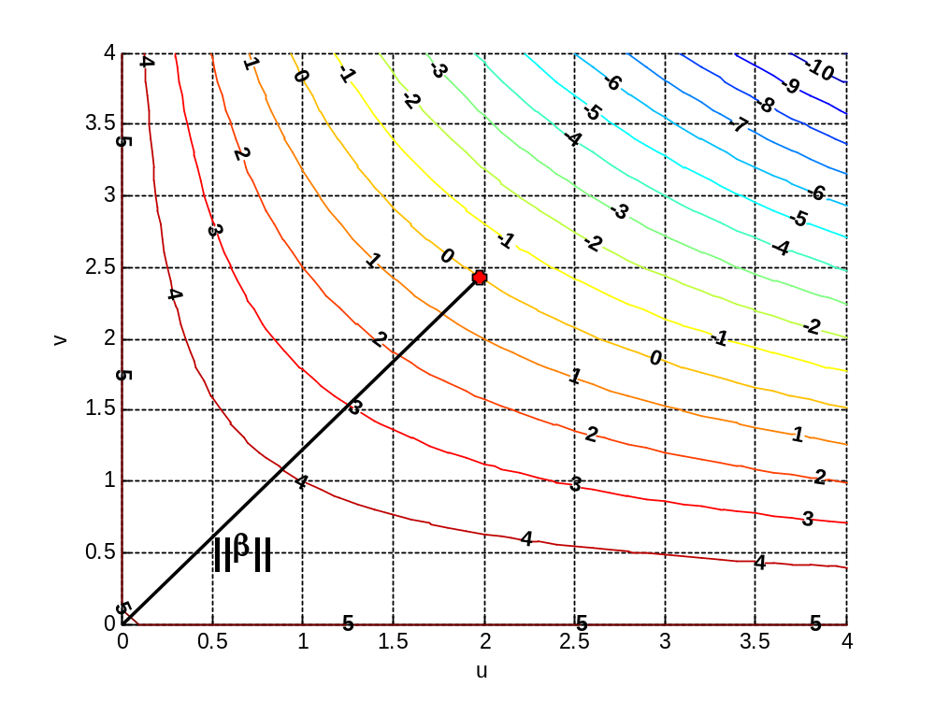
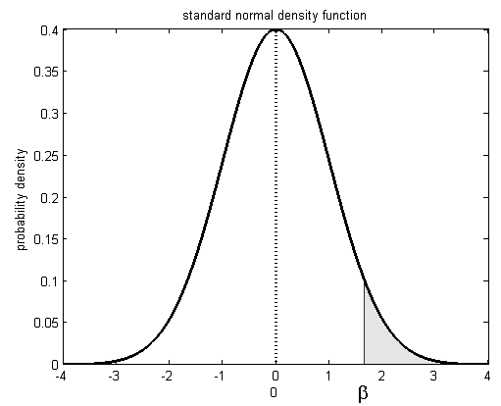
β-value of design point in standard normal space
P_{fail}

Slide 50
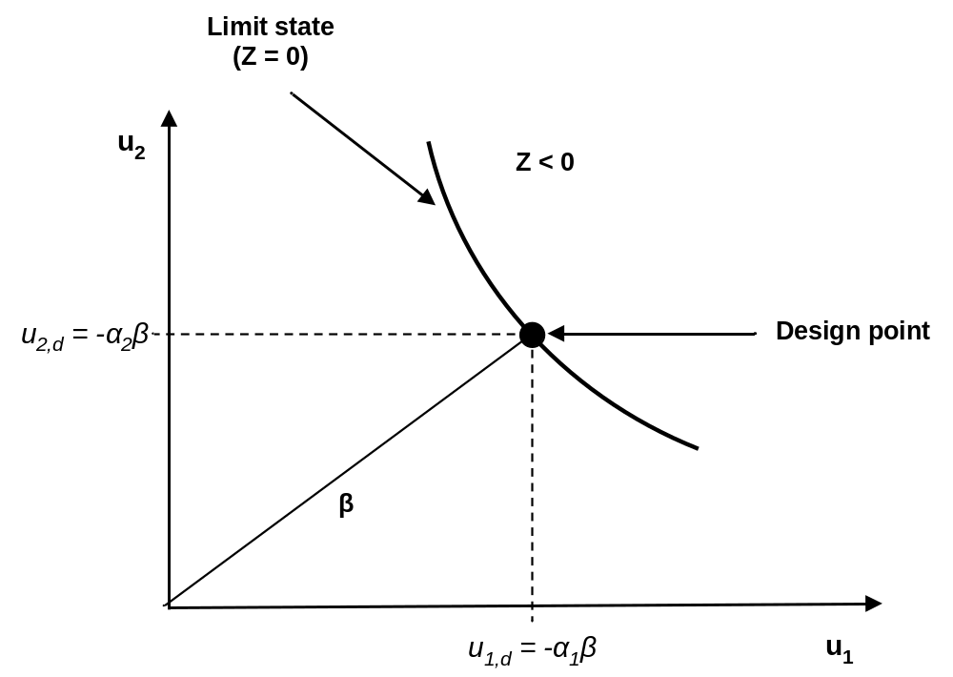
α-values in design point

Slide 51
FORM
Very fast method
Risk: iteration method does not converge, or converges to the wrong design point

Slide 52
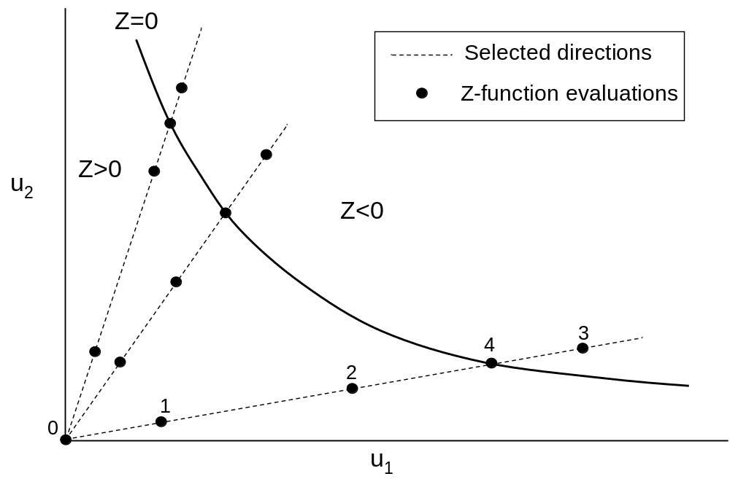
Directional sampling

Slide 53
Search along 1 direction
z
0
1
2
4
3

Slide 54
Resume
Crude Monte Carlo (MC)
Monte Carlo with importance sampling (MC-IS)
First Order Reliability Method (FORM)
Directional Sampling (DS)

Slide 55
Towards the exercises

Slide 56
Generic problem statement
x₂
f(x)
Z(x)=0
x₁

Slide 57
Generic problem statement
Probability functions, f(x): P -> X
Z-function: X -> Z

