Slide 1

STELLAR TESTNET · LEVEL 5 PITCH
Noodle Nova
Fund noodles. Collect stardust.
An anime-styled courier world that turns real Stellar Testnet interactions into a playful, verifiable product loop.
NEXT.JS · FREIGHTER · SOROBAN · PRISMA / POSTGRESQL
01 / 12

Slide 2
01 / THE FRICTION
Web3 asks users to understand the rails before they feel the value.
Wallet
Network
Sign
First-time users must navigate wallet installation, network selection, approval, and signing before the first meaningful action.
Transactions can feel invisible after clicking “submit,” leaving users unsure whether to wait, retry, or verify a receipt.
Builders need a human-scale, reviewable way to demonstrate real on-chain participation without hiding the technical truth.
Install + approve
Testnet context
Pending? Failed?
RECEIPT
Noodle Nova makes the invisible steps explicit — without hiding the chain.
The goal is not to abstract away Web3. It is to make the first interaction legible.
02 / 12
Source: Noodle Nova product baseline audit

Slide 3
02 / THE SOLUTION
Make the first route feel obvious.
Noodle Nova turns the technical path into a guided courier loop that stays non-custodial and verifiable.
01
02
03
Connect
Deliver
Verify
Freighter wallet, Stellar Testnet, and a lightweight courier profile.
Choose a ramen route and trigger the real application-backed Testnet flow.
See pending or confirmed status, then open the public Explorer receipt.
A playful interface on top of real rails — not a simulated blockchain demo.
03 / 12
Source: Noodle Nova product flow and Testnet architecture

Slide 4
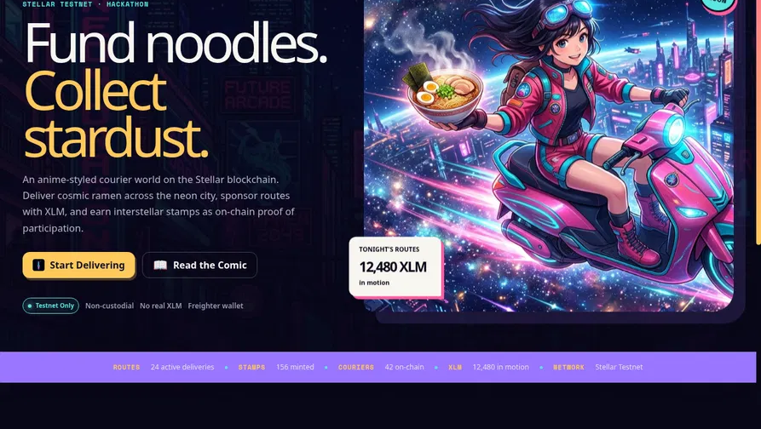
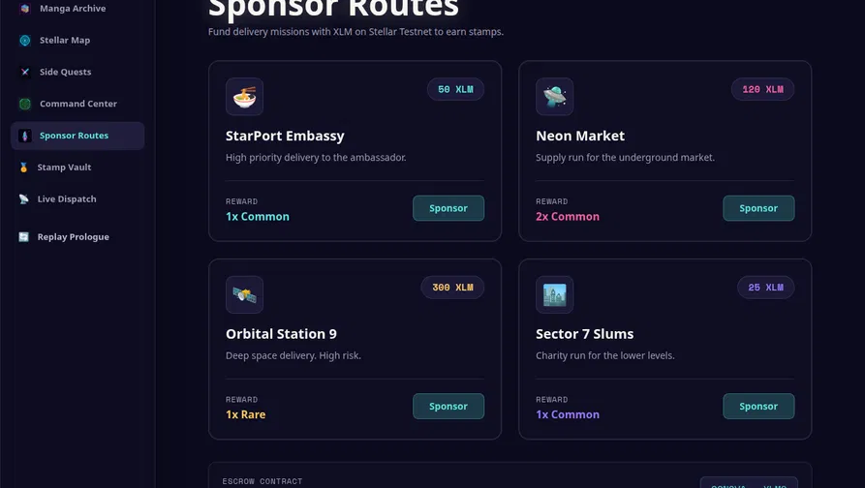
03 / PRODUCT EXPERIENCE
A guided route from first visit to public receipt.
The experience is playful on the surface, explicit about Testnet underneath.
Landing → Testnet context + first-run guidance
Routes → themed missions + transaction action
Dashboard checklist · explicit wallet errors · pending / confirmed / retry states · feedback loop
04 / 12
Source: local visual verification, 25 Aug 2026

Slide 5
04 / ARCHITECTURE
A familiar web stack with Stellar at the proof layer.
Each user action moves through a clear boundary: browser → API → database / Horizon → public receipt.
Client
Application
Data
Stellar proof layer
Next.js 14 React + TypeScript Tailwind CSS Freighter context
Next.js route handlers users · rewards transactions · feedback stats
Prisma Client PostgreSQL User / Transaction / Feedback models
Horizon Testnet payments Soroban DeliveryEscrow Stellar Expert receipts Public verifiability
Operations
Vercel deployment · GitHub Actions tests/build · Vercel Analytics events · explicit Testnet warnings
Level 5 iteration changed the user-facing flow and CI test scope; the Soroban contract and database schema remain unchanged.
05 / 12
Source: submission/noodlenova-architecture.png and repository audit

Slide 6
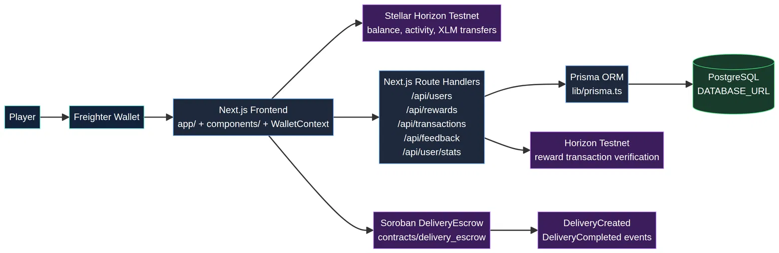
05 / REAL STELLAR PROOF
Public receipts make the demo reviewable.
The product story is backed by public Testnet records — with the limits of that evidence stated plainly.
SOROBAN CONTRACT
CC42H6…XPIUKSBCM
TESTNET HASHES
42 / 42 successful
Each candidate resolves through Horizon at audit time.
EVIDENCE BOUNDARY
Hash existence ≠ same-row user attribution.
Freighter → Next.js → Prisma / Horizon → Soroban
Re-check all public receipts immediately before submission: Stellar Testnet can reset, and a transaction hash alone does not prove user identity.
06 / 12
Source: submission/level5-user-activity.md

Slide 7
06 / EARLY TRACTION
The evidence is promising — and we count it carefully.
Owner-confirmed form data, admin records, and public Testnet verification show meaningful activity signals.
Observed records at audit time
What each number means
80 response rows; 76 unique wallet values after four repeated rows.
79 registered couriers in the latest admin application snapshot.
42 unique non-placeholder hashes resolved successfully through Horizon Testnet.
0 / 42 same-row wallet/source matches; attribution remains a private reconciliation task.
Submission decision: candidate onboarding and verified receipts are strong; “50 users with corresponding real transactions” remains partial until attribution is reconciled.
07 / 12
Source: submission/level5-user-activity.md, audit 25 Aug 2026

Slide 8
07 / FEEDBACK → PRODUCT
The response sheet became a prioritized backlog.
The strongest signal was “keep the visual direction” — then remove the friction around the first route.
4.34 / 5
SHIPPED IN CDC89E0
Four changes users can feel.
average rating · 80 responses
First-flight checklist and landing-page How it works guide.
Pending, confirmed, error, retry, and Explorer receipt states.
Registration failure handling and blank-comment validation.
Privacy-safe analytics events and deterministic CI tests.
UI and gameplay are the baseline strengths.
New users need clearer wallet and Testnet context.
Performance, sync, and provider clarity need visible states.
Traceability: submission/feedback-to-improvements.md · commit: github.com/SujAnverse1125/NoodleNova/commit/cdc89e0
08 / 12
Source: submission/feedback-to-improvements.md

Slide 9
08 / MARKET OPPORTUNITY
A growing ecosystem needs better first-run experiences.
Noodle Nova starts at the intersection of Stellar education, community activation, and playful on-chain participation.
22.5B
10.6M
86%
Stellar total operations
Unique addresses
Developer growth YoY
Builder onboarding
Community activation
Loyalty + play
Guided Testnet flows that help new users understand wallets, signing, receipts, and Stellar applications.
Hackathons, campus clubs, and ecosystem campaigns need memorable, measurable participation loops.
Rewards, stamps, and quests can make verifiable participation feel human without hiding the rails.
Official Stellar source: stellar.org/blog/foundation-news/q1-2026-execution-at-network-scale · Adjacent context: IMARC estimates blockchain gaming at USD 24.0B in 2025; directional only.
09 / 12
Sources: stellar.org · imarcgroup.com

Slide 10
09 / GROWTH STRATEGY
Acquire with story. Activate with proof. Retain with progress.
The first route is the product-led growth loop.
01
02
03
04
05
Acquire
Activate
Progress
Measure
Trust
Stellar hackathons, campuses, builders, and Web3 communities.
A two-minute first route with Testnet context and clear next steps.
Routes, stamps, quests, and rotating missions give users a reason to return.
Views, connects, onboarding, transactions, feedback, and repeat activity.
Public Explorer links, clear warnings, non-custodial handling, and privacy-safe evidence.
The moat is not the story alone. It is story + on-chain proof + a repeatable feedback loop.
10 / 12
Source: Noodle Nova Level 5 execution plan

Slide 11
10 / ROADMAP
Earn the next milestone with evidence, not guesses.
A staged path from Testnet validation to a controlled production pilot.
NOW
NEXT 60–90 DAYS
Ship the loop
Deepen play
Deploy onboarding and transaction UX. Publish deck, demo, docs, and evidence gates.
Expand route progression, sustainable rewards, wallet compatibility, and mobile status UX.
NEXT 30 DAYS
LATER
Prove activity
Controlled pilot
Complete the reviewed admin migration, protect verification, reconcile wallets and receipts, and publish reviewer-safe activity reporting.
Security, economics, consent, and monitoring reviews before any Mainnet decision.
Current position: Testnet validation and evidence reconciliation. Mainnet is not part of this Level 5 claim.
11 / 12
Source: Noodle Nova Level 5 roadmap

Slide 12
11 / DEMO + NEXT STEP
Let the receipt tell the story.
Landing → Freighter/Testnet → courier profile → route → receipt → feedback → evidence review
LIVE APP
REPOSITORY
EVIDENCE PACKAGE
noodle-nova-seven.vercel.app
github.com/SujAnverse1125/NoodleNova
submission/level5-checklist.md
Next gate: publish a new accessible walkthrough and finish private user/activity reconciliation before claiming complete Level 5 compliance.
12 / 12
Noodle Nova · Level 5 review package

